Slide 1


CHALLENGES RELATING TO COMMUNICATION, PROTECTION, AND ASSISTANCE TO EXTRA-CONTINENTAL IRREGULAR MIGRANTS

Slide 2
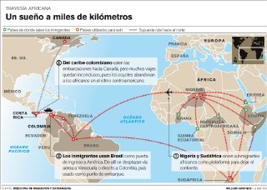

Slide 3
DATA FOR 2008-2012
ORIGIN: Eritrea, Sierra Leone, Ivory Coast, Somalia, Bangladesh, Sri Lanka, Pakistan, Nigeria, Nepal, Ghana, Zimbabwe, Ethiopia, Guinea, Afghanistan, India, and China.
GENDER: 88.39% are men and 11.60% are women.
AGES: 25-35 years.
Boys, girls, and adolescents: 1.78%.

Slide 4
Initial Requirements:
Communication: Identifying the language, access to interpreters, capacity of immigration officers to provide assistance, ensuring accessible due process.
Verifying identity and nationality; in some cases, of relatives (fathers/mothers).
A preliminary assessment of the profile of the migrant to guide actions.
Verifying health status.

Slide 5
Assistance Requirements:
Physical and emotional medical examination and assistance.
Coordinating with and convening various institutions to provide assistance in accordance with the preliminary assessment of the profile. Training officers from other institutions (health, child protection).
Consular assistance: Limited – or lack of – presence of representatives from countries of origin in countries in the region.
Access to shelter, food, preliminary documents.

Slide 6
Protection Requirements:
Implementing protection actions in accordance with the vulnerability profile:
  Unaccompanied boys, girls, and adolescents
  Victims of migrant smuggling and trafficking
  Victims of other crimes
Temporary immigration documents:
  Refuge seekers
  Accrediting victims of trafficking (CR)
  Temporary immigration documents
  Establishing programmes or alternatives for voluntary or assisted return to the country of origin or to a receiving third country (budget).

Slide 7
Other Requirements:
Implementing immigration control actions according to each situation and regulations in the transit and/or receiving country:
  Consular assistance and legal aid;
  Assistance in the language of the migrant;
  Humanitarian conditions in detention;
  Detention periods;
  Assistance for unaccompanied boys, girls, and adolescents;
  Assistance for family groups;
  Assistance for victims of migrant smuggling and trafficking;
  Assistance for victims of other crimes;
  Protection for refuge seekers.

Slide 8
Other Requirements:
Identifying smugglers and traffickers of the group of migrants;
Interventions by police officers and judicial authorities;
Sharing information between involved countries;
Promoting the exchange of migration alerts;
Following up on the irregular continuation of the journey;
Sustainability of assistance and protection actions.

Slide 9
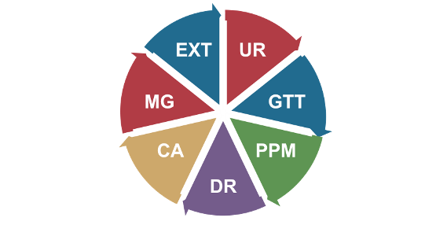
The Experience of Costa Rica in Regard to Assistance and Protection
ESME composed of:
Establishes general procedures for actions by the General Directorate of Migration and Immigration (DGME) in regard to special migration situations.

Slide 10

AVAILABILITY OF ESME
ESME should:
  Develop roles of availability by UNIT;
  Respond within a maximum period of 1 hour;
  Meet regularly.

Slide 11
ETHICAL ACTIONS BY ESME
To ensure respect for human rights;
Equal respect for everyone (gender, age, religion, ethnic group);
Responsibility in regard to SME information;
Confidentiality;
Actions oriented toward combating abuse and exploitation;
Comprehensive security in general.

Slide 12
THE ROLES OF ESME
To establish referral mechanisms;
To develop instruments for preliminary assessments;
Training on general concepts and actions;
To promote the establishment of local protection systems;
To identify and respond to any special migration situation;
To provide humanitarian aid (DR);
To monitor institutional actions;
To issue recommendations;
To execute any required actions (regulations and mandate).

Slide 13
- Use of an interpreter;
- Trained ESME officers;
- Special protection units for extra-continental migrants;
- Mobile immigration units.
a) Communication with irregular extra-continental migrants

Slide 14
Protocol of action (ESME) and a guide for conducting interviews that enables identifying immediate needs:
- Health requirements;
- Food requirements;
- Clothing requirements;
- Safe shelter requirements.

Slide 15
Protocol of action (ESME) and a guide for conducting interviews that enables identifying immediate needs:
- Police protection requirements;
- Legal aid or immigration assistance requirements;
- Communication requirements;
- Other requirements.

Slide 16

c) Providing shelter to identified extra-continental migrants
Two possibilities:
a) Shelter according to a prior assessment by ESME;
b) A temporary detention centre for irregular migrants.

Slide 17
Providing emergency humanitarian aid to migrants in need
Refuge is coordinated with ACAI and UNHCR;
Special migration situations: IOM;
Boys, girls, and adolescents: Child Protection Institution;
Limited and not sustainable resources.

Slide 18

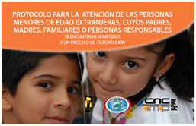

PROTOCOLS FOR BOYS, GIRLS, AND ADOLESCENTS

Slide 19
Providing emergency humanitarian aid to migrants in need
A category for victims of trafficking –irrespective of status. ARTICLE 94. General Migration and Immigration Act.
Migration status for humanitarian reasons.

Slide 20

ASSISTANCE FOR VICTIMS OF TRAFFICKING

Slide 21
Immediate Response Team
(ERI, Spanish acronym):
Established through Executive Decree in 2009;
A specialized inter-institutional body to provide assistance to victims of trafficking;
Confidentiality;
Composed of:
    Technical Secretariat of CNCTIMTP, DGME, Public Forces, INAMU, MTSS, OIJ, Attorney General’s Office, and PANI. In addition: IOM, UNHCR, and ILO.

Slide 22
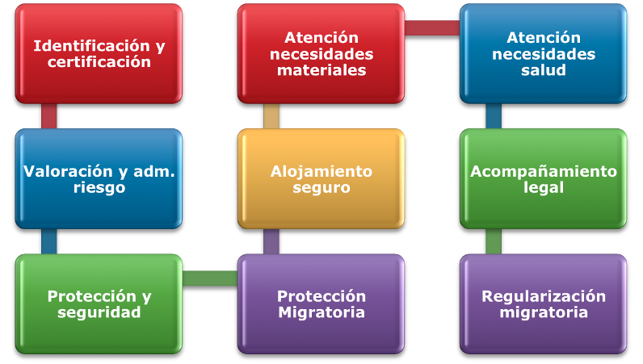
Addressing Material Needs
ASSISTANCE MODEL
Identification and Certification
Addressing Health Needs
Risk Assessment and Management
Safe Shelter
Legal Accompaniment
Protection and Security
Immigration Protection
Migration Regularization

Slide 23
THANK YOU!
Kathya Rodríguez Araica
General Director of Migration and Immigration
Republic of Costa Rica krodriguez@migracion.go.cr

