Slide 1


REGIONAL COALITION
AGAINST TRAFFICKING IN PERSONS

Slide 2
An initiative developed by governments in the region with the aim of contributing to the establishment, adoption and promotion of minimum standards, policies and regional processes to combat and prevent the crime of trafficking in persons and strengthen assistance to victims.

Slide 3
BACKGROUND
The first steps were implemented within the framework of the Regional Conference on Migration (RCM or Puebla Process) at the beginning of the 2000s.
Within this framework, the first regional information campaigns were promoted and organizations were established in each country that were later on known as National Committees or Coalitions Against Trafficking in Persons.

Slide 4
BACKGROUND
In August 2008, countries from the region met at the Preparatory Meeting for the III Global Congress Against Commercial Sexual Exploitation and Trafficking in Persons. At the meeting, representatives from Central American States made a decision to initiate coordination and cooperation efforts at a regional level.
The First Meeting of National Coalitions Against Trafficking in Persons in Central America was held on November 10-12, 2008 in San José, Costa Rica.
A project named “Bien Público Regional” (Regional Public Good), financed by IADB and executed by Ecpat-Guatemala, contributed to this Central American effort. The project was approved in December 2008 and execution was initiated in June 2009.

Slide 5
BACKGROUND
The first formal meeting of the Regional Coalition was held on September 16, 2011, with participation of representatives from Honduras, Guatemala, El Salvador, Panama, Nicaragua, Belize, Costa Rica and Nicaragua (host country) with support from Save the Children and IOM.
An Executive Committee was established, with Nicaragua as the coordinator; Costa Rica as the Technical Secretariat; and Guatemala as a member. Finally, it was agreed to continue sharing this effort and present it to representatives from SICA, IOM, SISCA, IADB, COMIGOB, OCAM, Heads of Police Forces, Councils and other regional organizations, among others.
The second meeting of the Regional Coalition was held in February 2012 in Panama, with the main objective of advancing the implementation of a regional operative work plan.

Slide 6
BACKGROUND
The third meeting was held in León, Nicaragua.
The fourth formal meeting of the Regional Coalition was held in Guatemala City on October 15-16, 2012.
The fifth meeting of the Regional Coalition was held in November 2012 in Belize.
2013
August 6, Guatemala
10-12, Honduras
October 11, Costa Rica
November 17, Costa Rica

Slide 7
Honduras

Slide 8
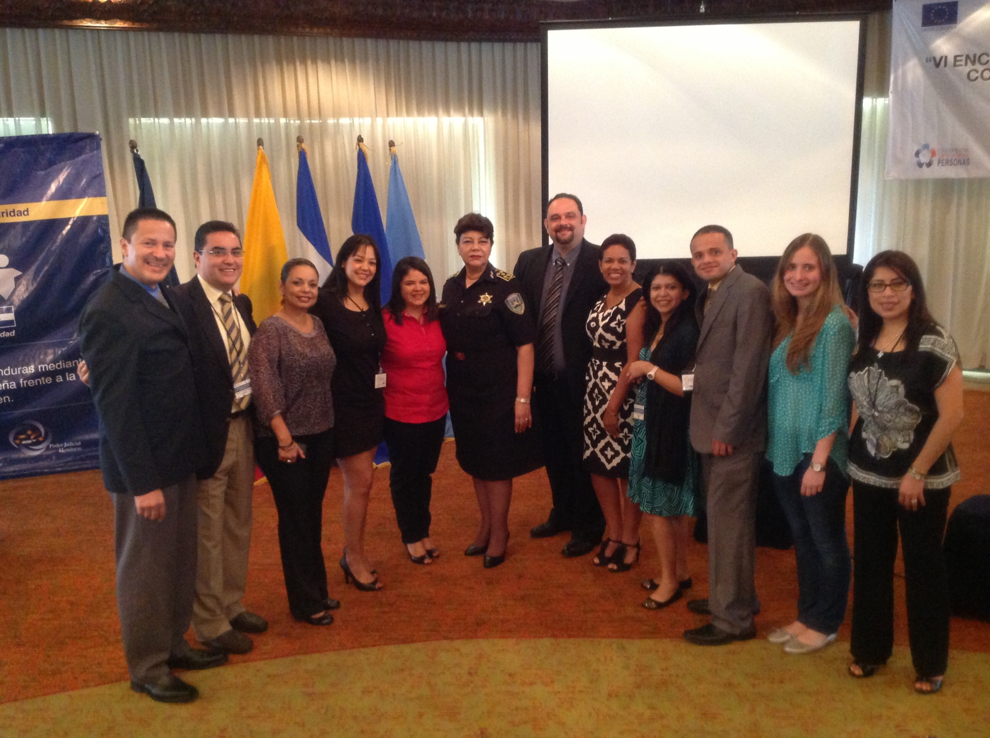

Slide 9
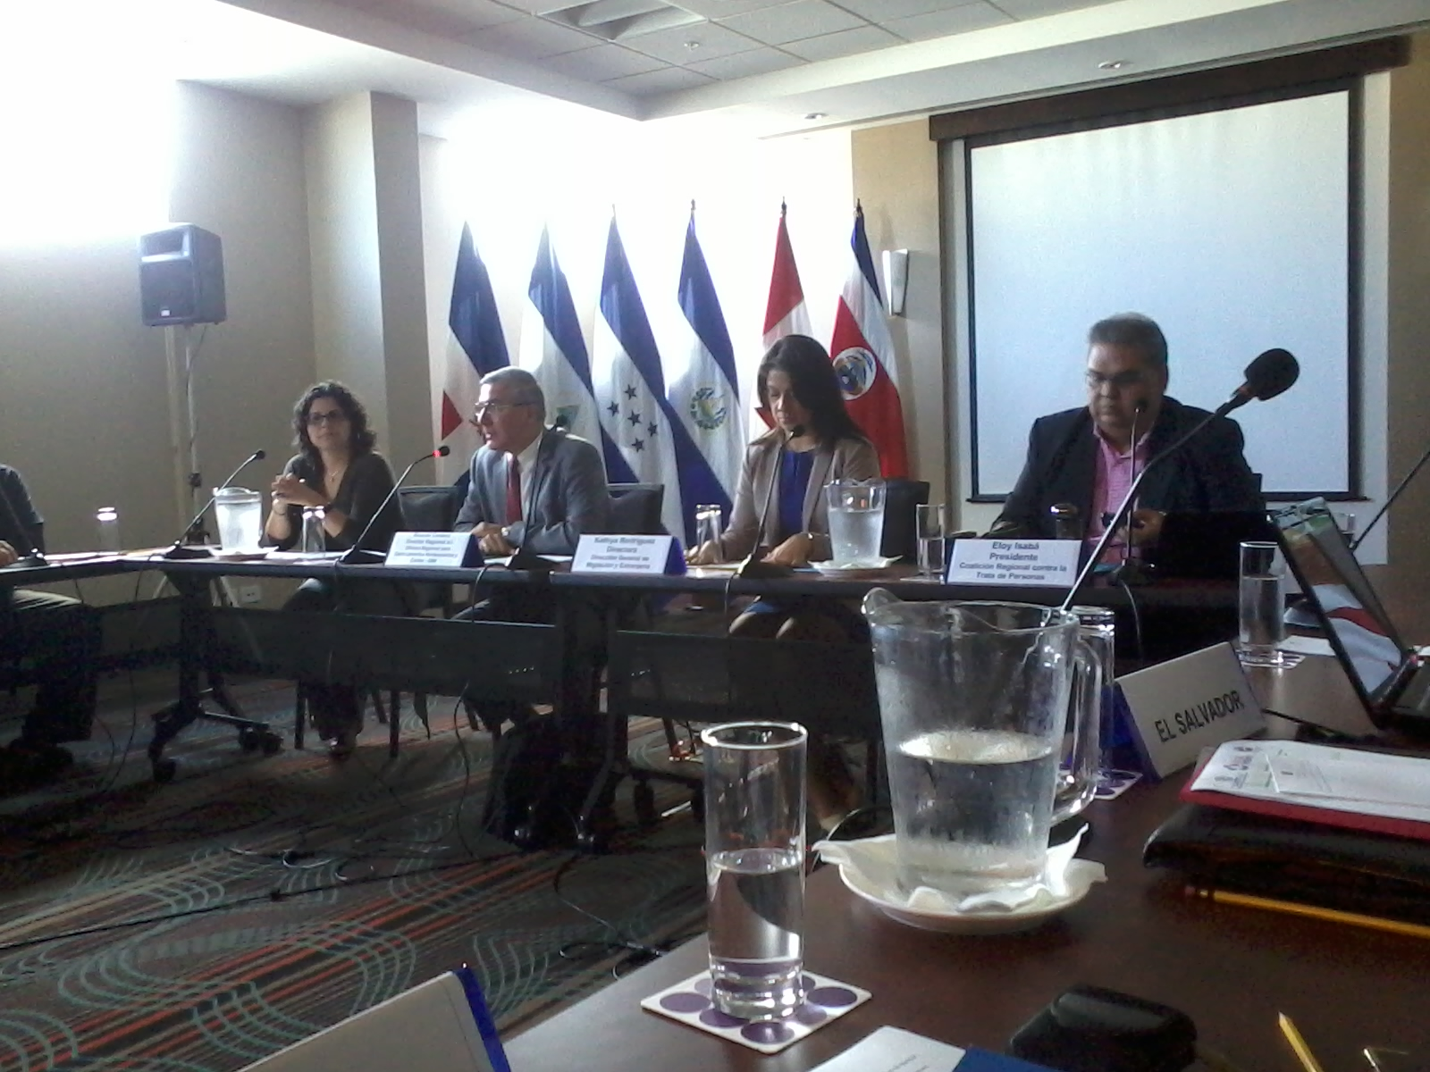
Meeting in October, Costa Rica

Slide 10
Scope
Meeting: Bogotá; Honduras and Nicaragua. Universidad de los Andes. “Observa la trata” [Observe Trafficking].
Mexico : IADB - Nicaragua, Guatemala and Costa Rica.
Peru: Nicaragua, Costa Rica, RNCOM Civil Society, Honduras.
Rome: Global experts on the topic for Central America – Guatemala and Nicaragua and Honduras, with the objective of establishing a global coalition.

Slide 11
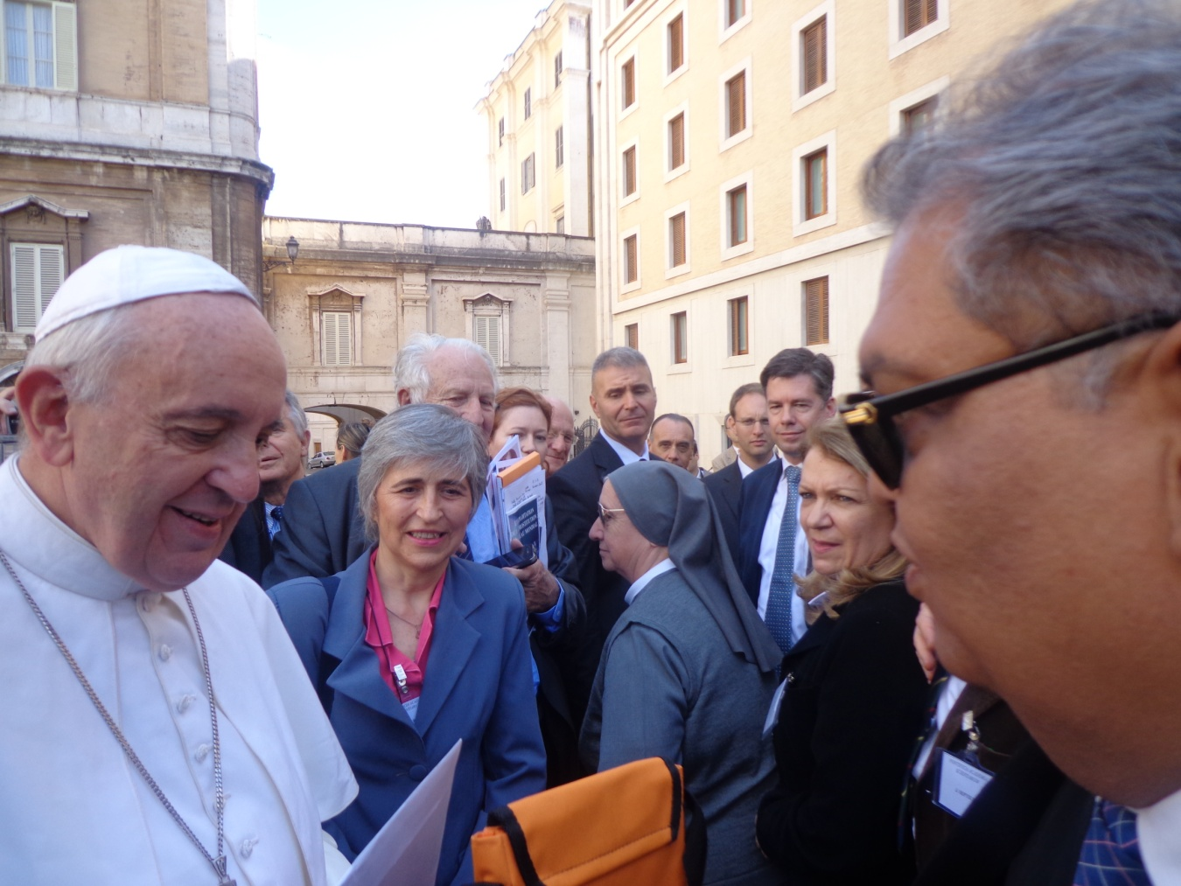
Rome

Slide 12
COMMITMENT
The Regional Coalition commits to supporting Committees, Councils and Coalitions in the region in the development of relevant regulations to combat the crime of trafficking in persons.

Slide 13
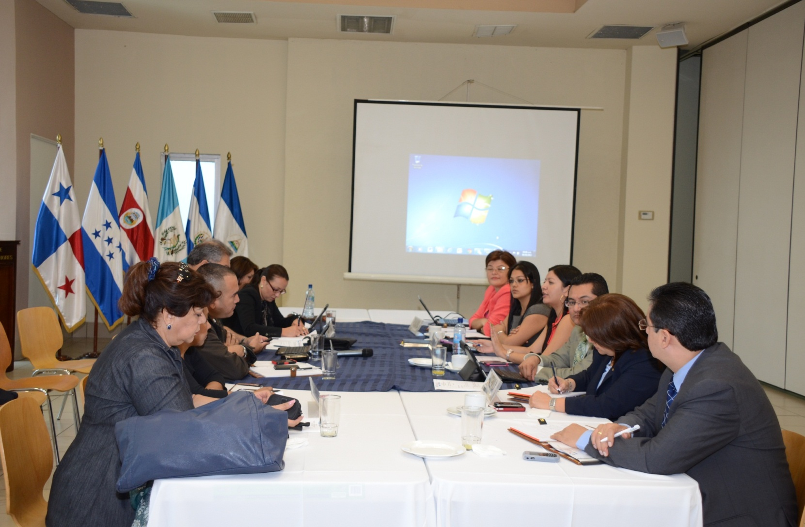

Slide 14
Topics to Address
Regional Coalition – IADB – ECPAT
National Guidelines for Institutional Coordination Strengthening
To combat the crime of trafficking in persons in each country. Countries provide input, guidelines and commitments to strengthen institutional coordination that guide the actions of Coalitions, Councils, Committees and National Secretariats, with the aim of contributing to capacity-building to enable coordination and collaboration, in terms of means and efforts, in order to combat the crime of trafficking in persons in an effective manner.

Slide 15
Topics to Address
Regional Coalition – IADB – ECPAT
Regional Strategies for the Comprehensive Assistance and Accompaniment of Victims of Trafficking in Central America
Agreed on by countries, to ensure effective and comprehensive assistance to victims of trafficking at a regional level and to provide an adequate framework for protection to victims, establishing minimum standards for assistance.

Slide 16
Topics to Address
Regional Coalition – IADB – ECPAT
A Regional Communication Strategy to prevent trafficking in persons
The objective is to implement a campaign on prevention of trafficking in persons in Central America, oriented toward populations in vulnerable situations that are potential victims.

Slide 17
Topics to Address
Regional Coalition – IADB – ECPAT
MEMO OF UNDERSTANDING BETWEEN THE GOVERNMENTS OF THE REPUBLICS OF COSTA RICA, EL SALVADOR, GUATEMALA, HONDURAS AND NICARAGUA, ESTABLISHING THE EXECUTION OF THE “FRAMEWORK FOR REGIONAL ACTION TO ADDRESS THE CRIME OF TRAFFICKING IN PERSONS IN CENTRAL AMERICA IN A COMPREHENSIVE MANNER”.

Slide 18
Topics to Address
Regional Coalition – IADB – ECPAT
Operative Programme
OBJECTIVE: To promote the institutionalization and implementation of national and regional guidelines to strengthen inter-institutional coordination to combat the crime of trafficking in persons; to implement the regional strategy for comprehensive assistance to and accompaniment of victims; and to implement the regional communication strategy to prevent trafficking in persons in Central America.

Slide 19
OPERATIVE PROGRAMME
Specific Objectives:
a) To contribute to capacity-building to promote collaboration, inter-institutional coordination and mobilization of public and private resources, with the aim of effectively combating the crime of trafficking in persons in each country.
b) To promote efforts to strengthen institutional coordination mechanisms at a regional level in combating the crime of trafficking in persons, contributing to current efforts to promote regional integration.
c) To contribute to the development and strengthening of programmes and services for comprehensive assistance to victims of trafficking in the region.
d) To help prevent the crime of trafficking in persons by alerting populations in vulnerable situations in the region about the problem.

Slide 20
Implementation of the Operative Programme
Human Resources: Government officials, cooperating agencies.
Financial Resources: The institutions in charge of coordinating Committees, Councils, Coalitions and National Secretariats Against Trafficking in Persons will mobilize and manage national financial resources and resources from international cooperation agencies to implement actions established under the Operative Programme.
Monitoring and Follow-up: The Regional Coalition Against Trafficking in Persons – together with the Regional Conference on Migration and the Coalitions, Councils, Committees and National Secretariats Against Trafficking in Persons – is in charge of coordination, follow-up, monitoring and evaluation of the execution of the Operative Programme.

Slide 21
Discussion Topics
To bear in mind the signing of the Memo of Understanding (SICA and support to the Coalition);
To explore the need to expand the Regional Coalition Against Trafficking in Persons to TIM, as previously requested. Topic addressed at the RCM in 2013;
Support is requested to potentiate the objectives of the Regional Coalition;
It is essential to join efforts and cooperate in order to strengthen the actions that are being implemented;
To appreciate and promote specific actions being implemented in the region.

Slide 22
REGIONAL COALITION
AGAINST TRAFFICKING IN PERSONS
Guatemala
Honduras
El Salvador
Nicaragua
Costa Rica
Panama
Belize
Dominican Republic
Mexico
coalicionregional@migracion.go.cr

