Slide 1


General Office of Migration and Immigration
REPUBLIC OF COSTA RICA
Extracontinental Migration Flows

Slide 2
Current Status
In the past 10 days, an increase of 1,500 extracontinental migrants has been recorded in Costa Rica.
100-150 extracontinental migrants are entering the country each day.

Slide 3
Campo Ferial Paso Canoas
Open from May 2, 2016 – July 7, 2016
Appointments granted: 2,490
Individuals served with records: 1,451

Slide 4
Assistance Centre
(operates since April 23)
  Assistance has been provided to 700 persons.
  Assistance is currently being provided to 167 persons:
    47 men
    52 women:
      7 pregnant women
    68 boys, girls and adolescents

Slide 5
CATECI Sur
(CATEM)
Operates since April 21.
1,240 persons have been received, with immigration procedures completed for all of them.

Slide 6
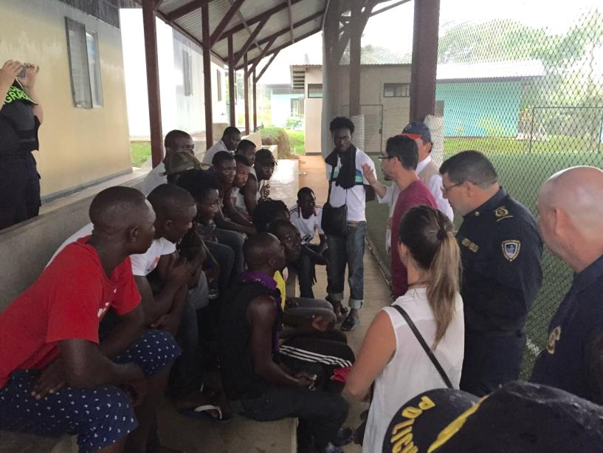

Slide 7
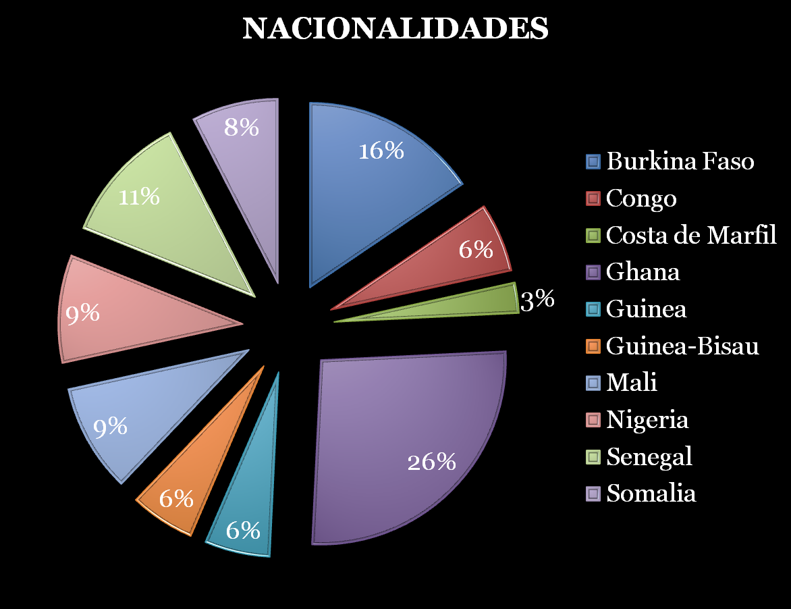
Ivory Coast
  NATIONALITIES
  NATIONALITIES

Slide 8
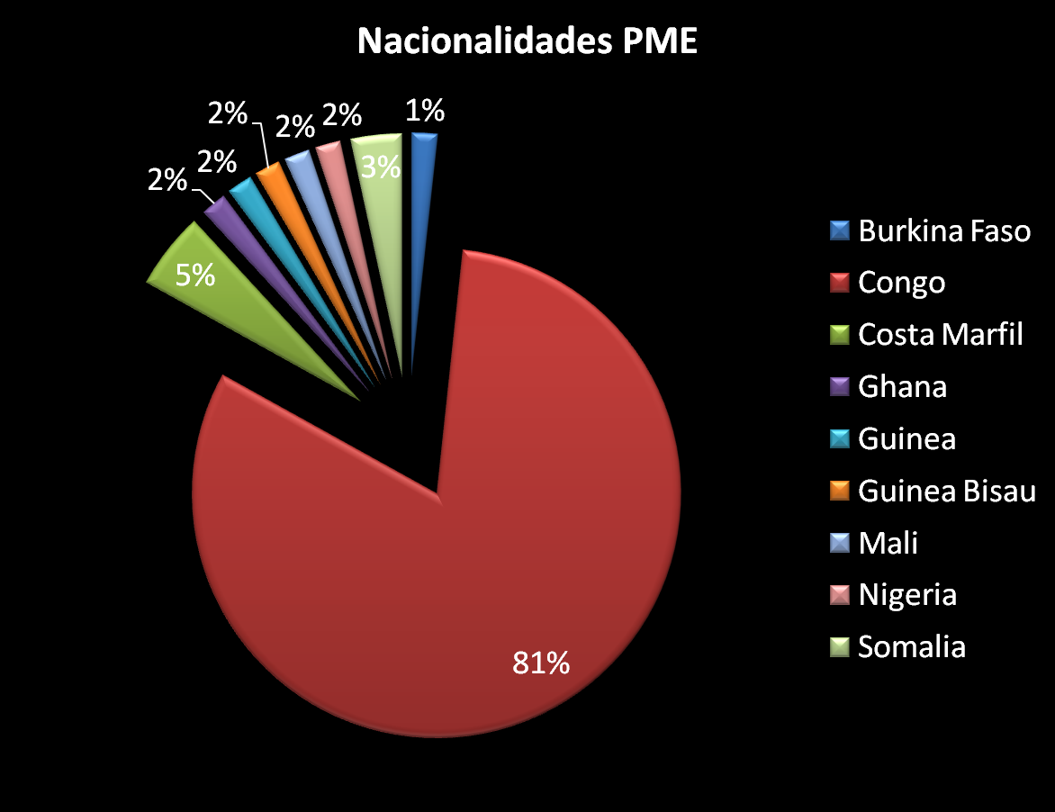
Ivory Coast
  Nationalities of Boys, Girls and Adolescents

Slide 9
Routes Used
Guinea-Ecuador-Brazil-Peru-Colombia-Panama-Costa Rica
Kinshasa-Argentina-Brazil-Peru-Colombia-Panama-Costa Rica
Ivory Coast-Peru-Colombia-Panama-Costa Rica
Congo-Brazil-Peru-Ecuador-Colombia-Panama-Costa Rica
Ghana-Ecuador-Colombia-Panama-Costa Rica
Ghana-Brazil-Ecuador-Peru-Colombia-Panama-Costa Rica
Nigeria-Brazil-Peru-Ecuador-Colombia-Panama-Costa Rica

Slide 10



Means of Transportation Used

Slide 11



MAIN LANGUAGES

Slide 12


RELIGION
Christians Muslims

Slide 13
Push Factors
Religion
Wars
Economic Crisis

Slide 14
DESTINATION
USA
Canada
Costa Rica (refugees)

Slide 15
OBJECTIVES OF THE STATE OF
COSTA RICA
To prevent an unmanageable human contingent;
To carry out immigration control actions in detention and assistance centres;
To prevent human rights violations.

Slide 16
To safeguard public health;
To strengthen border control actions;
To provide primary care to persons for whom immigration procedures can be initiated.

Slide 17
AN APPROACH OF CONTROL ACTIONS AND HUMANITARIAN AID

Slide 18
A humanitarian aid approach based on risk and vulnerable situations; and a public health issue, oriented toward finding a lasting solution.
2. To improve communication and coordination with countries in the region.

Slide 19
3. To grant an entry permit at the border to enable migrants to receive humanitarian aid at the offices of the General Office of Migration and Immigration once the basic immigration procedure has been completed.
4. To establish reception centres and comprehensive assistance centres for all population groups.
5. To provide assistance at reception centres involving all competent institutions.

Slide 20
6. To designate an institution to lead the entire process of addressing the situation in a comprehensive manner, in order to coordinate the actions of all involved institutions.
7. Upon explicit request, to initiate procedures to enable the individual to stay in national territory under a humanitarian category or as a refugee, if applicable, or to facilitate resettlement or relocation in a third country with support from IOM and UNHCR.
8. Assisted and voluntary return.

Slide 21
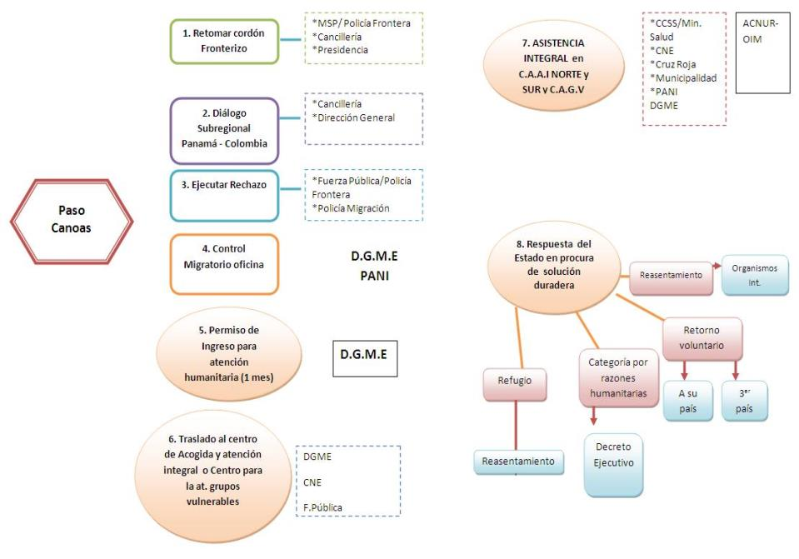

Slide 22
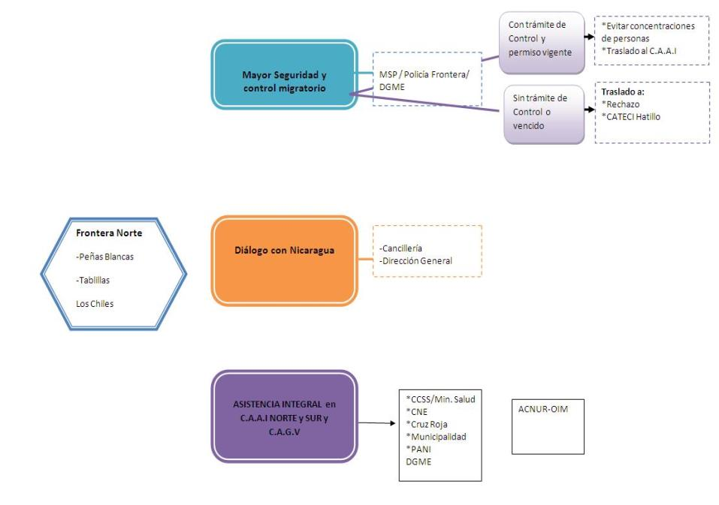

Slide 23

ASSISTANCE FOR BOYS, GIRLS AND ADOLESCENTS

Slide 24
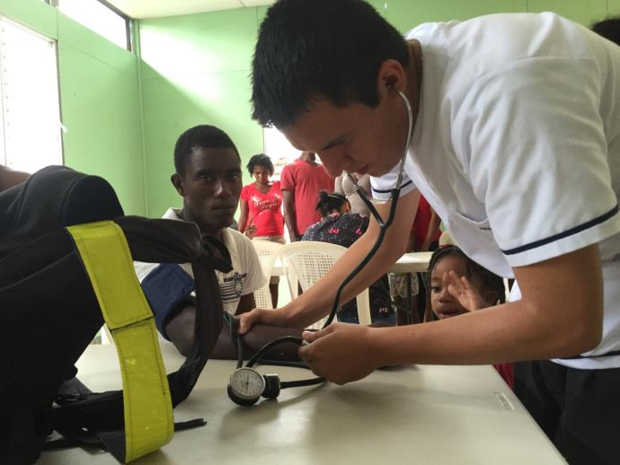
HEALTH CARE

Slide 25

ASSISTANCE FOR PREGNANT WOMEN

Slide 26
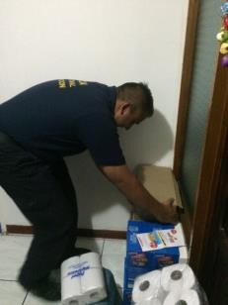

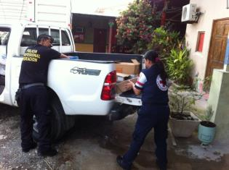
Support to transfer donations

Slide 27

Agreements Reached at the XLII Ordinary Meeting of OCAM
Panama, June 2-3, 2016

Slide 28
-To recognize the impact of irregular migration in countries in the region as a transit corridor toward countries of destination.
- To follow up on the issue of extracontinental migration, seeking a regional response.
-To seek participation of all Member Countries and observer countries.
- To request that IOM develop a critical mapping on response mechanisms being implemented in each country, with the aim of identifying how persons enter, what documents they obtain, what procedures are applied for rejection, detention, deportation, etc.

Slide 29
-To establish regional support mechanisms for the repatriation of extracontinental migrants from Africa, Asia and other countries entering the region in an irregular manner.
-To urge the countries of destination of irregular migrants to support the transit countries in projects for regularization, repatriation, deportation, reception and reintegration in territories in the region.
-To strengthen dialogue with South American countries in order to improve cooperation between countries.

Slide 30
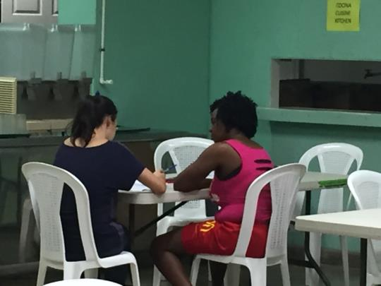
If we are to achieve regular, orderly and safe migration flows, we have to join efforts and record each case in each country.

Slide 31

AGREEMENTS
REGIONAL CONFERENCE ON MIGRATION (RCM)
Tegucigalpa, Honduras
June 8-9, 2016

Slide 32
ACTIONS AIMED AT DEVELOPING A REGIONAL PROPOSAL TO ADDRESS EXTRACONTINENTAL MIGRATION FLOWS
To reactivate the Ad Hoc Group to discuss, analyse and define objectives on the topic of extracontinental migration flows in the region and to invite the Member Countries to attend a meeting to be held in Panama on June 14-15, 2016. The need has been identified to address the matter in a comprehensive manner. All Member Countries are urged to participate.
To thank Costa Rica for the presentation on the current status of extracontinental migration and the conclusions of the XLII Ordinary Meeting of the Central American Commission of Directors of Migration (OCAM), held in Panama on June 2-3, 2016.

Slide 33
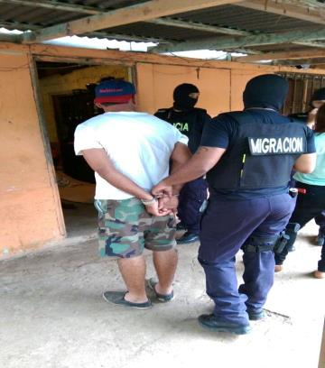
Actions Against a Transnational Criminal Migrant Smuggling Network, June 28, 2016
A transcontinental operation that was implemented with collaboration between various countries within the framework of the Network of Prosecutors Against Organized Crime and the Central American Council of Prosecution Authorities.

Slide 34
Investigation
The journey begins in Dubai, they are sent to Brazil by air. Then they travel by air, sea and land to Colombia and then on to Panama, Costa Rica, Nicaragua, Honduras, El Salvador, Guatemala and Mexico to the United States.
The cost of the journey is US$7,000 and US$25,000.
The first action against this migrant smuggling network was implemented on December 30, 2015. Three persons were arrested.
To date, 31 persons have been accused.

Slide 35
Investigation
Results
Guatemala: 10 persons arrested
El Salvador: 1 person arrested
Honduras: 5 persons arrested
Panama: 7 persons arrested
Costa Rica: 2 persons arrested

Slide 36
Costa Rica considers the following aspects to be essential:
To share clear, transparent and updated information about extracontinental migration flows;
To continue monitoring organized criminal groups of migrant smugglers in order to continue to have an impact in combating these networks;
To enable persons to migrate in an orderly, safe and visible manner;
To share information about the approach regarding public health of the population.

Slide 37
How to achieve sustainability in assistance and inter-institutional coordination?
The decision of one country significantly affects the actions of the other countries in the region.
To promote an agreement to enable controlled and regular transit through the region.
To promote support and cooperation from consular authorities concerning the issuance of documents for their citizens.

Slide 38

THANK YOU

