Slide 1


COSTA RICA
CONATT

Slide 2

OVERALL SITUATION
The most important achievement: Entry into force of Act 9095.

Slide 3
OVERALL SITUATION
On August 14, 2013 the Public Prosecutor’s Office created the Deputy Prosecutor’s Office Against Trafficking in Persons and Migrant Smuggling (Fiscalía Adjunta Contra la Trata de Personas y el Tráfico Ilícito de Migrantes – FACTRA).
Victims of trafficking for the purpose of illegal extraction of organs were recognised.

Slide 4
ASSISTANCE TO VICTIMS

Slide 5
ASSISTANCE TO VICTIMS

Slide 6
ASSISTANCE TO VICTIMS

Slide 7
Immediate Response Team
  Initially established through Executive Decree in 2009. The rank of the Immediate Response Team was raised through Act 9095 of 2013.
A specialized inter-institutional body to activate primary assistance for victims of trafficking in persons and their dependents.
  All matters reported to the Immediate Response Team shall be confidential.
  Composed of:
  Technical Secretariat of CONATT, General Directorate of Migration and Immigration, Public Police Force, INAMU, CCSS, MTSS, OIJ, Public Prosecutor’s Office (FADCO & OAPVD) and PANI. In addition: IOM, UNHCR and ILO.
CONATT Technical Secretariat

Slide 8
Comprehensive Assistance Model
Identification and certification
Risk assessment and management
Protection and security
Migration protection
Safe shelter
Material assistance
Assistance for health care
Legal accompaniment
Migration regularization
CONATT Technical Secretariat

Slide 9
PREVENTION
Training in 2013 (18,379)
TOTAL NUMBER OF OFFICERS TRAINED AND MADE AWARE IN 2013 | 2826
STUDENTS
Total number of persons trained and made aware in 2013 | 13,499
CIVIL SOCIETY
Total number of persons trained and made aware in 2013 | 2054
Notes:
Detalles introductorios del curso y/o libros/materiales necesarios para una clase/proyecto.

Slide 10
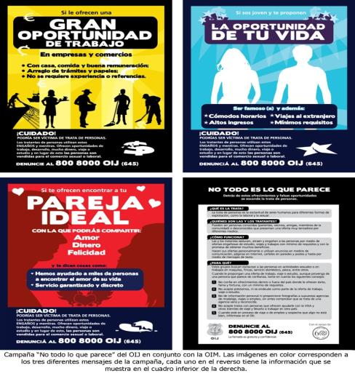
PREVENTION
Notes:
Notas introductorias.

Slide 11
PREVENTION
  INAMU-IOM: “No más trata de Mujeres”;
  CONACOES: “Memes, memes everywhere”;
  CIDEHUM: “A Usted También: Necesidades de protección para personas desplazadas forzadas en Centroamérica”;
  RAHAB FOUNDATION: “Maniquí”, 25 articles, 35 advertisements.
Notes:
Notas introductorias.

Slide 12
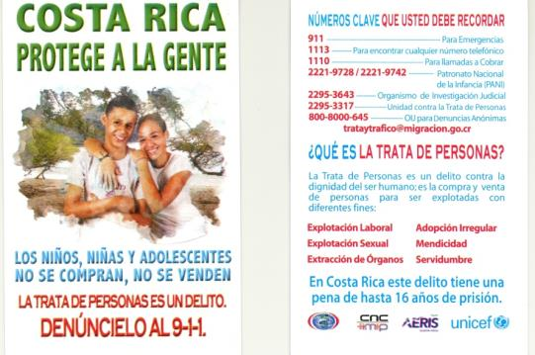
PREVENTION
GTT/General Directorate of Migration and Immigration/UNICEF
Notes:
Notas introductorias.

Slide 13
PROSECUTION
New cases of trafficking in persons investigated
(March 1, 2013 – January 16, 2014)

Slide 14
Number of trials completed:
March 1, 2013 – January 16, 2014
A total number of 65 persons were convicted by the Public Prosecutor’s Office of Costa Rica through its different prosecuting offices.
The data on convictions provided in this section include the crimes of trafficking in persons, migrant smuggling, procuring, aggravated procuring, remunerated sexual acts with under-age persons, rape and qualified rape.

Slide 15
PROSECUTION
The bylaws to Act 9095 are currently being developed.
Efforts will be initiated relating to the Law Against Migrant Smuggling.

Slide 16
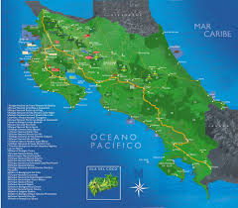
INFORMATION, ANALYSIS AND RESEARCH
Strategic and operational mapping

Slide 17

Thank you
General Directorate of Migration and Immigration
Costa Rica
June 2014

