Slide 1

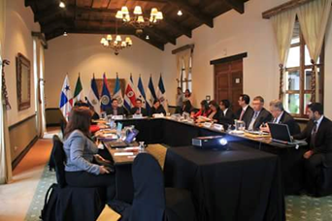
REGIONAL COALITION
AGAINST TRAFFICKING IN
PERSONS

Slide 2
Throughout the 90s and since 2000, the international community has implemented processes to recognize and address a problem that has taken on global significance: the increase in criminal activity by organized groups, with an influence and scope that transcend national borders.

Slide 3
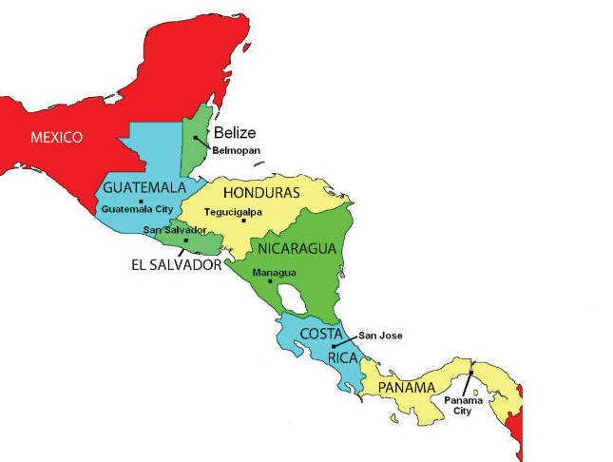

Members of the Regional Coalition Against Trafficking in Persons and Migrant Smuggling

Slide 4
The Regional Coalition Against Trafficking in Persons and Migrant Smuggling was established on September 16, 2011 and has achieved consensus among Member Countries regarding various topics, as well as products and advances since then.
The Regional Coalition has held 15 ordinary meetings since its inception.

Slide 5
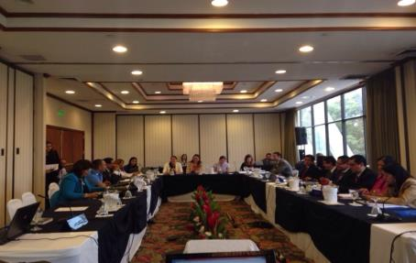
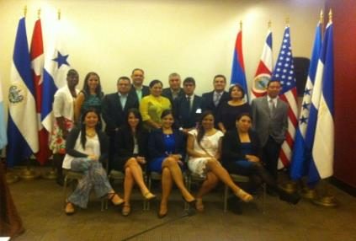
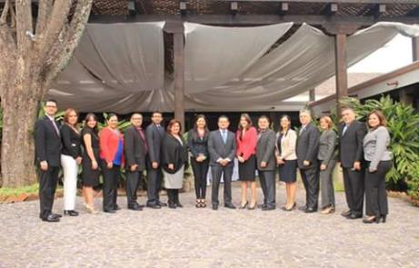
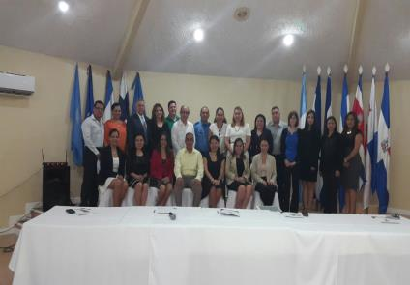

Slide 6
Representation
President of the Coalition:
2011-2013 Nicaragua
2014-2015 Guatemala
2015-2016 Panama
Regional Technical Secretariat of the Coalition:
2011-2013 Costa Rica
2014-2015 El Salvador

Slide 7
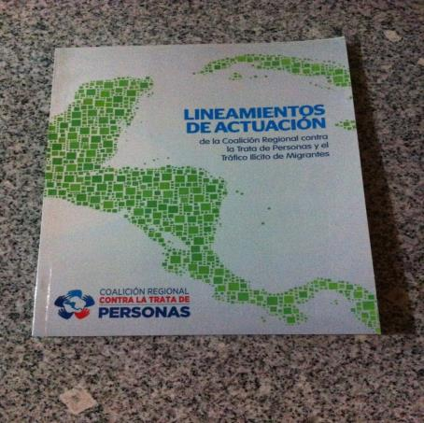
Regional Guidelines for Strengthening Institutional Coordination to Combat Trafficking in Persons in Central America

Slide 8
Regional Guidelines for Strengthening Institutional Coordination to Combat Trafficking in Persons in Central America
Contents
Background
Definitions
Contents
Methodology
Institutionalizing the process of combating the crime of trafficking in persons and migrant smuggling
Contents
Regional Coalition Against Trafficking in Persons and Migrant Smuggling
Annexes

Slide 9
On February 13, 2015 a Memorandum of
Understanding was signed between
governments of the republics of Costa Rica,
El Salvador, Guatemala, Honduras and
Nicaragua on implementation of the
“Regional Framework for a
Comprehensive Approach to Combat the
Crime of Trafficking in Persons in
Central America”.

Slide 10
Contents of the Memorandum
Contents
Objectives
Regional Coalition
Obligations of the Parties
Background
General Provisions
Contributions of the Parties

Slide 11
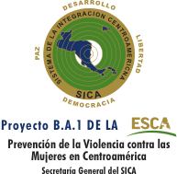

Updating Workshop
October 2015, an updating workshop on the strategy for comprehensive assistance to and accompaniment of victims of trafficking in Central America, with support from SICA, to promote the activity within the framework of Project B.A.1: “Prevention of Violence Against Women, Trafficking in Persons, and Feminicide in Central America”.

Slide 12








Strategic Partners

Slide 13
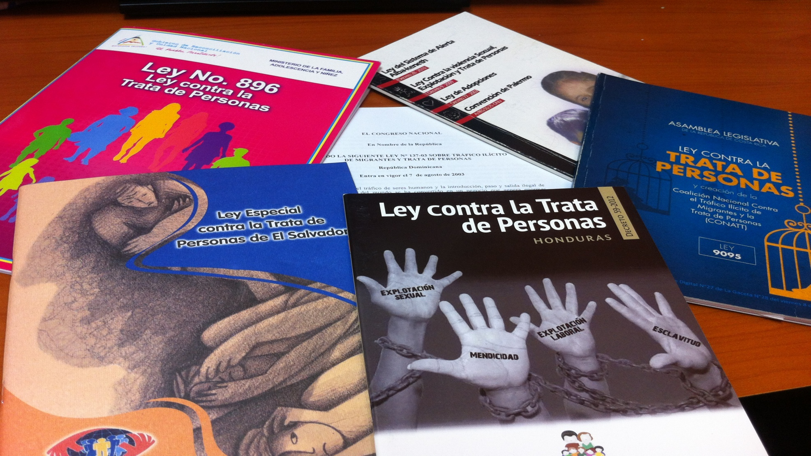
Advances

Slide 14
Advances
Signing a Memo of Understanding between countries
Implementing national regulations with a comprehensive approach
Updating the Strategy for Comprehensive Assistance to Victims of Trafficking
Signing a Memo of Understanding between countries

Slide 15
Advances
Approaching strategic partners for coordination
Cooperation between States in cases of combating and
prevention, as well as assistance and protection for victims
Positioning the issue at a national and international level

Slide 16

REGIONAL COALITION
AGAINST TRAFFICKING IN
PERSONS
Belize
Costa Rica
El Salvador
Guatemala
Honduras
Mexico
Nicaragua
Panama
Dominican Republic
coalicionregionaltrata@gmail.com

