Slide 1
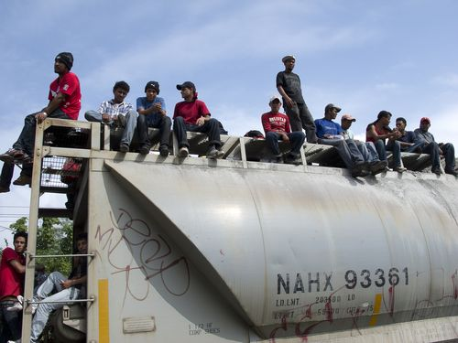
Actions to Promote the Health of Migrants
ICRC – Regional Delegation
Meeting of the Liaison Officer Network for Consular Protection
Regional Consultation Group on Migration (RCGM)
Panama City, Panama
December 4, 2012

Slide 2
Objective:
To inform about the activities of the ICRC in order to improve coordination in serving migrants requiring health care.

Slide 3
Mission of the ICRC
The International Committee of the Red Cross (ICRC), an impartial, neutral and independent organization, has the exclusively humanitarian mission of protecting the life and dignity of victims of armed conflict and other situations of violence and providing assistance to them.
In addition, ICRC implements efforts to prevent suffering through promoting and strengthening the right and universal humanitarian principles.

Slide 4
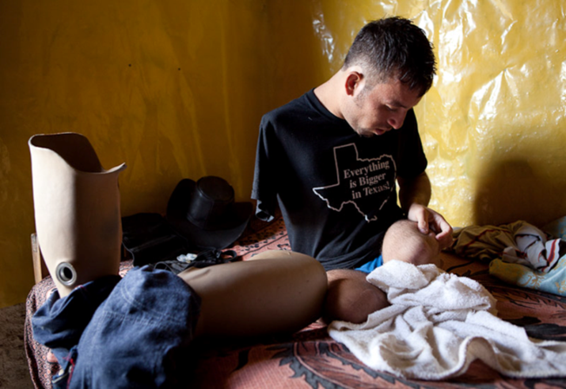
I. Assistance to Persons with Amputations
Prostheses, wheelchairs/crutches, support to help them communicate with their families (reunification), transfers, etc.

Slide 5
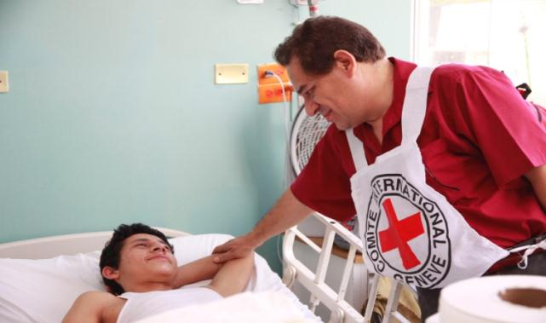
II. Assistance to Persons Requiring Supplies for Surgery
Wheelchairs/crutches, support to help them communicate with their families (reunification), transfers, etc.

Slide 6
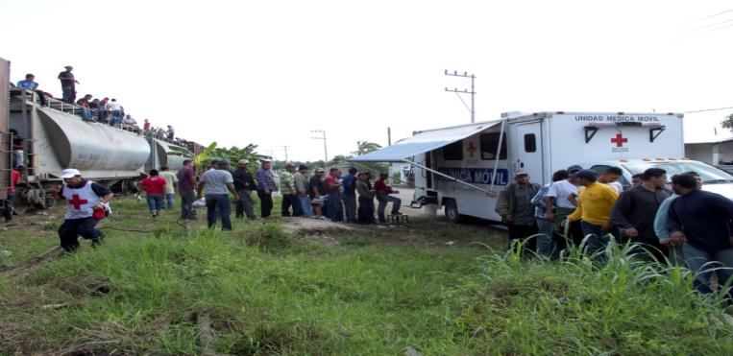
III. Essential Health Care along the Migration Route
Mobile clinics, medical brigades, and modules for repatriated persons
Pre-hospital health care, drinking water, hygiene kits, guidance, telephone calls, etc.

Slide 7
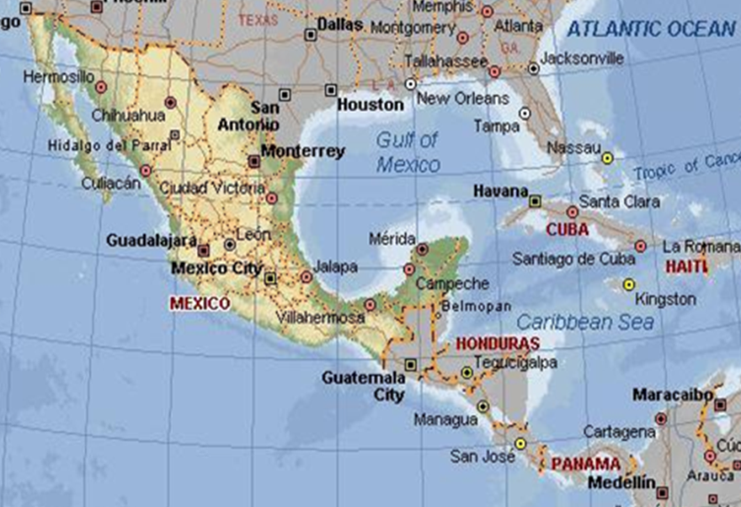
III. Essential Health Care along the Migration Route

Slide 8
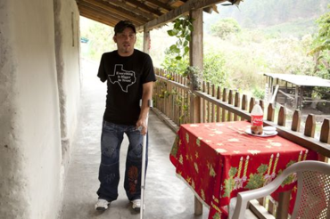
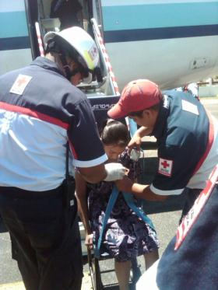
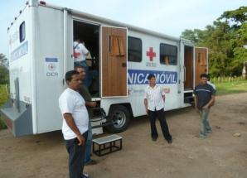
Assistance to:
Persons with Amputations
Injured/Sick Persons
Persons in Transit or Repatriated Persons

Slide 9
To submit/refer cases, contact mex_mexico@icrc.org
01 (55) 25 81 21 10

Slide 10
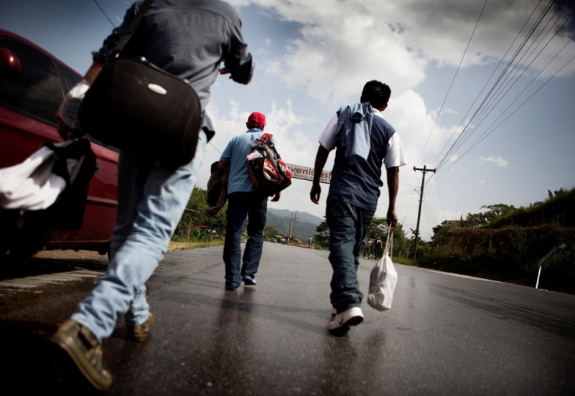
Thank you

