Slide 1
Individual Cases Assisted in Mexico
January 2012 - September 2013
INTERNATIONAL COMMITTEE OF THE RED CROSS
Regional Delegation for Mexico, Central America and Cuba
November 18, 2013

Slide 2
Objective
To share statistical information and challenges relating to individual cases assisted by the International Committee of the Red Cross.

Slide 3
Contents
1. Assistance actions by ICRC
2. Individual assistance
3. Challenges

Slide 4
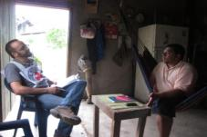

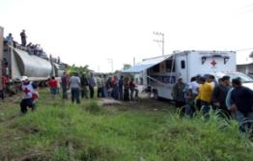
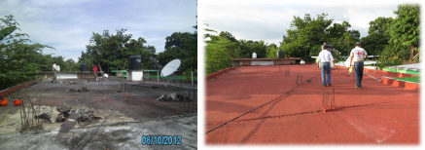
Assistance Actions by the Regional Delegation of ICRC on Migration Matters
a) Individual cases
b) Essential health care
c) Support to other humanitarian aid actors (WatHab/Salud)

Slide 5
Assistance to Individuals in Mexico
January 2012 - September 2013
109 Persons

Slide 6
Causes of Accidents
Travel conditions
Violence
Train accidents
Limited skills
Obstacles along the railroad
Car accidents
Pedestrian knock-down accidents
Weather conditions

Slide 7
Nationalities
A total number of 109 persons
109 personas en total

Slide 8
Age

Slide 9
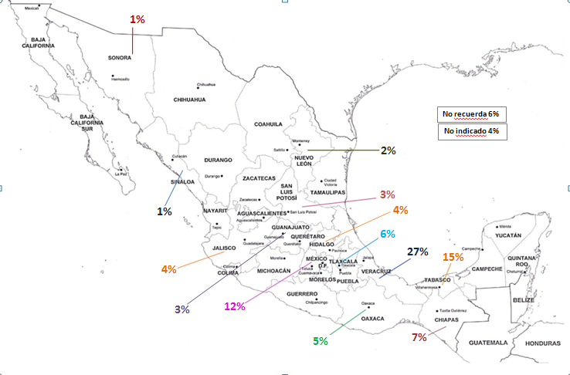
Accident Locations
Does not remember 6%
No information 4%

Slide 10
Assistance to Individuals in Honduras and Guatemala
January 2012 - September 2013
Guatemala | 49
Honduras | 84
The cases of Salvadoran and Nicaraguan nationals are followed up on in Mexico. They are included in the total number of 109 persons assisted (see Slide 7).

Slide 11
Other Needs
Specialized shelters
Referral to specialized health facilities
Accompaniment of family members
Material needs
Support in migration regularization processes
Counselling
Social and labour reintegration

Slide 12
Challenges
To expand the existing mapping of actors in Mexico and in the region.
To strengthen coordination with various actors in Mexico and in the region.
To promote access of migrants to comprehensive health care in countries of origin and transit.
To provide opportunities to enable individuals to fully integrate into society.

