Slide 1
Border Modernization
Regional Conference on Migration
Managua, Nicaragua
June 24-27, 2014

Slide 2



  CBSA Overview
Mission:
The Canada Border Services Agency works to ensure Canada's security and prosperity by managing the access of people and goods to and from Canada.
Vision:
An integrated border agency that is recognized for service excellence in ensuring Canada's security and prosperity.
Mandate:
The Agency is responsible for providing integrated border services that support national security and public safety priorities and facilitate the free flow of persons and goods, including animals and plants, that meet all requirements under the program legislation.
Agency Values: Integrity - Respect - Professionalism
Agency Motto: Protection - Service - Integrity

Slide 3
Evolution of the CBSA
2003-2006: Integration
Significant energy and resources devoted to functions from three Agencies
that shaped the CBSA.
Integrating cultures, people, infrastructure and IT into a cohesive organization.
2006-2010: Consolidation
Emphasis on arming frontline border officers and building a law enforcement culture.
Focus on improving internal management through “Change Agenda”.
Beginning to move forward on transformational change with numerous initiatives.
2010-Current: Transformation
The implementation Beyond the Border initiatives position the Agency to modernize and meet the challenges of the future.
Leveraging investments in IT and building enterprise solutions.
Transform the work culture of the CBSA.
Notes:
.

Slide 4
  Border Modernization
Border Modernization (BM) refers to the consolidated efforts of the CBSA to transform its current border management policies, practices, and technologies to bring about and sustain a modern and advanced future state.
Border Modernization establishes the Agency’s trajectory for the next five to seven years. It shows how the CBSA will be managing the Canadian border after the full implementation of the Canada-US Beyond-the-Border Action Plan and other large transformational projects and initiatives.
The CBSA does not view the border as a fixed point, but rather a continuum where threats are addressed as early as possible and risk is managed throughout.
Our modernization initiatives cross both the Traveller and Commercial Continuums and align with the six strategic principles that guide the Agency’s modernization agenda.

Slide 5
Border Modernization Drivers
Increasing Volumes: More people and goods cross the Canadian border every year
- 22% increase in commercial shipments, 18% increase in travellers, over four years.
Changing Risk Environment: Fast-evolving security threats are challenging our enforcement and control systems: international terrorism, transnational organized crime, migrant smuggling and trafficking, irregular migration, nuclear proliferation, etc.
Program Performance: Canadian public and business expect the CBSA to provide highest quality of service, including rapid adoption of advanced technological solutions.
Operating in Fiscal Constraint and Increasing Costs.
Increased Coordination with the United States.
Adopting International Standards of Border Management.
Increasing Levels of Immigration to Canada.

Slide 6
Key Priorities – Beyond the Border Action Plan
In partnership with the US, the CBSA will strengthen border security and promote economic competitiveness by developing, implementing, managing, and monitoring security and facilitation initiatives.
The Action Plan will enhance and modernize our integrated border management approach with our US counterparts and Canadian partners.
In particular:
  The CBSA leads on 10 of the 32 Action Plan initiatives. These initiatives cover the core objectives of the Action Plan and address key Government of Canada priorities.
  Industry stakeholders, with whom the CBSA is actively engaged, is highly supportive of the Action Plan and its goal of promoting economic competitiveness.

Slide 7

CBSA Strategic Principles
CBSA Strategic Principles
Pushing The
Border Out
  Pushing the Border Out by targeting and intercepting high-risk travellers and goods as early as possible in the continuum;
  Facilitating Low Risk through fast and secure processing of low-risk travellers and goods;
  Making Enforcement more Effective and Integrated by using the full extent of the CBSA’s tools and capabilities to conduct more targeted and timely enforcement activities;
  Improving Efficiency by modernizing business systems and streamlining processes to reduce red tape for travellers and businesses;
  Increasing Harmonization with International Partners particularly with the US; and
  Excelling at Client Service by providing quality service and prompt redress processes.
Making
Enforcement More Effective
& Integrated
Excelling At
Client Service
Increasing
Harmonization With Our
International Partners
Improving
Efficiency
Facilitating
Low Risk

Slide 8
Our Approach
The Government of Canada’s Blueprint 2020 initiative and CBSA’s Border Modernization goals are complementary.
We have communicated to our workforce that Border Modernization is CBSA’s Contribution to Public Service Modernization.

Slide 9
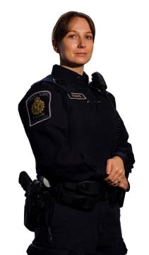

Transforming our Workforce…
Our workforce profile will evolve. Automation and technology will result in CBSA officers moving from transactional processing to intelligence-based enforcement activities requiring enhanced analytical and technical skills.
Our workforce will need to be more mobile and flexible. It will be able to perform a wider range of high-value, knowledge-intensive activities.
The relative balance of expenditures will shift from labour to technological solutions, as will the CBSA “footprint”.
The corporate culture will shift as CBSA transitions to an armed, professional, law enforcement agency.
CBSA careers will become increasingly attractive to a new generation of well educated, highly motivated recruits who will see themselves as knowledge workers and law enforcement professionals.
9

Slide 10
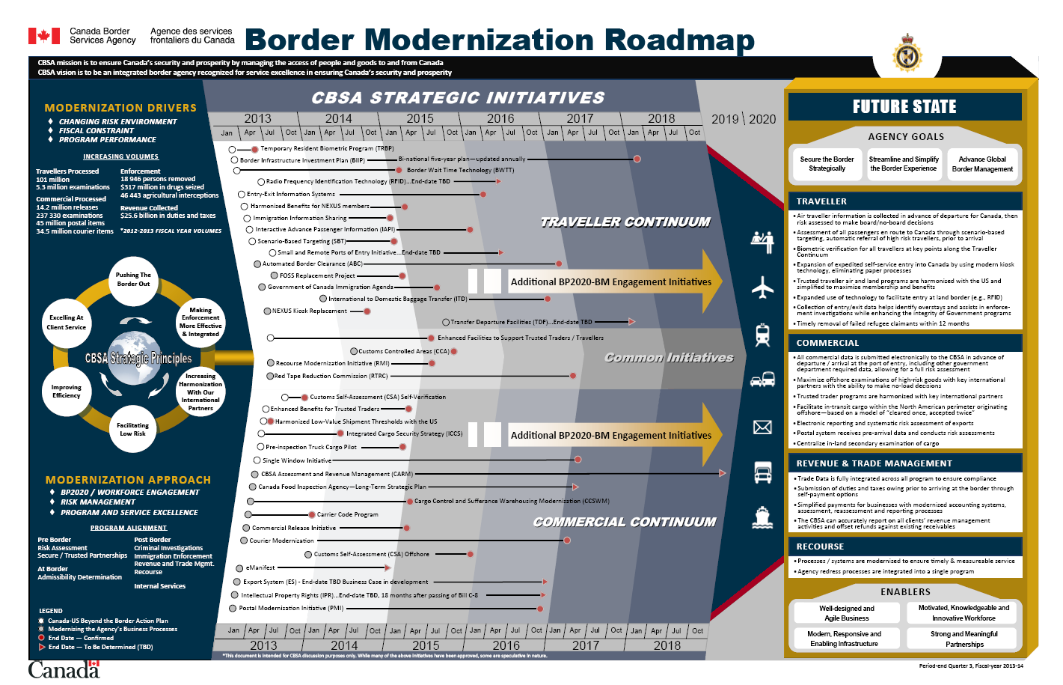

Slide 11
Summary
Transformation means enhanced border security for Canada, simpler and more efficient border services, and increased facilitation of legitimate goods and people.
Our efforts to transform will enable us to realign resources and make the critical investments that will modernize our business.
Investing in, and getting enforcement right, will ensure faster flow of people and goods through our borders.
Applied business analysis and workflow process management will better enable us to adapt, adjust and meet evolving domestic and international expectations.
Our workforce will be impacted by the increasing use of technological solutions. The nature of the work of the CBSA will evolve significantly over the next 5-10 years.

