Slide 1
Settlement and Integration in Canada: an Overview
Presented by Angela Arnet Connidis
Integration Branch, CIC
RCM Workshop, Costa Rica
February 22- 24, 2012

Slide 2
Outline
Settlement and Integration
Newcomers to Canada by source country
Current Challenges
Settlement Program Services
Shared Responsibility
Settlement Program Delivery
Promotion of Settlement Services
Refugees resettlement and assistance
Foreign Credential Recognition
Multiculturalism
Citizenship
Outcomes of newcomers to Canada

Slide 3
Settlement and Integration in Canada
Settlement and integration of newcomers is an important objective under the Immigration and Refugee Protection Act.
Settlement: The early years after arrival (three to five years)
  government support and services are critical to meet newcomer needs.
Integration: A longer-term process
  adaptation by both newcomers and Canadian society,
  Full participation of immigrants in the economic, political, social and cultural life of Canada.

Slide 4
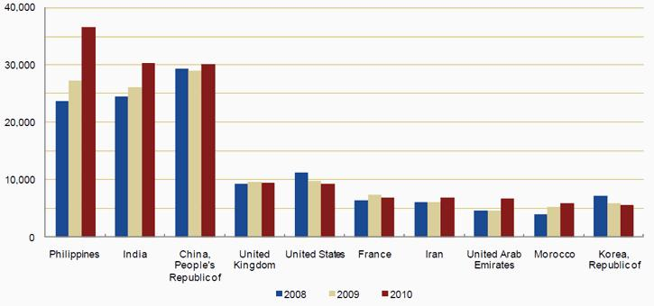
Newcomers to Canada: Permanent Residents by source country

Slide 5
Current Challenges: Social and Cultural
  Increasing numbers of newcomers who do not speak English or French
      In 2010, 27% of those granted permanent status had no proficiency in either English or French: family class 30.6%; refugees 40.9%; economic class 24.4%.
  Challenges regarding diversity
  A 2008 survey found 60% of Canadians agreeing that “there are too many immigrants coming into this country who are not adopting Canadian values.”
  Persistence of racism and hate crimes, concern of radicalization
  Perceived vulnerability to flashpoints/international conflicts
  Integration of specific groups (e.g. youth, 2nd generation, women)
  Concerns about ethnic neighbourhood concentration (including virtual enclaves)

Slide 6
Current Challenges: Economic
  Recent immigrants facing underemployment and limited upward mobility
  Earnings gap between recent immigrants and Canadian-born widening
      In 2005, immigrant men earned 63 cents for every dollar earned by Canadian-born men, compared to 85 cents 25 years ago and immigrant women earned only 56 cents.
  Some visible minorities doing worse than others
      Newcomers from Europe tend to fare better than those from Latin America and Asia.
      Recent immigrants (especially refugees) from Africa experience the highest unemployment rate

Slide 7
Current Challenges: Civic and Political
  Declining civic participation
      Like the Canadian-born, there is declining civic participation and engagement among immigrant populations
      In 2003, 5% of immigrants who had lived in Canada for less than six years reported voting in a recent election, compared to 80% among those who have lived in Canada for more than 25 years.
  Lack of knowledge of Canadian history and political institutions amongst all Canadians
      Over time visible minorities display less attachment to Canada and a weakened Canadian identity.
  Perceptions of citizenship of convenience
      New initiatives to against fraudulent immigration consultants and marriages of convenience
  Elected bodies at all levels do not yet reflect Canada’s diversity

Slide 8
Settlement and Integration Along the Continuum
Application
Selection
Arrival
Formal Citizenship
Access to Information & Awareness
Access to Services
Focus of Public Policy & Programs
Equality of Opportunities
Life Satisfaction
Sense of Belonging
Awareness
Newcomers access public services & community resources
Newcomers understand life in Canada.
Results
Newcomers have the official language skills and know how to obtain employment
Newcomers are connected to social & economic networks
Communities are welcoming and inclusive
Integration
Immigrants participate in civic processes, exercise their rights and responsibilities
Immigrants participate in social and cultural institutions and networks
- Immigrants participate in the economy contribute
- People, communities and institutions are inclusive and welcoming
Satisfaction & Belonging
Immigrants feel a sense of belonging to their community and Canada
Canadians’ attitude toward immigration and cultural diversity is favourable
Outcomes & Indicators

Slide 9
Settlement Program Services
Needs Assessment and Referrals
  Determine eligibility, assess needs, and refer newcomers to other services
Information and Awareness Services
  Provide pre- and post-arrival information
Language Learning and Skills Development Training
Employment-related Services
  Search, gain, and retain employment
Community Connections
  Establish a social and professional network
Support Services
  Help to access settlement services (childcare, transportation)

Slide 10
Shared Responsibility
Immigration is a shared jurisdiction:
  Canada’s Settlement Program entails strong partnerships between federal, provincial and territorial governments.
Federal settlement services are funded, designed and administered by federal government in all provinces and territories, except:
  Québec, British Columbia and Manitoba: devolution of responsibility
  Alberta: co-management agreement
  Provinces and territories also provide settlement support and services in areas such as:
    Income support, language and job training, labour market integration, recognition of foreign credentials, social services, housing, legal aid, business development and youth integration.

Slide 11
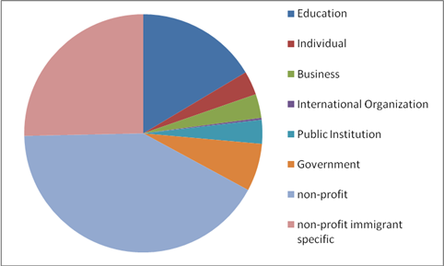
Settlement and Integration Program Delivery
The bulk of settlement services are delivered by non-profit organizations, and are funded by the federal government.
Educational institutions, government organizations and other public institutions are becoming important players in settlement delivery
Trend toward co-ordination and one-stop service points

Slide 12
Promotion of Settlement Services
Settlement Information and Orientation
Overseas
  In-person orientation: Canada Orientation Abroad (COA) & FCRO-led Canadian Immigration Integration Project
  Working in Canada Tool: Helps newcomers find Canadian job descriptions and wages
  Entry Requirements Tool
In Canada
  Newcomer Information Centres
  The Vaughan Welcome Centre
  Community Connection Projects
    Settlement Workers in schools
    Local immigration partnerships
    Library settlement partnerships
Notes:
.

Slide 13
Overview of Overseas Current Activities
Settlement and labour market information available online at each stage in the process
(CIC website - FCRO website – P/T Immigration Portals - Municipal Portals)
Pre-Application, Application and Acknowledgement of receipt
Post-selection (pending medical, security, etc.)
Post-Arrival
Stages
Online resources
Service Offerings
Materials sent out by CIC with acceptance letters or visas
In-person orientation currently available to newcomers in more than 50 countries (subject to demand)
Bridging initiatives
Links to settlement services and in-Canada SPOs

Slide 14
Other Key CIC Programs
Resettlement Assistance Program
  Immediate and essential services to government assisted resettled refugees and income support for a year
Foreign Credentials Referral Office
  Information and referral services on foreign credential recognition
Multiculturalism Program
  Focuses on building intercultural understanding, pride in Canada’s history and core democratic values, and equal opportunity for Canadians of all ethnic origins
Citizenship
  Promotion starts at the pre-migration stage, and early naturalisation is encouraged and viewed as a key integration milestone.

Slide 15
Refugee Resettlement
Under Canada’s resettlement program, refugees and persons in need of protection can be resettled to Canada and can access resettlement assistance and settlement services.
Main barriers for refugees are related to their youth and health:
  40% of resettled refugees are under 18;
  refugee youth has lower level of formal education compared to Canadian youth;
  health concerns: malnutrition, psychosocial issues, lack of prior dental care.
Other barriers for resettled refugees:
  less formal education overall, less official language ability, and larger families than other immigrants.
Refugees tend to be the highest users of settlement services, particularly information and orientation and language training.

Slide 16
Foreign Credential Recognition
Client focused
Systemic change
Foreign Credentials Referral Office
Citizenship and Immigration Canada
Provides:
Information
Path finding
Referral services
to internationally trained individuals overseas and in Canada
Foreign Credential Recognition Program
Human Resources and Skills Development Canada
Supports initiatives that will improve assessment and recognition processes for employment in Canada.
Internationally Educated Health Professionals Initiative
Health Canada
Supports programs that promote a consistent integration of international health professionals into the Labour Market.

Slide 17
Multiculturalism
Program Objectives
Build An Integrated, Socially Cohesive Society
Improve the Responsiveness of Institutions to the Needs of a Diverse Population
Actively Engage in International Discussions on Multiculturalism and Diversity

Slide 18
Multiculturalism
Build An Integrated, Socially Cohesive Society by:
  Building bridges to promote intercultural understanding;
  Fostering citizenship, civic memory, civic pride, and respect for core democratic values grounded in our history;
  Promoting equal opportunity for individuals of all origins.
How?
  Ministerial outreach to communities
  Public Education programs (e.g., Black History Month, Asian Heritage Month)
  Multiculturalism Grants and Contributions Program
  Historical Recognition Programs
  Canada’s Action Plan Against Racism
  Research

Slide 19
Multiculturalism
Improve the Responsiveness of Institutions to the Needs of a Diverse Population by:
  Assisting federal and public institutions to become more responsive to diversity by integrating multiculturalism into their policy and program development and service delivery.
How?
Working with Public Institutions:
  Annual Report on the Operation of the Canadian Multiculturalism Act
  Interdepartmental collaboration and the Multiculturalism Champions Network
  Federal-Provincial-Territorial meetings
  Canadian Race Relations Foundation

Slide 20
Multiculturalism
Actively Engage in Discussions on Multiculturalism and Diversity at the International Level by:
  Promoting Canadian approaches to diversity as a successful model while contributing to an international policy dialogue on issues related to multiculturalism.
How?
  International Task Force on Holocaust Education, Remembrance, and Research
  Positioning in Global forums (e.g., UN, OSCE)
  Global Centre for Pluralism
  Ongoing international research (e.g., Metropolis) and policy discussions
Notes:
.

Slide 21
Citizenship: Program Approach and Objectives
To become a Citizen, a permanent resident must:
  Reside in Canada for three years
  Pass a test demonstrating knowledge of English or French, of Canada, and of citizens’ rights and responsibilities
  Cannot be a security risk or criminally prohibited
Inclusive approach to citizenship that:
  Encourages and facilitates naturalization by permanent residents
  Enhances the meaning of citizenship as a unifying bond
  High naturalization rate: 85% of eligible permanent residents apply
A tool for nation building that helps foster a shared identity and a sense of belonging

Slide 22

Promoting Citizenship : Citizenship Action Plan
Objectives
Key Initiatives
Access to essential knowledge base for citizenship
Enhanced respect for democratic values and citizenship
Integrity of naturalization process and promotion of civic responsibility
  Citizenship study guide – Discover Canada
  Changed citizenship test
  Language testing
  Meaningful citizenship ceremonies
  Improving tools for citizenship education and promotion
  Improving client service processing times
  Measures to address fraud
  Streamlined revocation process

Slide 23
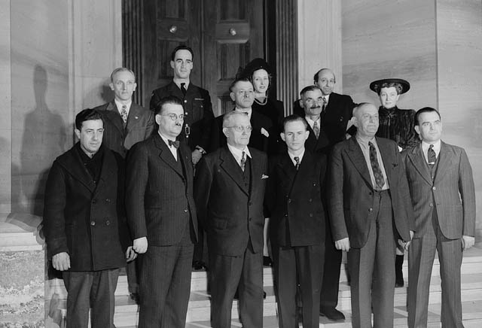
First Official Canadian Citizenship Ceremony: 1947
Front row: Naif Hanna Azar (Palestine), Jerzy Wladyslaw Meier (Poland), Louis Edmon Brodbeck (Switzerland), Joachim Heinrich Hellmen (Germany), Jacko Hrushkowsky (Russia), and Anton Justinik (Yugoslavia)
Back row: Zigurd Larsen (Norway), Sgt. Maurice Labrosse (Canada), Joseph Litvinchuk (Roumania), Mrs. Labrosse (Scotland), Nestor Rakowitza (Roumania), Yousuf Karsh (Armenia), Mrs. Helen Sawicka (Poland)

Slide 24
Understanding Newcomer Outcomes
Available research is showing the first four years are key for newcomers
In the first years newcomers are most likely to experience difficulties in:
  finding employment
  accessing education and health care
  finding affordable housing
Newcomer needs vary along the integration continuum: what is adequate in the initial settlement stage (e.g. finding a job) may no longer be sufficient for long-term integration (e.g. job commensurate with education and skills).

Slide 25
Understanding Newcomer Outcomes
Successes
  Uptake of Canadian citizenship is 85% (one of world’s highest rates)
  Four years after landing about three-quarters of newcomers are satisfied or very satisfied with their life in Canada
  Voting, volunteering and charitable giving of immigrants are at comparable level or slightly higher to Canadian-born
  Second generation immigrant children more likely to have a university degree and higher average earnings compared to both first generation and Canadian-born

Slide 26
Understanding Newcomer Outcomes
Challenges
  Recent immigrants have consistently low earnings and experience difficulties integrating the labour market (difficulties decrease with time spent in Canada)
  Official language literacy of immigrants is below-average compared to Canadian-born (60% of immigrants below Level 3 on International Adult Literacy Survey scores)
  Women, seniors, visible minorities and refugees face additional disadvantages and are more vulnerable to poor economic outcomes.

Slide 27
Second Generation Outcomes
Second-generation Canadians are significant proportion of the population
  In 2006, accounted for 13% of the population 15 and over
On average, equal or better economic outcomes than those with Canadian-born parents - a unique finding among OECD countries
Some areas of concern, such as lower labour market outcomes for visible minority men from West Africa, Caribbean and Latin America
Most data suggests first-generation and second-generation Canadians have a stronger sense of belonging to Canada than the general population, increasing with each generation

Slide 28
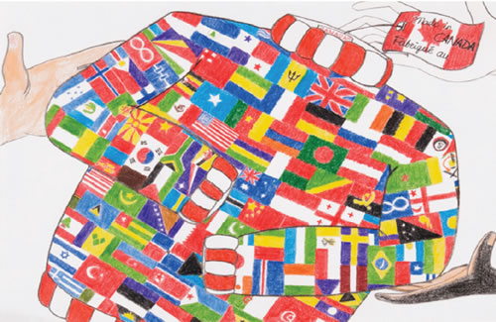
Made In Canada
By PHOEBE XINYI CHANG Title: Made in Canada
Winner of Mathieu Da Costa Challenge National Writing and Artwork Contest 2009 (13-15 year old category)

Slide 29
Questions?
Angela Arnet Connidis
Director
Integration Branch
Citizenship and Immigration Canada
(613) 946-0572
Angela.Connidis@cic.gc.ca

