Slide 1
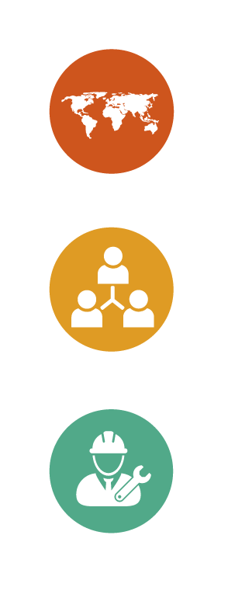




Communication technics

Slide 2
Communication gaps
There is a gap between the message that is issued by the person who communicates and the one that is received by the other person, which can cause certain distortions:
  The reduction: 70% of the details are discarded after five or six transmissions; the final message is much shorter.
  The emphasis on certain details: what had the most impact for the person receiving the message.
  The assimilation or reconstruction of the message: it is influenced by habits, interests and feelings.
It takes a lot of learning to reduce these gaps and ensure a good understanding of the message.

Slide 3
According to several studies, the factors that affect communication are the following and can be observed in these proportions:
57%
The intensity of the message (level of emotion):
The voice tone
(level according to emotion):
The selection of words:
36%
7%
The richness of the vocabulary is not a determining factor in communication, but to but to express it in a convincing manner and with an appropriate tone is.

Slide 4


Active listening: the professional activity
9%
Talking:
Listening:
30%
Writing:
Reading:
16%
45%
  More tan half of the professional activity consists in listening to others. Hence the importance of active listening:
  Try to understand what others want to say.

Slide 5
How to re-learn to listen effectively?
-Four effective listening techniques-
3. The recap: at the end of an exchange it is appropriate to recapitulate what was understood.
4. The reformulation: repeat in your own words what the speaker said. It makes it possible to confirm mutual understanding and obtain clarifications.
1. Acknowledgement: Provide a brief answer to the interlocutor.
2. The return: retake the last sentence or the last words of the interlocutor in the form of a question followed by a pause.

Slide 6
Attention!
Reformulate repeat (but to express in your own words what was understood.
Reformulate to immediately give your point of view or talk about yourself.
Reformulate focus on the reasoning of the other person.
  To express the interlocutor's effort to listen and / or make themselves understood.

Slide 7
Ways to reformulate
Echo
Synthesis
Re-orientation
Inductive and deductive reformulation
Re-take the last words of the interlocutor; elaborate on what has been said.
Briefly re-take the purpose of the interlocutor.
Reorient the discussion; avoid digressions.
Deduce a logical consequence of what was not expressed. Induce a cause that was not expressed.

Slide 8
Thank you for your attention

