Slide 1
Refugee and Migrant Health
in the United States
Regional Conference on Migration:
Migration Health Workshop
September 29, 2016
Curi Kim, MD, MPH
Director, Division of Refugee Health
Office of Refugee Resettlement
Administration for Children and Families
U.S. Department of Health and Human Services

Slide 2
History of ORR
1980
The federal Office of Refugee Resettlement (ORR) established through the 1980 Refugee Act
2008
2000
ORR expands its service provision to cover three new categories: persons granted asylum, survivors of torture, and certified adult victims of human trafficking
The Trafficking Victims Protection Reauthorization Act (TVPRA) of 2008 extends ORR’s mandate to confer eligibility and services to trafficked children
2003
Oversight of services to Unaccompanied Children (UC) is transferred to ORR through the Homeland Security Act of 2002

Slide 3
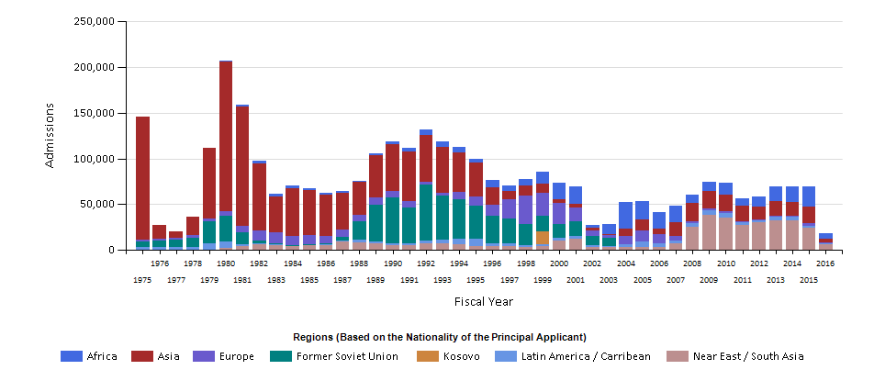
U.S. Refugee Admissions by Region
Fiscal Year 1975 through Jan 31, 2016
http://www.wrapsnet.org/Reports/AdmissionsArrivals/tabid/211/Default.aspx

Slide 4
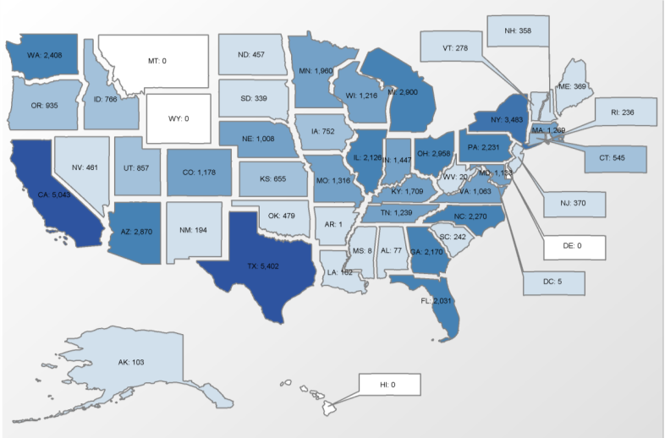
Refugee Arrivals by State, Oct 2015 – July 2016

Slide 5
U.S. Refugee Resettlement Program, FY15 Arrivals
Top Refugee Numbers by Country of Origin, FY2015
Burma | 18,000
Iraq | 13,000
Somalia | 9,000
Democratic Republic of Congo | 8,000
Bhutan | 6,000
Syria | 2,685

Slide 6
ORR Caseload Projection for FY16
Entry Status | Total Projected
Refugees | 85,000
Asylees | 29,200
Cuban/Haitian Entrants/Parolees | 64,000
Foreign Victims of Human Trafficking | 600
Special Immigrant Visa holders (SIV) | 13,000
Total projected ORR caseload for FY2016* | 191,800
*does not include Unaccompanied Children
*does not include UAC

Slide 7
Refugee Health
Medical screening
  Overseas
  Domestic
Access to health care is needed for economic security
  Medicaid
  Refugee Medical Assistance

Slide 8





http://www.acf.hhs.gov/programs/orr/programs/refugee-health

Slide 9
Who are Unaccompanied Children?
Intercepted in U.S., under 18 years old, with no lawful immigration status in the U.S., no parent or legal guardian in the U.S., OR, with no parent or legal guardian in the U.S. available to provide care or legal custody.
Unaccompanied children (UC) are referred to ORR for placement by another Federal agency, usually the Department of Homeland Security (DHS).
By law, other Federal agencies have to transfer the custody of a UC to ORR within 72 hours.
The majority of UC come into ORR care because they were apprehended by DHS while trying to cross the border.
Others are referred as a result of interior apprehensions after involvement with local law enforcement or internal immigration raids.

Slide 10


UC Program Responsibilities
Care and custody of UC (provide shelter, food, clothing, and services)
Make and implement placement and transfer decisions
Reunify UC with qualified sponsors
Oversee a network of ORR-funded care provider facilities
Monitor care providers and ensure compliance with national care standards

Slide 11

UC Countries of Origin, FY 15
 | Honduras (17%)
 | Guatemala (45%)
 | El Salvador (29%)
 | All Other Countries Combined: (9%)

Slide 12
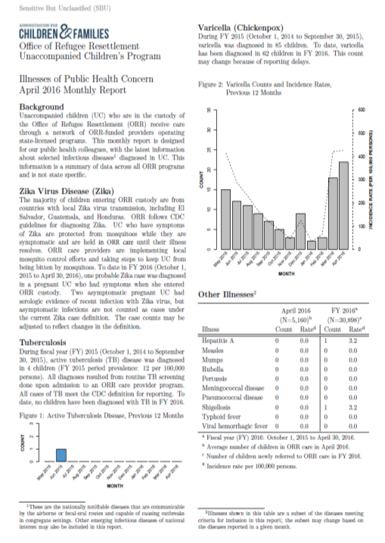

Slide 13

Photo credit: HHS Administration for Children and Families

Slide 14
Services for Survivors of Torture, FY 2015
> 9,000 survivors served by 30 grantees offering medical, mental health, social, and legal assistance
Most common primary need was mental health (37%)
36% of clients were from Africa, 22% from Latin America, and 20% from the Middle East
46% of clients were asylum-seekers and 27% were refugees
Most common form of torture was beatings (49%), followed by threats (43%)

Slide 15
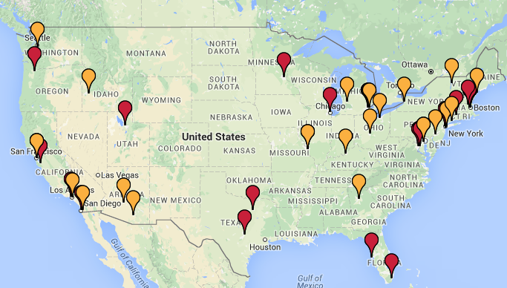
Services for Survivors of Torture:
Healing Centers
http://www.healtorture.org/content/domestic-healing-centers
Red pin indicates full members of National Consortium of Torture Treatment Centers (NCTTP)

Slide 16
Thank you!
For more information about ORR programs,
please visit our website at:
www.acf.hhs.gov/programs/orr

Slide 17
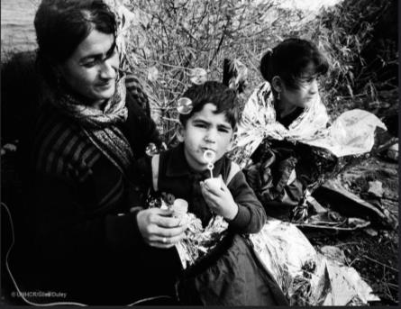

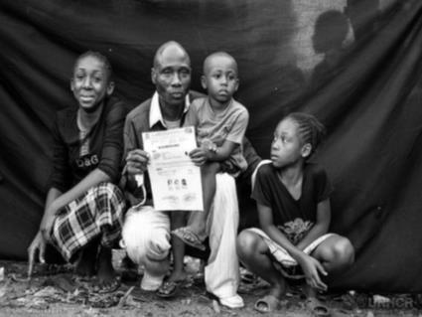
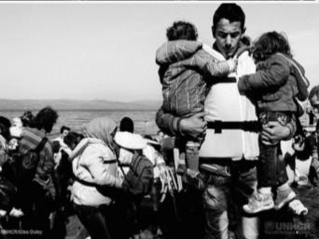
Photos courtesy of UNHCR

