Slide 1

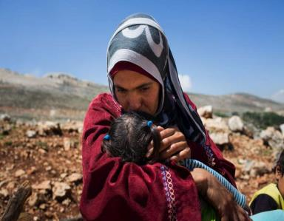
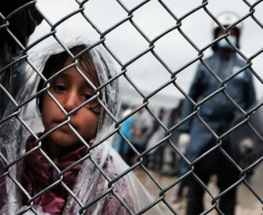
Immigrant and Refugee Health: A U.S. Perspective
Martin S Cetron, MD
Director, Global Migration and Quarantine CDC
Nina Marano DVM MPH Dipl ACVPM
Immigrant, Refugee and Migrant Health Branch, DGMQ, CDC
National Center for Emerging and Zoonotic Infectious Diseases
Division of Global Migration and Quarantine

Slide 2
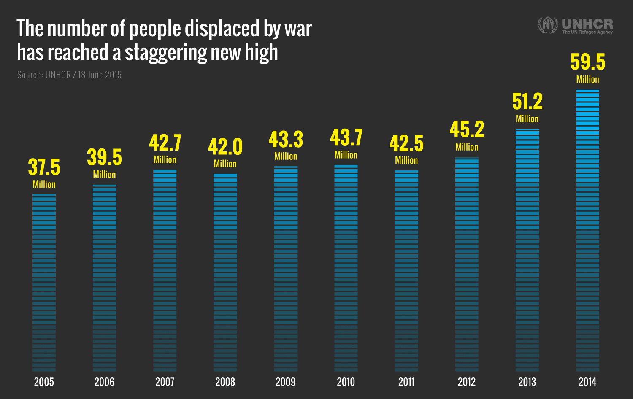
Overview of the Global Refugee Crisis

Slide 3
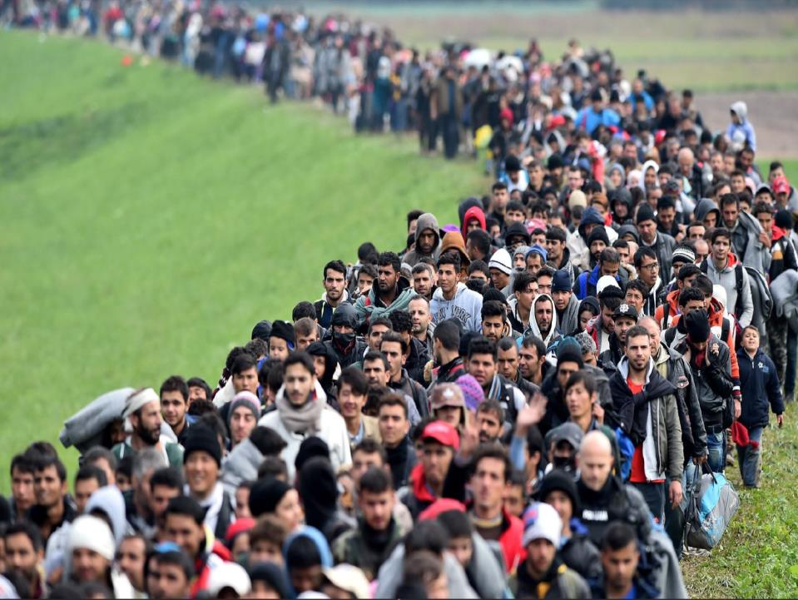
With so many countries under siege, this has led to the largest refugee crisis since World War II.
4.8 million Syrians have fled their country since the beginning of the civil war in 2011 as part of the Arab Spring.

Slide 4
FY 2006 – 2015 U.S. Refugee Arrivals, by Region
Data source: Disease Notification Analysis (DNA) database based on Worldwide Refugee Admissions Processing System (WRAPS) from the U.S. Department of State

Slide 5
Top 10 Countries of Nationality for US-Bound Refugees, 2015
Total: 69,933
DRC
7,823
Burma
18,323
Iraq
12,608
Somalia
8,852
Bhutan
5,563
Iran
3,099
Syria
1,693
Eritrea
1,576
Sudan
1,576
Cuba
1,526

Slide 6
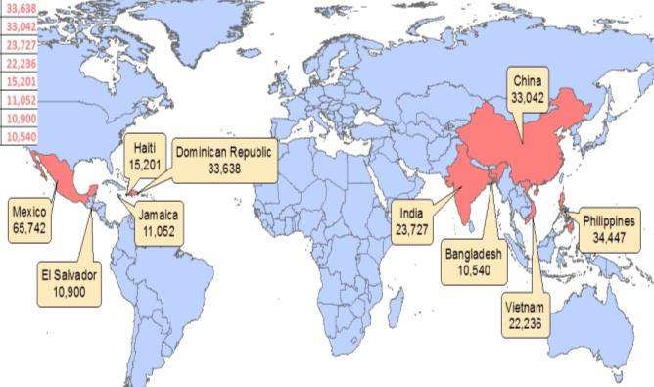
U.S. Immigrant Arrivals for FY2014
Map of top 10 Nationalities
Top 5 Nationalities: Mexico, Philippines, Dominican Republic, China, India
Data source: Department of Homeland Security

Slide 7
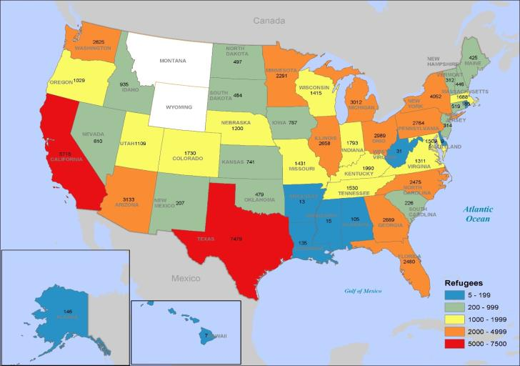
FY 2015 U.S. Refugee Arrivals by State
Data source: Disease Notification Analysis (DNA) database based on Worldwide Refugee Admissions Processing System (WRAPS) from the U.S. Department of State

Slide 8
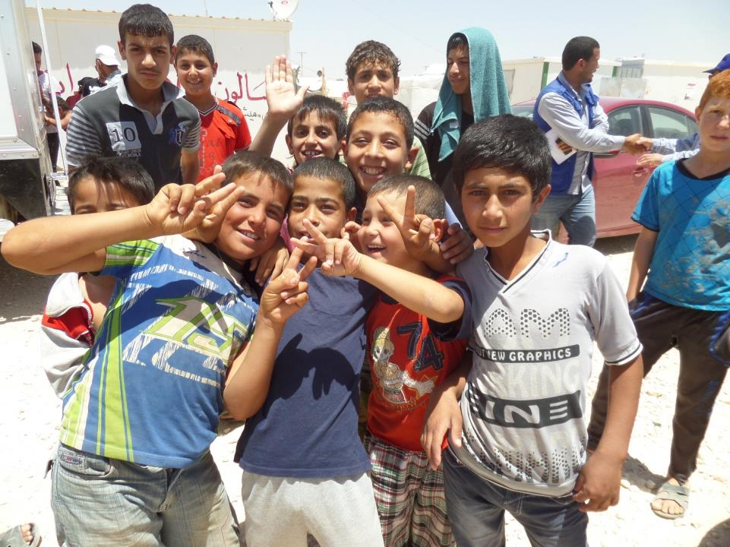
Syrian Refugees
US resettled 10,000 Syrians in FY16
  Majority are from from Iraq, Jordan, Turkey, Lebanon, Egypt
  Most Syrian refugees reside in urban/semi-urban settings
  Additional processing site established in Erbil, Iraq (located closer to Syrian border)
  * FY16 global refugee arrivals set at 85,000

Slide 9



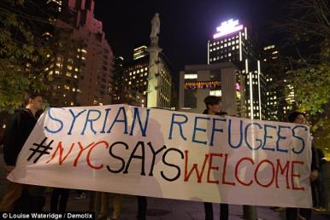
Reactions to Syrian Refugee Resettlement

Slide 10
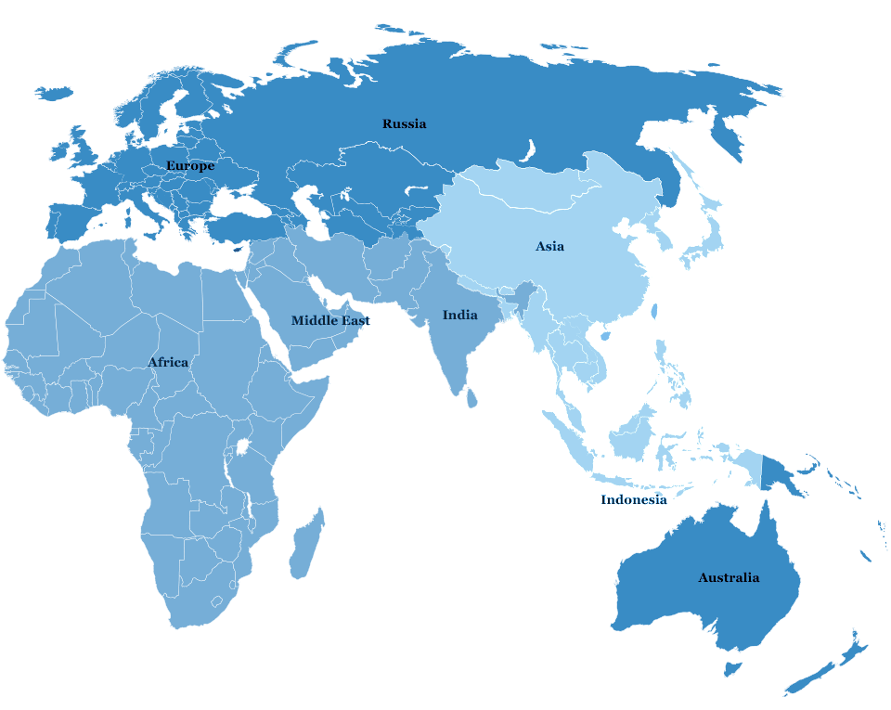
Locations of CDC’s Overseas Refugee Health Programs
Amman Jordan
(2016)
Bangkok Thailand
(2006)
Nairobi Kenya
(2007)

Slide 11
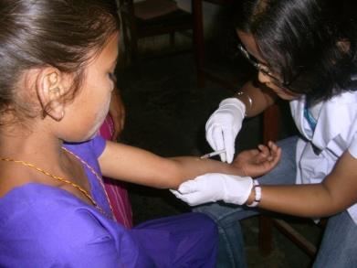
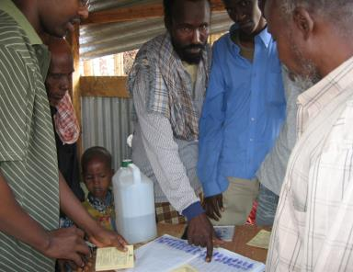
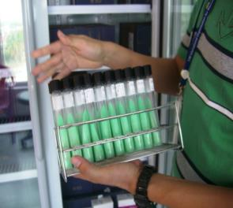
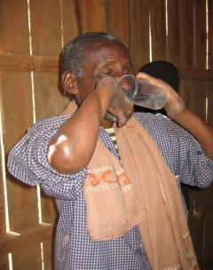
Healthy Resettlement Promotes Health Security:
Overseas Tuberculosis Screening
TB skin testing, Nepal
Directly observed therapy for TB, Kenya
TB cultures, Nepal

Slide 12
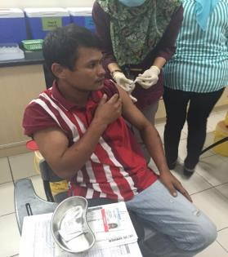
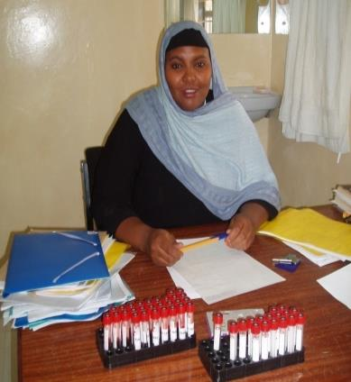
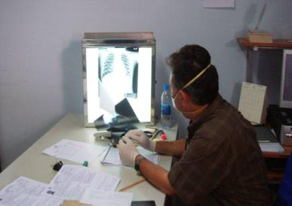
Components of the Overseas Medical Exam
Vaccine Administration
Syphilis testing
Radiologic assessment for TB

Slide 13
Tuberculosis Cases, United States, 1995-2014
2014 TB rates:
Total 2.96 per 100,000
US-born 1.2 per 100,000
Foreign-born 15.4 per 100,000
TB : 65% Foreign-born
MDR TB: 88% Foreign-born

Slide 14
TB Rates in Refugee Populations –
USRP, 2014
Screening Location | Primary Populations | Refugees Examined | TB Cases | Cases with Drug Resistance | TB Rate per 100,000
Egypt | Iraqi, Syrian, Somali, Sudanese | 3,301* | 0 | 0 | 0
Ethiopia | Eritrean, Somali | 7,511 | 14 | 0 | 186
Iraq | Iraqi | 13,480 | 1 | 0 | 7
Jordan | Iraqi, Syrian | 3,448* | 0 | 0 | 0
Kenya | Somali, Congolese | 7,005 | 25 | 1 | 357
Malaysia | Burmese | 13,969 | 111 | 17 | 795
Nepal | Bhutanese | 7,653 | 50 | 0 | 653
Thailand | Burmese | 8,376 | 54 | 0 | 645
Turkey | Iraqi, Syrian | 5,367* | 2 | 0 | 37
Uganda | Congolese | 2,940 | 6 | 2 | 204
*Primarily refugees, but may include small number of immigrant exams
Preliminary data courtesy Ms. Michelle Russell

Slide 15
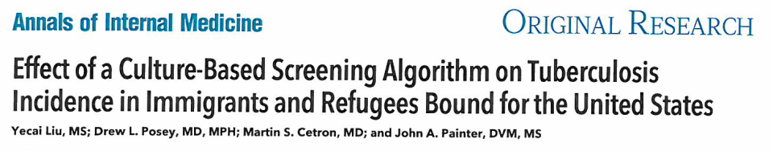
Annals of Internal Medicine
  March 17, 2015
  Video online accompanying article
Describes impact of TB TI implementation on US foreign-born TB
With Culture and DOT TB TI
  Increase detection by >600 cases per year

Slide 16
Effect of a Culture-Based Screening Algorithm on TB Incidence in US-Bound Immigrants and Refugees
Smear-Based Algorithm
2002-2006
Baseline
Liu et al. Annals of Internal Medicine, 2015

Slide 17
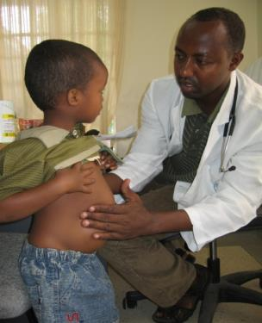
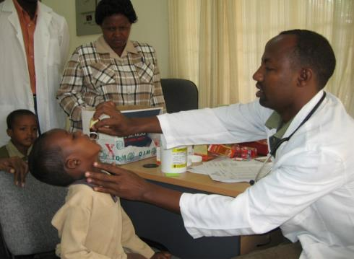
Presumptive Treatment for Intestinal Parasites,
Dadaab Refugee Camp, Kenya

Slide 18
Estimated Program Costs & Outcomes
Intestinal Parasites, Asian refugee cohort, n= 27,700
B. Maskery et al. Unpublished data, 2016

Slide 19
Disease Outbreaks in Proximity to
U.S.-Bound Refugees, FY 2014-2016
KYRGYZSTAN
IRAQ
(Iraqis)
NEPAL (Bhutanese)
5000
CHAD
THAILAND (Burmese)
ETHIOPIA (Somalis)
Measles
Mumps
Rubella
Varicella
Typhoid
Cholera
Watery Diarrhea
Hep. E
Meningitis
Influenza A
1600
150
KENYA
(Somalis)
MALAYSIA (Burmese)
25
UGANDA (DRC)
TANZANIA
(DRC)
Nationality | Departures FY 2014-2016*
Burmese | 35,685
Iraqi | 34,420
Somali | 19,594
Bhutanese | 15,120
DRC | 14,020
*Through Jan, 2016
BURUNDI (DRC)
ZAMBIA
(DRC)
Not shown: Malaria in Kenyan refugee camp, ~25,000 cases

Slide 20
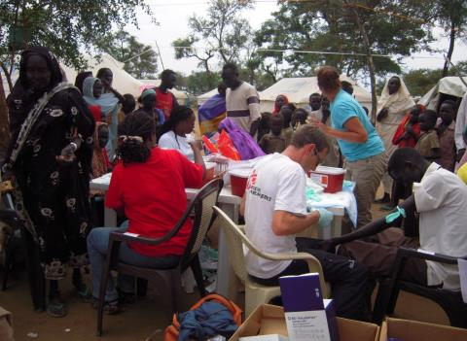
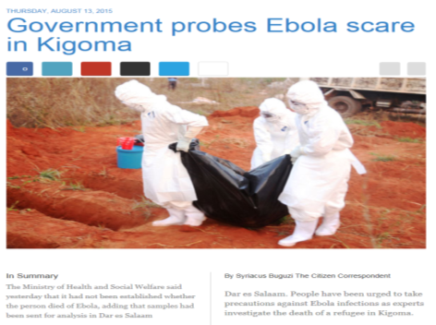
Outbreak Detection and Response
Hepatitis E outbreak, South Sudan
Suspected Ebola, Tanzania

Slide 21
Horn of Africa Migration Movement:
Why Migration is a Health Concern
To the UK
15,134 migrants
Northern
migration route
Migration out of Somalia is global
Gulf of Aden
migration route
2,412 migrants
In 2013, MDR TB cases surged in Dadaab and Eastleigh, Kenya
Most (>80%) were migrants from Somalia seeking treatment
To USA
● Hargeisa
●
Addis Ababa
To Ethiopia
223,243
migrants
To Kenya
513,292 migrants
● Mogadishu
● Dadaab
●
South Africa
migration route
Nairobi (Eastleigh)
Image reproduced from Cain KP, Marano N et al.
The movement of multidrug-resistant tuberculosis across borders in East Africa needs a regional and global solution
. PLoS Med. 2015 Feb 24;12(2):e1001791.
MDR TB and other deadly infectious diseases commonly occur in states om turmoil. For example, in 2013, a surge of MDR TB cases were reported in the Kenyan towns of Dadaab and Eastleigh. Over 80% of these cases were patients arriving from Somalia.
This map shows that migration out of Somalia is global. TB anywhere is TB everywhere.

Slide 22
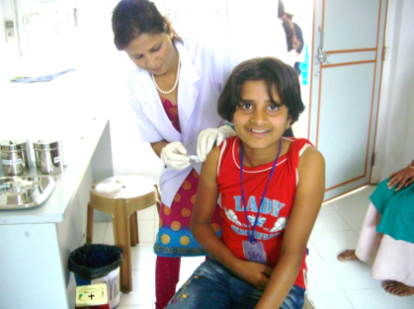
Refugee Vaccination Program: Overview
Up to 2012 - Many refugees arrived in U.S. with no vaccinations
  Reports of VPD’s in newly arrived refugees
  Missed opportunity to vaccinate between overseas health exam & US arrival (4-6 months)
Partnership between CDC, DOS, implemented by IOM
2012 – began in 5 pilot countries: Malaysia, Nepal, Thailand, Ethiopia and Kenya
2016 and beyond – continuing to roll out globally with intentions of reaching 100% of USRP refugees

Slide 23
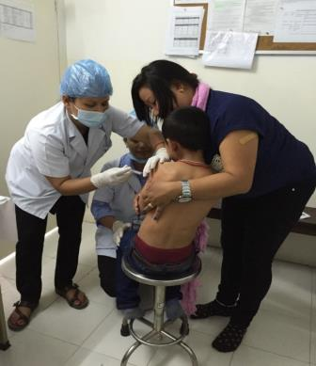
Overseas Refugee Vaccination Program:
Protecting against 11 Diseases
Diphtheria
Haemophilus influenzae type b
Hepatitis B
Measles
Mumps
Rotavirus
Rubella
Pertussis
Polio
Streptococcus pneumoniae (pneumococcal disease) [vaccine procurement still pending]
Tetanus

Slide 24
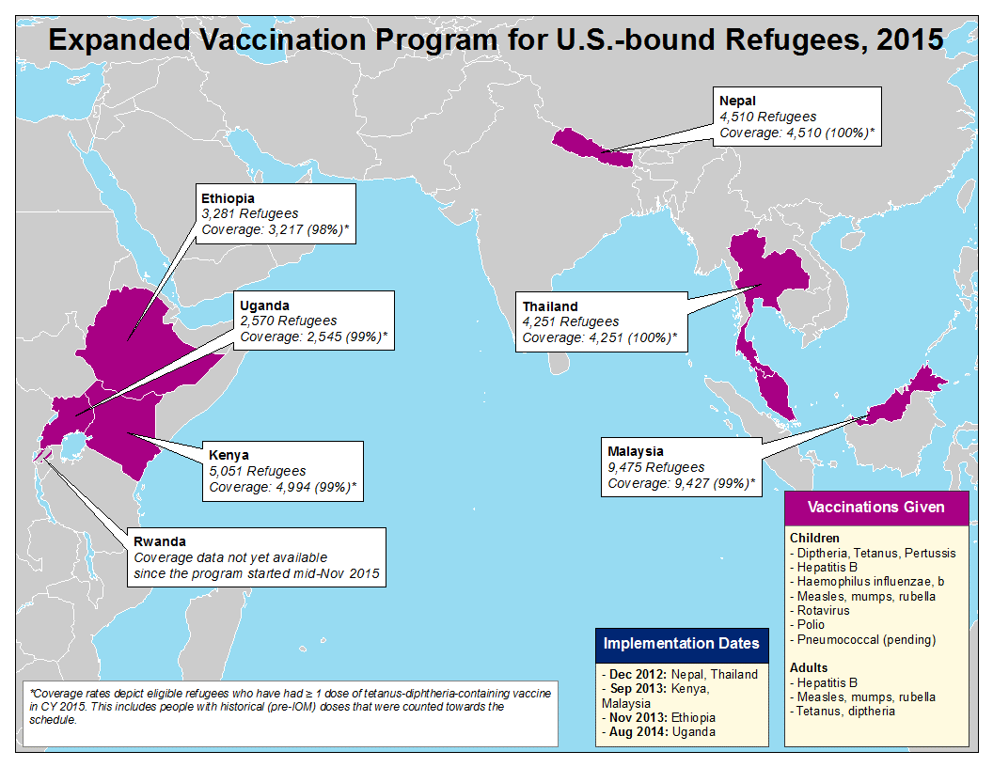

Slide 25
CDC Refugee Health Guidelines and Profiles
Refugee health profiles
www.cdc.gov/immigrantrefugeehealth/profiles/index.html
  Bhutanese, Congolese, Iraqi, Burmese
Refugee health guidelines
www.cdc.immigrantrefugeehealth/guidelines/domestic/domestic-guidelines.html
  History, physical, hepatitis, HIV, immunizations, parasites, lead, mental health, malaria, nutrition, STI’s, tuberculosis

Slide 26
Continuing Refugee Health Care Stateside
Strengthening Surveillance for Disease Among Newly Arrived Refugees (2012-2017)
  Enhanced refugee health surveillance databases in 10 jurisdictions
Centers of Excellence in Refugee Health (2015-2020)
  Initially focusing on
    Surveillance/epidemiology of refugee populations
      Development of multi-state surveillance networks
      Investigating long term health outcomes of refugees post-arrival
    Post-arrival screening guidance to U.S. clinicians
      Create new guidelines to improve refugee health
      Update existing refugee health guidelines
      Survey refugee healthcare providers to evaluate content and presentation of existing guidelines (survey sent to Society of Refugee Healthcare Providers Listserv on 6/1/2016)

Slide 27
Outbreak Notifications to
State Refugee Health Coordinators
“ Dear Refugee Health Coordinator, CDC has been informed of 8 cases of measles in refugees in a camp in ………..”
3 Types:
News/Updates
Outbreak/Exposure Alert Notices
Outbreak/Exposure Alert Notices with Individual Refugee Arrival Notification
16 notifications in 2015

Slide 28
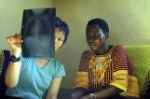

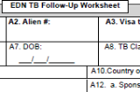
CDC’s Electronic Disease Notification (EDN) System
EDN Purpose:
EDN Users:
Capture overseas medical exam data
Health Departments in all 50 States and D.C.
>800 active users
Notify state health departments
TB Controllers
27%
Refugee Health Coord.
20%
Capture domestic TB follow-up exam data
TB/Refugee Health Coord.
35%

Slide 29
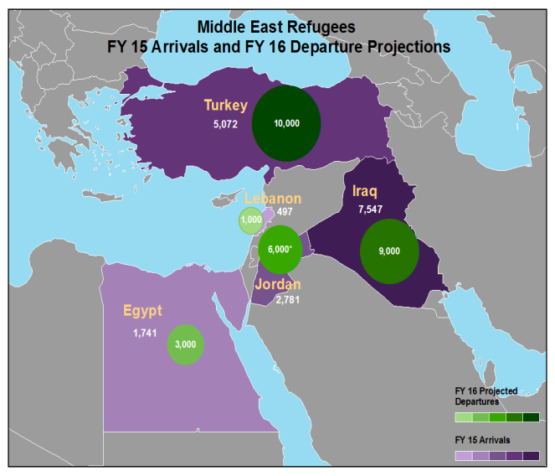

Slide 30
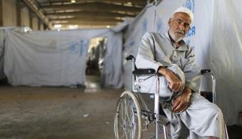
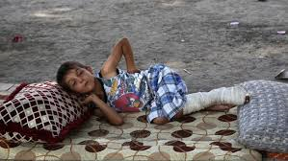
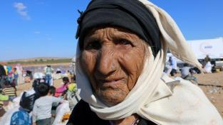
USRAP Middle East Challenges
Regional security issues
Complex caseload with substantial medical conditions
Image: NGO Coordination
Committee for Iraq
Image: The Daily Telegraph
Image: Fox News

Slide 31
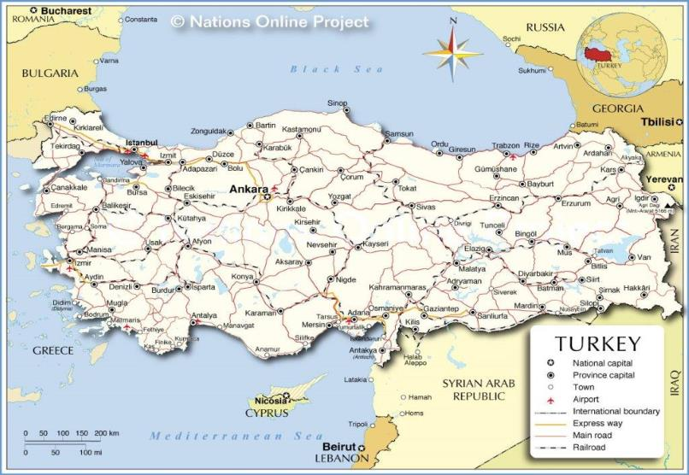
Locations of Refugees in Satellite Cities of Turkey
Satellite cities
Panel Physician Sites

Slide 32
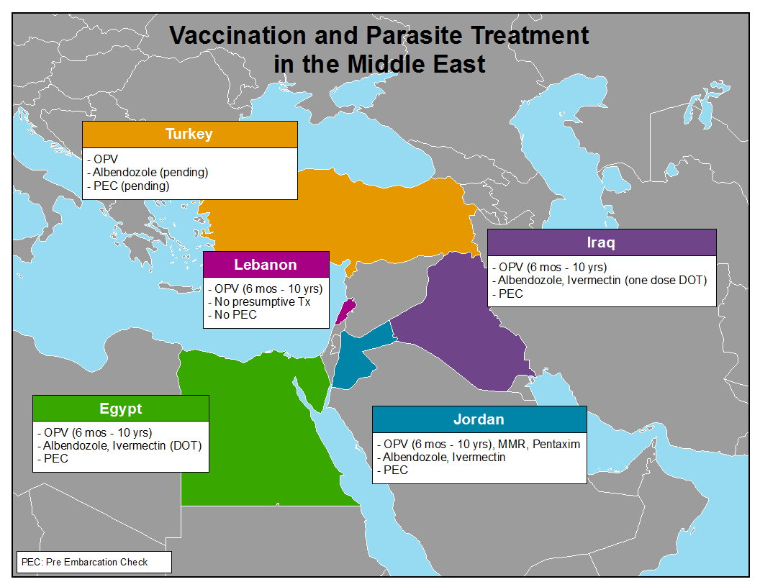

Slide 33
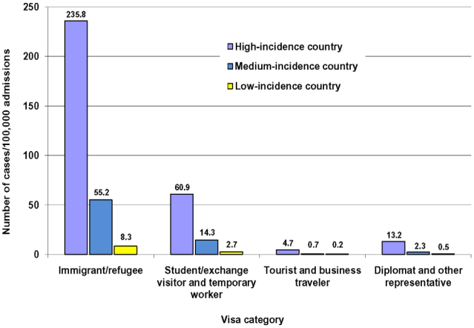
What’s Next? Overseas Screening of Long-Term Visitors
Liu Y, et al. Estimating the impact of newly arrived foreign-born persons on tuberculosis in the United States. PLoS ONE 2012;7(2): e32158. doi:10.1371/journal.pone.0032158.

Slide 34
Overseas Refugee Screening and Treatment for Latent Tuberculosis Infection (LTBI):
A Cost-Benefit Analysis
Cost saving for high and moderate LTBI prevalence
Not cost saving for low LTBI prevalence
Wingate, et al. BMC Public Health 2015;15:1201. DOI 10.1186/s12889-015-2530-7.

Slide 35
Diabetes in US Bound Refugees
Objectives:
  To assess diabetes prevalence and factors associated with diabetes among US bound adult refugees
Methods:
  Analyzed overseas medical evaluations of US bound refugees from 2009-2014 through CDC’s Electronic Disease Notification System
Results:
  Of 248,850 refugees aged >18 years, 5767 (2.3 %) had diabetes
  Iraqis had highest crude (5.1 %) and age-adjusted (8.9 %) prevalence
  Higher age group and body mass index were associated with diabetes
  Diabetes prevalence varied by refugee nationality
Conclusions:
  Although absolute rates were lower than US, prevalence is still concerning given younger age and their need for health services upon resettlement
Benoit S et al Diabetes Among United States-Bound Adult Refugees, 2009–2014
J Immigrant Minority Health DOI 10.1007/s10903-016-0381-7

Slide 36
Conclusions
Much progress has been made
  Overseas vaccination and pre-departure interventions
  Establishment of CDC presence in Middle East to meet growing resettlement numbers
  Partnerships with state health departments
More to come
  Screening of long term visitors
  Assessment of feasibility of overseas LTBI treatment

Slide 37
Acknowledgements
Division of Global Migration and Quarantine, CDC
Heather Burke
Tarissa Mitchell
Emily Jentes
Drew Posey
Courtney Chappelle
Christina Phares
Zanju Wang
Nekeia Gray
Deborah Lee
Clelia Pezzi
Jenna Beeler
Maurice Ope
Annelise Doney
Michelle Weinberg
Lisa Rotz
William Stauffer
Martin Cetron
International Organization for Migration
Warren Dalal
Alexander Klosovsky
Bureau of Population, Refugees, and Migration
Larry Bartlett
Margaret Burkhardt
Kelly Gauger

Slide 38
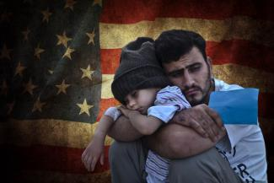
June 20th 2016 is the international observance of World Refugee Day.
This year’s theme is
“ With courage, let us all combine”
Image: Philly Voice
For more information please contact Centers for Disease Control and Prevention
1600 Clifton Road NE, Atlanta, GA 30333
Telephone: 1-800-CDC-INFO (232-4636)/TTY: 1-888-232-6348
Visit: www.cdc.gov | Contact CDC at: 1-800-CDC-INFO or www.cdc.gov/info
The findings and conclusions in this report are those of the authors and do not necessarily represent the official position of the Centers for Disease Control and Prevention.
National Center for Emerging and Zoonotic Infectious Diseases
Division of Global Migration and Quarantine

