Slide 1
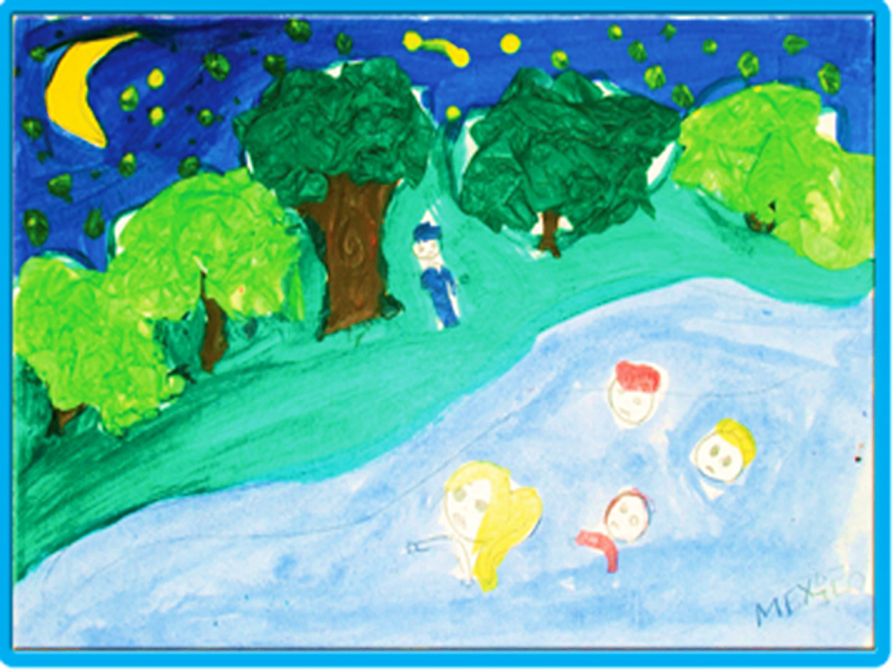
Returned Migrant Boys, Girls and Adolescents
©UNICEF México/Mauricio Ramos
unite for
children

Slide 2



Returned migrant boys, girls and adolescents. An analysis of the contexts and responses by protection services and policies in El Salvador, Guatemala, Honduras and Mexico.
unite for
children

Slide 3
The study focuses on returned boys, girls and adolescents, that is, migrants or children born in the country of destination of migrant parents that return to the country of origin, unaccompanied or with a family member, voluntarily or as the result of a deportation or repatriation procedure.
A Focus on Returned Boys, Girls and Adolescents
unite for
children

Slide 4
The study was designed as a tool for technical actors and professionals that are responsible for the protection of boys, girls and adolescents in situations of migration.
To identify actions, projects and programmes of action that have helped ensure respect for the rights of migrant boys, girls and adolescents, with the aim of sharing them throughout the region.
To identify and address challenges faced by government institutions and non-governmental organizations in developing public policy and programmes for the protection of the rights of returned boys, girls and adolescents.
To propose courses of action to help ensure respect for the rights of returned boys, girls and adolescents and prevent the need for boys, girls and adolescents to leave their countries of origin, advancing in the development or strengthening of a Comprehensive Protection System.
Purpose of the Study
unite for
children

Slide 5
The study places special emphasis on actions to restore the right to family life and integration into the community.
Purpose of the Study
unite for
children

Slide 6
We acknowledge that the region is transforming in a positive manner in terms of migration legislation and policy, with a more comprehensive and human rights-based approach.
This is reflected in various regional forums on this matter, as well as projects and actions seeking coordination between government institutions and civil society organizations involved in the protection and restoration of rights of migrant boys, girls and adolescents, particularly those that are unaccompanied.
Results
unite for
children

Slide 7
It is necessary to generate a better understanding of the problems that occur in the places of migration of boys, girls and adolescents, where they return after being deported.
It is necessary to gain a better understanding of the public policy and protection services that are available to assist boys, girls and adolescents in these locations.
This understanding will inform the development of policies and services to ensure appropriate protection of the rights of the returned boys, girls and adolescents and their effective long-term reintegration.
Results
unite for
children

Slide 8
Advances concerning reception procedures and designing protocols for assistance.
Strategies focused on unaccompanied migrant boys, girls and adolescents are in place.
Limited strategies and programmes focused on community, education and family reintegration.
Absence of integrated strategies to follow up on returned boys, girls and adolescents.
Results
unite for
children

Slide 9
At this point in time, it is crucial to translate the legislative and operational advances that have been achieved at a national and regional level into policies and services to ensure the appropriate protection of rights, through the establishment – in communities of origin – of comprehensive protection systems for the effective long-term reintegration of the returned boys, girls and adolescents.
Results
unite for
children

Slide 10
To develop or strengthen a System for the Comprehensive Protection of the Rights of Boys, Girls and Adolescents.
“The use of the child protection system with its associated services should prevail over that of institutions exercising control of immigration.”
Advisory Opinion 21/14, International Court of Human Rights,
Rights and Guarantees of Children in the Context of Migration and/or in Need of International Protection
Key Recommendation
unite for
children

Slide 11
To strengthen communication and coordination between divisions and entities from various sectors that are involved in ensuring respect for the rights of boys, girls and adolescents at a local, national and regional level, with the aim of developing uniform programmes and services with a broader scope;
To expand the coverage of existing programmes and services; this will require increasing investment in children, seeking more financing;
To establish stewardship by an institution or organization that takes on the role of coordinating the various functions of the involved institutions at a local and national level;
To promote programme and service decentralization processes with the aim of expanding coverage and reaching the most remote regions in each country.
Recommendations for Strengthening the System for the Comprehensive Protection of Rights
unite for
children

Slide 12
Recommendations
To design and implement specialized responses to address the various causes of migration: family reintegration, unmet basic needs, fleeing from situations of violence, etc.;
To establish accountability mechanisms at a state level, considering the participation of boys, girls and adolescents in demands for respect for their rights;
Participation of civil society and public human rights institutions;
To establish mechanisms to monitor and follow up on the situation of boys, girls and adolescents once they have reintegrated into their families and communities;
To develop and implement standards or protocols for action oriented toward the protection of the rights of migrant boys, girls and adolescents.
unite for
children

Slide 13
The following principles should be incorporated into the Comprehensive Protection System and translated into public policies for the protection of the rights of boys, girls and adolescents:
The Best Interests of the Child (BID)
The prohibition of discrimination, for whatever reason, of boys, girls and adolescents or members of their families;
The principle of non-refoulement;
The right to family life of boys, girls and adolescents (including family reunification);
Judicial guarantees and due process.
Recommendations
unite for
children

Slide 14
Recommendations
In a more general manner, the responses to ensure respect for the rights of boys, girls and adolescents should be the result of dialogue between all countries in the region, in order to develop regional policies that enable improving the living conditions of boys, girls and adolescents in their societies of origin once they have returned.
unite for
children

Slide 15
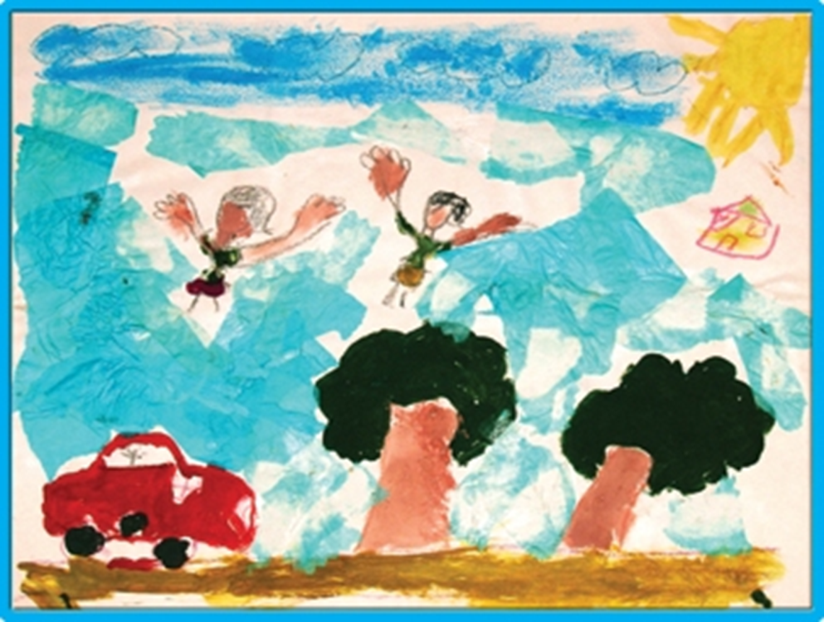
States should accord priority to the human rights of boys, girls and adolescents. This should prevail over any consideration of nationality or migratory status.
Advisory Opinion 21/14 International Court of Human Rights.

Slide 16
Thank you
unite for
children

