Slide 1
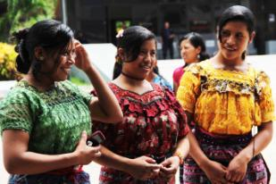

REGIONAL CONFERENCE ON MIGRATION (RCM)
The Regional Consultation Group on Migration (RCGM)
Migration: a shared responsibility
Regional migration, gender and the importance of CEDAW and its General Recommendation 26 as tools of protection for migrant women

Slide 2
Agenda post-2015
From the Millennium Development Goals (MDGs) to the Sustainable Development Goals (ODS):
For the first time in the debate, migration was formally recognized as an important factor in development

Slide 3

SDG8: Promote inclusive and sustainable economic growth, employment and decent work for all
.
Targets with gender perspective
Achieve full and productive employment and ensure decent work for all men and women and equal pay
Adopt immediate and effective measures to eradicate forced labor, end modern forms of slavery and human trafficking.

Slide 4
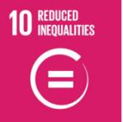
SDG10: Reduce inequality within and among countries
10.7 Facilitate orderly, safe, regular and responsible migration and mobility of people, including through the implementation of planned and well-managed migration policies
10.c By 2030, reduce to less than 3 per cent the transaction costs of migrant remittances and eliminate remittance corridors with costs higher than 5 per cent

Slide 5
Integrating migrant women in the framework of regional shared responsibility
More women and children in recent decades
They migrate as dependent or independently
Contribution to development
Specificity of women in migration
The inequalities in migration, labor and life experiences between men and women is the result of relationships and gender roles.

Slide 6
UN Women study in the southern border of Mexico
Status of women:
greater adversity and vulnerability,
a large majority in irregular condition (without legal residence documents or work permits)
employed in the informal economy, precarious jobs, very low wages and low-skilled,
in invisible sectors or socially considered "female" (household employment, care of persons, peddling, agricultural work, work in the sex industry.. )

Slide 7
Regulating the work of migrant women and ensuring their rights according to international standards is a key equality issue in all aspects of development

Slide 8
INTERNATIONAL INSTRUMENTS FOR THE PROTECTION OF RIGHTS OF MIGRANT WORKERS
Convention on the Protection of the Rights of All Migrant Workers and Members of their Families (MWC) - Adopted by the UN in 1990 and ratified among others by Belize, El Salvador, Guatemala, Honduras, Mexico and Nicaragua.
Convention 189 of the International Labour Organization (ILO) - On domestic work
Migrant Workers Convention with the Convention on the Elimination of All Forms of Discrimination Against Women (CEDAW) and its General Recommendation no. 26 on migrant workers - seeking deep solutions to discrimination and exclusion based on gender that, in combination with other dimensions (ethnicity, economic status, national origin, age, occupation) limit the exercise of the rights of women migrant workers.

Slide 9
General Recommendation No. 26 of CEDAW
It addresses the situation of women migrant workers who perform paid jobs, which may be at risk of abuse and discrimination and have a high probability of not meeting the requirements for permanent residence or citizenship.
It focuses on women that:
Migrate independently
They meet with their husbands or other relatives who are also workers
Migrant workers in an irregular situation that might be in any of the above categories.

Slide 10
Areas of analysis of the
General Recommendation 26 of CEDAW. (1/2)
It recognizes the complexity of migration in the context of globalization.
2. It establishes the condition to respect, protect and facilitate the exercise of the rights of women in any stage of the migration cycle.
3. It recognizes the social and economic contributions of women migrant workers.
4. It makes visible the role of women as workers, often unrecognized by the lack of social recognition of the type of work performed
5. It states that migration is not independent from gender and women are affected differently than men in the migration process.

Slide 11
Ejes de análisis de la Recomendación General 26 de la CEDAW . (2/2)
Considera el enfoque de derechos y de género, y las formas interrelacionadas de discriminación.
Señala que la discriminación y la violación de derechos se presentan en el interior de la familia, en el trabajo, en las interacciones sociales.
Discriminación y violación de derechos se producen tanto en países de destino como en los de origen y de tránsito, por lo que distingue las responsabilidades de los países para la atención de cada caso.
No sólo promueve los derechos humanos de las trabajadoras migrantes, sino que busca garantizar su pleno ejercicio y disfrute de facto.
Los principios de la CEDAW de no discriminación y obligación del Estado llaman a acción punitiva contra quienes violen los derechos de las trabajadoras migrantes.

Slide 12
UN Women´s contribution
Joint research between Central American Court of Justice UNFPA-UN Women on violence against women and girls in migration route in the Northern Triangle.
Design of a new protocol to prevent and address violence against women in Mexico consulates abroad.
UN Women project funded by EU on migrant workers:
Project in Mexico, Philippines and Moldova
Data Analysis and laws in light of the R26 CEDAW
Methodologies applicable in national frameworks, and with potentiality to define a transformative regional approach

Slide 13
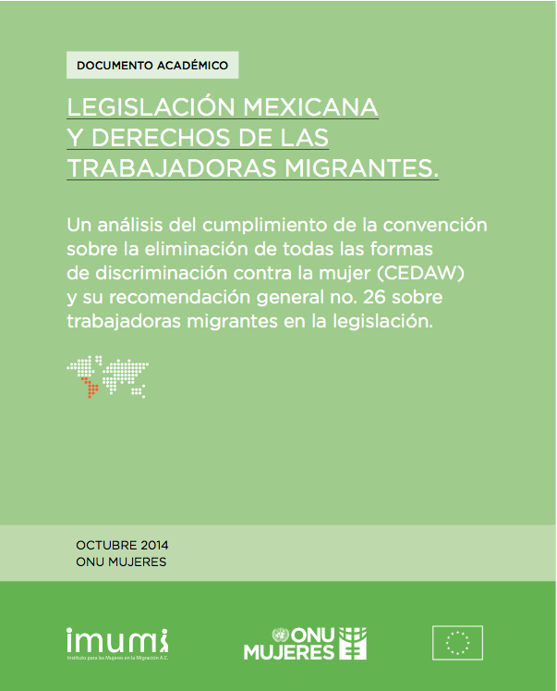

Slide 16
Thank You
Juliette Bonnafé, Programm Specialist in UN Women Mexico
Juliette.bonnafe@unwomen.org
Luiza Carvalho, UN Women´s Regional Director
Luiza.carvalho@unwomen.org

