Slide 1



MINISTRY OF THE INTERIOR AND POLICE
ADVANCES AND CHALLENGES
NATIONAL PLAN
FOREIGNERS
TO REGULARIZE

Slide 2
MIGRATION POLICY OF THE D.R.
NATIONAL MIGRATION BOARD
ACT 285-04
DECREE 631-11
GENERAL MIGRATION ACT
DECREE BYLAWS TO THE MIGRATION ACT
DECREE 327-13
ACT 169-14
DECREE 250-14
NATIONAL PLAN TO REGULARIZE FOREIGNERS (PNRE)
SPECIAL NATURALIZATION ACT
BYLAWS TO THE SPECIAL ACT

Slide 3
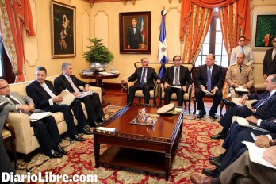
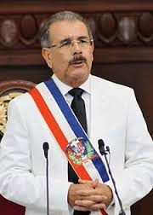
THE NATIONAL MIGRATION BOARD UNANIMOUSLY APPROVES THE NATIONAL PLAN TO REGULARIZE FOREIGNERS
PRESIDENT DANILO MEDINA SIGNED DECREE 327-13, WHICH ESTABLISHES THE TERMS AND CONDITIONS OF THE NATIONAL PLAN TO REGULARIZE FOREIGNERS WITH IRREGULAR MIGRATION STATUS IN THE DOMINICAN REPUBLIC

Slide 4
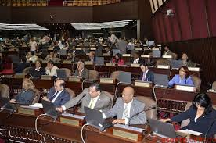
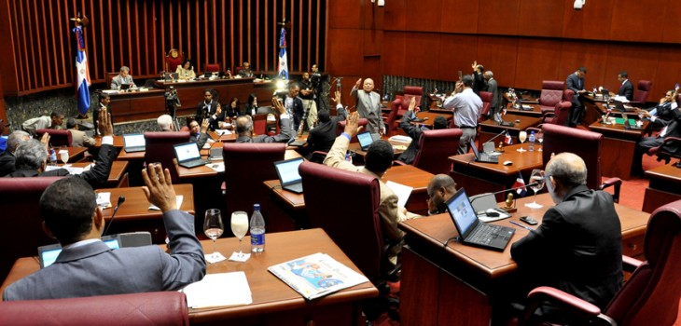
PASSING ACT 169-14 AND ITS BYLAWS AND EXTENDING THE TERM
The objective of the bylaws to Act 169-14 is to ensure the strict, objective and effective implementation of the Act, to benefit those that are rightfully entitled and, at the same time, to establish the necessary control mechanisms to prevent any abuse of the law.
APPROVAL OF THE EXTENSION OF
ACT 169-14
NATIONAL CONGRESS APPROVED, IN TWO CONSECUTIVE READINGS, THE REQUEST BY THE EXECUTIVE, FIRST READING 96 IN FAVOR, 1 AGAINST, SECOND READING 100 OUT OF 100. THE EXTENSION IS FOR 90 DAYS AND ENDS ON FEBRUARY 1, 2015.

Slide 5
ORGANIZATIONAL CHART OF THE PNRE
Vice-Ministry
Migration and Citizenship
Executive Directorate
National Plan to Regularize Foreigners
Support Committee
Analysis Unit
Regional Supervision and Coordination
User Support
*788
Regularization Centres

Slide 6
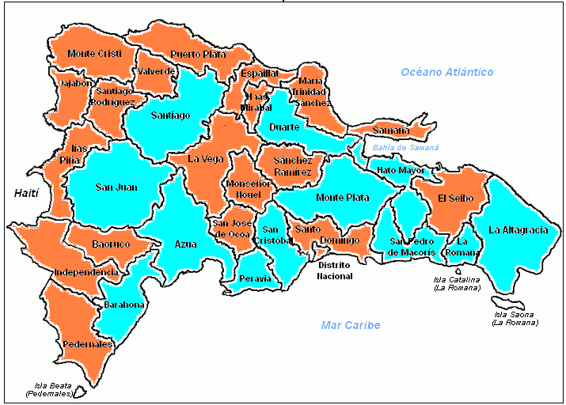
JUNE 2: LAUNCHING OF THE PLAN, 12 PROVINCIAL OFFICES

Slide 7
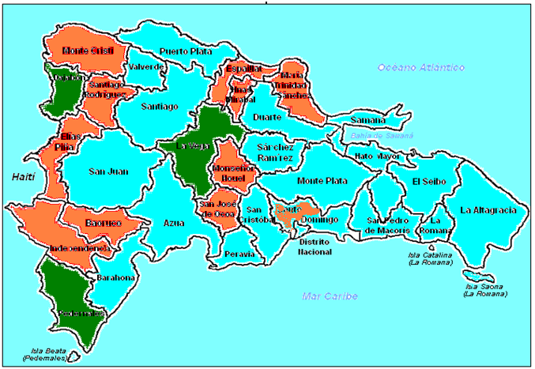
TO DATE, 24 OFFICES THROUGHOUT THE COUNTRY

Slide 8
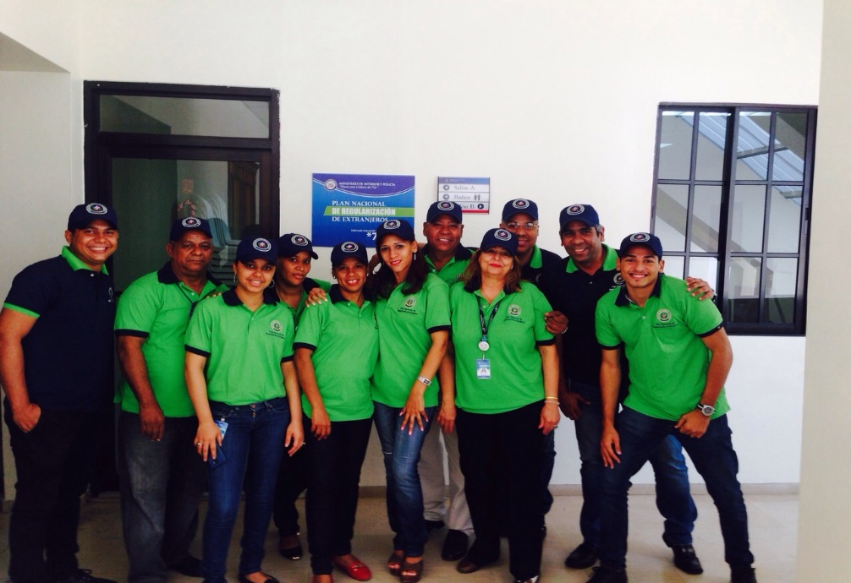
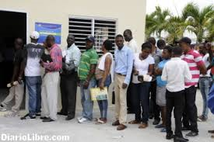
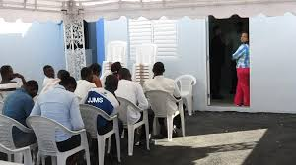
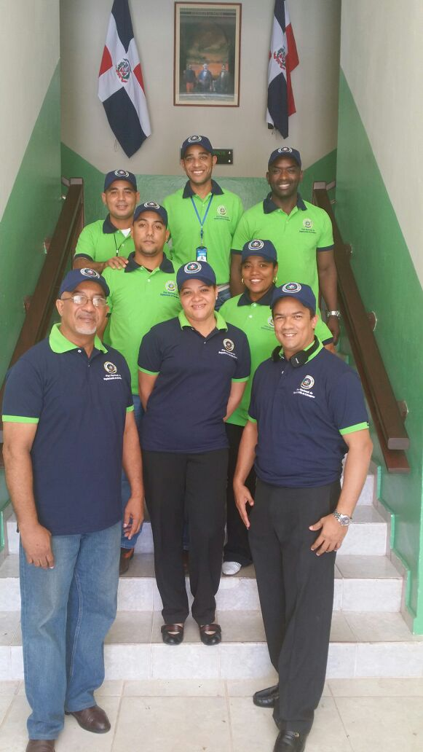
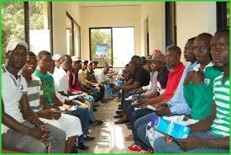
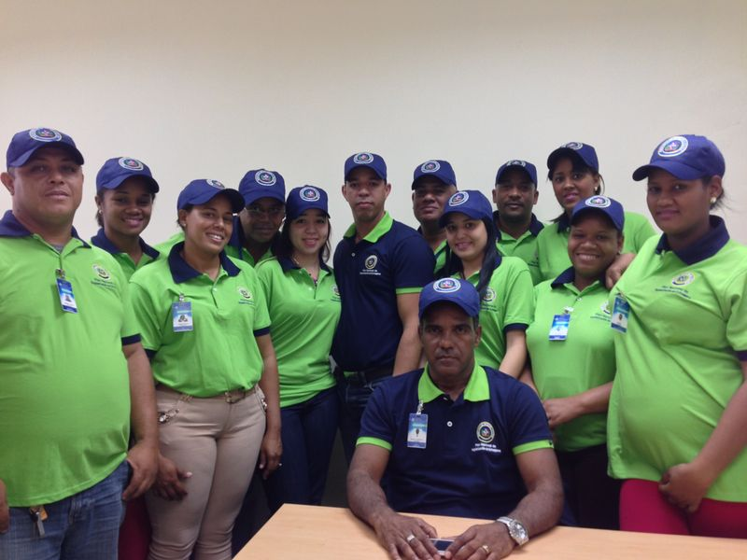
OFFICES AND STAFF OF THE PLAN

Slide 9
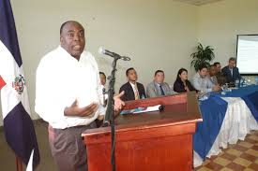
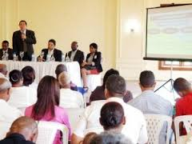
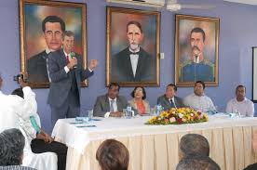
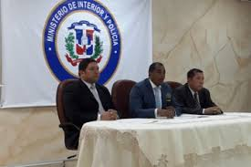
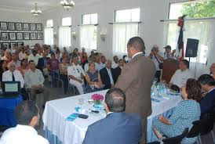
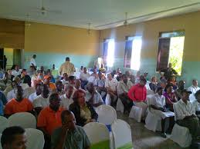
PROVINCE-LEVEL DIALOGUE, NATIONAL REGULARIZATION PLAN
TO DATE, 19 MEETINGS HAVE BEEN HELD

Slide 10
GENERAL STATISTICS
TO DATE, BIOMETRIC IDENTIFICATIONS AT
24 OFFICES OF THE PNRE
105,481

Slide 11
REQUESTS RECORDED BY PROVINCE
NATIONAL PLAN TO REGULARIZE FOREIGNERS WITH IRREGULAR MIGRATION STATUS
REGULARIZATION CENTRE | NUMBER
AZUA | 6,594
BANI | 1,445
BARAHONA | 5,005
CONSTANZA | 494
COTUI | 1,554
DAJABON | 1,343
DISTRITO NACIONAL | 17,037
EL SEIBO | 3,185
HATO MAYOR | 6,480
HIGUEY | 6,087
LA ROMANA | 8,811
LA VEGA | 999
MAO | 2,439
MONTE PLATA | 2,906
PEDERNALES | 1,020
PUERTO PLATA | 2,154
SAMANA | 1,214
SAN CRISTOBAL | 5,811
SAN FRANCISCO DE MACORIS | 2,241
SAN JUAN DE LA MAGUANA | 2,760
SAN PEDRO DE MACORIS | 3,365
SANTIAGO DE LOS CABALLEROS | 9,750
SANTO DOMINGO ESTE | 8,385
SANTO DOMINGO NORTE | 4,402
TOTAL | 105,481

Slide 12
REGISTRATIONS OF BIRTHS OF CHILDREN OF FOREIGNERS WITH IRREGULAR MIGRATION STATUS
REGULARIZATION CENTRE | NUMBER
AZUA | 92
BANI | 98
BARAHONA | 313
CONSTANZA | 3
COTUI | 63
DAJABON | 12
DISTRITO NACIONAL | 891
EL SEIBO | 422
HATO MAYOR | 431
HIGUEY | 399
LA ROMANA | 143
LA VEGA | 23
MAO | 206
MONTE PLATA | 410
PEDERNALES | 10
PUERTO PLATA | 468
SAMANA | 0
SAN CRISTOBAL | 53
SAN FRANCISCO DE MACORIS | 42
SAN JUAN DE LA MAGUANA | 32
SAN PEDRO DE MACORIS | 484
SANTIAGO DE LOS CABALLEROS | 61
SANTO DOMINGO ESTE | 36
SANTO DOMINGO NORTE | 87K2
TOTAL | 4,779

Slide 13
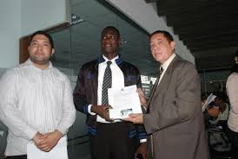
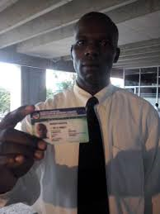
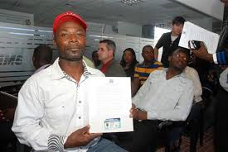
THE FIRST REGULARIZATION CARDS DELIVERED

Slide 14

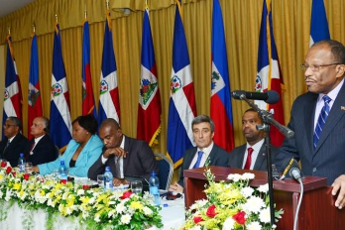
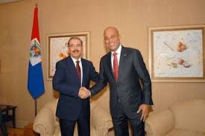
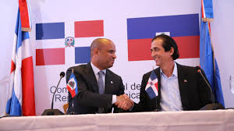
IMPORTANT AGREEMENTS BETWEEN BOTH COUNTRIES IN THE PETIONVILLE DECLARATION (20/11/2014)
COMMERCE, SECURITY, HIGHER EDUCATION, MIGRATION, AIR TRANSPORTATION, HEALTH, THE ENVIRONMENT AND AGRICULTURE

Slide 15

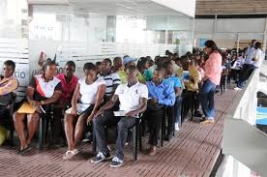
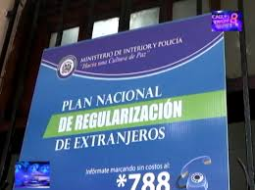
THANK YOU

