Slide 1

ACTION PLAN
Preparing to Meet the Demand for Legal Services relating to the Executive Action
April 2015
www.immigrantjustice.org
Twitter: @NIJC

Slide 2
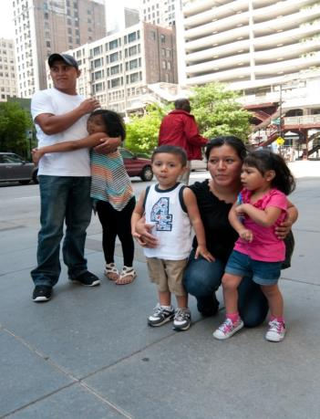
Agenda
I. Opportunities
II. Limitations and Challenges
III. Implementation Model

Slide 3
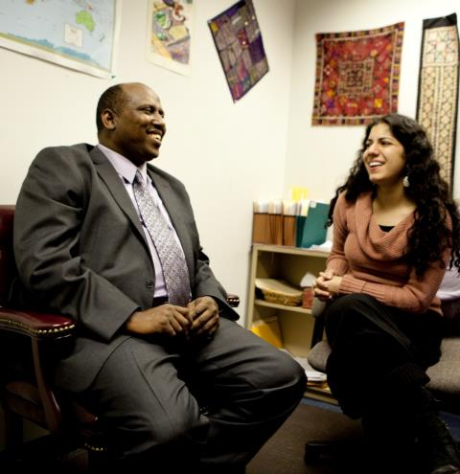
National Immigrant Justice Center
Provides legal services to more than 10,000 individuals each year;
Litigates in courts;
Lobbying before the US Congress, White House, Department of Homeland Security and Department of Justice;
Informs the media and legislators about the impact of immigration policy and legislation.
The direct legal services of NIJC inform our efforts to
promote a systematic and comprehensive reform.

Slide 4
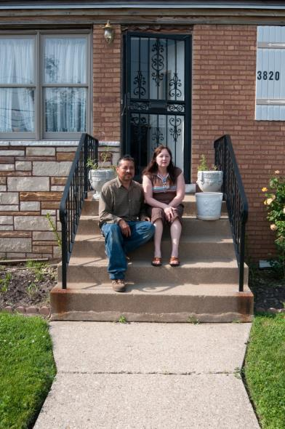
Successful Implementation of DAPA
DAPA benefits include:
Reducing family separation;
Positioning the topic for a legislative reform;
Showing the next President of the United States that the stability of immigrant families benefits our country;
Reducing the risk for new administrations to cancel the programme.

Slide 5
The limitations of the Executive Action show why a comprehensive reform is required in the
United States
Seven million people have been excluded from the Executive Action programme.
Four groups will not benefit from DAPA:
Families without children that are citizens or permanent residents;
Family members living outside the US;
Individuals that arrived in the US after January 2010;
Individuals with criminal records (they need to consult with an attorney).

Slide 6

Risks for Communities
Three risks for communities:
Fraud:
  Exploiting vulnerable communities.
Deportation:
  If an individuals submits an application and is not eligible.
Invisibility and isolation:
  Fleeing and hiding is more dangerous than revealing the immigration status.

Slide 7
Legal Counsel is Critical
With representation
Without representation

Slide 8
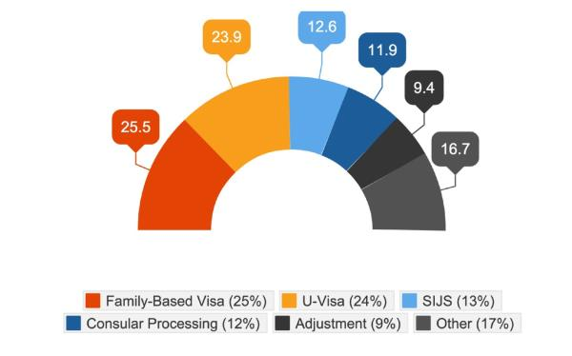
Legal Counsel is Critical
14.3% of the individuals that sought legal counsel relating to DACA were potentially eligible for a more permanent legal remedy.
Source: Tom K. Wong, et al., “Paths to Lawful Immigration Status: Results and Implications from the PERSONS Survey,”
Journal on Migration and Human Security 2, no. 4 (2014): 287-304.

Slide 9

Helping Families Prepare for the Executive Action
Educating communities;
Providing legal counsel;
Collecting documents:
  Identity documents from consulates;
  FOIA and FBI records;
  Proof of entry and on-going presence in the country;
  Saving money to pay for the application (US$465).

Slide 10
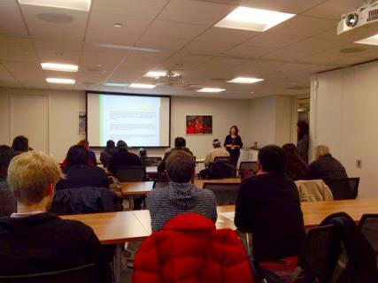

NIJC Implementation Model
Using an online consultation service;
Preparing a list of documents for immigrants, governments and consulates;
Training faith-based or community organizations on providing assistance on how to prepare the required documents;
Integrating information in schools, libraries and organizations;
Providing legal counsel;
Implementing various models to provide services to persons with limited resources.

Slide 11
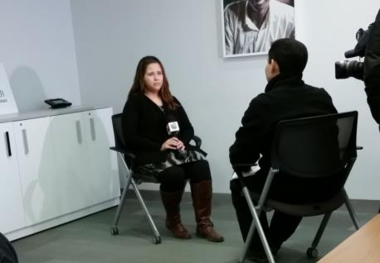
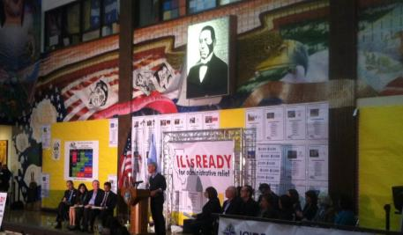
Establishing and Maintaining New Partnerships and Alliances
Community organizations;
Consulates;
State and municipal governments;
Corporations;
Financial institutions;
Faith-based organizations;
Hispanic media;
Unions, contractors, trade and agriculture associations.

Slide 12
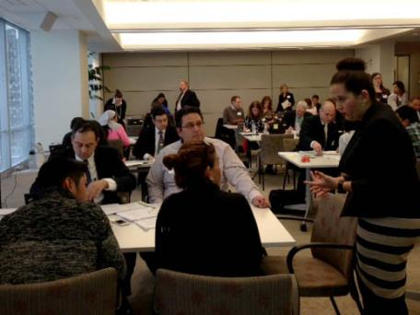
Moving Forward: Implementation
Actions by NIJC:
Implement information sessions and workshops with faith-based and community organizations or local governments;
Train pro bono attorneys;
Hold pro se workshops on requirements and necessary documents;
Provide access to legal counsel.
National-level actions:
Committee for Immigration Reform Implementation (CIRI);
iAmerica;
A national campaign to promote a broad interpretation of the Executive Action;
Cities United for Immigration Action.

Slide 13
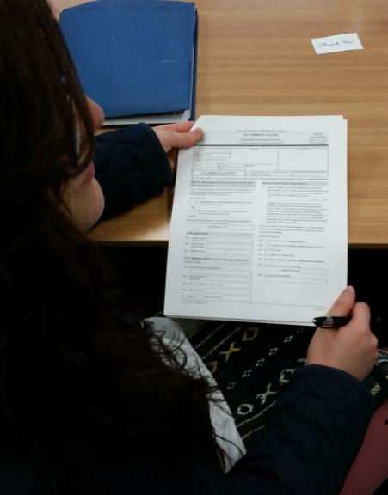
Next Steps for the Mexican and Central American Governments
The Mexican and Central American governments are essential partners in this process, in three aspects:
Informing communities to prepare them to apply for the Executive Action;
Providing information about fraud and how to prevent it;
Helping community members to obtain identity documents.

Slide 14
THANK YOU
www.immigrantjustice.org
Twitter: @NIJC

