Slide 1
In Their Own Words:
A Nationwide Survey of Undocumented Millennials
Tom K. Wong, Ph.D.
University of California, San Diego
April 14, 2015
Tom K. Wong, tomkwong@ucsd.edu, @twong002

Slide 2
Survey
Survey
Online survey using Facebook ads and snowball sampling fielded over 2 waves in late 2013 and early 2014
1,472 respondents nationwide
Validation test for undocumented status to address “spoiled ballots”
IP address tracking to address “ballot stuffing”
Tom K. Wong, tomkwong@ucsd.edu, @twong002
1 of 8

Slide 3
Results
Demographics
Average and median age of survey respondents is 23-years-old
Survey respondents represent 42 states plus Washington DC
Race/ethnicity of survey respondents mirrors national estimates
More female than male respondents
Tom K. Wong, tomkwong@ucsd.edu, @twong002
2 of 8
Notes:
90% Hispanic/Latino, 4% Asian, 2% Black, 2% White, 2% Other

Slide 4

Results
Education
Reflecting the generally high educational attainment of DREAMers, 71% of survey respondents reported having some college education or reported already have a 4-year college or advanced degree
16% with a 4-year degree have their degrees in a STEM field
Tom K. Wong, tomkwong@ucsd.edu, @twong002
3 of 8
Notes:
This, despite over two-thirds of respondents reporting that they’re education has been delayed because of their undocumented status

Slide 5
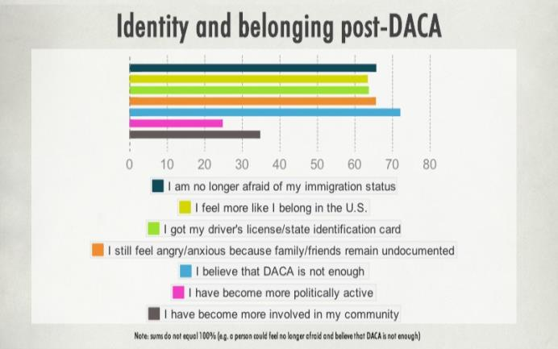
Results
Identity & Belonging Post-DACA
Tom K. Wong, tomkwong@ucsd.edu, @twong002
4 of 8
Notes:
Identity: “I feel free. I feel I can dream and my dreams will come true.”
Identification: “My life has changed dramatically. I was able to get a license, get a different job, get an internship in D.C., and just live my life without being afraid”

Slide 6
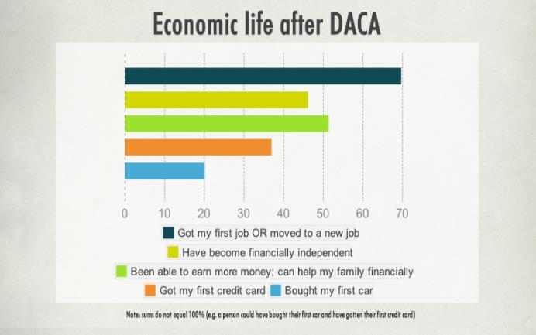
Results
Economic Life After DACA
Tom K. Wong, tomkwong@ucsd.edu, @twong002
5 of 8
Notes:
Economic Impact:
“I know work as an assistant engineer for a local municipality.”
“Finally I was able to put my degree to use. 3 years after graduating from college, I was still holding my high school job at McDonalds. 6 months after getting DACAmented, I was finally able to get a full-time job at Bloomberg”

Slide 7
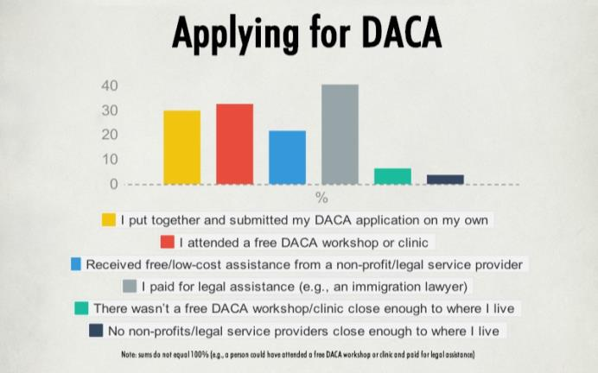
Results
Becoming DACAmented
Tom K. Wong, tomkwong@ucsd.edu, @twong002
6 of 8
Notes:
Economic Impact:
“I know work as an assistant engineer for a local municipality.”
“Finally I was able to put my degree to use. 3 years after graduating from college, I was still holding my high school job at McDonalds. 6 months after getting DACAmented, I was finally able to get a full-time job at Bloomberg”

Slide 8
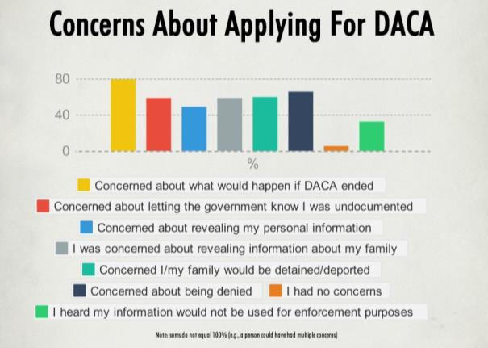
Results
Concerns About Applying
Tom K. Wong, tomkwong@ucsd.edu, @twong002
7 of 8
Notes:
Economic Impact:
“I know work as an assistant engineer for a local municipality.”
“Finally I was able to put my degree to use. 3 years after graduating from college, I was still holding my high school job at McDonalds. 6 months after getting DACAmented, I was finally able to get a full-time job at Bloomberg”

Slide 9
Conclusion
Conclusion
On balance, DACA can be viewed as an integration success story
At the same time, more research is needed to firmly establish the positive impact of deferred action—this research can be one of the most potent arguments for comprehensive immigration reform
The experience of the original DACA program tells us that not all who are eligible will apply—concerns about applying are likely to be exacerbated by the state lawsuit
Implementing DAPA/expanded DACA is thus likely going to be more difficult than the original DACA program, but in this challenge lies opportunity
Tom K. Wong, tomkwong@ucsd.edu, @twong002
8 of 8

