Slide 1


From de MDG to the 2030
Agenda for Sustainable
Development
A call for transformative action.
XXI RCM, San Pedro Sula
November 16, 2016

Slide 2
From the MDG to the SDG:
Impact of global development frameworks
The success of the MDG serves as a starting point for the new agenda for sustainable development:
The MDG helped more than one thousand million people out of extreme poverty
The MDGs have contributed greatly to this progress and have taught us how governments, business and civil society can work together to achieve transformative progress.

Slide 3
Outstanding achievements worldwide
The amount of people now living in extreme poverty has decreased by more than half.
There are now more girls in schools and women have gained ground in parliamentary representation in almost 90% of the 174 countries.
The average proportion of women in parliament has practically doubled over the same period.
The mortality rate in children under five years old has decreased in more than half, changing from 90 to 30 per every 1,000 children born alive since 1990.
The numbers for maternal mortality show a reduction of 45% worldwide, a decrease that occurred mainly since the year 2000.

Slide 4
Some challenges
More than 800 million people still live in extreme poverty and starve.
Women continue facing discrimination regarding work access, economic assets and participation in the adoption of decisions in the private and public spheres.
Children in the poorest 20% of households are more than twice as likely to suffer from delays in growth that children of the richest 20% of households, and have four times more chances of not attending school.
Global carbon dioxide emissions have grown more than 50% since 1990 and the drought now affects 40% of the world's people and is expected to increase.

Slide 5
2030 agenda for sustainable development goals
Global cooperation framework for the next 15 years.
Approved by 193 Heads of State in September 2015.
17 Sustainable Development Goals
169 Goals
231 indicators.

Slide 6
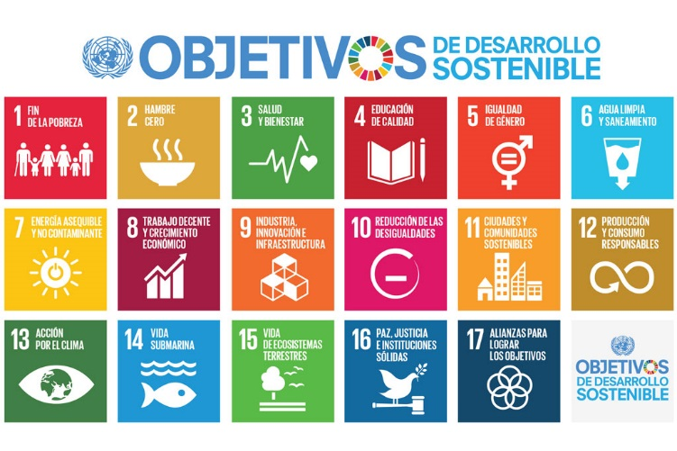
2030 Agenda for sustainable development goals

Slide 7
Sustainable Development
SOCIAL DEVELOPMENT
ENVIRONMENTAL SUSTAINABILITY
ECONOMIC
DEVELOPMENT

Slide 8
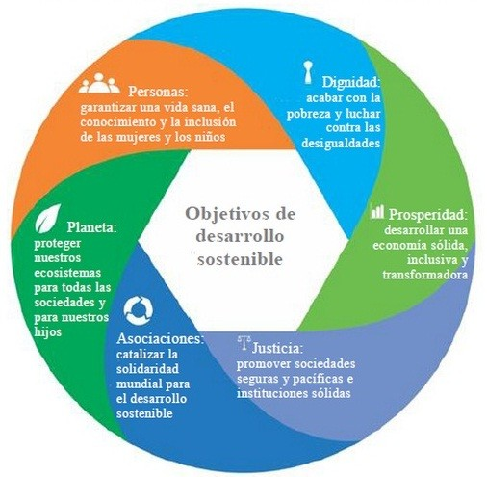
6 Essential elements:

Slide 9
Fostering an integral approach is essential
An approach to recognize synergies and connections between the different goals and dimensions of the 2030 Agenda.
Mapping of public policies and identification of inter-sectoral, inter-territorial and lifecycle challenges.
Interventions in one the SDGs often has direct or indirect impact on other SDGs, meaning the joint intersectoral collaboration is the key .
Fosters the concept of multidimensional progress beyond income (multidimensional poverty, multidimensional vulnerability and multidimensional sustainability)

Slide 10
Leave no one behind!
It is essential that marginalized people or who live in poverty play a central role, get involved in their own development processes and that other stakeholders held to account.
There is a particular need to promote inclusion as a procedural mechanism both to safeguard inclusive outcomes and to encourage trust in the policy making process.
It is strongly recommended implementing the Agenda at a central and local level to promote the inclusion of the different parts of society and diversity acceptance.

Slide 11
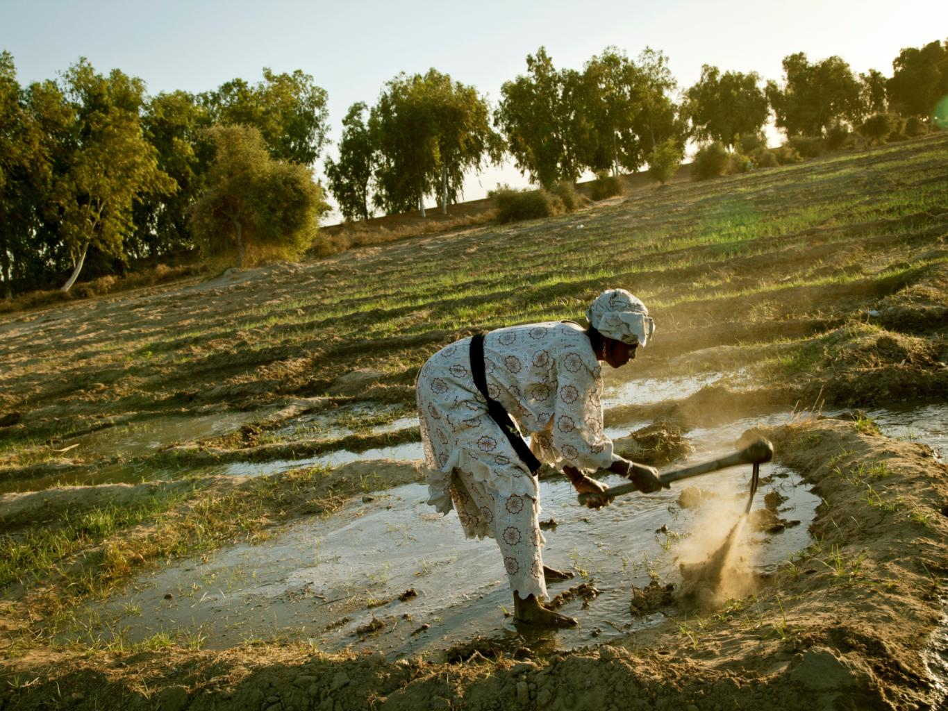
Rural populations living in extreme poverty
UN Photo / Marco Dormino

Slide 12
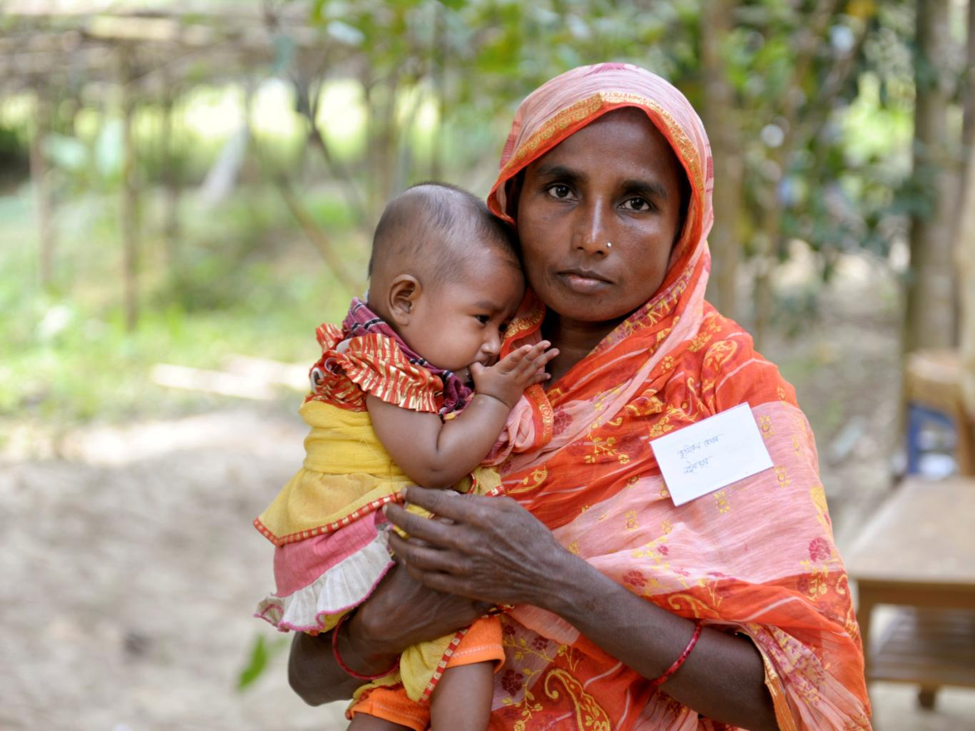
Women & children
UN Photo / Mark Garten

Slide 13
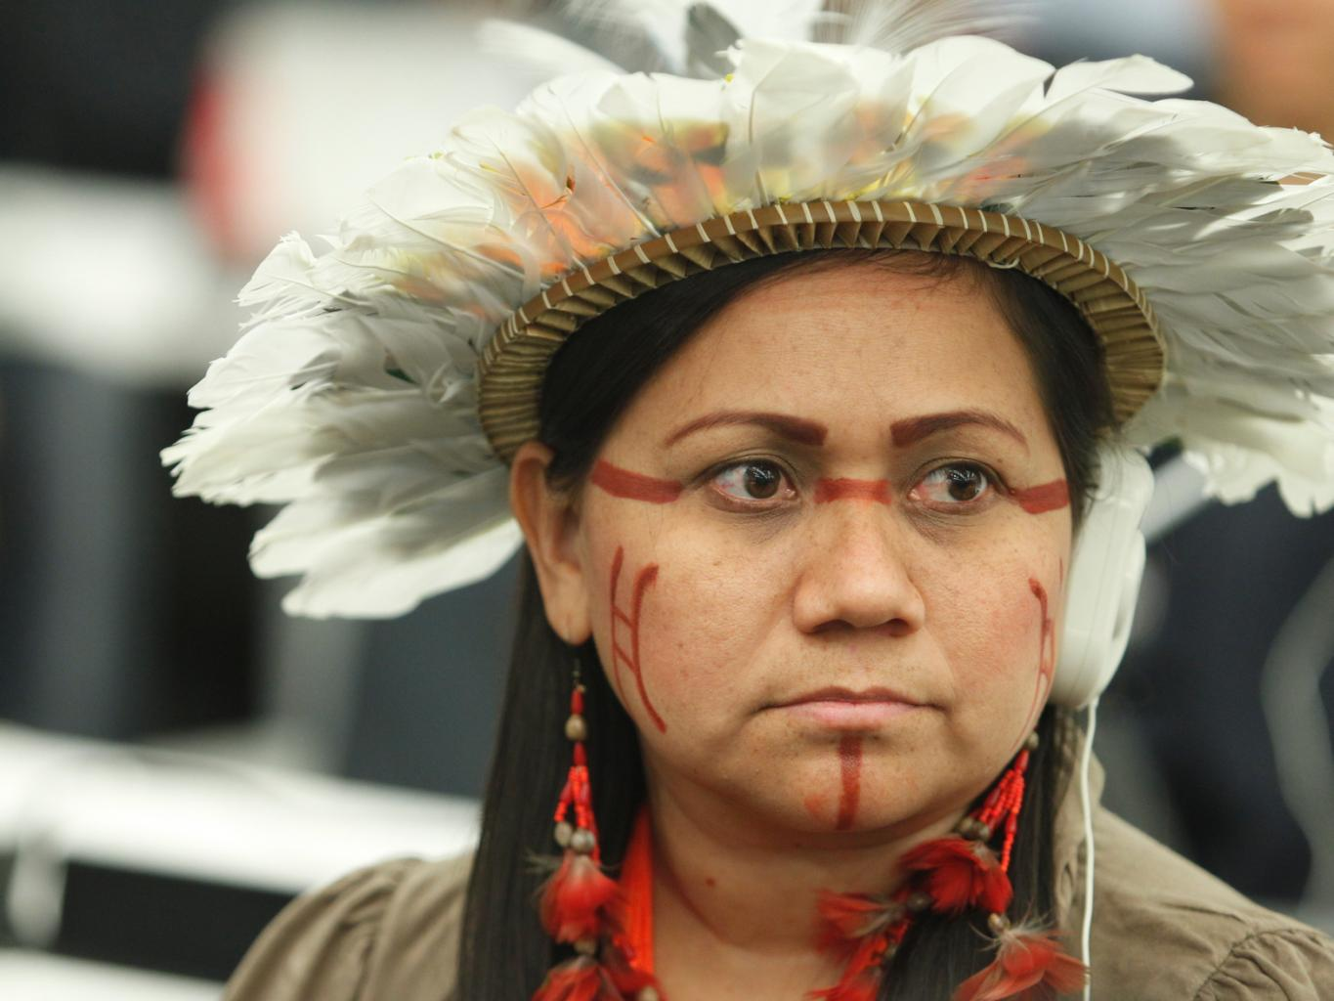
Indigenous People
UN Photo / Loey Felipe

Slide 14
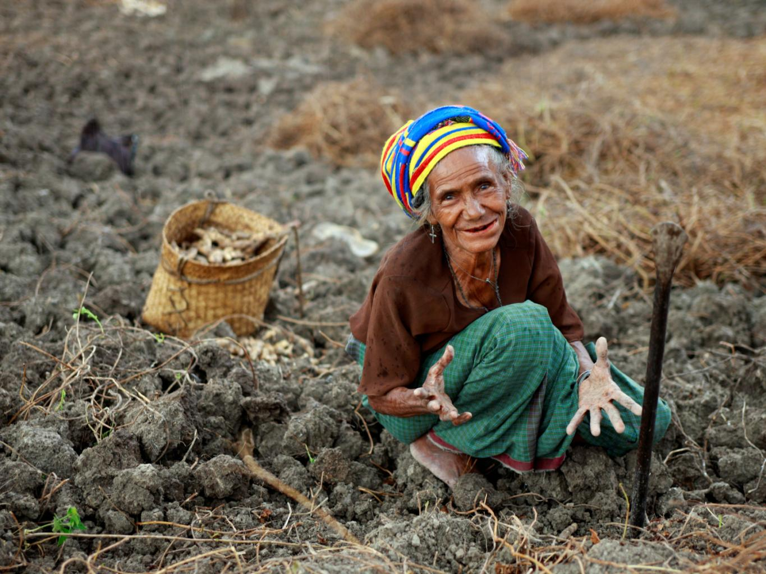
Linguistic & cultural minorities.
UN Photo / Martine Perret

Slide 15
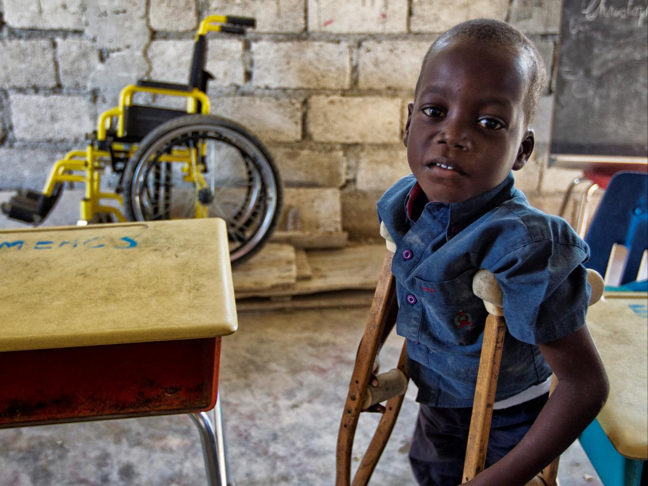
People with disabilities, living with HIV, LGTB
UN Photo / Mark Garten

Slide 16
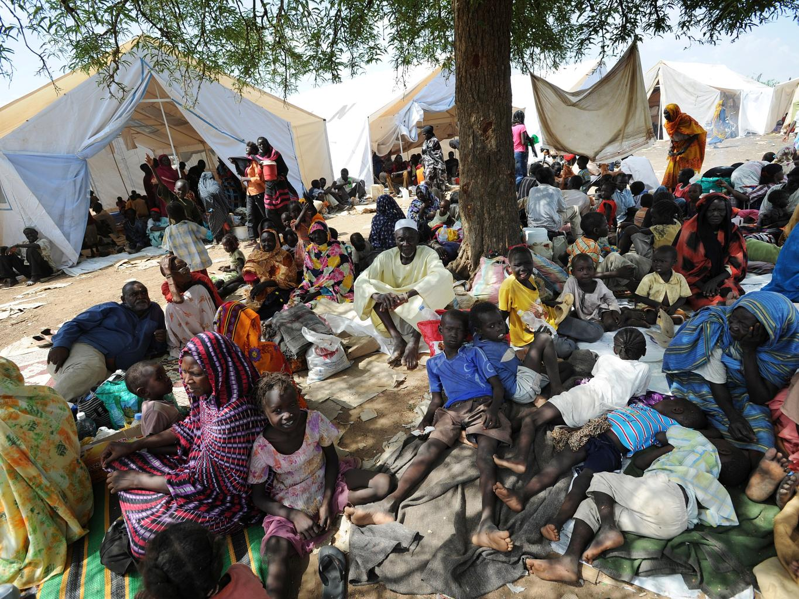
People that live in remote or vulnerable areas
UN Photo / Paul Banks

Slide 17
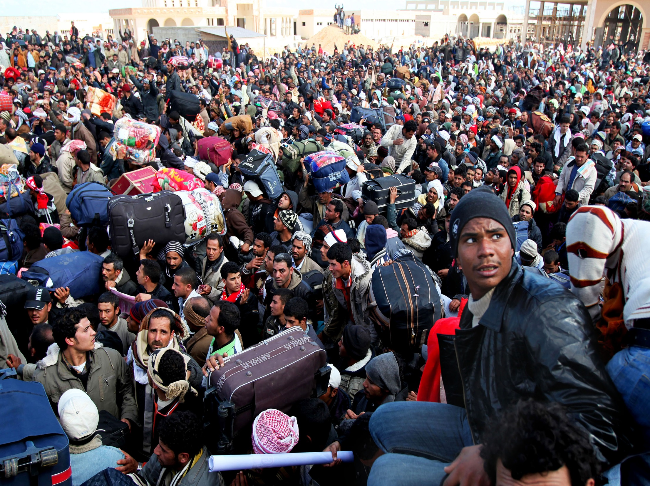
Migrants
UN Photo /UNHCR/A Duclos

Slide 18
2030 Agenda & migration
General Director of IOM, Ambassador William Lacy Swing, strongly urged the member States of the United Nations Sustainable Development Summit to "address the causes and consequences of migration to promote decent, orderly and secure migration for the benefit of all."
The 2030 agenda for the recognition of migrants positive contributions and their fundamental role in sustainable development.
Migration and human mobility were included in four of the seventeen Sustainable Development Goals, which amends its absence in the Millennium Development Goals.

Slide 19
AGENDA 2030 y MIGRAtioN
There is a general consensus that no one is left behind, with specific mention of migrants, refugees and displaced persons, vulnerable groups and minorities.
It recognizes that new demographic trends are changing the world, including our world becoming more mobile and that these trends have a direct impact on the SDGs.
It highlights the need to have more and better data, including the breakdown of information by immigration status.
It points out that a sound, inclusive and transformative economy requires ensuring decent employment, social protection and access to financial services for all people, including migrants.
Regarding the financial terms of the agenda, it is recommended to intensify efforts to reduce the costs of the remittances in order to respect completely the migrants wrights.

Slide 20
Some links between SDGs & migration
Goal 4b (Education) includes reference about expanding the number of scholarships for enrolment in higher education for developing countries;
Goal 5.2 ( Gender equity) it refers to women and girls trafficking and other types of exploitation;
Goal 8.8 ( Economic Growth) it is related to the protection of all workers wrights, including migrant workers, especially migrant women;
Goal 10.7 ( Inequalities) Advocates for orderly, secure, regular and responsible migration, with measures such as the implementation of planned and well-managed migration policies, among others;
Goal 10-10c (Inequalities) also refers to the reduction of transactions costs of migrant remmitances,
Goal 16.2 (peaceful & inclusive societies) embraces the fight against child trafficking. Calls for an end to exploitation, abuse, trafficking and any form of violence against children;

Slide 21
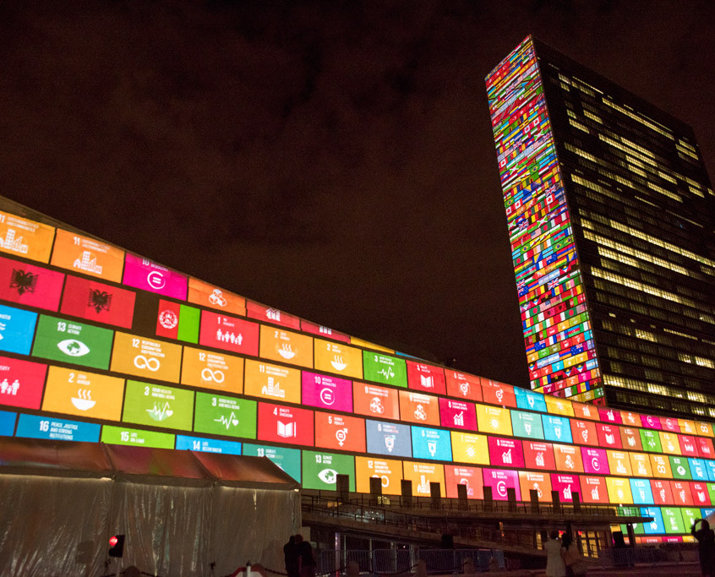
Muchas
Thank you

