Slide 1


Slide 2
International legal framework: International Health Regulations
San José, Costa Rica
September 27th , 2016
Dr. Enrique Pérez-Flores, PHMs
Advisor on Prevention and Control of Diseases
PAHO-WHO Costa Rica

Slide 3
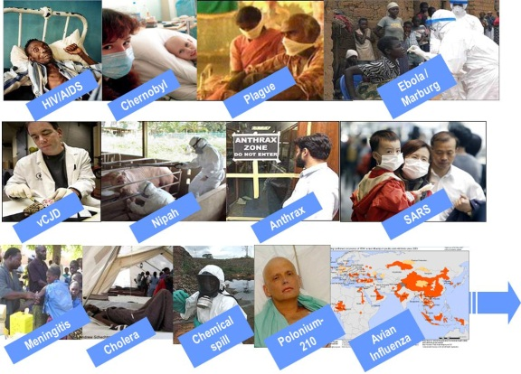
International Health Regulations
WHO Member States recognized need to collectively respond to public health emergencies of international concern
An Intergovernmental Working Group tasked with the revision of the IHR(1969) in 2004
WHO Member States adopted the current IHR during the 58th World Health Assembly in 2005 with Resolution WHA58.3
Current IHR entered into force on 15 June 2007
A legal tool: describes procedures, rights and legal obligations for States Parties and WHO
10 Parts, 66 Articles, and 9 Annexes

Slide 4
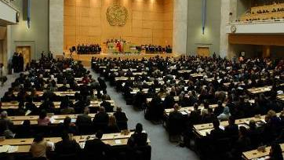
International Health Regulations
Legal framework requested, negotiated, and developed by WHO Member States - based on dialogue, transparency and trust
State’s commitment – beyond the health sector
Not a new technical discipline (…existing…) - tool that serves public health according to good, evidence-based, practice and adapted to the context
Opportunity
  To institutionalise lessons learned from real life in a continuous and dynamic manner
  To forge and nurture inter-sectoral coordination mechanisms
  To mobilize resources, both internally and externally, to strengthen the essential public health functions

Slide 5
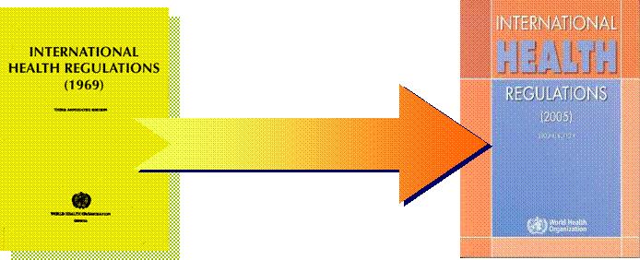
Article 2 - Purpose and scope
“to prevent, protect against, control and provide a public health response to the international spread of disease in ways that are commensurate with and restricted to public health risks, and which avoid unnecessary interference with international traffic and trade“
From three diseases to all public health hazards, irrespective of origin or source
From control of borders to containment at source
From preset measures to adapted response

Slide 6
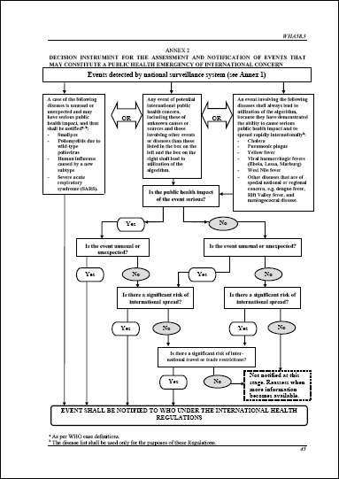
IHR operational framework
Determine Public Health Emergency of International Concern (PHEIC)
Make temporary and standing recommendations
WHO
Director-General
Emergency
Committee
Expert
Roster
Review
Committee
Accessibility at all times
Primary channel for WHO-NFP event-related communications
Disseminate information within WHO
"Activate" the WHO assessment and response system
WHO IHR
Contact Points
Regions
Other competent
organizations
(IAEA etc.)
Notification
Consultation
Report
Verification
Art.6-12
Annex 1
Accessibility at all times
Communication with WHO
Dissemination of information nationally
Consolidating input nationally
National IHR
Focal Points (NFP)
Ministries and
sectors concerned
Art.4
Detect
Assess
Report
Respond
Unusual
health events
National surveillance and response systems
Incl. Points of Entry
Art. 5, 13, 19, Annex 1

Slide 7
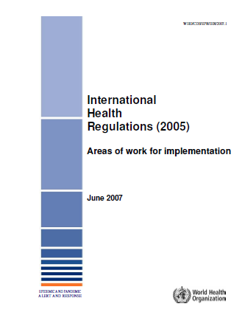

WHO strategic framework
IHR Areas of Work, 2007
Foster global partnerships
Strengthen national disease prevention, surveillance, control and response systems
Strengthen public health security in travel and transport
Strengthen WHO global alert and response systems
Strengthen the management of specific risks
Sustain rights, obligations and procedures
Conduct studies and monitor progress
Core Capacities
M.C. Escher, Möbius Strip II (Red Ants), 1963
Notes:
7

Slide 8
IHR operational framework
Determine Public Health Emergency of International Concern (PHEIC)
Make temporary and standing recommendations
WHO
Director-General
Emergency
Committee
Expert
Roster
Review
Committee
Accessibility at all times
Primary channel for WHO-NFP event-related communications
Disseminate information within WHO
"Activate" the WHO assessment and response system
WHO IHR
Contact Points
Regions
Other competent
organizations
(IAEA etc.)
Notification
Consultation
Report
Verification
Art.6-12
Annex 1
Accessibility at all times
Communication with WHO
Dissemination of information nationally
Consolidating input nationally
National IHR
Focal Points (NFP)
Ministries and
sectors concerned
Art.4
Detect
Assess
Report
Respond
Unusual
health events
National surveillance and response systems
Incl. Designated Points of Entry
Art. 5, 13, 19, Annex 1
Everybody is contributing!

Slide 9
Annex 1 - Core Capacities
Surveillance and Response and at Designated Points of Entry
Article 3 – Principles: […] 4. States have […] the sovereign right to legislate and to implement legislation in pursuance of their health policies. In doing so they should uphold the purpose of these Regulations
Entry into force
Assessment of public health core capacities
National IHR Action Plan
Implementation of National IHR Action Plan
Core capacities present
June 2007
June 2009
June 2012
2014
2016
However…preparedness is forever

Slide 10
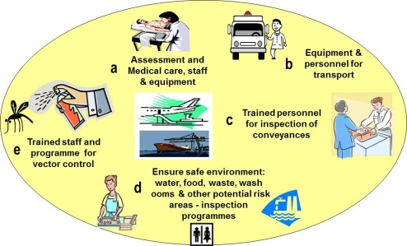
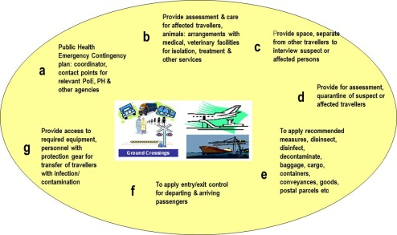
Annex 1 - Core capacities
Community/
Local level

Detection
Communication
Preliminary control
⇒
Integration
Confirmation
Control
Assessment
Communication
1A
Surveillance
Response

Art. 5
Art. 13

Intermediate level
→

National level
Assessment and notification
→
Biological
NFP
Art. 4
Public health response
Radionuclear
Chemical
At all times

Art. 7
1B
Designated
Points of Entry
⇒
Ports
Airports
(Ground crossings)
Art. 19
Art. 20
Art. 21
Art. 22
→
Potential
public health emergency of international concern

Notes:
World Health Organization
28 September, 2016
10
10

Slide 11
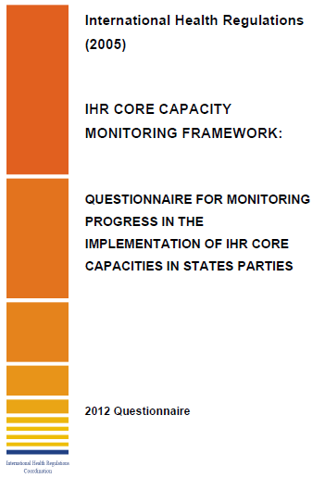
Core Capacities
WHO, 2010 (rev. 2011, 2012)
National legislation, policy and financing
Coordination and NFP communications
Surveillance
Response
Preparedness
Risk communication
Human resource capacity
Laboratory
Points of Entry
IHR Potential hazards 1: zoonotic events
IHR Potential hazards 2: food safety
IHR Potential hazards 3: chemical event
IHR Potential hazards 4: radiation emergencies
Notes:
11

Slide 12
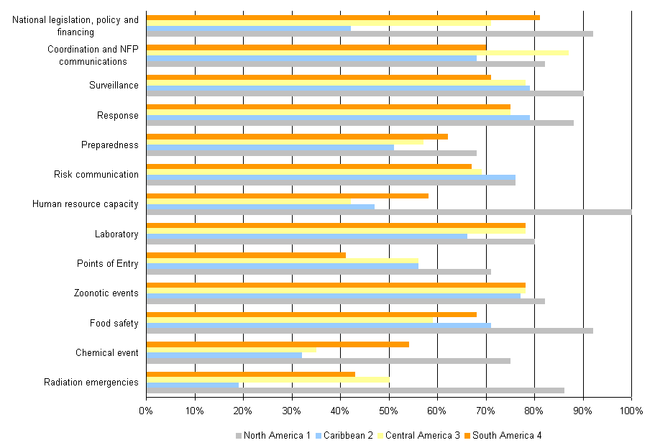
State Party Report to 65th World Health Assembly, 2012
Core Capacities Average Score (%) by Sub-Region in the Americas
(submissions Aug 2011- 18 May 2012; response rate 32/35 (91%))
1 North America; CAN, MEX, US; response rate 100%
2 Caribbean: ANB, BAH, BAR, BLZ, CUB, DOM, GRE, HAI, JAM, SLU, SKN, SVG, TRT; response rate 100%; information from 12 EP
3 Central America: COR, DOR, ELS, GUT, HON, NIC, PAN; response rate 86% (6/7); information from 6 EP
4 South America: ARG, BOL, BRA, CHI, COL, ECU, GUY, PAR, PER, SUR, URU, VEN; response rate 75% (9/12); information from 9 EP

Slide 13
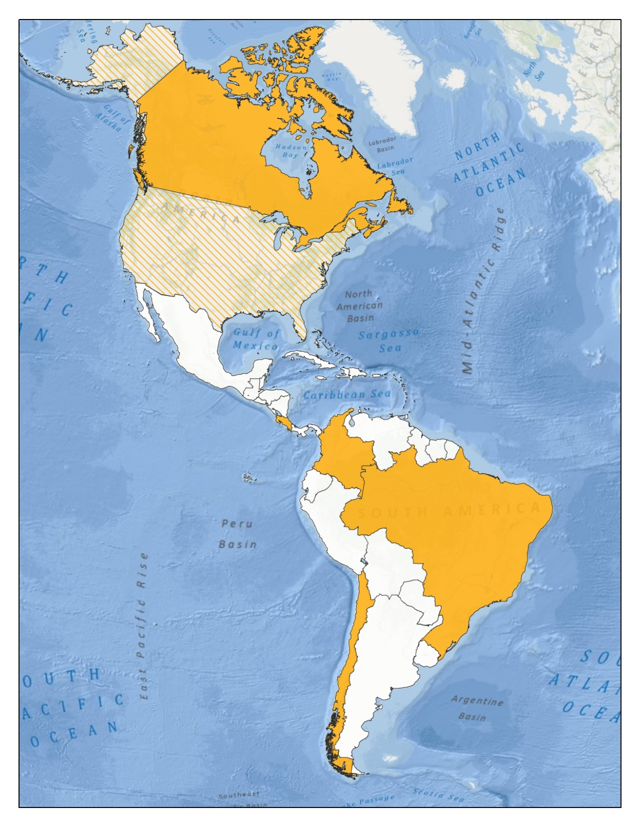
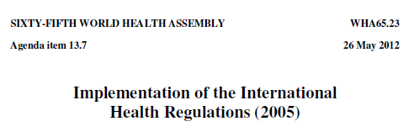
29/35 (83%) States Parties in the Americas were granted a two years extension (15 June 2014)
~70% globally

Slide 14
IHR operational framework
Determine Public Health Emergency of International Concern (PHEIC)
Make temporary and standing recommendations
WHO
Director-General
Emergency
Committee
Expert
Roster
Review
Committee
Accessibility at all times
Primary channel for WHO-NFP event-related communications
Disseminate information within WHO
"Activate" the WHO assessment and response system
WHO IHR
Contact Points
Regions
Other competent
organizations
(IAEA)
Notification
Consultation
Report
Verification
Art.6-12
Annex 1 A
Accessibility at all times
Communication with WHO
Dissemination of information nationally
Consolidating input nationally
National IHR
Focal Points (NFP)
Ministries and
sectors concerned
Art.4
Detect
Assess
Report
Respond
Unusual
health events
National surveillance and response systems
Incl. Points of Entry
Art. 5, 13, 19, Annex 1

Slide 15


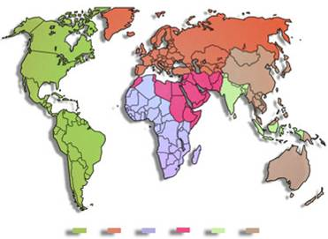

WHO Event Management Process
Disseminate information
States Parties
Formal reports
WHO
Verification
Event’s
Risk assessment
Initial screening
Assist
Respond
Informal/
Unofficial information`
Others sources

Slide 16
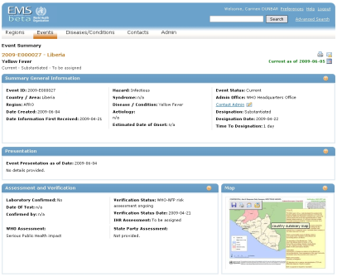
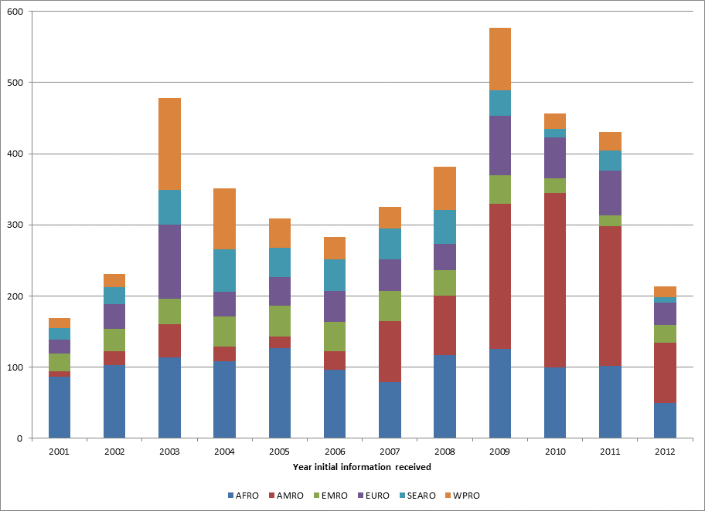
Public health events of potential international concern considered by WHO Region
1 Jan 2001 - 5 Sept 2012
(n=4,204; 1,034 (24%) in the Americas)
 | Number events | %
Substantiated | 2,692 | 64
No outbreak | 710 | 17
Discarded | 317 | 8
Unverifiable | 296 | 7
Undetermined | 189 | 4
Total | 4,204 | 100

Slide 17
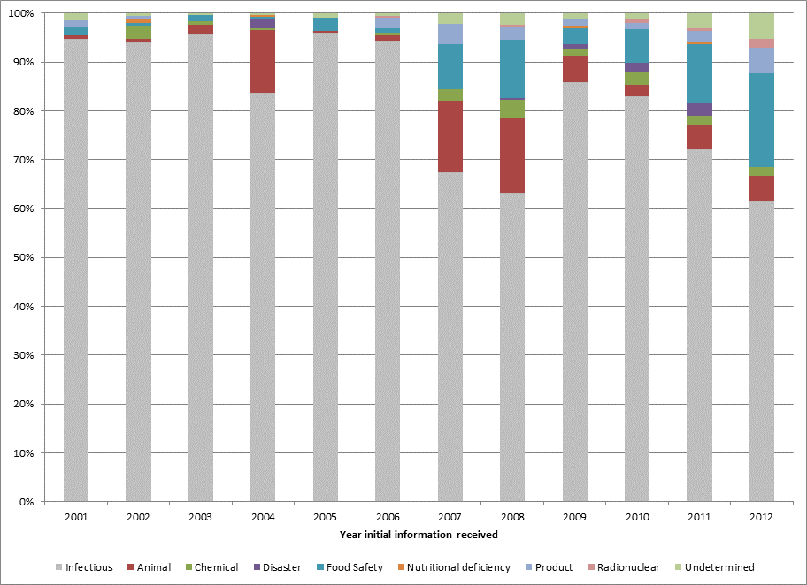
Substantiated public health events of potential international concern
by hazard
1 Jan 2001 - 5 Sept 2012
(n=2,692; 559 (21%) in the Americas)
Criteria for substantiated
Serious Public Health Impact
Unusual or Unexpected
International disease spread
Interference with international travel or trade

Slide 18
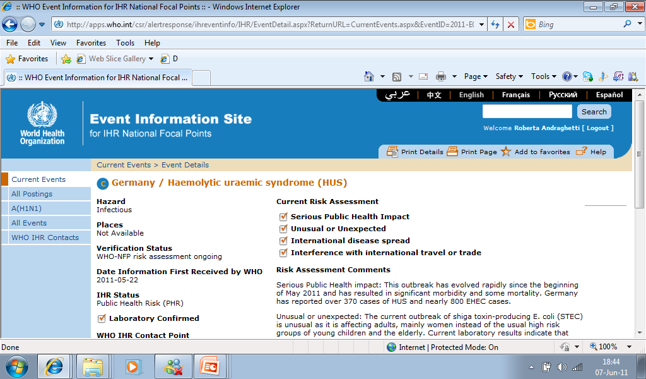
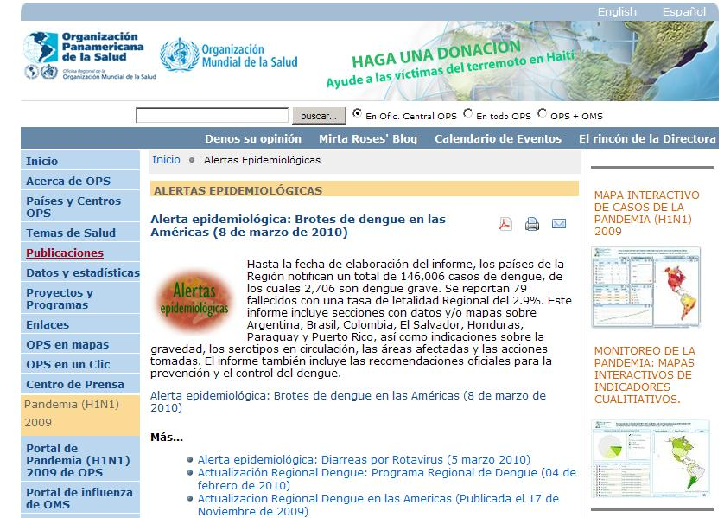
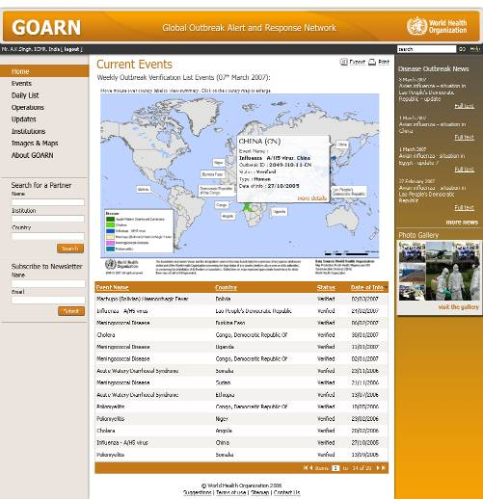
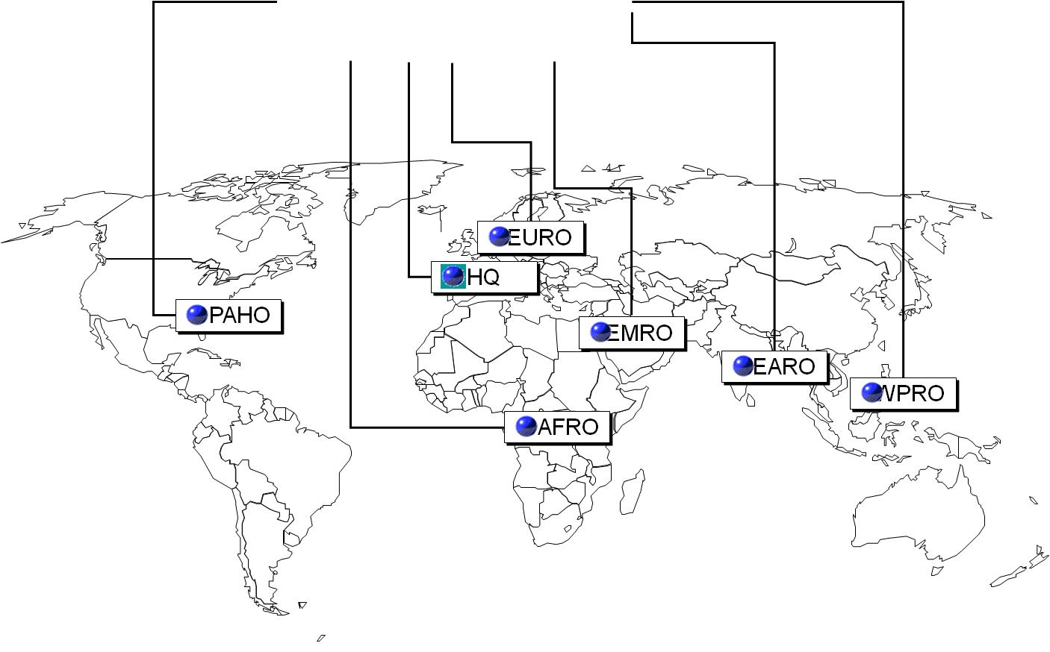

Slide 19
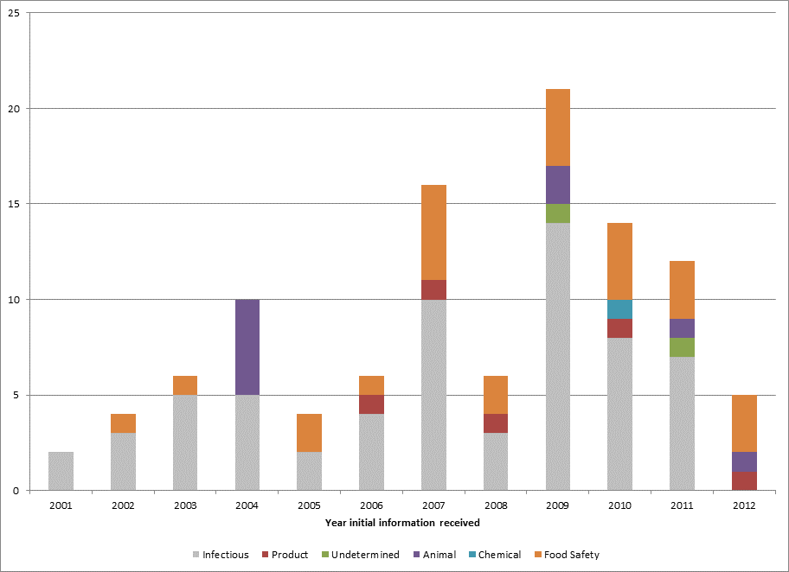
Substantiated public health events of potential international concern
by hazard
United States, 1 Jan 2001 - 5 Sept 2012 (n=106)
151 events assessed
85/151 (56%): initial information from national authorities
26 events posted on secure IHR Event Information Site

Slide 20
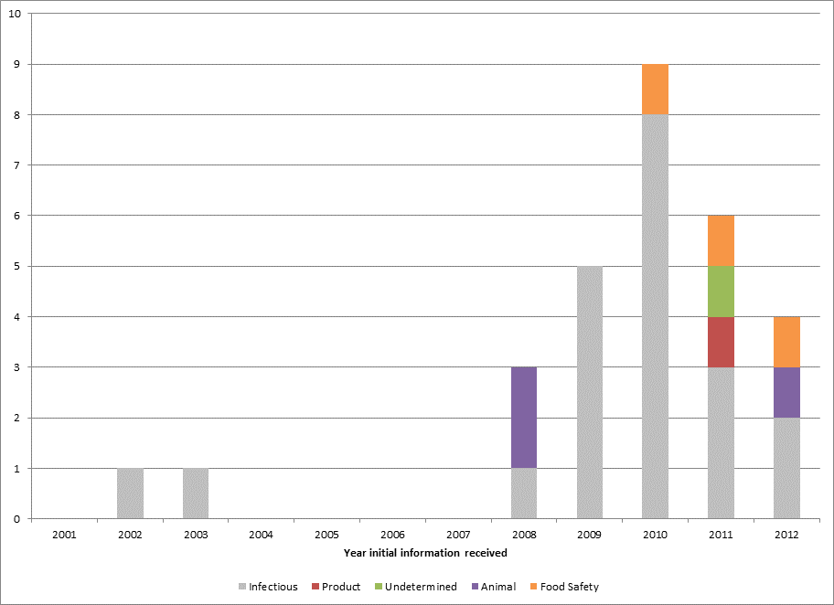
Substantiated public health events of potential international concern
by hazard
Mexico, 1 Jan 2001 - 5 Sept 2012 (n=29)
56 events assessed
15/56 (27%): initial information from national authorities
11 events posted on secure IHR Event Information Site

Slide 21
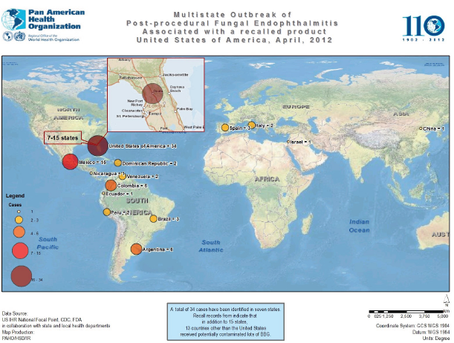
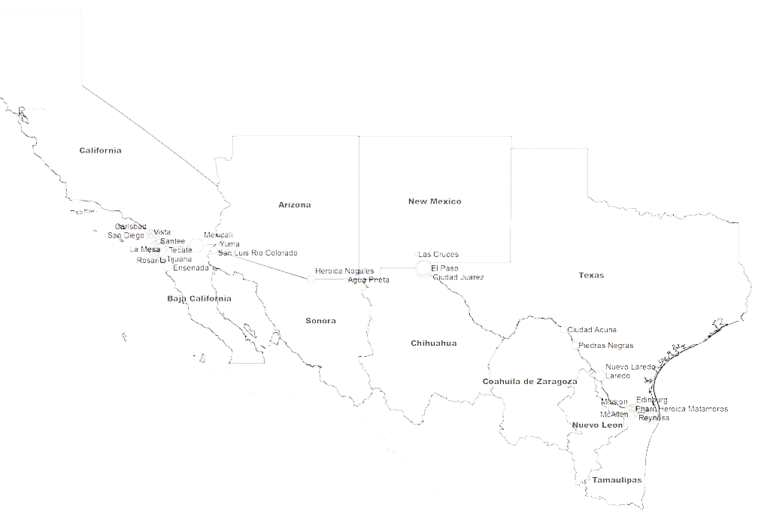
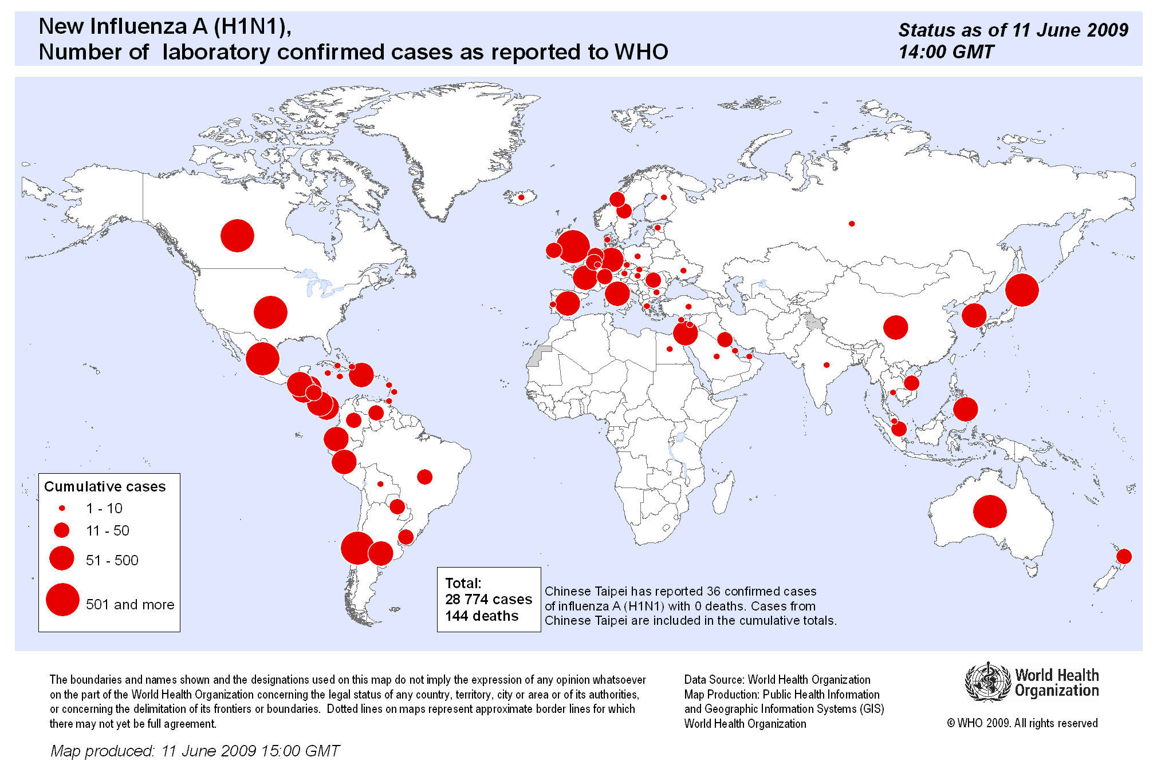
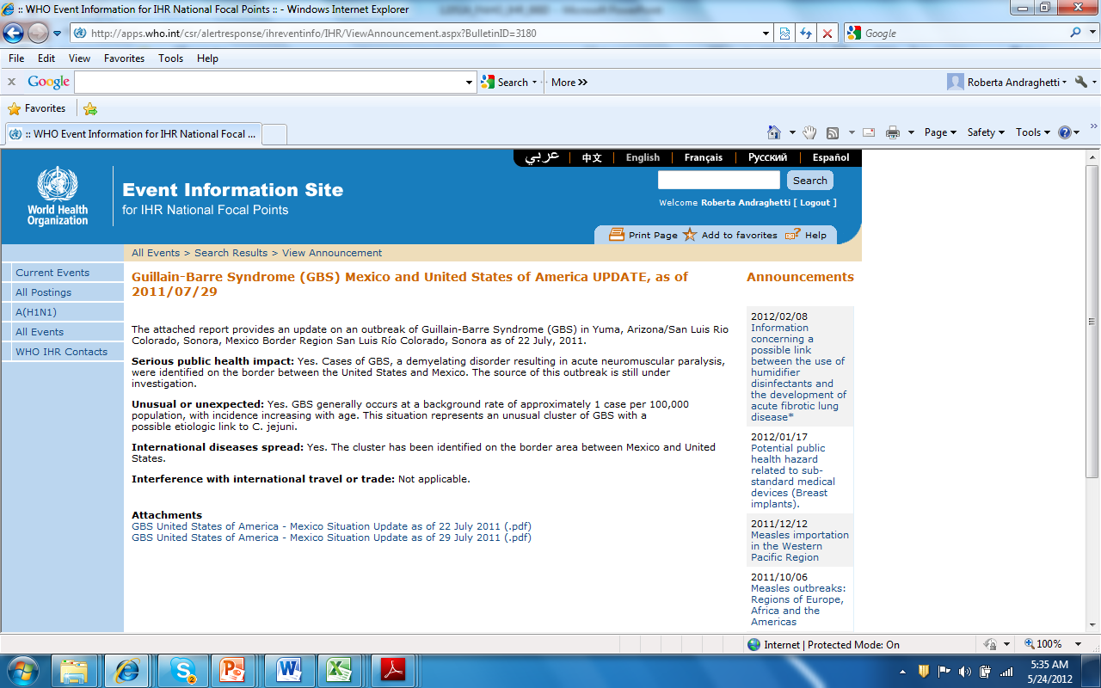
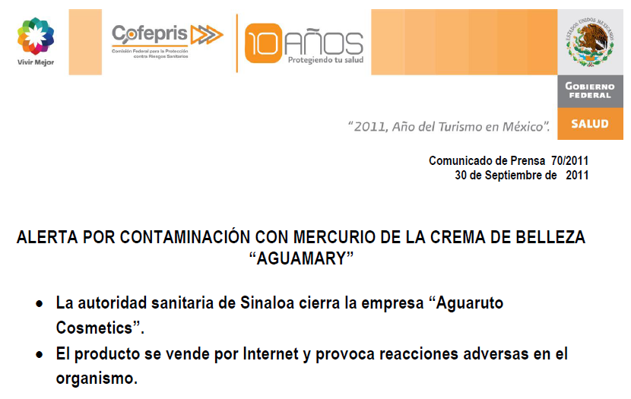

Slide 22
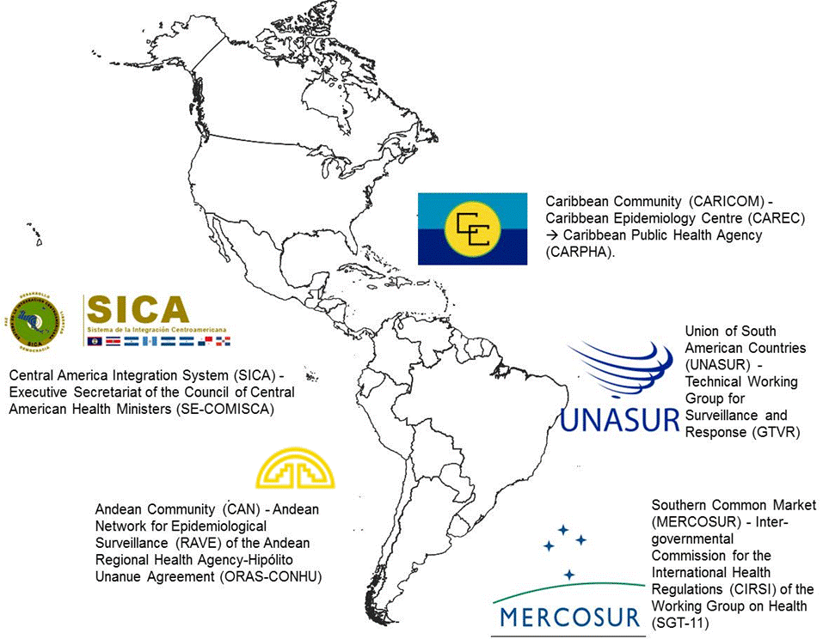
Articles 21, 44, 46, 57

Slide 23
Article 21 Ground crossings
1. Where justified for public health reasons, a State Party may designate ground crossings that shall develop the capacities provided in Annex 1, taking into consideration […]
2. States Parties sharing common borders should consider:
(a) entering into bilateral or multilateral agreements or arrangements concerning prevention or control of international transmission of disease at ground crossings in accordance with Article 57; and
(b) joint designation of adjacent ground crossings for the capacities in Annex 1 in accordance with paragraph 1 of this Article.

Slide 24
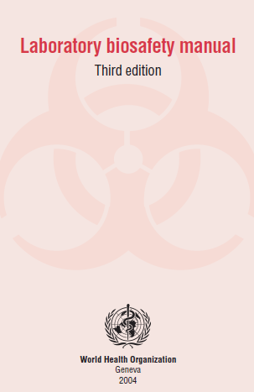
Article 46 - Transport and handling of biological substances, reagents and materials for diagnostic purposes
States Parties shall, subject to national law and taking into account relevant international guidelines, facilitate the transport, entry, exit, processing and disposal of biological substances and diagnostic specimens, reagents and other diagnostic materials for verification and public health response purposes under these Regulations

Slide 25
Article 44 Collaboration and assistance
1. States Parties shall undertake to collaborate with each other, to the extent possible, in:
(a) the detection and assessment of, and response to, events as provided under these Regulations;
(b) the provision or facilitation of technical cooperation and logistical support, particularly in the development, strengthening and maintenance of the public health capacities required under these Regulations;
(c) the mobilization of financial resources to facilitate implementation of their obligations under these Regulations; and
(d) the formulation of proposed laws and other legal and administrative provisions for the implementation of these Regulations.
[…]
3. Collaboration under this Article may be implemented through multiple channels, including bilaterally, through regional networks and the WHO regional offices, and through intergovernmental organizations and international bodies

Slide 26
Article 57 Relationship with other international agreements
[…]
2. […] nothing in these Regulations shall prevent States Parties having certain interests in common owing to their health, geographical, social or economic conditions, from concluding special treaties or arrangements in order to facilitate the application of these Regulations, and in particular with regard to:
(a) the direct and rapid exchange of public health information between neighbouring territories of different States;
(b) the health measures to be applied to international coastal traffic and to international traffic in waters within their jurisdiction;
(c) the health measures to be applied in contiguous territories of different States at their common frontier;
(d) arrangements for carrying affected persons or affected human remains by means of transport specially adapted for the purpose; and
(e) deratting, disinsection, disinfection, decontamination or other treatment designed to render goods free of disease-causing agents

Slide 27
THANK YOU
perezenr@paho.org
www.paho.org/

