Slide 1

Regional Conference on Migration
Workshop on Migration and Health, September 29th, 2016
Dr. Mario Cruz Peñate, Advisor on Health Systems and Services.

Slide 2
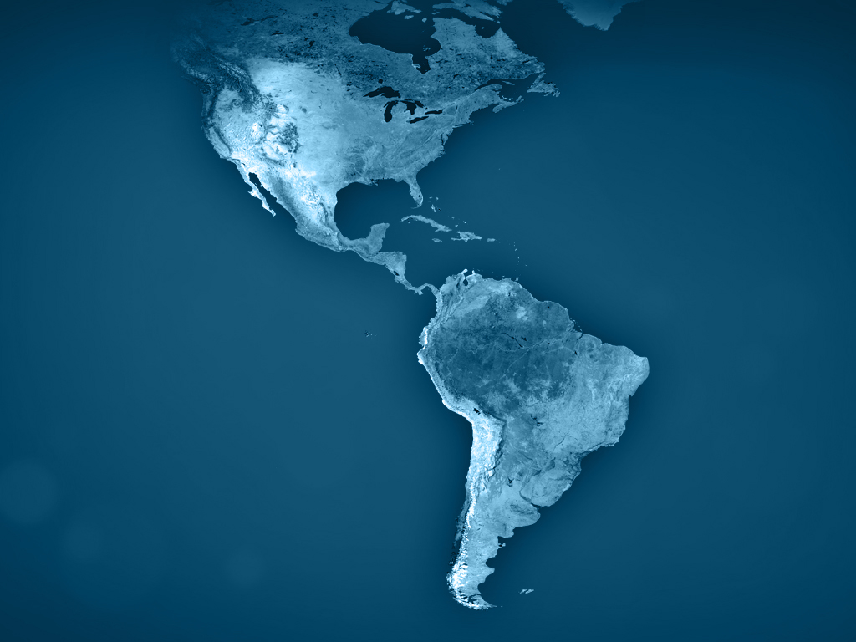

2014
The countries of the Americas have committed to achieve universal access to health and universal health coverage
Countries adopt Strategy for Universal Access to Health and Universal Health Coverage
Notes:
The countries of the Americas have pledged to achieve universal access to health and universal health coverage. (The Pan American Health Organization uses the shorthand term “universal health” to describe both universal access to health and universal health coverage.)

Slide 3
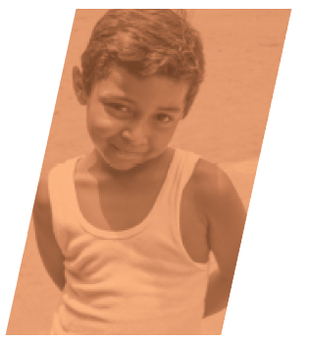
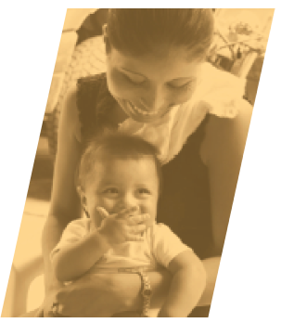
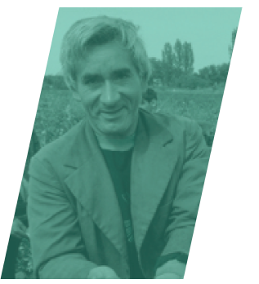
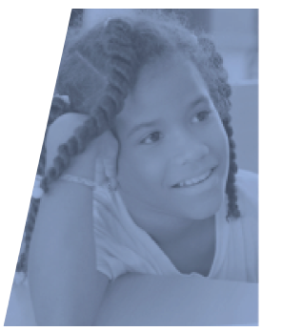
What is Universal Access to Health and Universal Health Coverage?
Access
means the absence of barriers to health services utilization
means the organizational mechanisms and financing to cover an entire population
Coverage
Notes:
What is universal access to health and universal health coverage? Access means the absence of barriers to health services—be they economic, demographic, geographic, social, cultural or gender-based. Coverage means the organizational mechanisms and financing to cover an entire population. Coverage without access is insufficient to ensure the health and well-being of a population. As the strategy states, “Without universal, timely, and effective access, universal coverage is an unattainable goal: both are necessary conditions for achieving health and well-being.”

Slide 4
What would this mean?
Everyone is covered
There are no barriers to these services
Health services are comprehensive
All are protected from financial hardship
Health systems are resilient with strong social participation
Notes:
What would the realization of the countries’’ shared ambition would mean for the Region’s nearly 1 billion people?
Everyone would be covered by a well-financed, well-organized health system offering quality health services
There would be no barriers to these services. Everyone—rich and poor, old and young, urban and rural, male and female—would have access when they need it
Health services would be comprehensive, covering not just treatment but also prevention, rehabilitation and palliation
Everyone would be protected against financial hardship. No one who needed care would go broke, or lose her home, or decide to forgo care because she could not afford it.
Health systems would be flexible, innovative, and resilient in the face of changing health needs and health emergencies

Slide 5
Social and economic benefits
Children are less absent from school
Growth is more robust and sustained
Poverty and inequality decrease
Workers are more productive
Societies are more harmonious
Notes:
The resulting healthier population would be good for the Region’s economies. Workers would be more productive. Children would miss fewer days of school. Poverty and inequality would decrease. Societies would be more harmonious. Growth would be more robust and sustainable.

Slide 6
Governments would grow in their people’s esteem…
…for universal health is popular!
Notes:
Governments would win, too. They would grow in their people’s esteem, for universal health is popular!

Slide 7
Fulfilling this ambitious goal takes:
Money
Well-trained doctors, nurses and other health workers
Affordable, of good quality, safe and effective medicines
Comprehensive, adequate, opportune and quality health care services
Thoughtful prioritization of services
Most of all…
Notes:
Universal health is an ambitious goal. It takes money, affordable medicines, plenty of well-trained doctors and nurses, integrated health care networks, and thoughtful decisions about what services to prioritize.

Slide 8
…it takes:
Vision
Planning
Political will
Community buy-in
Commitment
to the principles of:
Health as a Human right
Equity
Solidarity
Notes:
Most of all, it takes vision, planning, political will, community buy-in, and commitment to the principles of affordability, accessibility, quality, equity, and solidarity.

Slide 9
It also takes intersectoral cooperation:
[Universal health] require[s] determining and implementing policies and actions with a multisectoral approach to address the social determinants of health and promote a society-wide commitment to fostering health and well-being.
Strategy for Universal Access to Health and Universal Health Coverage
Notes:
It also takes intersectoral cooperation. The strategy calls for the Member States of the Pan American Health Organization to “implement policies and actions with a multisectoral approach” to address what we call the social determinants of health, which are generally defined as the social and economic conditions in which a person is born or lives, and to “promote a society-wide commitment to fostering health and well-being”. In particular, the strategy calls for the Member States to “strengthen links between health and community by promoting the active participation of municipalities and social organizations in improving living conditions and developing healthy spaces to live, work, and play.”

Slide 10
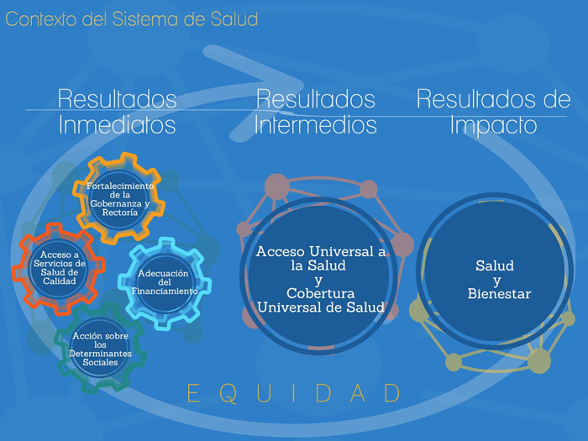
Investing in models based on primary care and the integrated delivery of efficiency, people-centered, and progressively expanding services
Eliminating payments at the point of service
Ensuring the rational use of medicines and health technologies
Finding sustainable ways to increase health financing
Protecting people financially, especially those who can least afford to pay
“Each country has the capacity to establish its own action plan, taking into account its social, economic, political, legal, historical, and cultural context, as well as current and future health challenges.”
Notes:
Nevertheless, there is a consensus in the Region that it should include:
Investing in models based on primary care and the integrated delivery of efficiency, people-centered, and progressively expanding services
Eliminating payments at the point of service
Ensuring the rational use of medicines and health technologies
Finding sustainable ways to increase health financing
Protecting people financially, especially those who can least afford to pay
Empowering people and communities by providing them health information, educating them about their rights and responsibilities, and encouraging their participation in health policy-making

Slide 11
Health is a human right, the rigth to health and health related human right belong to all persons
The Strategy for Universal Access to Health and Universal Health Coverage establishes that: “This right should be promoted and protected without distinction of age, ethnicity, sex, gender, sexual orientation, language, national origin, place of birth, or any other condition. Promoting and protecting this right requires linkages with other related rights”.
Health-related human rights, as established by the Universal Declaration of Human Rights, belong to all persons, including migrants, refugees and other non-nationals.

Slide 12
Migration results from and can lead to human insecurity and restrictions of health-related human rights
Economic deprivation, food insecurity, environmental hazards, violence, political and religious persecution, and ethnic and gender-based discrimination all can give rise to massive migration flows. Fragmented families are a major consequence of migration.
Unprecedented levels of displacement are producing enormous implications for population health and health systems.

Slide 13
Migrants often lack access to adequate health services and financial protection for health
While all health-related human rights protected by the Universal Declaration of Human Rights apply equally to all persons, including migrants, WHO estimates that, globally, the health needs of migrants and refugees are not consistently addressed, and that access to health services in recipient countries remains highly variable.

Slide 14
PAHO’s Strategy for Universal Access to Health and Universal Health Coverage establishes the framework whereby the Region’s countries can design and implement collaborative strategies to address the health needs of migrant populations. A firm commitment to the right to health where nationally recognized or the enjoyment of the highest attainable standard of health, to equity, and solidarity—as embraced in the above-mentioned strategy—must remain at the center of efforts to respond to the health needs of migrant populations. Such commitment entails providing access to quality comprehensive health services for migrants in their territories of origin and destination, during transit, and upon their return to their country of origin. It requires addressing the social determinants of health and the elimination of barriers to access health services, including cost, language, cultural differences, discrimination, and lack of information.

Slide 15
Acknowledging that migrants constitute a group in condition of vulnerability in our Region, Member States, as appropriate to their contexts and priorities, can leverage the following policy elements to address the differentiated health needs of migrants:
Health services that are inclusive and responsive to the health needs of migrants
Institutional arrangements to provide access to comprehensive, quality, people centered health services.
Mechanisms to provide financial protection in health.
Intersectoral action and development of partnerships, networks and multicountry frameworks

Slide 16

Getting there does not happen overnight.
It takes patient and concerted effort to build a strong and resilient health system that is accessible to all.
Notes:
Many countries are already well on the way. Getting there does not happen overnight. It takes patient and concerted effort to build a strong and resilient health system that is accessible to all. No country has arrived at a state of perfect universal health. It is a journey, and many challenges remain.

Slide 17
Thank you!
www.paho.org/universalhealth
Notes:
Thank you!
For more information, please visit our website!

