Slide 1
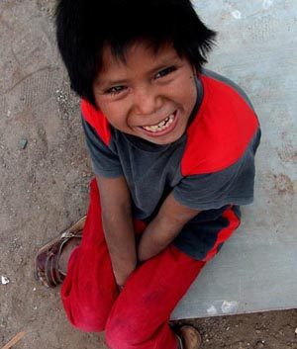
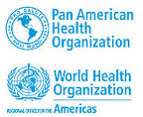
2030 Agenda for Sustainable Development
| Reflections on the Region of the Americas
Marcelo Korc, Ph.D., MPH
Advisor, Special Programme on Sustainable Development and Health Equity
San José, Costa Rica, September 2016

Slide 2
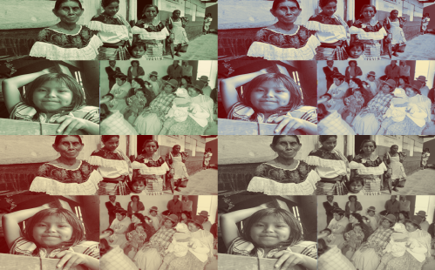
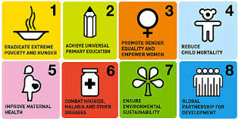
Reflections on Advances in the Region of the Americas
Millennium Development Goals (MDGs):
Reduce child mortality;
Combat infectious diseases;
Increase access to drinking water and basic sanitation services;
  Reduce poverty;
  Increase access to education and infrastructure.

Slide 3
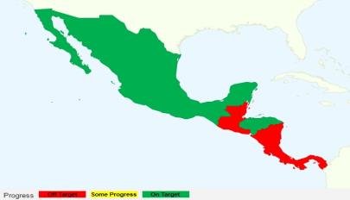
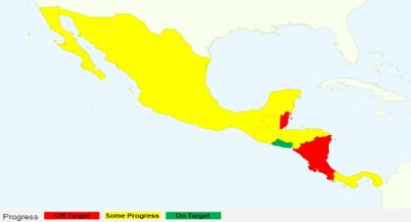

Challenges that Remain at a Subregional Level
Social inequality is directly linked to negative health results
Progress toward MDG 6 (combat infectious diseases)
The achievement of the MDGs and other health goals differs widely among countries
Progress toward MDG 5 (reduce maternal mortality)
Source: Center for Global Development, 2011

Slide 4
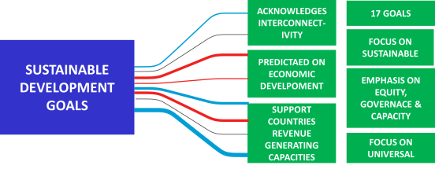
Guiding Principles of the 2030 Agenda
Looking Back: The Declaration of Alma-Ata (1978)
Calls for a comprehensive health strategy to provide health care and address the underlying social, economic and political causes of poor health.
Recognizes that the great advances relating to healthy life expectancy achieved in developed countries in the past century were due, to a great extent, to better social, environmental and economic conditions.
Currently: Transforming our world: the 2030 Agenda for Sustainable Development (United Nations Resolution A/RES/70/L1, September 2015)
The most integrating and participative process in the entire history of the United Nations;
An opportunity to innovate and demonstrate a broader vision of development.

Slide 5
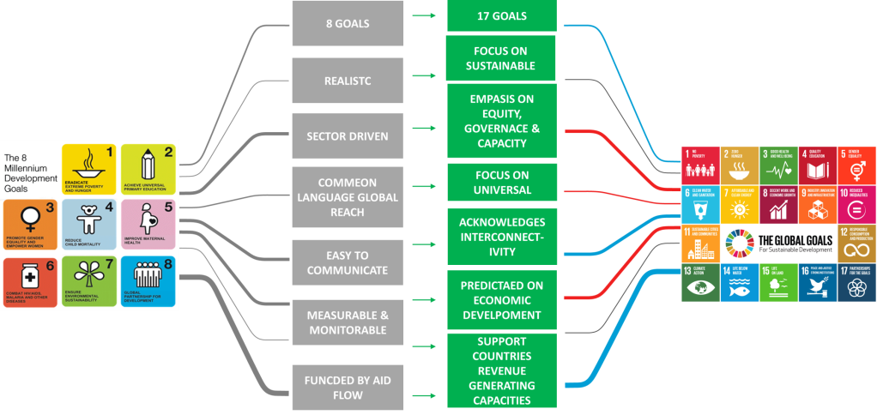
From the MDGs to the
Sustainable Development Goals (SDGs)

Slide 6
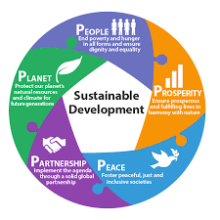
The SDGs and Equity
Equity is the principle that defines the SDGs
Notes:
6

Slide 7
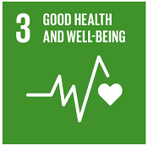
SDG No. 3 and its 13 Targets
By 2030, end preventable deaths of newborns and children under 5 years of age, with all countries aiming to reduce neonatal mortality to at least as low as 12 per 1,000 live births and under-5 mortality to at least as low as 25 per 1,000 live births
By 2030, end the epidemics of AIDS, tuberculosis, malaria and neglected tropical diseases and combat hepatitis, water-borne diseases and other communicable diseases
By 2030, reduce by one third premature mortality from non-communicable diseases through prevention and treatment and promote mental health and well-being
By 2020, halve the number of global deaths and injuries from road traffic accidents
By 2030, reduce the global maternal mortality ratio to less than 70 per 100,000 live birth
Ensure healthy lives and promote well-being for all
Strengthen the prevention and treatment of substance abuse, including narcotic drug abuse and harmful use of alcohol
By 2030, substantially reduce the number of deaths and illnesses from hazardous chemicals and air, water and soil pollution and contamination
By 2030, ensure universal access to sexual and reproductive health-care services, including for family planning, information and education, and the integration of reproductive health into national strategies and programmes
Strengthen the implementation of the World Health Organization Framework Convention on Tobacco Control in all countries, as appropriate
Substantially increase health financing and the recruitment, development, training and retention of the health workforce in developing countries, especially in least developed countries and small island developing States
Strengthen the capacity of all countries, in particular developing countries, for early warning, risk reduction and management of national and global health risks
Support the research and development of vaccines and medicines for the communicable and non-communicable diseases that primarily affect developing countries, provide access to affordable essential medicines and vaccines, in accordance with the Doha Declaration on the TRIPS Agreement and Public Health, which affirms the right of developing countries to use to the full the provisions in the Agreement on Trade-Related Aspects of Intellectual Property Rights regarding flexibilities to protect public health, and, in particular, provide access to medicines for all
Achieve universal health coverage, including financial risk protection, access to quality essential health-care services and access to safe, effective, quality and affordable essential medicines and vaccines for all

Slide 8
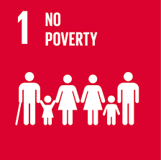

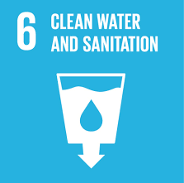
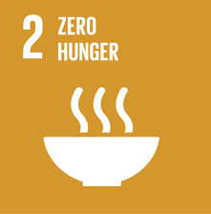
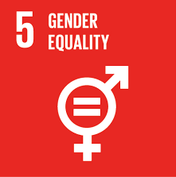
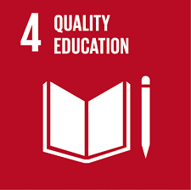
Links between Health and the Broader SDG Agenda
Goal 1.3: Implement social protections systems for all
Goal 16.1: Reduce all forms of violence and related death rates everywhere
Ensure healthy lives and promote well-being for all
Goal 6.1: Achieve universal and equitable access to safe and affordable drinking water for all
Goal 2.2: End all forms of malnutrition, achieve the targets on stunting and wasting in children
Goal 5.2: Eliminate all forms of violence against all women and girls…
Goal 4.2: Ensure access to quality early childhood development, care and pre-primary education
Other goals and targets – for example, No. 10 (Reduced Inequalities), No. 11 (Sustainable Cities and Communities) and No. 13 (Climate Action)

Slide 9
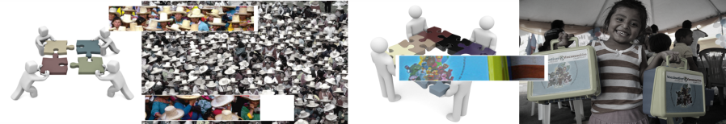
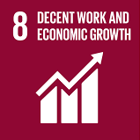
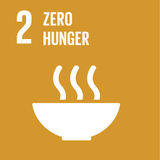
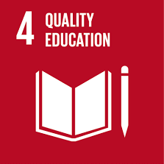
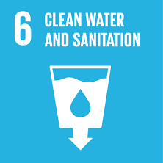
Each SDG requires multisectoral collaboration.
The Role of the Pan American Health Organization (PAHO)
1
2
3
4
Prioritize Indicators
Exchange Information
Cooperation
Coordinate Plans
Ensure healthy lives and promote well-being for all
=
+
+
+

Slide 10
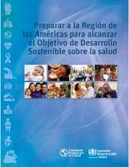
Implementing the Vision:
Publication of Key Documents
1
The first initiative to support the implementation of the SDGs, especially SDG No. 3.
53th Directing Council of PAHO (2014)
2
Compares the targets of the SDGs with the current health policies and programmes of countries.
Compares the targets and indicators of the SDGs with the targets and indicators of the PAHO Strategic Plan 2014-2019, the Health Agenda for the Americas and the current mandates of PAHO.
3
Highlights the most important mandates and relevant associations.

Slide 11
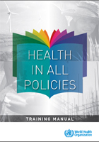
Implementing the Vision:
Health in All Policies
Health in All Policies
An emphasis on reducing health inequities through multisectoral approaches and by identifying benefits for other sectors.
“An approach to public policies across sectors that systematically takes into account the health implications of decisions, seeks synergies, and avoids harmful health impacts in order to improve population health and health equity.”
1
White Book: Options and opportunities.
2
Special group and working group on health in all policies and the SDGs: Reference note and work plan to harmonize health in all policies and the agenda of the SDGs.
Helsinki Statement on Health in All Policies (2013)
3
Capacity-building: PAHO is implementing training efforts throughout the region of the Americas.

Slide 12



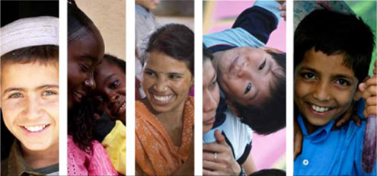

Implementing the Vision:
A regional Assessment of Health Inequalities
  Highlights: Regional Assessment
  Partnering with the Institute of Health Equity of University College London;
  With the aim of collecting and summarizing quantitative and qualitative data on the links between gender, equity, human rights, cultural diversity and health in 13 selected countries;
  The key deliverable will be a set of practical recommendations that Member Countries can apply to ensure that the cross-cutting issues are being effectively addressed in their health policies.
  Gender
  Cultural diversity
  Equity
  Human rights

Slide 13
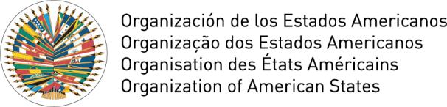
Implementing the Vision:
Inter-institutional Collaboration
Five-Year Target (2016-2021)
To promote synergies, strengthen cooperation and establish a broader inter-institutional alliance around the SDGs in order to to convene other organizations of the Inter-American System and the United Nations System and champion countries:
CEPAL, UNDP LAC
Colombia, Ecuador, Jamaica and Mexico
To enable information exchange, promote dialogue between ministries of health and ministries of foreign affairs and identify the existing means and mechanisms that will facilitate the process.
PAHO/OAS Working Group (September 2015)
  To establish preliminary joint actions between the Inter-American System and the United Nations System in regard to the SDGs and their targets.
  An initial mapping document including an analysis of each SDG that will help achieve convergence between the SDGs and the existing mandates and inter-institutional collaboration efforts.
1
2

Slide 14


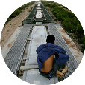
Universal Declaration of Human Rights
Constitution of the World Health Organization
0
Health Emergencies
Universal Health
Human Security
Origin
Transit
Destina-tion
Return
Notes:
La propuesta de la OPS para abordar las inequidades en salud de la población migrante: conectar la asistencia humanitaria de corto plazo con el acceso universal en salud y la cobertura universal de salud de largo plazo a través de la incorporación del enfoque de la seguridad humana en los planes de salud para fortalecer la resiliencia de los migrantes en situación de vulnerabilidad y de las comunidades de origen, tránsito, destino y retorno.
Constitución de la OMS: …..” El goce del grado máximo de salud que se pueda lograr es uno de los derechos fundamentales de todo ser humano sin distinción de raza, religión, ideología política o condición económica o social.

Slide 15
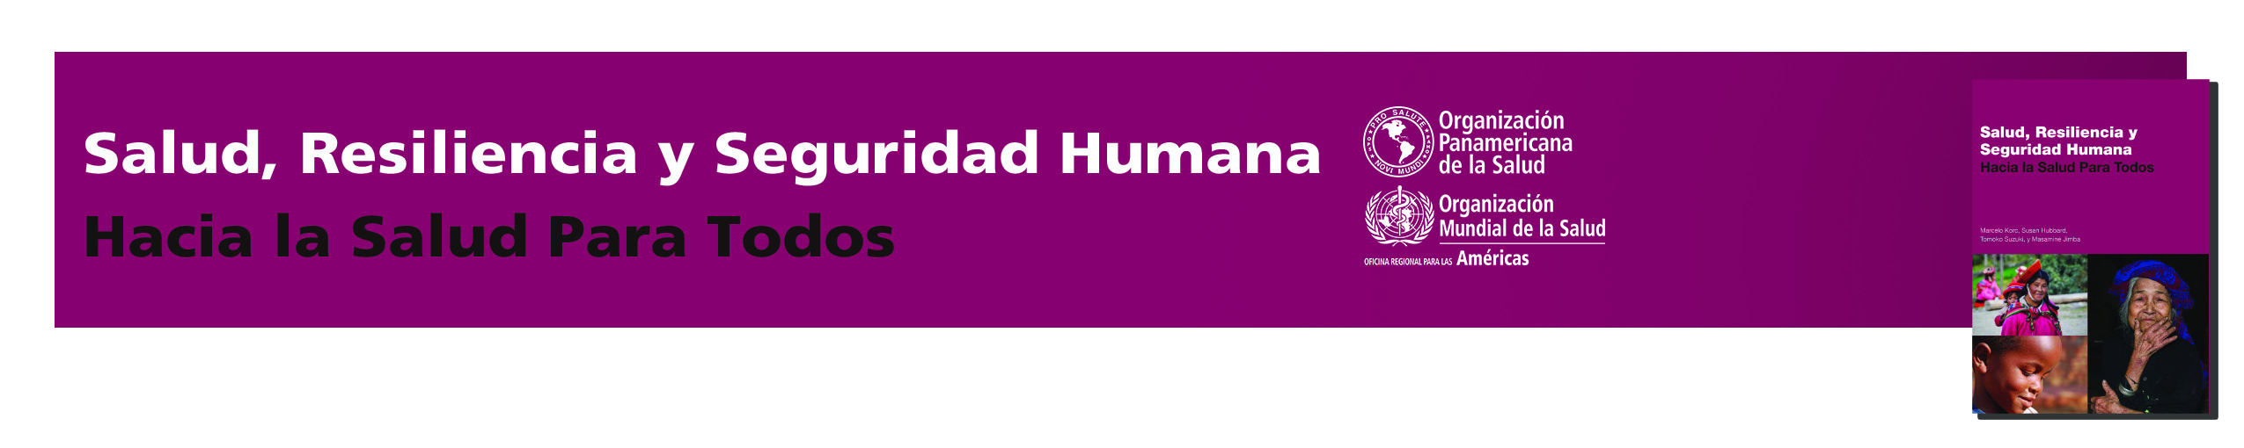
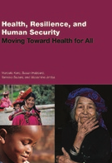
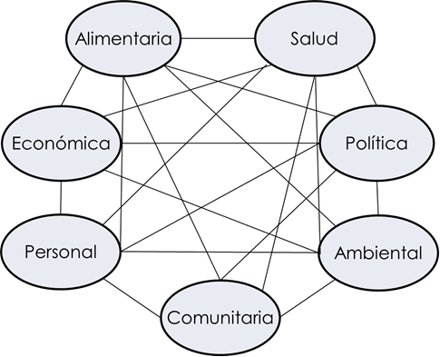
Health, Resilience, and Human Security
Moving Toward Health for All
All individuals are entitled to freedom of fear, freedom of misery, and dignity.
Resolution 66/290 of the United Nations General Assembly (2012)
Safe Migration
To strengthen the resilience of individuals, families and communities of origin, transit, destination and return by promoting a system of good governance.
Food
Health
Economic
Political
Environ-mental
Community

Slide 16
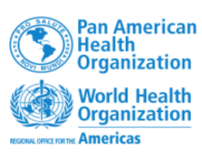
THANK YOU

