Slide 1
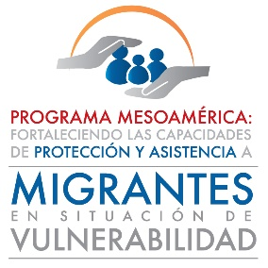

Boys, Girls and Adolescents
RISKS DURING MIGRATION

Slide 2
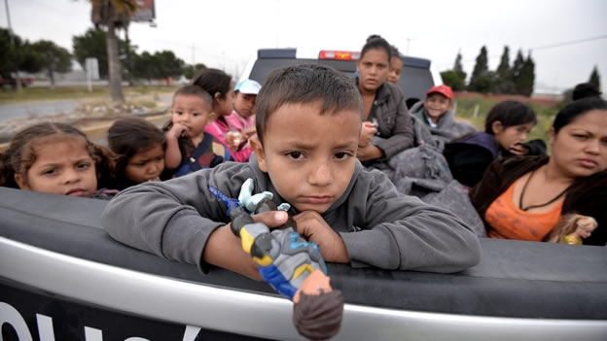
A better understanding to inform decision-making and actions…

Slide 3
Threat
Vulnerability
Risk

Slide 4
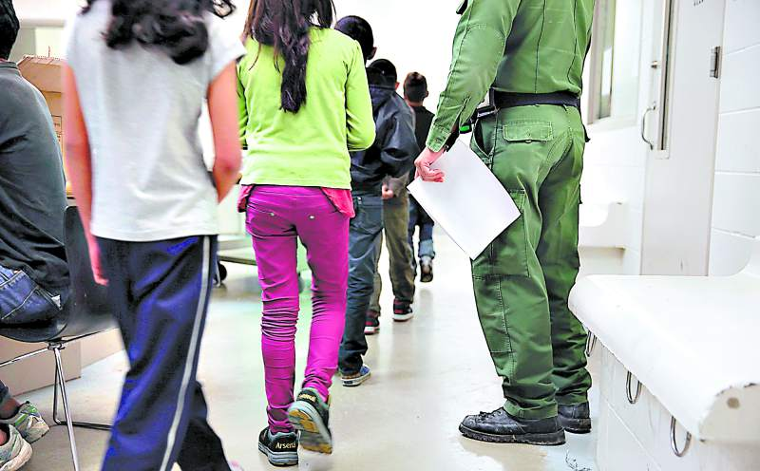
Risk
Likelihood of occurrence of damage.
Anticipated vision of what could happen if a threat becomes a reality.
A context or social environment with characteristics and conditions that anticipate future harm.
Harm = The probability becomes a reality.

Slide 5
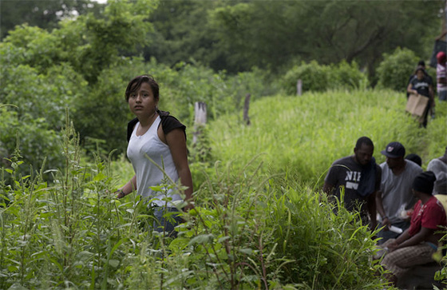
Threat
A dangerous phenomenon or condition that could cause serious harm.
Potential harm.
A synonym for danger.

Slide 6
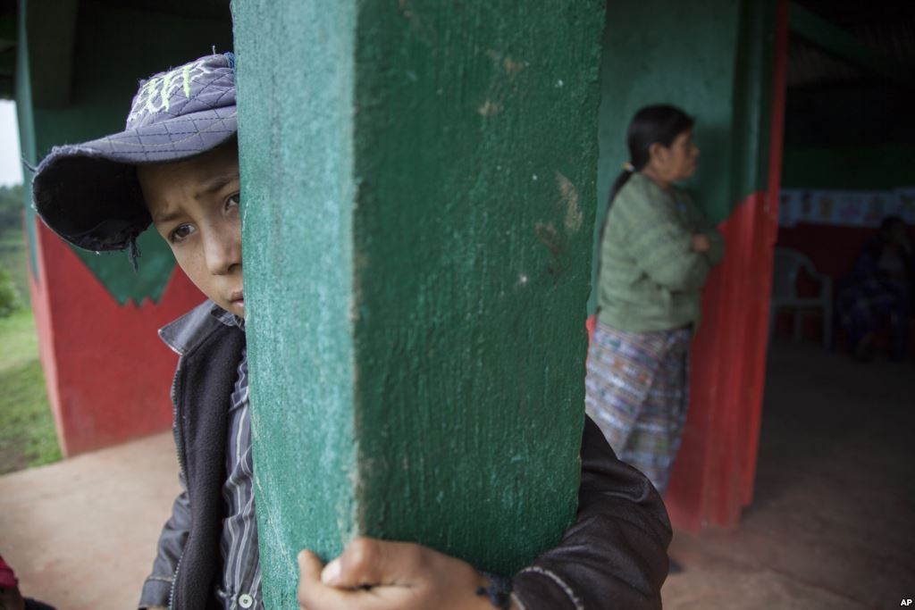
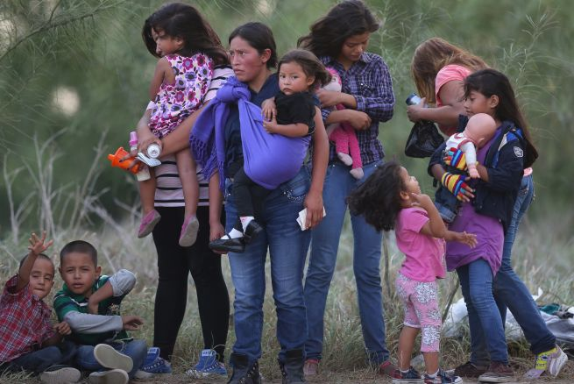
Vulnerability
The characteristics of an individual, community or group that make them prone to suffering harmful effects in the contexts where they are.
A result of the social impacts of political, economic and sociohistorical determinants.
Inability to face certain risks.

Slide 7
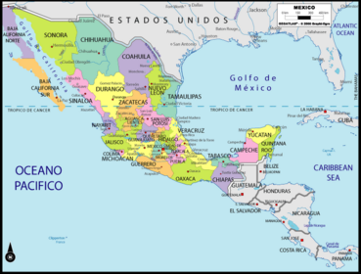
Social Construction of Vulnerabilities and Threats
Contextual and sociohistorical conditions

Slide 8
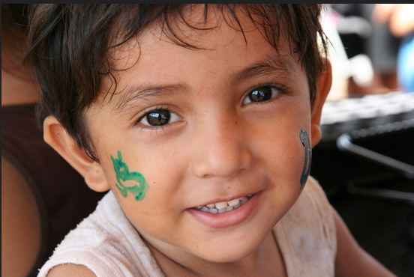
Part 2

Slide 9
Resources
Personal
Family
Community
State
Regional
Institutional
Capacities and tools to face the effects of a harmful event.

Slide 10
Prevention
Addressing threats and factors that create certain conditions of vulnerability.
Strengthening personal, family, community, social and State resources to prevent vulnerabilities and threats.

Slide 11
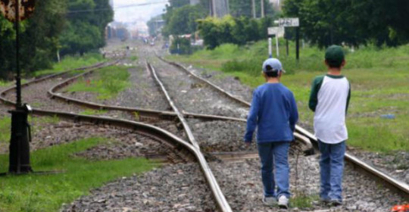
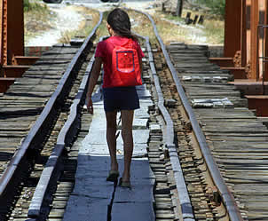
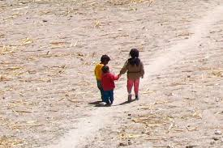
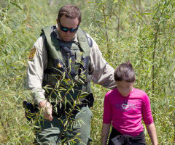
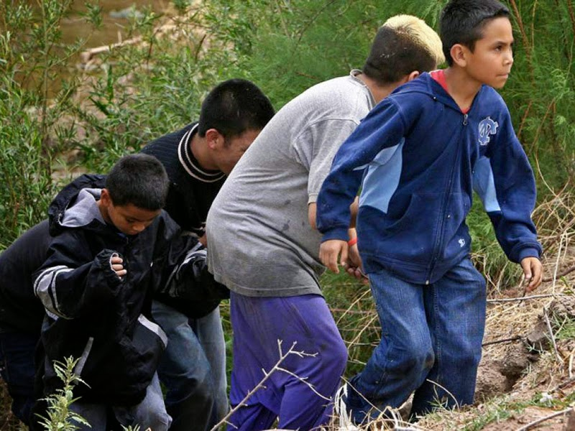
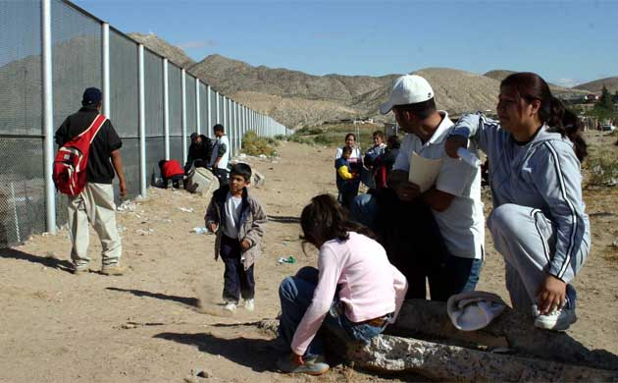
How many obstacles are there before the dream is fulfilled?

