Slide 1

International Organization for Migration
Regional Workshop on Temporary Protection Status and/or Humanitarian Visas in Situations of Disaster
San José, Costa Rica
February10-11, 2015
Luz TANTARUNA
Salvador GUTIÉRREZ

Slide 2
Presentation Objectives
Presentation Objectives:
  To briefly share the experience of IOM in regard to border movements in the context of disasters, as useful input for discussions and policies on this matter.

Slide 3
Contents
1- Basis for the involvement of IOM in the topic;
2- Efforts implemented by IOM on this matter;
3- MCOF as a useful framework for the discussion and development of policies for the management of migration emergencies.

Slide 4
1. Basis for the involvement of IOM in the topic

Slide 5
Legal Basis
International environmental instruments:
  UN Framework Convention on Climate Change (UNFCCC)
  International disaster response regulations
International human rights instruments:
  International Covenant on Civil and Political Rights (1966)
  International Covenant on Economic, Social and Cultural Rights (1966)
  International Convention on the Elimination of All Forms of Racial Discrimination (1965)
  Convention against Torture and Other Cruel, Inhuman or Degrading Treatment (1984)
  Convention on the Rights of the Child (1989)
  International Convention on the Protection of the Rights of All Migrant Workers and Members of Their Families (1990)
  Guiding Principles on Internal Displacement
  Nationality Law
Notes:
Environmental law
UN Framework Convention on Climate Change
UNFCCC was initially unrelated to migration
Conference of the Parties has integrated climate change from the Cancun Agreements (2010)
The Parties should adopt “Measures to enhance understanding, coordination and cooperation with regard to climate change induced displacement, migration and planned relocation, where appropriate, at the national, regional and international levels”
Doha Decisions (2012): advance understanding of loss and damages deriving from climate change, including impact on human mobility, displacement and migration.
International Disaster Response Law
International Law Commission Draft Articles on the Protection of Persons in the event of disaster
1st World Disaster Reduction Conference (2005) and Hyogo Framework for Action
It is more at the border between environmental law and humanitarian law. Usually applicable to both man-made and natural disasters.
Human rights law
International Covenant on Civil and Political Rights (1966)
International Covenant on Economic, Social and Cultural Rights (1966)
International Convention on the Elimination of All Forms of Racial Discrimination (1965)
Convention against Torture and Other Cruel, Inhuman or Degrading Treatment (1984)
Convention on the Rights of the Child (1989)
International Convention on the Protection of the Rights of All Migrant Workers and Members of Their Families (1990)
Guiding Principles on Internal Displacement
Nationality Law
There are also regional legal approaches:
Additional Protocol to the American Convention on Human Rights in the Area of Economic, Social and Cultural Rights (Protocol of San Salvador)
Article 11: right to healthy environment
Case of the Sawhoyamaxa Indigenous Community v. Paraguay (IACtHR, 2006) and Case of the Yakya Axa Indigenous Community v. Paraguay (IACtHR, 2005)
MERCOSUR Declaration of Principles on International Refugee Protection
Cartagena Declaration on Refugees (developing)

Slide 6
Conceptual Basis
1. Environmental Migrants
Environmental migrants are persons or groups of persons who, predominantly for reasons of sudden or progressive changes in the environment that adversely affect their lives or living conditions, are obliged to leave their habitual homes, or choose to do so, either temporarily or permanently, and who move within their country or abroad.” – IOM working definition.
Notes:
IOM working definition of environmental migrants
Environmental migrants are persons or groups of persons who, predominantly for reasons of sudden or progressive changes in the environment that adversely affect their lives or living conditions, are obliged to leave their habitual homes, or choose to do so, either temporarily or permanently, and who move within their country or abroad.

Slide 7
Conceptual Basis
ENVIRONMENTAL MIGRATION CATEGORIES
Evident factors
Factors that are difficult to identify
Internal movement of persons
International movement of persons
Voluntary or forced movement
Inexorability of the movement
Temporary movement
Permanent movement
Sudden occurrence
Progressive changes
(Predominance versus exclusivity)
Notes:
Temporary and permanent: difficult to know from the outset, but easy to go from one category to the other.
Voluntary and forced: what is the best solution? Apply to both the same protection scheme.

Slide 8
Conceptual Basis
2. State obligations during each phase of an emergency:
Prevention and mitigation before the event;
Protection during the event;
Protection after the event.
Notes:
Right to access to justice and reparation
Continuing humanitarian needs: They may need temporary shelter until destroyed houses are rebuilt, food rations until the first crops are available, or emergency health services until the health system has been re-established.

Slide 9
1. PREVENTION AND MITIGATION BEFORE THE EVENT
Conceptual Basis
Actions
Relevant Rights
Identify needs;
Collect and disseminate information about risks;
Early alert systems;
Evacuation plans;
Community education.
Right to information;
Right to consultation;
Right to participation in decision-making and plan development processes.
Notes:
1. In this phase the State should provide measures of prevention, mitigation and preparedness to prevent the event, mitigate its consequences or respond to the situation.

Slide 10
2. PROTECTION DURING THE EVENT
Conceptual Basis
Actions
Relevant Rights
The obligation of affected States to seek support and not delay the acceptance of assistance offers;
Implement protection actions;
Assess potential options and implement actions to minimize displacement and its adverse effects;
Seek the free and informed consent of displaced persons;
The relevant legislation should establish an authority responsible for addressing displacement and making relevant decisions.
Right to request and to receive protection and humanitarian assistance;
Principle of non-discrimination (on the basis of nationality and vulnerable groups);
Prohibition of arbitrary displacement;
Right to respect for family unity;
Right to full information on the reasons and procedures for their displacement;
Right to safe conditions of displacement/voluntary movement;
Right to adequate standard of living;
Right to a safe shelter during displacement;
Right to freedom of movement;*
Right to seek safety in another part of the country;
Right to choose one’s residence;
Right to leave the country;
Right to protection of properties or possessions left behind.
Notes:
Rights relevant to this phase: Right to request and to receive protection and humanitarian assistance from the government;
Principle of non-discrimination, including on the basis of nationality, and special protection of groups at risk;
Prohibition of arbitrary displacement (displacement should be used only when necessary to protect the health and safety of the affected population and should not last for longer than reasonably required by the circumstances);
Right to respect for family unity;
Right to full information on the reasons and procedures for their displacement;
Right to safe conditions of displacement;
Right to adequate standard of living, including essential food and potable water, appropriate clothing and essential medical services and sanitation;
Right to a safe shelter during displacement;
Right to freedom of movement, including within and from the camps or shelters;
Right to seek safety in another part of the country;
Right to choose one’s residence;
Right to leave the country;
Right to protection of properties or possessions left behind.

Slide 11
Conceptual Basis
3. PROTECTION AFTER THE EVENT
Actions
Relevant Rights
Facilitate voluntary return, integration and resettlement;
Facilitate reintegration upon return;
Facilitate the recovery of land, properties and possessions that have been left behind.
Application of the principle of non-refoulement;
Right to voluntary return, in safety and with dignity;
Right to be informed of the existing options and to participate in the planning of return;
Right to adequate standard of living, including essential food and potable water, appropriate clothing and essential medical services and sanitation;
Right to access to employment;
Right to recover possessions or properties left behind;
Right to access to justice and to compensation.
Notes:
Rights relevant to this phase: Application of the principle of non-refoulement (which, combining Refugee Law and Human Rights Law principles, means that no one should be sent back to a place where his life or freedom would be threatened or where he or she would be submitted to conditions or treatments contrary to his or her dignity);
Right to voluntary return, in safety and with dignity;
Right to be informed of the existing options and to participate in the planning of return;
Right to adequate standard of living, including essential food and potable water, appropriate clothing and essential medical services and sanitation;
Right to housing;
Right to access to employment or livelihood;
Right to recover possession or properties left behind;
Right to access to justice and to compensation.

Slide 12
Conceptual Basis
LESSONS LEARNED
Multiplicity of factors;
Given that the movements caused by emergencies are expressed in countless variables and include many different types of persons, one-size-fits-all or unchanging solutions should not be proposed;
Specific solutions should be developed from the bottom up, with communities and individuals.
Notes:
Rights relevant to this phase: Application of the principle of non-refoulement (which, combining Refugee Law and Human Rights Law principles, means that no one should be sent back to a place where his life or freedom would be threatened or where he or she would be submitted to conditions or treatments contrary to his or her dignity);
Right to voluntary return, in safety and with dignity;
Right to be informed of the existing options and to participate in the planning of return;
Right to adequate standard of living, including essential food and potable water, appropriate clothing and essential medical services and sanitation;
Right to housing;
Right to access to employment or livelihood;
Right to recover possession or properties left behind;
Right to access to justice and to compensation.

Slide 13
2- Efforts implemented by IOM

Slide 14
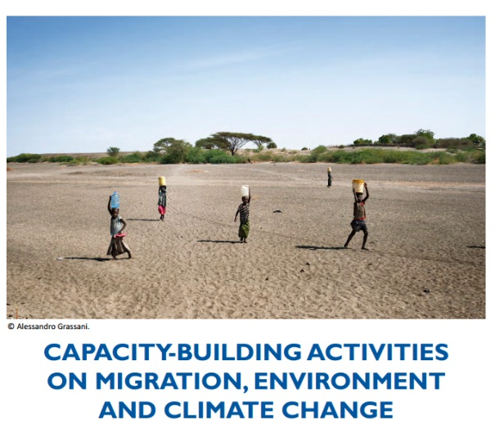
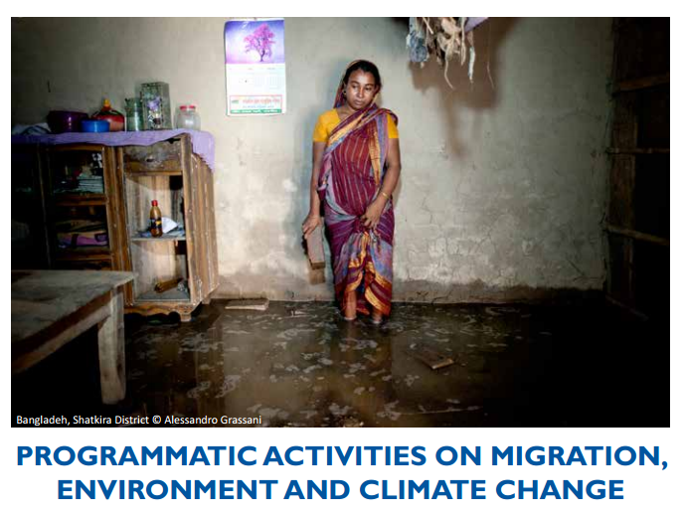
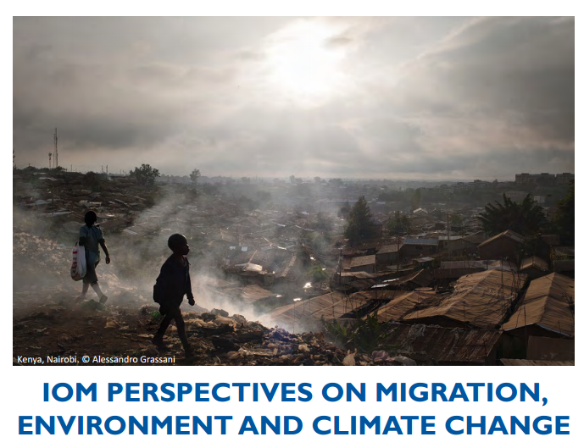
IOM Efforts
A Migration, Environment and Climate Change Division since January 2015
Notes:
New MECC division at IOM
For more on MECC activities, see: http://www.iom.int/cms/envmig

Slide 15
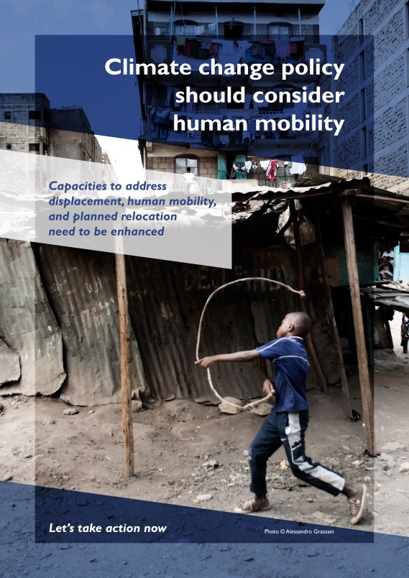
IOM Efforts
Migration as a cross-cutting theme in key processes:
  Climate negotiations;
  Development of SDGs;
  DRR (Hyogo Framework for Action);
  Humanitarian Summit.
Notes:
Climate negotiations
climate issues must be part of migration policy debates and human mobility considerations must be part of climate negotiations
IOM’s work within the UNFCCC framework since 2006, aims to engage with UNFCCC, states and partners to bring human mobility on the climate negotiations agenda and to position the organization as a key player on the management of climate induced migration
Example of IOM efforts: IOM actively contributed to a number of events at the 21st Conference of the Parties (COP20) climate change negotiations that took place in Lima, Peru in 2014
The development of the Sustainable Development Goals (SDG)
For more information, see: http://www.iom.int/cms/post2015
DRR (Disaster Risk Reduction) Hyogo Framework for Action 2005–2015: Building the Resilience of Nations and Communities to Disasters
The Hyogo Framework outlines five priorities for action, and offers guiding principles and practical means for achieving disaster resilience
Since the current Hyogo Framework for Action (HFA) has limited recognition of human mobility as a driver of risk, the post-2015 agreement on disaster risk reduction (DRR) (HFA2) must adequately recognize mobility as a fundamental human process that – although can increase risk – can also be central to building resilience.
Humanitarian Summit
IOM is contributing to processes and discussions in the lead up to the World Humanitarian Summit (WHS), scheduled for May 2016, in Istanbul, Turkey, with a view to ensure migration issues are featured in the Secretary General’s report to be published before the Summit.

Slide 16
IOM Efforts
Objective of Humanitarian Border Management (HBM):
  To improve preparedness and responses to protect those who cross borders in emergencies, as well as to ensure that the security of the border is maintained.
Notes:
Objective of IOM’s HBM:
Humanitarian Border Management (HBM) activities seek to improve preparedness and responses to protect those who cross borders in emergencies, as well as to ensure that the security of the border is maintained
http://www.iom.int/files/live/sites/iom/files/What-We-Do/docs/IBM-Factsheet-HBM.pdf
IOM can provide support in a number of capacities related to HBM:
Assessments on HBM capacities; • Delivery of HBM training for border officials; • Drafting or review of Standard Operating Procedures (SOPs) for emergencies; • Initiation of and improvement to emergency preparedness and contingency plans; • Establishment of a referral system to assist migrants and provide humanitarian relief; • Creation of interagency cooperation mechanisms to allow for a more coherent response to crises; • Design and procurement of mobile communication and registration technology solutions; etc.
For more on HBM activities: http://www.iom.int/files/live/sites/iom/files/What-We-Do/docs/IBM-Factsheet-HBM.pdf
IOM also has general immigration and border management (IBM) activities:
IBM activities are directed at helping governments create policy, legislation, administrative structures, operational systems and the human resource base necessary to respond effectively to diverse migration and border challenges and to institute appropriate migration governance.
For more on IBM activities, see: http://www.iom.int/cms/tcm

Slide 17
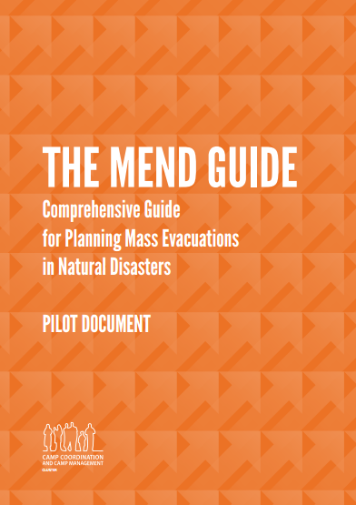
IOM Efforts
IOM is the global cluster lead for camp management and camp coordination (CCCM) in the context of responses to natural disasters.
The MEND Guide:
  Contains a template to help create and develop national evacuation plans.
Notes:
IOM is the global cluster lead for camp management and camp coordination (CCCM) in natural disasters
The goal of the CCCM Cluster:
improve living conditions of internally displaced persons by facilitating the provision of protection/services in camps and camp-like settings
advocate for durable solutions
ensure organized closure and phase-out of camps upon the IDPs’ relocation, return, resettlement or local integration.
CCCM gathers, monitors and disseminates information on population needs as well as on displacement patterns and dynamics throughout the crisis
CCCM cluster is cross-sectoral: it facilitates the coordination of services in response to the assistance and protection needs of IDPs in camps and camp-like situations.
Co-lead for the CCCM Cluster: United Nations High Commissioner for Refugees (UNHCR)
For a list of other partners: http://www.globalcccmcluster.org/about-us/our-partners
For more on CCCM, see: http://www.globalcccmcluster.org/system/files/publications/CCCM%20Brief_052012.pdf
The Comprehensive Guide for Planning Mass Evacuations in Natural Disasters (MEND guide):
A gap exists in the availability of relevant tools to guide national disaster management agencies as well as humanitarian actors in planning for mass evacuations
The MEND Guide contains a template to help create and develop national evacuation plans.
The collaboration on the MEND Guide brought together best practices and knowledge of experts in the field of disaster management and humanitarian aid.
Guidelines for the workshop: “[113] RCM Governments should thus seek ways to facilitate and encourage migrants’ access to emergency protection and assistance in disaster contexts”
“[126] The Government of each RCM State should consider preparing for the eventuality of renewed and increased humanitarian protection challenges as a result of disasters overseas by:
[…]
Revising, updating or adopting national, provincial and local emergency plans […]”

Slide 18
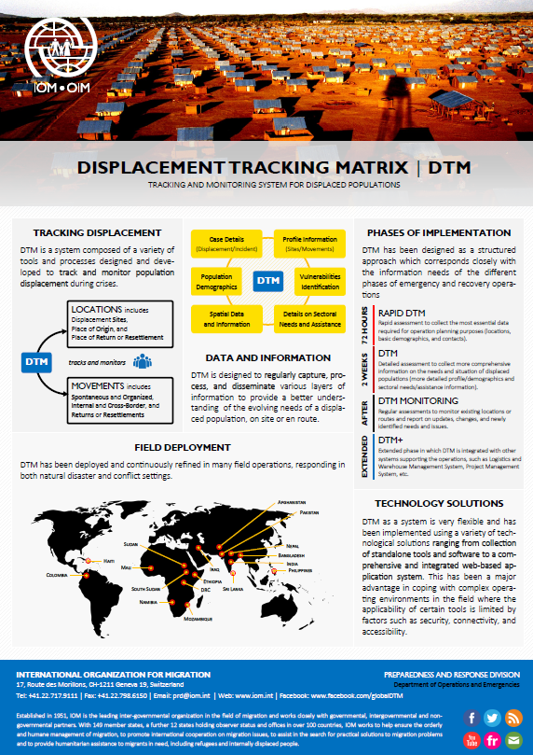
IOM Efforts
Understand vulnerabilities through collecting data in situations of displacement;
Displacement Tracking Matrix (DTM):
  Captures the evolution of the displaced persons’ numbers and flows.
Notes:
We must collect data in order to better understand vulnerabilities
The DTM is a Camp Coordination and Camp Management (CCCM) cluster tool developed by IOM
The DTM is designed to collect information at regular intervals, thereby providing a series of “snapshots” that allow to capture the evolution of the displaced persons’ numbers, flows and conditions where they have temporarily settled.
The DTM is implemented by supporting national and local partners in countries facing internal displacement in the aftermath of disasters
Find the infosheet here: http://www.iom.int/files/live/sites/iom/files/What-We-Do/docs/DOE-Infosheet-DTM-v2-1.pdf
Background study for the workshop (by DJ Cantor)
“The data on human mobility in the context of rapid-onset disasters caused by natural hazards in the Americas is decidedly fragmentary and lacking in detail”
Guidelines:
“[126] The Government of each RCM State should consider preparing for the eventuality of renewed and increased humanitarian protection challenges as a result of disasters overseas by:
[…] Revising, updating or adopting a process for collecting information about disasters and their humanitarian protection impact […]”

Slide 19

MCOF – A Strategic Planning Tool to Respond to Human Mobility in Crisis Situations
Concept
Migration Crisis: Complex migration flows-movements-vulnerabilities
Perspective
Intersectoral practices
Comprehensive: Analyses the type and intensity of the crisis;
Combines traditional and non-traditional humanitarian sectors.
Approach
Implementation
Pillars: 1) Phases (before, during and after);
2) Assistance sectors (15);
3) Links to response systems.
Notes:
Nota: situaciones y condiciones no aliviadas: por ejemplo cambio climatico, actividades criminales, etc.
Crisis migratoria – es la descripcion de los flujos migratorios complejos y los patrones de movilidad humana a consecuencia de la crisis y eso trae considerables vulneraibilidades para las personas y poblaicones afectadas.
Cooperacion con socios involucrados en actividades de paz, seguridad y desarrollo.

Slide 20
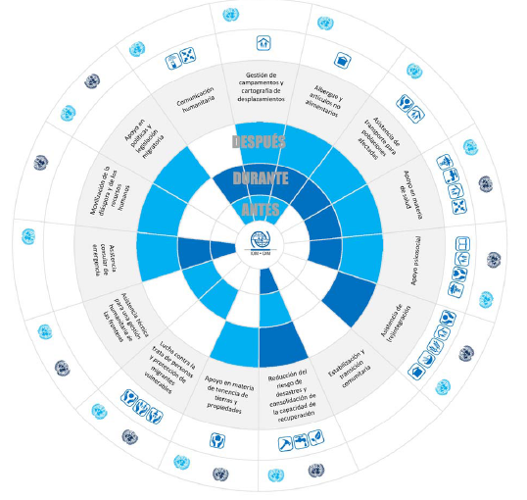
Sector Diagram: 15 sectors.
Sector 8 – Reducing disaster risk and building recovery capacities.
Sector 11 – Technical assistance for humanitarian border management.

Slide 21
Sectors 8 & 11 – Movement of persons during crisis caused by natural phenomena in an international context
Crisis: Affected Populations
Cross-border movement of migrants without international protection
Border management capacity
Capacity-building
To address the causes of vulnerability to natural hazards
Emergency consular assistance: i.e. Biometric identification
Protection actions against human smuggling
To improve the capacity to recover from a crisis

Slide 22
MCOF: After 1 Year of Training
21 OR and IOM countries trained.
32 governments (ministries) trained.
12 events for national/international NGOs.
6 countries have integrated MCOF into their national strategies.
Notes:
Nota: situaciones y condiciones no aliviadas: por ejemplo cambio climatico, actividades criminales, etc.
Crisis migratoria – es la descripcion de los flujos migratorios complejos y los patrones de movilidad humana a consecuencia de la crisis y eso trae considerables vulneraibilidades para las personas y poblaicones afectadas.
Cooperacion con socios involucrados en actividades de paz, seguridad y desarrollo.

Slide 23
MCOF – Lessons Learned
Helps gain a holistic understanding of the implications of human mobility versus protection and assistance to affected persons;
Can be adjusted to national conditions and contexts;
Identifies situations and conditions that have not been addressed and that lead to a migration crisis;
Promotes cooperation with involved actors: peace, security and development;
Useful to policymakers (specialists and government authorities).
Notes:
Nota: situaciones y condiciones no aliviadas: por ejemplo cambio climatico, actividades criminales, etc.
Crisis migratoria – es la descripcion de los flujos migratorios complejos y los patrones de movilidad humana a consecuencia de la crisis y eso trae considerables vulneraibilidades para las personas y poblaicones afectadas.
Cooperacion con socios involucrados en actividades de paz, seguridad y desarrollo.

Slide 24
International Organization for Migration
Thank you

