Slide 1



MESOAMERICA
REGIONAL PROGRAMME
Sofía Salas ssalas@iom.int
Regional Coordinator
With support from:

Slide 2
MESOAMERICA REGIONAL PROJECT
Capacity-building for Protection and Assistance to Migrants
in Vulnerable Situations
Beneficiary Countries: Guatemala, El Salvador, Honduras, Mexico (southern border), Costa Rica and Panama
Objective: To strengthen the capacity of government institutions and civil society organizations to provide protection and assistance to migrants in vulnerable situations, with a human rights and gender approach.
COMPONENTS
Capacity-building (workshops, online courses and classroom training);
Prevention and dissemination (campaigns, information windows for migrants, strengthening civil society networks);
Direct assistance and voluntary return for migrants in highly vulnerable situations;
Regional coordination activities (cross-border meetings, support RCM, OCAM)

Slide 3
Expected Results
Strategic Actions (examples)
Capacity-building for identification, referral and assistance to migrants in vulnerable situations
Training (at the central level and at the border);
Referral guidelines/mechanisms;
A specialized workshop on migrant boys, girls and adolescents (training of trainers, service providers, management training for decision-makers).
Prevention and awareness-raising on human rights and the risks associated to irregular migration
Campaigns with community participation (youth) in communities of origin, transit and destination;
Establish information windows for migrants (Paso Canoas (CR); Suchiate (Chiapas), San Marcos, Sibinal and Tacaná (GT)).
Improved capacity and services for direct assistance to migrants in vulnerable situations
Direct assistance and voluntary return;
Support shelters and NGOs.
Strengthen inter-institutional and intersectoral boards;
Support cross-border meetings/committees and organize sectoral and thematic boards;
Strengthen protection mechanisms for migrant boys, girls and adolescents at the border;
Support and follow-up on regional commitments and agreements (RCM).
More efficient dialogue and coordination mechanisms at a local, national and regional level

Slide 4
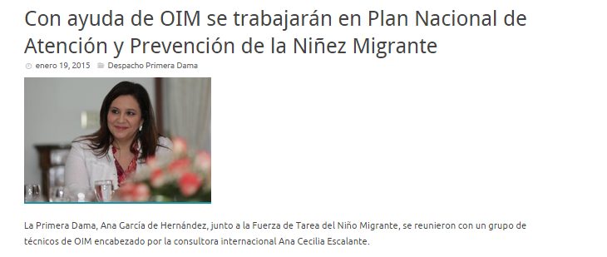
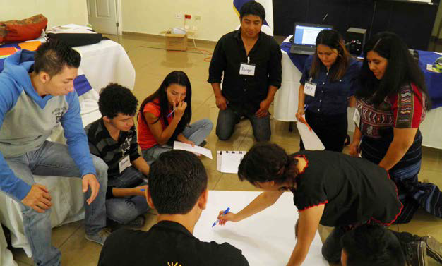

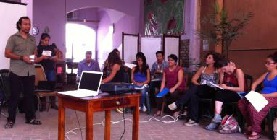
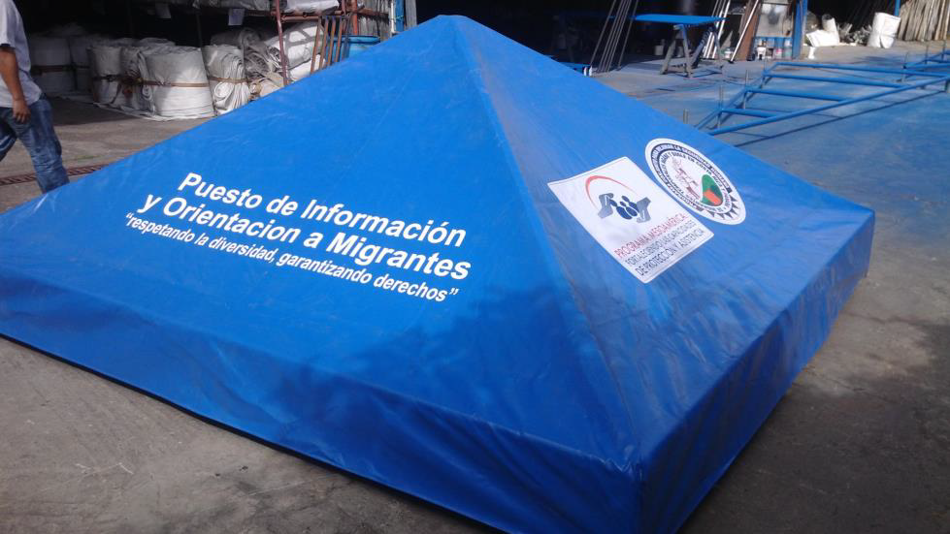

Slide 5
Sustainability of efforts
An inter-institutional and intersectoral approach
Technical accompaniment
Monitoring and evaluation

