Slide 1
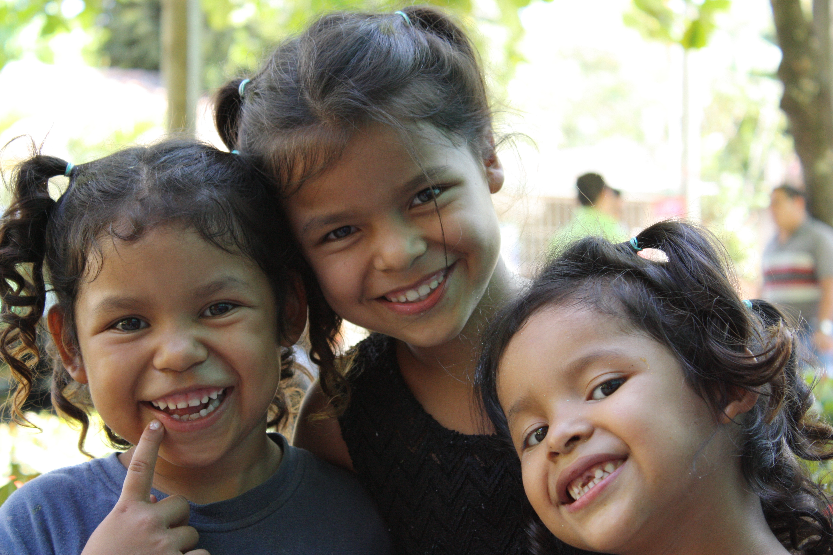
Healthy migrants in Healthy communities
Dr. Carlos Van der Laat
International Organization for Migration
Migration Health Division – Regional Office San José

Slide 2
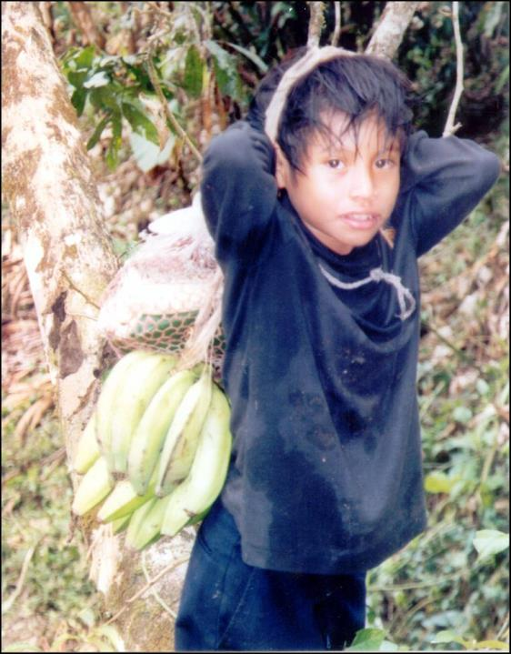
Mensaje Clave:
La migración como determinante social de la salud
Although migration is not a risk to health, it is a determinant of health.
Depending on how mobility occurs, the risks of it affecting health increase.

Slide 3
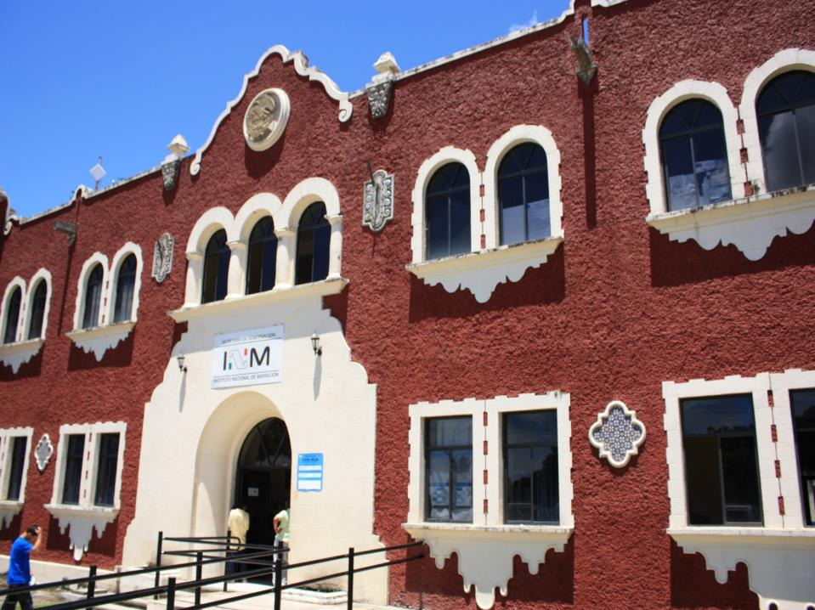

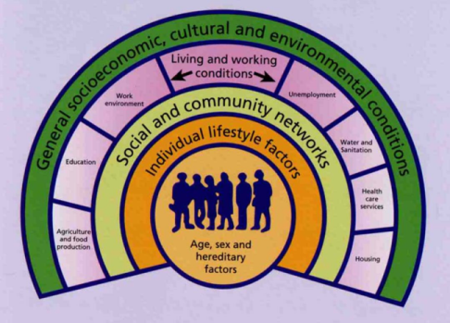
Social Determinants of Health
Migration
MIGRACION

Slide 4
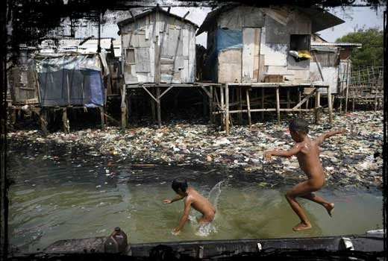

Slide 5

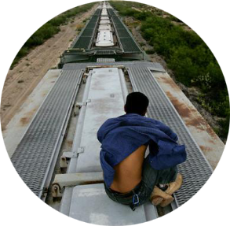
Spaces of vulnerability according to the stage in the Migration cycle
Transit
Destination community
Return
Community of origin

Slide 6
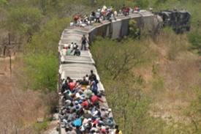

IOM Proposal
Guatemala - El Salvador – Honduras - Nicaragua
Investigation Protocol-Technical Committees
Collection of information
National Dialogues
Document Approval
National Plan for Migration and Health
Regional Dialogue
(OCAM - RESSCAD- COMISCA-CRM)
Other Forums
National Consultations
Irregular Migrant Population
Families fragmented by migration
Return population

Slide 7
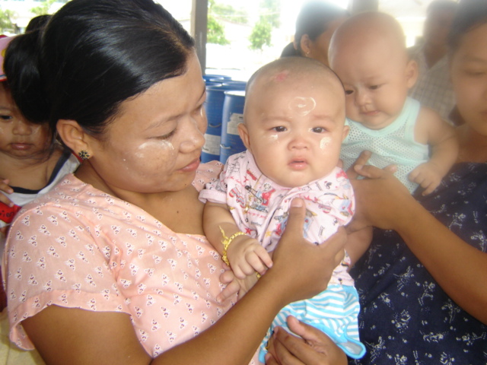
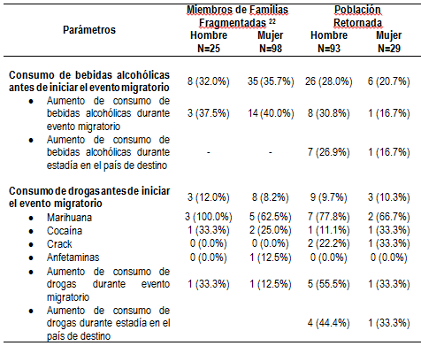
Vulnerability to the use of drugs
It was found that 16%-36% of participants reported the consumption of alcoholic beverages, and at least 17% increased their consumption at the event of migration
10% reported the use of drugs, marijuana being the most frequently consumed. In the returned population, more than 50% reported an increase in the use of drugs associated with the event of migration.
Source: IOM/Sierra

Slide 8
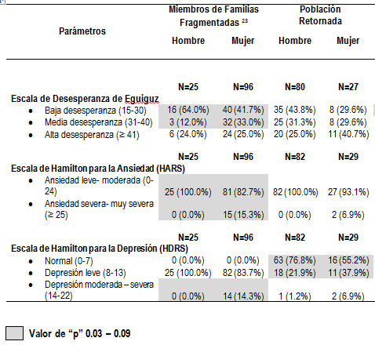
Vulnerability to mental health
It was observed that migration had a greater impact on the mental health of members of fragmented families and on women.
Source: IOM/Sierra
Notes:
Very interesting since the issue of mental health is fundamental to understanding the health of returned migrants.
Through the study we succeeded in making visible the conditions of hopelessness, principally in the returned population, who also reported significant levels of anxiety.
Family fragmentation was the situation that presented the highest levels of depression, according to the scales presented.
Violence in the communities of origin is also a push factor. However, there is also evidence of much violence during the return phase, with serious effects on the people, families and communities:
Stigma and discrimination
1 in 5 reported at least one type of violence during the event of migration. Men: verbal and psychological violence/ Women: discourtesy
Customs officials, police and military authorities are identified as the principal attackers of migrants according to the interviewed population.

Slide 9
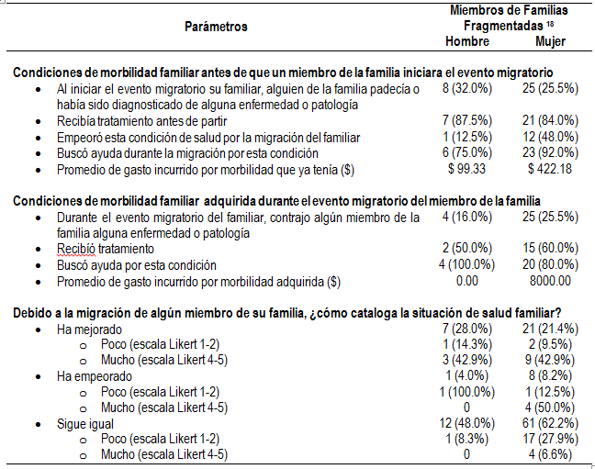
Families fragmented by migration
Social-Epidemiological Profile
1/3 reported at least one member of the family being unwell before the event of migration.
50% indication that health conditions worsened subsequent to their migration, associating sadness, frustration and anxiety as causes.
30% indicated improvement, due to receiving remittances to attend to their health conditions
Source: IOM/ Sierra
Notes:
.

Slide 10
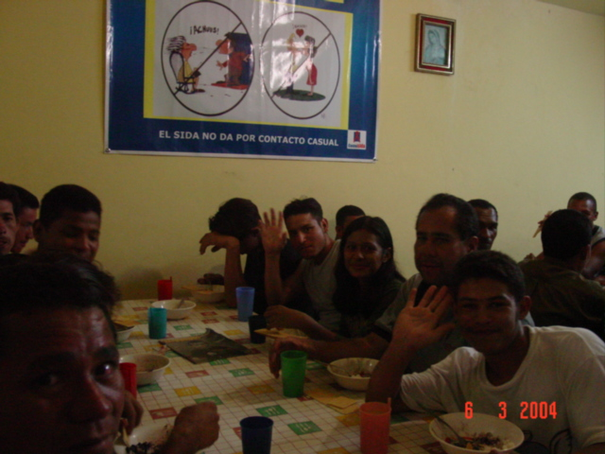
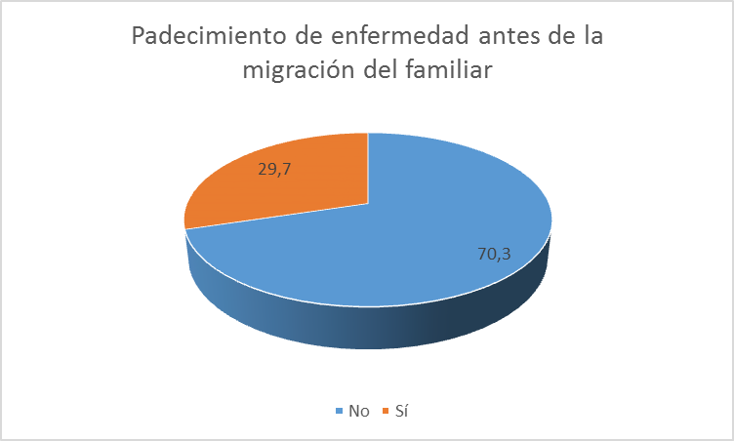
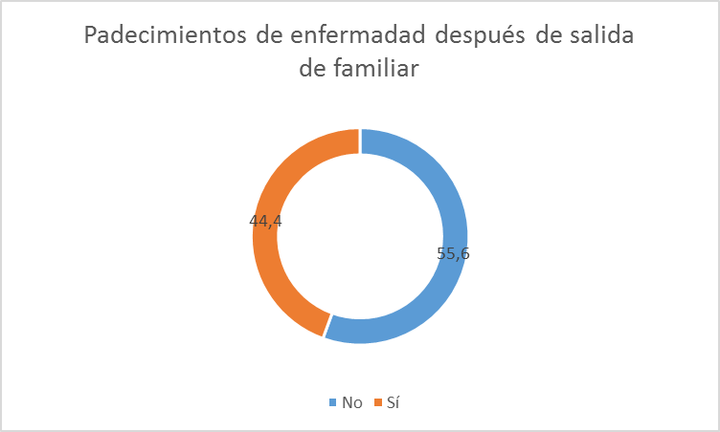
“Since he left I live in anguish, it makes me very nervous, I think that something might happen to him/(…) it has upset my blood pressure, I had to admit myself, then I stabilized/ I think about him a lot, I don’t know where he is (…) and that is affecting my health/ I cry a lot, I have become violent with the children, sometimes I don’t want to eat, I get sick with the flu, the child misbehaves in class and is very rebellious…” (Woman, mother of a migrant. Focus group-Chinandega)
Source: IOM/ Jesuit Service-Nicaragua

Slide 11
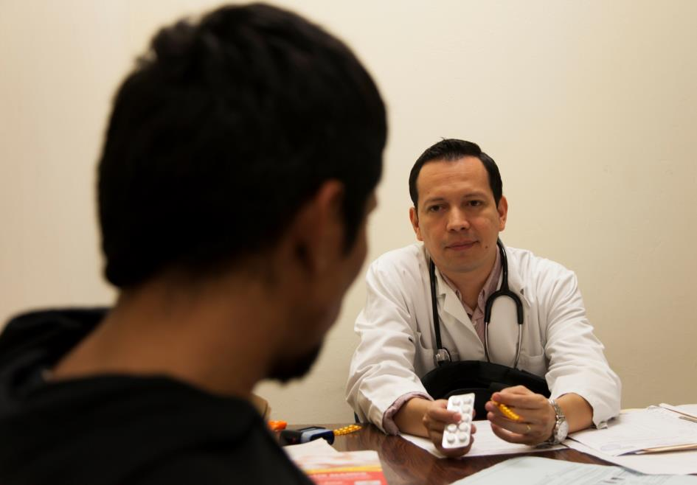
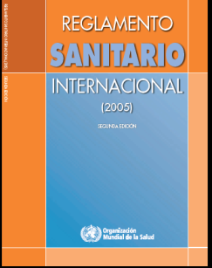
.
Premise of Health and Migration
(Human Rights Focus)
Pro-active measures to support migrant persons.
NEVER with solely restrictive purposes

Slide 12
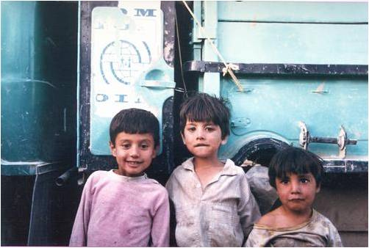
Monitoring Migration Health
Important cause of vulnerability:
invisibility
Inter-sectoral systems of information
  Inclusion of the migration variable
To improve the knowledge of trends and results through the breakdown and analysis of the information, considering diversity
To compare data and establish links in order to facilitate decision-making and the monitoring of policies and programs
Monitoring of behaviors, perceptions, specific needs
To follow-up with people who have a high-risk.

Slide 13
Human Resources Training
Migratory and Consular Officials
  Basic ability to detect signs and symptoms of infectious/contagious diseases
  To develop capacities for intercultural conduct and communication skills
  At least 1 or 2 people trained in basic first aid
  Information and sensitization about the health of migratory persons (To avoid stigma)

Slide 14
Migrant sensitive systems
Strengthen capacities for response
  Kidnapping/trafficking/ rape
  Standard Operational Procedures
  Training
Also monitor occupational health within the network
Intercultural contextualization
Partnerships, multi country framework
Service Network: Bi-national / Regional
Partnerships with Ministries of Health
Communication SOPs

Slide 15
Health in detention centers: Minimum level
Gender: Separation of spaces
    Well-lit spaces/ Areas with privacy
Sanitation: provision of basic supplies
Interculturally appropriate
  Language
  Spaces for prayer
Promotion of mental health
Voluntary access to health services
  Health promotion and education

Slide 16
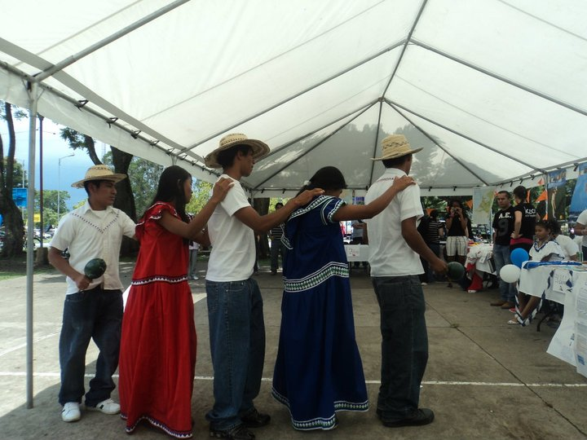
Formal Requests to GRCM
We support Canada’s initiative
To consider the technical support that IOM could contribute with regards to the subject of the health of migrant persons

Slide 17

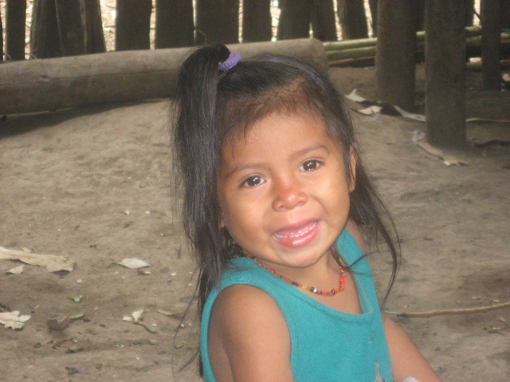

Healthy Migrants in Healthy Communities
Dr. Carlos Van der Laat
Migration Health Officer
International Organization for Migration
cvanderlaat@iom.int

