Slide 1

Workshop on Migration Health
San Jose
Costa Rica
28-29 September, 2016
Advancing the Migration Health Agenda
Jacqueline Weekers
Senior Migration Health Policy Advisor,
International Organization for Migration (IOM), Geneva

Slide 2
Content
IOM and Migrant Health
What has happened since the milestone WHA Resolution
Challenges and opportunities
Advancing the agenda post UNGA 2016

Slide 3
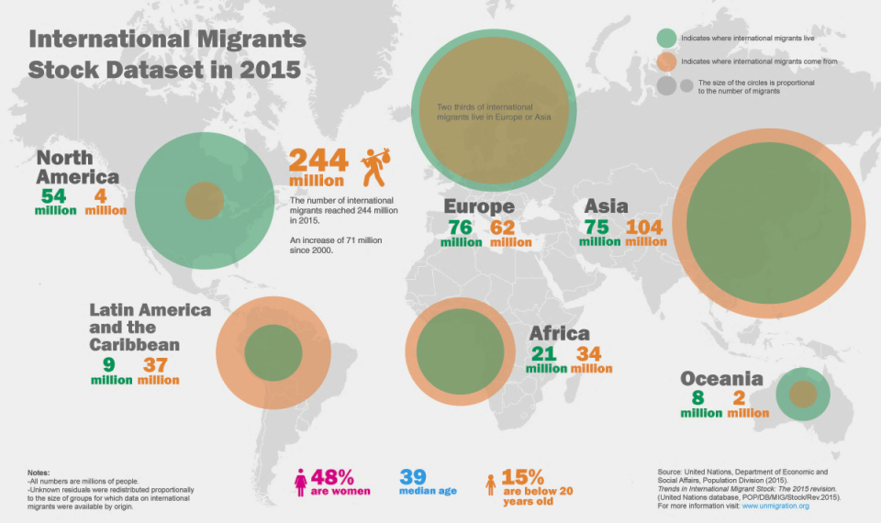
Where do they go and where do they come from?
Notes:
First some context, migration is mega-trend of the 21st Century now represents unprecedented human mobility, with one of every seven people worldwide living or working somewhere other than their place of birth.
where are the 244 IM ? Most are in Asia.Orange number of migrants o emigrating. Green is number of people immigrating.
After India, mexico sees the biggest number of emigrants
Biggest migration corridor by FAR is between Mexico and the USA.
The most important challenge we face today, however, lies not in the numbers, but in the fact that policies have not kept pace with the realities and drivers of human mobility, such as disparities, the unprecedented number of crises, demographic trends, skill shortages, and. This increasingly visible crisis of the humanitarian and solidarity system as well as integration strategies and management of diversity in societies, calls for a new way of thinking about what development is , including within the health sector. This is why we are all here today.

Slide 4
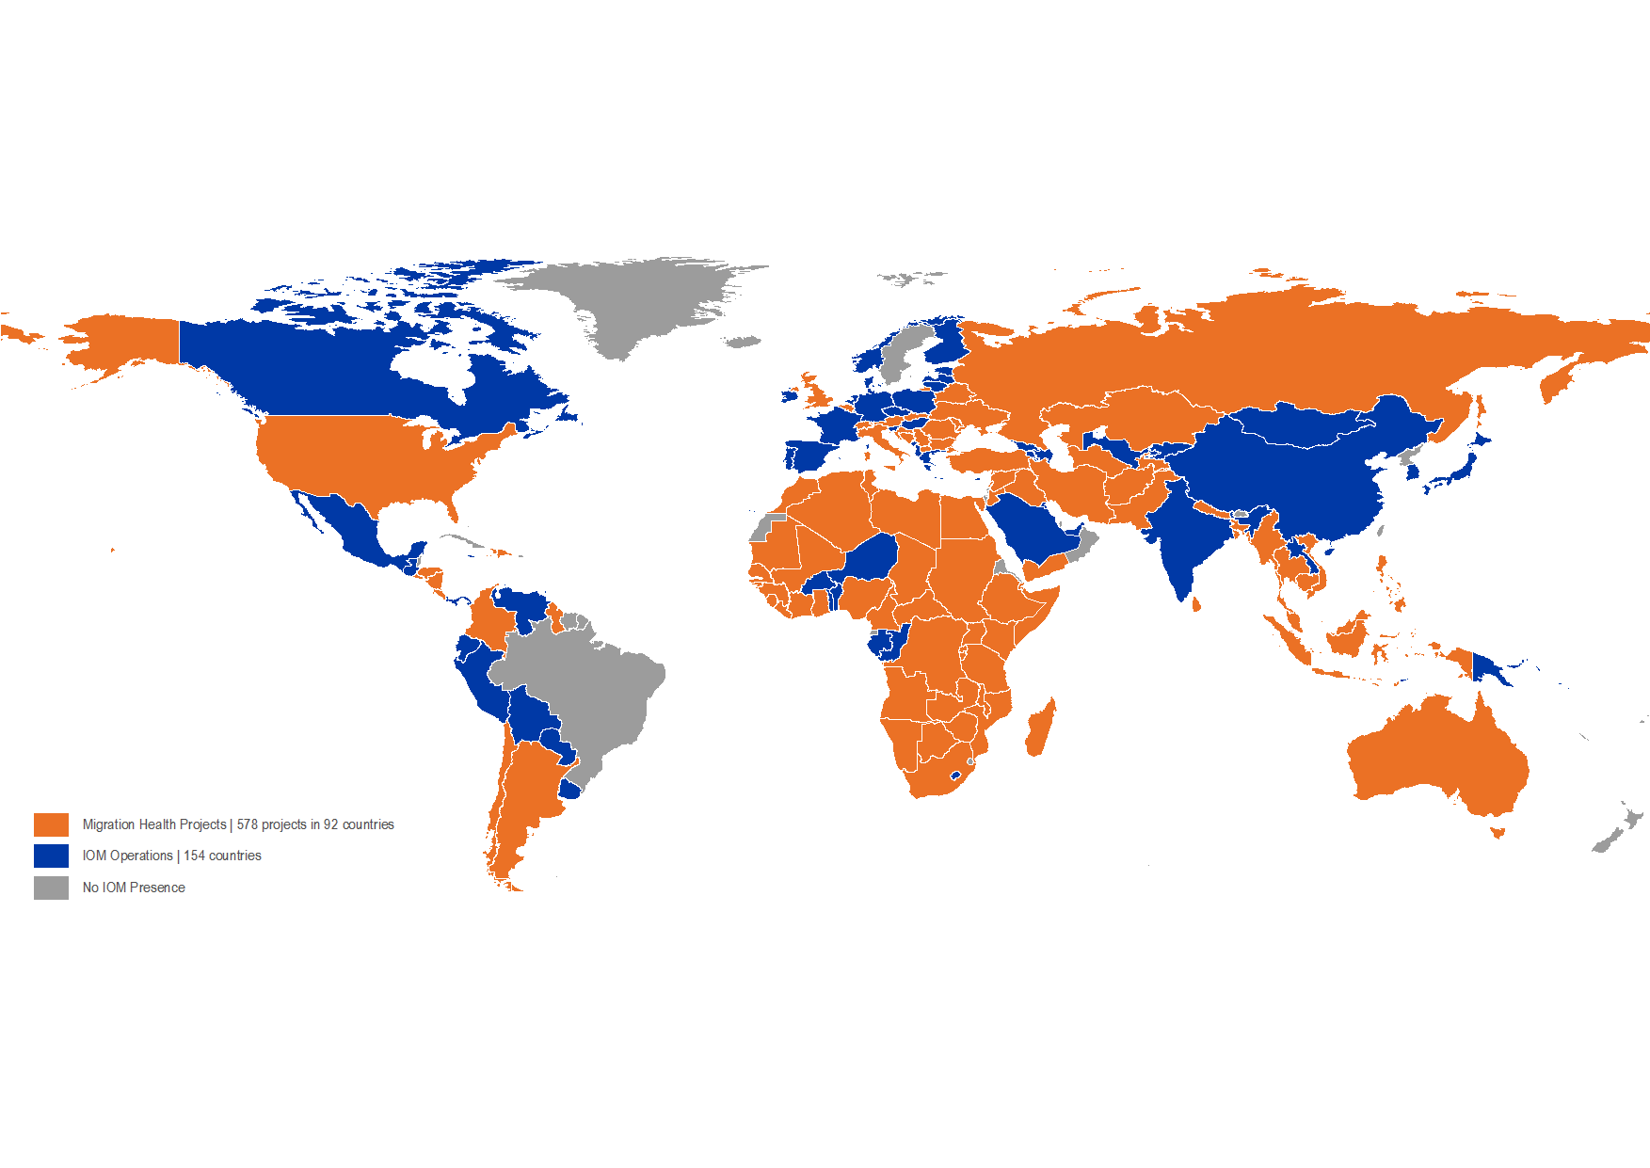
IOM MHD global presence
Notes:
>1000 staff
>60 countries
Orange countries: MHD activitities/ blue is where IOM is active
Medical activities in the IOM constitution (1951)
Migrant health cuts accross the different areas of work of the Organization (resettlement, CT, AVR, emergencies etc).
Aim to Deliver equitable health services for all
Build capacity among partners on health issues associated with migration and population mobility.
Within its Migration Health Division (MHD), the International Organization for Migration (IOM) delivers and promotes comprehensive, preventive and curative health programmes which are beneficial, accessible, and equitable for migrants and mobile populations. Bridging the needs of both migrants , host communities and IOM’s member states, MHD contributes towards the physical, mental and social well-being of migrants, enabling them and host communities to achieve social and economic development.
Build capacity among partners on health issues associated with migration and population mobility.

Slide 5
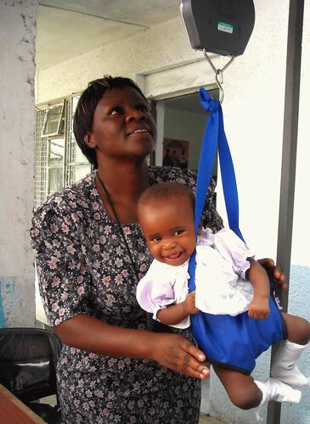

Why we focus on migrant health?
  Migrants are human beings, and have a right to health
  Including migrants in health systems improves public health outcomes
  Healthy migrants contribute to positive development outcomes
  Migrants and mobile populations connect communities and their epidemiological profiles

Slide 6
IOM s Evolution of Migrant Health
2010
GFMD session on Migrant Health
WHO- IOM Global Consultation, Spain
Cooperative agreement between UNAIDS-IOM
WHO -IOM MOU
WHA Resolution 61.17 on the health of migrants
IOM Council ‘migrant health for the benefit of all’
15 years migrant health expenditures
HIV- TB
Psychosocial
Health assessments
Disasters/crises
Ebola - HBMM
HSS
2010
2008
1999
Notes:
Although IOM is not the only actor in migration and health, our evolution over the past 15 years does illustrate the growth in this domain.
Some major reasons behind this growth ?__HIV/AIDS epidemic was sweeping the globe. The first-hand exposure to the issues linking the HIV/AIDS and migration formed the basis for the Organization’s involvement in the sector. In addtion, TB related programmes (Dx, Rx )gained important interest (e.g. GFATM funding )
-Requests for immigration related health assessments (HA) increased steeply for varying migrant populations: labour migrants, students; more destination countries asked for them and HA became more migrant-centred facilitating pre-departure treatment and prevention
-IOM progressively became a major humanitarian actor, including the health sector. One of the most important areas of activity is the response to public health emergencies with a human mobility component. For instance, the Ebola crisis highlighted the global community’s limited understanding of the links between health and mobility and the lack of targeted outreach health services and surveillance along mobility pathways which undermined the effectiveness of disease control measures,. IOM developed a considerable “health, border and mobility management” programme.,.
- We also witnessed increasing interest in mental health and psychosocial support activities, esp related to crisis.
-Capacity building activities for health and non health sector workers in health matters associated with migration.
All this against Milestones including the MOU w WHO and UNAIDS. WHA resolution: on
the health of migrants
2015: IOM council document ‘Advancing the unfinished agenda of Migrant Health and a HLD on Global Health……2015: MoH Italy HL meeting on migrant health
2016 : Executive Board and WHA agenda item and a special briefing on Migration and Health

Slide 7


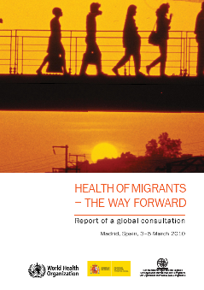
2008 WHA Resolution
2010 Global Consultation, Spain
Operational Framework on Migrants’ Health:
Monitoring Migrant Health
Policy and Legal Frameworks
Migrant-Sensitive Health Systems
Partnerships, Networks and Multi country Frameworks
Notes:
WHA resolution on the health of migrants, was triggered by Portugal during their EU presidency; This resolution asked MS to prmote the health of migrants, migrant sensitive health systems, multi sectoral and international collaboration……..
2 years later, The first Global Consultation , was organized by WHO , in collaboration with IOM and the government of Spain. in 2010 in Madrid.
To: Take stock of concerns by MS & Stakeholders; Reach consensus for an operational framework with priority actions to assist MS and stakeholders in order to implement the WHA resolution. Priority actions were grouped in 4 areas: monitoring…

Slide 8
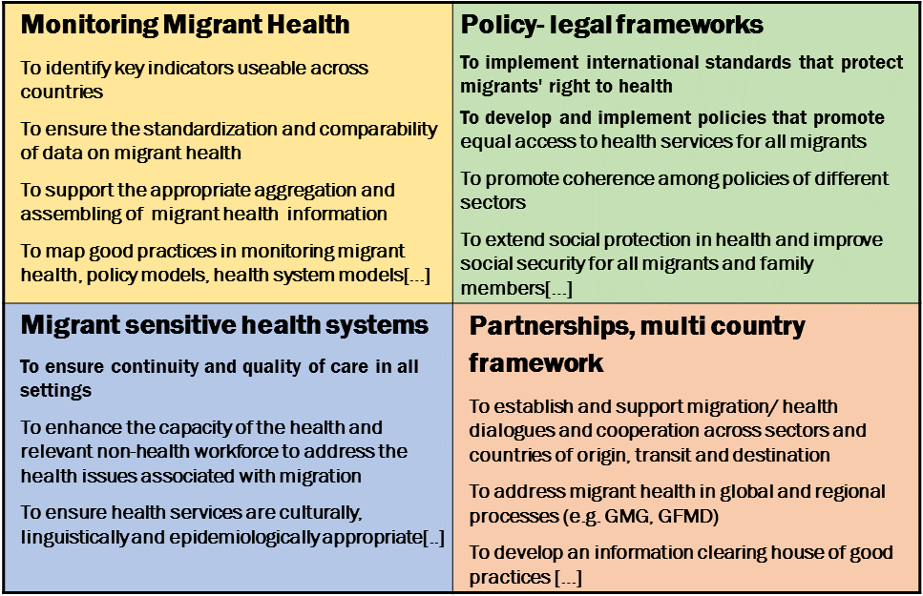

2010 Operational Framework:
what has happened since?
Notes:
Let s take a closer look at the Operational framework, and see what happened since: It has since been adopted by a number of governments and it has been the blue print for IOM programming (Equihealth; PHAMESA Africa)
1- Monitoring: we see more data and important efforts on the indicators front (MIPEX)---the extend to which data have informed policies is another issue though. In fact, policies may even contradict research findings that attempt to guide wise public health policy development
2- on the Policy and legal frameworks level: esp countries of labour migrant origin made relevant progress. (PH, TH , S Lanka, B desh, L america) Health financing models, for instance in the form of insurances continue to be explored, as a means to protect outgoing nationals. These countries may depend heavily on remittances; focal points in MoH to coordinate among ministries; Governments of Thailand and Sri Lanka, both of undertook policy reform to provide more equitable and accessible health services for migrants, regardless of their legal status in the country ; Mexico specifically attempts to target their 12 million workers in the United States through a Comprehensive Health Care Strategy, including low cost insurance for their family members back home. Consulates in the USA provide health information and triage (windows of health). Argentina, host to half of South America's migrant population, adopted universal access to all migrants, regardless of their legal status. Spain and Portugal have similar arrangements.. (Sounds promising but there are many proven limitations to these systems. Limitations: many go through informal channels without compulsory insurance and economic crisis lead to reduction of benefits for migrnts)
3 on the Health systems level: Capacity building of health and non health actors; cultural competence has been widely promoted and tools developed and financially supported
4- Partnerships: RCP: especially Regional dialogues on labour migration and health have evolved , examples include ASEAN, Colombo process, GFMD 2010 agenda item Mexico; we saw more Regional health programming (GFATM as well)- .The Ibero american multilateral agreement on social security is a pioneering initiative to guarantee the right of Ibero American migrant workers and their families to obtain contributory pensions for old age, disability, and work related accidents, within the Ibero american community. (This legal instrument would allow over 4. 5 million migrant workers to enjoy the portability of social security benefits. Health benefits are only in part addressed in the current agreement and is limited to accidents at the workplace and work related illness and disability..)
Bi national health week ! Largest mh network i m aware of.
These are good examples

Slide 9
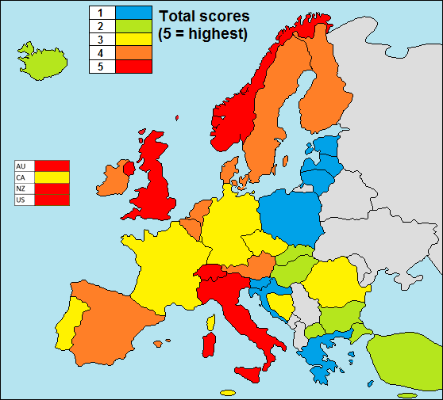
Monitoring: health services for migrants
Map showing total scores on the MIPEX health strand, 2016
www.mipex.eu
http://members.costadapt.eu/images/7/73/MIPEX_July.pdf
Notes:
The MIPEX Health strand is a questionnaire designed to supplement the existing seven strands of the ‘Migrant Integration Policy Index’, which in its latest edition (2015) monitors policies affecting migrant integration in 38 different countries. (The Health strand questionnaire is based on the Recommendations on Mobility, migration and access to health care which were based on a consultation process which lasted two years and involved researchers, IGOs, NGOs and a wide range of specialists in health care for migrants). The questionnaire including over 160 indicators, measures the equitability of policies relating to four issues: (A) Migrants’ entitlements to health services; (B) Accessibility of health services for migrants; (C) Responsiveness to migrants’ needs; and (D) Measures to achieve change . The project is a EC funded collaboration of the IOM, in collaboration with the Migrant Policy Group (MPG) and COST Action IS1103 (‘Adapting European health services to diversity’).
(High scores are obtained by non-European countries – with the exception of CA, where the government that was removed from office by the voters in 2015 weakened many ‘migrant-friendly’ measures. The wealthy EFTA countries CH and NO also occupy top positions. Perhaps because of its remote geographical position, EFTA country Iceland is not well adapted to the needs of migrants.)

Slide 10
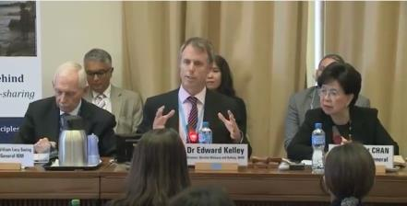
What has happened since ?
Systematic discrimination: millions of migrants have restricted access to health services
Lack of emphasis on migration health in global health initiatives and global policies,
Lack of policy coordination and leadership ‘to do the right thing’
Lack of consideration of research data for policy and planning
Only 1 country reported back to the WHA on its progress towards the WHA 61.17 implementation
World Humanitarian Summit: global health ‘leaving no one behind’ (May)
69th WHO WHA: migrant health on the agenda; Technical Briefing on migration and health:
Sustainable development and migration and, Large-scale displacement (May)
106th IOM Council- HL panel on migrant health incl. Invitation of Sri Lanka to host 2nd Global Consultation (November)
138th WHO EB migrant health on the agenda (January)
2030 agenda and SDG (10.7)- UHC; People centred health systems- ‘Leaving no one behind’ (September)
2016
2015
Notes:
But Lets be frank, despite the positive developments mentioned, Millions of migrants are still denied access to health care and remain invisible to global health initiatives; --a lack of coordinated policies prevents the achievement of their right to health; --a lack of leadership makes their voices unheard; --a lack of data impedes the monitoring of health parameters;-- and internal and cross-border human mobility is insufficiently understood and addressed within surveillance and response mechanisms. A recent study by IOM revealed that migrants and other mobile population groups have not been included in National, Regional and Global Pandemic Preparedness Plans in 27 countries within the Asia-Pacific region.
--1 cntry only reported back to the WHA on the 2008 Resolution -showing lack of accountability
All this against a 2030 agenda and sweeping concepts like UHC, people centred health systems and leaving no one behind. These concepts are only real if all people incl migrants are accounted for.
--the 2015 IOM council and 2016 EB of WHO (Italy) and last WHA had dedicated sessions on MH--IOM Director General William Lacy Swing participated the WHA, alongside WHO Director General Margaret Chan, Ministers of Health from several Member States and close partners. This was the first time the World Health Assembly organized a Technical Briefing on Migration and Health. It conclusions reiterated previous recommendations such as solutions require multisectoral partnership-based and system-wide approaches. Solutions along the continuum of human mobility –– require the support of intercountry diplomacy . In the absence of solutions, the health needs of migrants, and host communities are unmet, with economic, social, health security and public health consequences at significant cost to both migrants and societies.

Slide 11
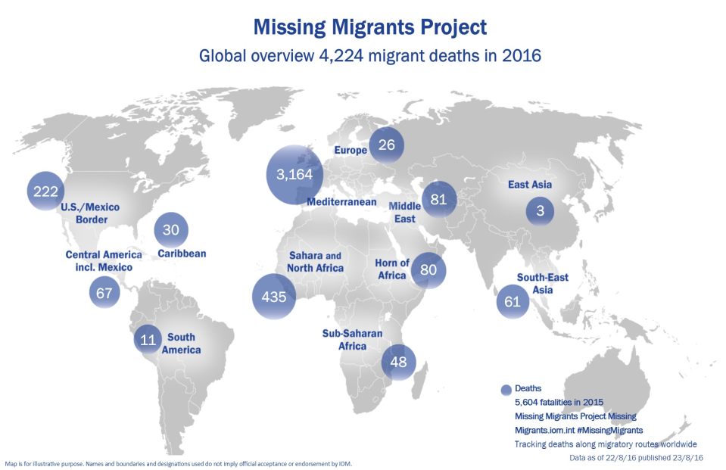
Dangerous migration routes 2016
Notes:
Meanwhile dangerous migration routes continue and shift. ….at the moment, the most dangerous destination for ‘non orderly’ migration in the world is Europe- this shows the sad IOM Project which counts deaths and missing migrants en route.

Slide 12
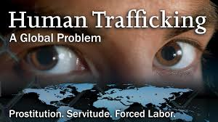

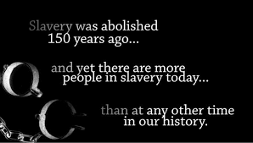
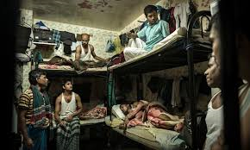
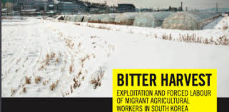
Dangerous migration trends
Forced displacement and irregular migration
Omni present exploitation, abuse, discrimination –slavery
Widely used detention practices
Deportation on health grounds
Notes:
IOM always says that migration in and of itself is not a risk to health but the circumstances surrounding the migration process can render people vulnerable to health risks. Trends to worry about in particular include:
--Increasing forced mgration and irregular migration flows. Those whose health is at most risk, have the least access to health services, esp IM s.
--Slavery is omnipresent: _ think of the B deshis, nepalese, and of course central and south americans , working and living in wealthier parts of the world under unbearable conditions,
--Detention practices from guantanamo till manus island in the S Pacific
--Deportation based on health grounds, incl HIV, TB and pregnancy are still widely practiced.
This is the reality of million migrants looking to better their lives and those of their families.

Slide 13
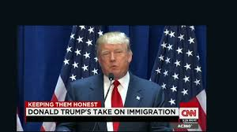
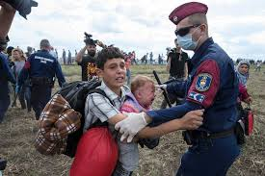
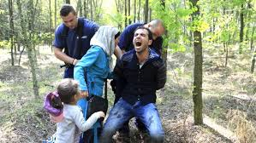
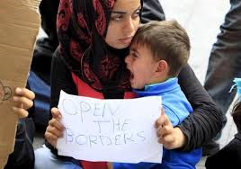

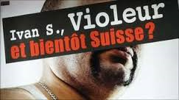
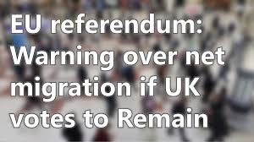
Changing the toxic migration narrative
Notes:
Our biggest challenge no matter what we do in this domain , is to change the public discourse on migration , which is toxic. As long as this trends moves on, efforts to progress in our domain , are in vain.

Slide 14
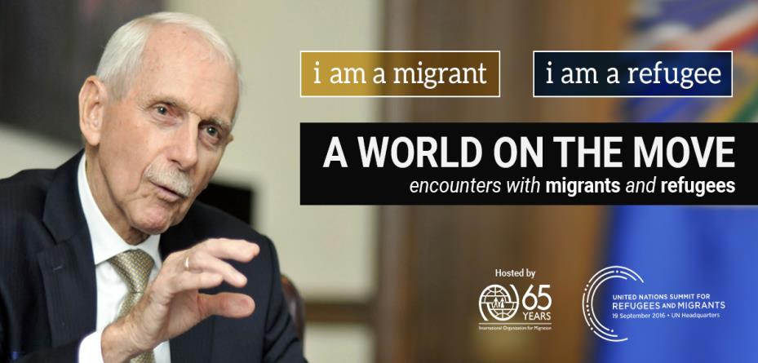
Changing perceptions
Notes:
In partnership with facebook IOM runs a Campaign to change perceptions and raise awareness

Slide 15
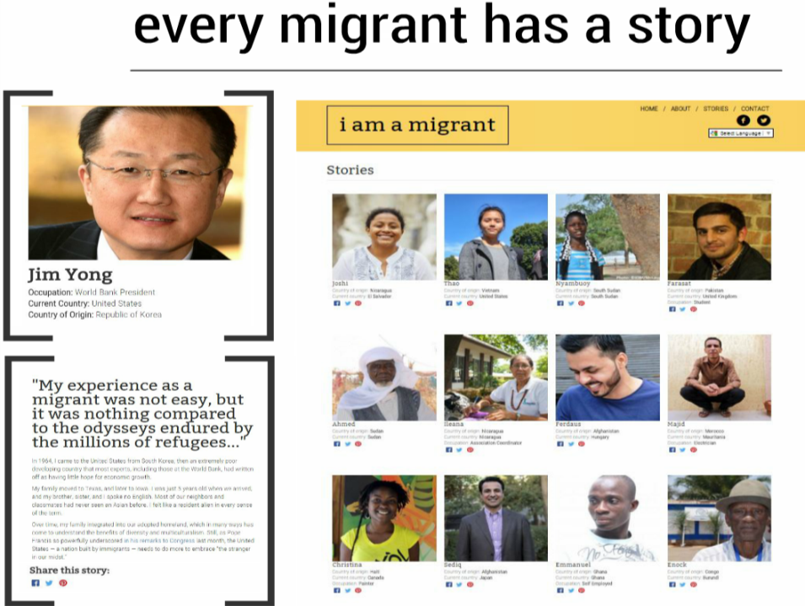
Notes:
Which tells the story of Refugees,, econom migrants, diaspora, students who share their stories and Give a hUMAN face to migrants and change perceptions . Also Jim Yong of the WB did.

Slide 16
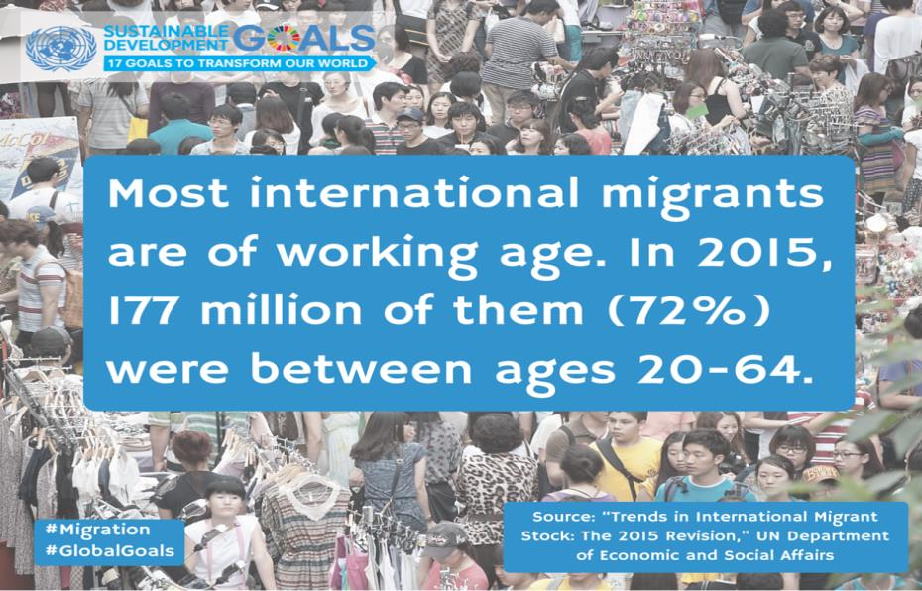
Migrants and the economy
Notes:
We cannot talk about migrant health without mentioning the discourse on migrants and the economy
When talking about migration we talk about the world of work

Slide 17
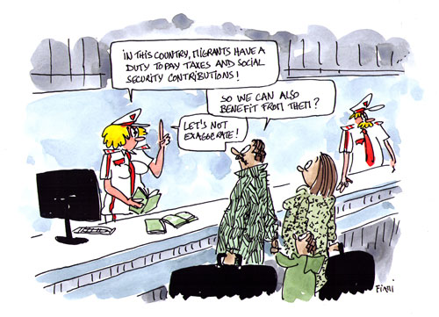
Migrants and the economy
Migrants contribute to economies and development
Migrants contribute more in taxes and social contributions than they receive in benefits
Image: ILO/OHCHR, 2013.
Notes:
Yet, The argument of States to restrict access to health services is often: high costs. No matter the existing proof and data that PHC , prevention are the cheapest….migrant health is still often thought of as unaffordable by many states.

Slide 18
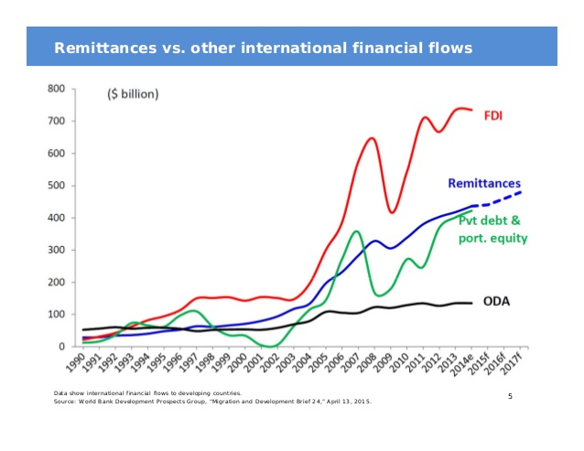
Migrants and the economy
Source: World Bank Development Prospects Group, “Migration and Development Brief 24,” April 13, 2015.
Notes:
Migrants send more than 500 BILLION USD home/year !!
Worldbank:
“At more than three times the size of development aid, international migrants’ remittances provide a lifeline for millions of households in developing countries…” (Dilip Ratha).
The United States was the largest remittance source country, with an estimated $56 billion in outward flows in 2014, followed by Saudi Arabia ($37 billion), and Russia ($33 billion).
India was the largest remittance receiving country, with an estimated $72 billion in 2015, followed by China ($64 billion), the Philippines ($30 billion) and Mexico (25.7 B)
The by far top remittance corridor was USA-Mexico with 25.2 Bin 2015 compared to the second biggest USA- China of only 16 B

Slide 19
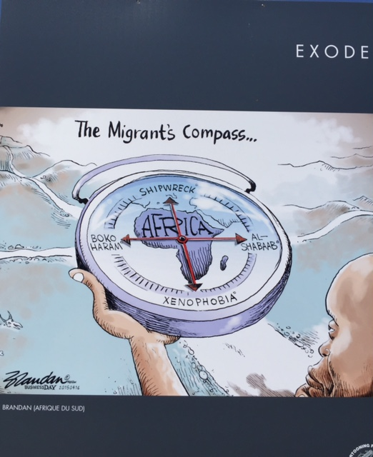
Where are we heading ?

Slide 20
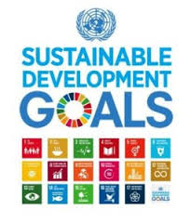


Agenda 2030
3.8 Achieve universal health coverage, including financial risk protection, access to quality essential health-care services and access to safe, effective, quality and affordable essential medicines and vaccines for all
LEAVE NO ONE BEHIND !
Notes:
Here is were we need to go

Slide 21










Tracing Migrant Health in the SDGs
Migration Health in Goals and Targets
Migration Health in the Goals and Targets
1.1: ERADICATE EXTREME POVERTY
1.15: RESILIENCE TO CLIMATE EVENTS & ECONOMIC, SOCIAL, & ENVIRONMENTAL SHOCKS
2.1-2: END HUNGER, MALNUTRITION
3.8: UNIVERSAL HEALTH COVERAGE
3.d: STENGTHEN CAPACITIES FOR EARLY WARNING IN GLOBAL HEALTH RISKS
5.2: TRAFFICKING (WOMEN AND GIRLS)
5.6: UNIVERSAL ACCESS TO SEXUAL AND REPRODUCTIVE RIGHTS
6.1: UNIVERSAL ACCESS TO DRINKING WATER
6.2: UNIVERSAL ACCESS TO SANITATION AND HYGIENE
8.7: TRAFFICKING
8.8: PROJECT LABOUR RIGHTS OF MIGRANT WORKERS (MIGRANT WOMEN)
10.7: PLANNED AND WELL-MANAGED MIGRATION POLICY
11.1 ACCESS TO SAFE HOUSING
11.5: REDUCE DEATHS & NUMBER OF PEOPLE AFFECTED BY DIASTERS
16.1: REDUCE ALL FORMS OF VIOLENCE
16.2: TRAFFICKING (CHILDREN)
17.16: ENHANCE GLOBAL PARTNERSHIPS
17.18: DATA DISAGGREGATED BY MIGRATORY STATUS
Notes:
It is now widely acknowledged that migration carries a development potential, owing to migrants’ intellectual, cultural, social and financial capital and their active participation in societies of origin and destination. Nevertheless, discussions of the health and well-being of migrants had not yet gained much momentum in relevant global debates, such as the 2006 and 2013 United Nations High-level Dialogue on International Migration and Development .
The good news is that The 2030 Agenda refers to migrants or migration in some of the targets in the SDGs
No longer is human mobility seen as just background context for development, or worse merely seen as a consequence of lack of development. migration is an issue to act upon to enhance sustainable development . We may have an opportunity here !

Slide 22
Migration is an enabler for development, if:
Public pereceptions of migrants are improved
migration in crisis situations is managed
human rights of all migrants are protected
Enhance access to health
Migrants’ well-being
policy coherence and institutional development is promoted
Migration is factored into development planning
Address the SDH
evidence building and knowledge-based policy-making is enhanced
IOM, UNGA HLD, 2013
Notes:
This concept is based on IOM’s policy recommendations to the 2013 UNGA HLD : migration is an enabler for development if two crucial actions are taken :
Enhance access for migrants to health promotion, prevention, and care, and
Address the social determinants for health for migrants, i.e. The conditions in which they work, live and travel. Doing this will mean:
1. Public perceptions of migrants are improved– will reduce marginalization and improve access
2. Human rights of all migrants are protected – only then, we can truly talk about INCLUSIVE development, and talk about human-rights- and people-centred development is not merely cheap talk (1 bio migrants!)
3. Migration is factored into development planning
4. Evidence building and knowledge-based policy-making is enhanced – to increase knowledge about factors that determine migrants’ health, and how to address them
5. Policy coherence and institutional development is promoted – e.g. coherence between health and migration policies. A first step is that colleagues from different ministries talk to each other, which is great to see at this event today.
6. Migration in crisis situations is better managed

Slide 23
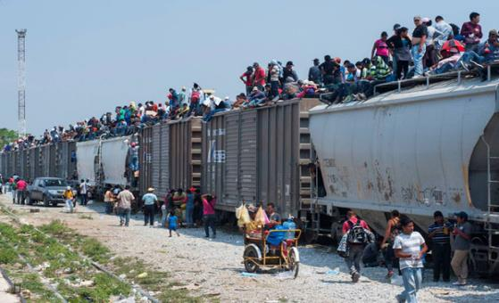
Migration: A Crucial Force for Development and Global Integration
“The evolution of humanity has been shaped around the migration of people between regions and continents”, writes Mexican President Enrique Pena Nieto in a blog for the Huffington Post, Sept 2016.
Notes:
A very recent quote of relevance from the president of mexico

Slide 24



Opportunities: Regional dialogues
Regional Conference on Migration
Migration Health Workshop
September 28 - 29, 2016
Crowne Plaza Hotel
San Jose, Costa Rica
Notes:
Let s focus on opportunities: This year has shown important regional level attention . Not only in the health domain through the RCM of WHO (in SEARO, EURO, PAHO RCMS have migrant health on the agenda). Also in the migration sector we see good initiative such as todays event

Slide 25
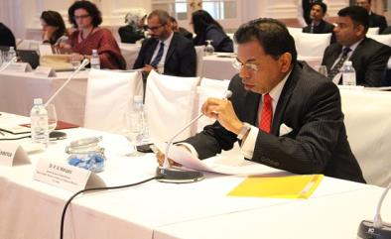
Opportunities: Regional dialogues
Fifth Ministerial Consultation on Overseas Employment and Contractual Labour for Countries of Origin in Asia (Colombo Process)
25th August 2016, Colombo, Sri Lanka
Colombo Process Ministerial Declaration:
“…To consider the inclusion of Migrant Health as a new thematic priority for the CP…”
Notes:
Meanwhile , On the other side of the globe
The ColomboProcess ministerial declaration includes a recommendation to consider the inclusion of Migrant Health as a new thematic priority for the CP, given the importance of the health of migrant workers throughout the migration cycle to reduce long-term economic and social costs, and the acknowledgement of the right to healthcare for migrant workers by the 26th Session (26/21) and 29th HRC Session (29/2) of the Human Rights Council and the stipulation in the SDGs of access to universal health coverage.

Slide 26




2nd Global Consultation on Migrant Health:
Resetting the Agenda
Jointly Organized by IOM, WHO and the Government of the Democratic Socialist Republic of Sri Lanka
Colombo, Sri Lanka | February 2017
Opportunities: Global Dialogues
Notes:
At global level, IOM and WHO are co organizing 2nd GC following the offer of the president of S L during the IOM Council and WHA
Objectives:
-To share lessons learned, good practices and research in addressing the health needs of migrants since the adoption of the 2008 WHA Resolution,
-To reach consensus on key policy strategies for a unified agenda across regions;
-To engage multi-sectoral partners at policy level for a sustained international dialogue and an enabling policy environment for change.
Some 100 Participants will be invited across sectors and regions.
(Expected outcomes
A Report on the Consultation to be presented to the IOM Council and the 140th Session of WHO Executive Board;
An agreed upon ‘Accountability Framework’, based on the 2010 Madrid ‘Operational Framework’, including a set of indicators to also be considered within a possible new WHA Resolution on the health of migrants, within relevant SDGs, and in line with the priorities as outlined in WHA 69/27 report ‘Promoting the health of migrants’;
A common roadmap towards research and policy dialogue milestones 2016-2018;
Elements for the establishment of an international network of expertise on - provide leadership, technical guidance, mobilize expertise, document and share information and best practices)

Slide 27
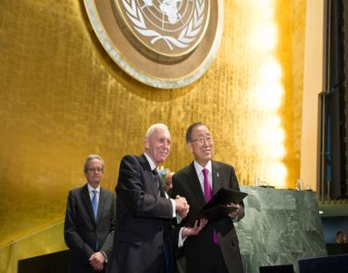
September 2016: UNGA High Level meeting to
Address Large Movements of Refugees and Migrants
Build a greater consensus on managing the world’s movements of migrants and refugees
New York Declaration for Refugees and Migrants was adopted
Global Compact on safe, regular and orderly migration (2018)
IOM became a UN related Organization
Obama: 50 Countries to Take in 360,000 Refugees this Year , 20 September 2016
"We cannot avert our eyes or turn our backs.
To slam the door in the face of these families would betray our deepest values,"
Notes:
Moreover, The UN Summit on Large Movements of Refugees and Migrants, which took place last week (19/09) in New York, created a unique opportunity for the global community to forge a greater consensus on managing the world’s movements of migrants and refugees.
-The UN Summit adopted a declaration with important commitments to improve the wellbeing of migrants and refugees and recognize their international development role and human rights, it also set in motion a much longer process focused on migration – a 2018 Global Compact on safe, regular and orderly migration that upholds the human rights of migrants and their families, irrespective of migration status. Health however, is only marginally addressed in a fragmented manner.
-signing ceremy: IOM Director General William Lacy Swing and UN Secretary General Ban ki-Moon . IOM became a UN related organization giving the UN for the first time, an explicit migration mandate.
impacts: World Bank announcing the Global Crisis Response Platform offering to low- and middle-income countries hosting refugees access to grants and loans on favourable conditions; the Education Cannot Wait initiative; 50 plus countries committing their resources to do work on the ground… ;
the United States helped to establish the Emergency Resettlement Country Joint Support Mechanism (ERCM) – a IOM and UNHCR– which will provide both financial and technical assistance to countries that are interested in establishing or expanding refugee resettlement programs

Slide 28
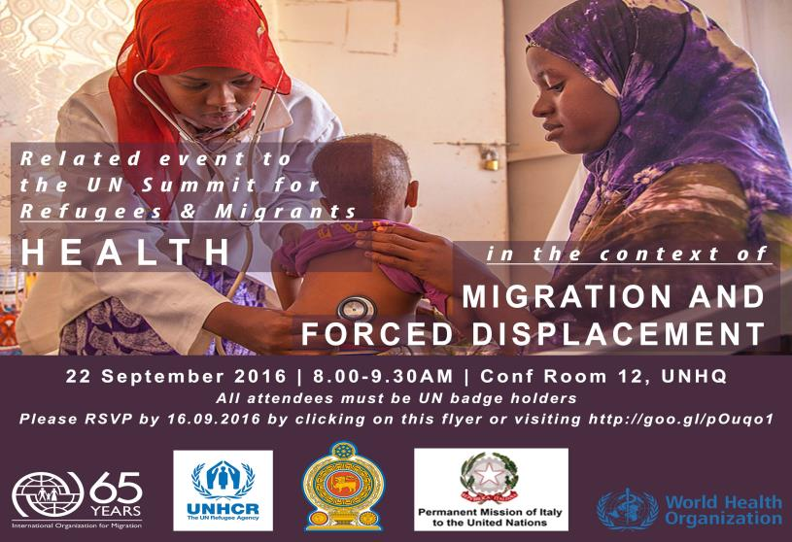
UNGA Side event on
‘health and migration and forced displacement’
Notes:
During the UNGA events a side event on migrant was organized by IOM, UNHCR , WHO and hosted by S Lanka and Italy. The event was the first on migration, human mobility and health at the UNGA.
Outcomes : moving towards integrating refugee health needs into HS , rather than having parallel systems; and from a health financing point of vies, integrating migration health the development agenda, rather than relying on emergency funding.
the UNGA is our chance to ensure the development of a meaningful Global Compact for Safe, Orderly and Regular Migration. This is our unique opportunity to promote the health of migrants and refugees within this framework. Our task is to ensure calls for ‘equitable access to health services without discrimination’ are heard. As fragmented initiatives rarely produce worthwhile results, this is our opportunity for a multi sectoral dialogue and engagement on health , which is essential to reach a unified agenda reconciling acute, crises-driven large scale displacement as well as long term economic and disparity-driven structural migration, and pave the way towards a joint roadmap of key benchmarks and accountability. After all, migration health issues cannot be solved by the health sector alone and migration and health are inextricably linked with other policies on development, labour, foreign policy, security, the environment, and so on.
-- interesting quote :-The health sector is the frontline of service delivery, but at the same time it is the weakest sector in advocacy,” said Dr. Ranieri Guerra, Director General of Preventive Health and Chief Medical Officer at the Italian Ministry of Health.

Slide 29
The way forward
Sustainable Development
Agenda
Global Consultation on Migrant Health (February)
9th GFMD (December)
IOM 107th Council (December)
Puebla Process (September)
World Health Summit, Migration and Refugee Health (October)
71 st UNGA HL Meeting (Sept): Large Movements of Refugees & Migrants
The Colombo Process (August)
2030
More consistent and targetted engagement
  Coordinated and comprehensive multi-sectoral response across regions
Reference platform and mechanism for consultation and partnership
  To provide leadership, technical guidance, mobilize expertise, resources and share information and best practices
Common Roadmap and Unified agenda
  Reconciling large scale displacement-structural disparity-driven migration migration
2017
2016
Notes:
To achieve the global health initiatives and development goals, like UHC, and see migrant health mainstreamed in national Hs, we need to see more consistent and targeted engagement; a reference platform for partnership .(maybe within the GMG)… Reach a unified agenda across regions on the health of migrants, reconciling acute large scale displacement as well as long term economic and disparity-driven structural migration, reconciling mandates of different agencies and different sectors; and to pave the way towards a possible roadmap of key benchmarks within both health as well as migration processes – incl RCPc like Colombo process , the Puebla proces, the UNGA (including the 2018 COMPACT), 2nd Global Consultation, Global meetings such as the GFMD …all the way to 2030

Slide 30
Future considerations and next steps :
lessons learned and priorities
Monitoring Migrant Health
Policy and Legal Frameworks
Migrant-Sensitive Health Systems
Partnerships, Networks and Multi country Frameworks
Notes:
bearing in mind the recent dialogues….

Slide 31
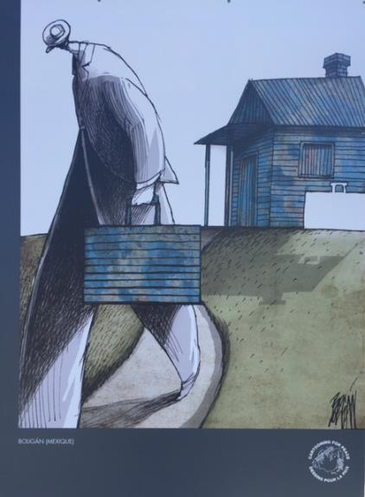

    Migration is….
    Inevitable – demographics & disasters
    Necessary – development
    Desirable – if well-governed
  “Migration is not a problem to be solved, but a reality to be managed”
  W.L. Swing
Notes:
Migration is a fact of life and part of human nature.
Migration is not a problem….
Thanking the many partners with whom IOM has collaborated and made progress. We look forward to continue our collaboration

