Slide 1

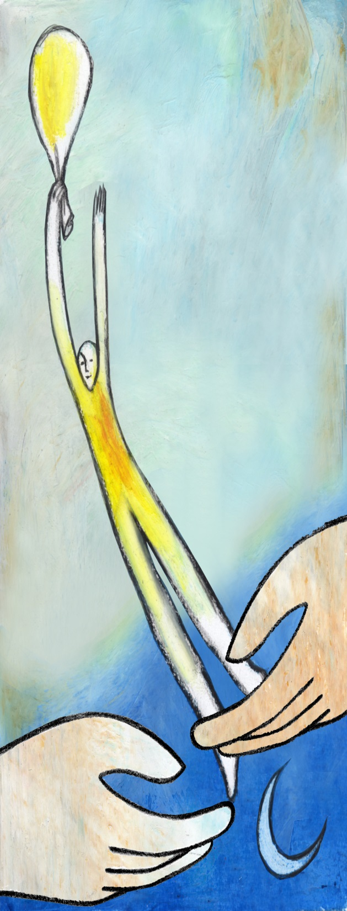
Regional Consultation Groupo on Migration
Honduras, November 16th de 2016
Manual for the Elaboration of Migration Policies on the Reintegration of Returned Migrants

Slide 2
Progress of the RCM on reintegration of returned persons

Slide 3
2012 Regional Seminar on Policies for the Integration of Immigrants, Refugees and Returned Migrants.
MODULE I
Political and cultural challenges for States in the processes of integration of immigrants, returnees and refugees.
MODULE II
Integration programs.
Strengths and limitations of reception policies for the reception of refugees.
Integration of returned migrants to their countries of origin.
MODULE III
Research as a starting point for the improvement of services,
Policies and programs in the area of social integration
MODULE IV
International cooperation programs to assist States in
the implementation of resettlement of returned migrants and integration of immigrants and refugees in the Member Countries of the RCM.

Slide 4
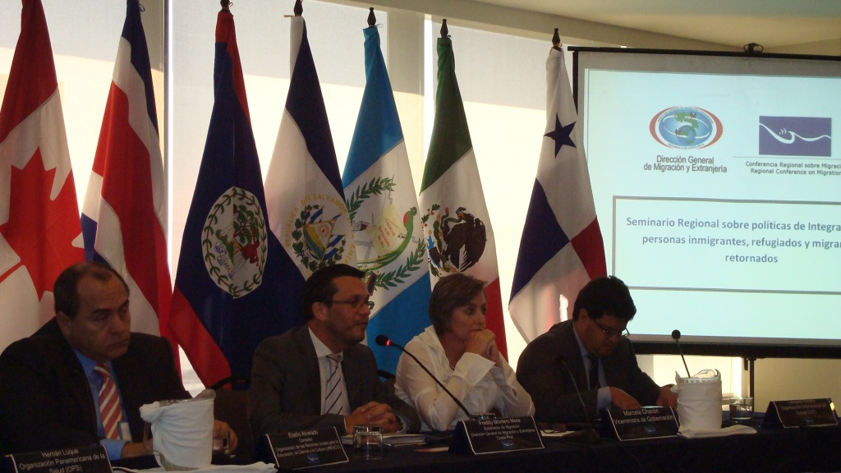

Slide 5
2013 Regional Workshop on Policies, Practices and Conclusions for the Return, Reintegration and Integration of Migrants.
Deepen on return flows and its implications for countries receiving returnees nationals.
Exchange experiences on integration, return and reintegration initiatives that allow the creation of public policies on these issues.
3. Develop a document of basic principles that guide the regional and national action on the return, reintegration and integration of migrants.

Slide 6


Slide 7
2015 MEETING OF THE REGIONAL CONSULTATION GROUP ON MIGRATION OF THE RCM. (RCGM) Mexico City, Mexico.
Thank IOM for presenting a proposal for a Manual for the Development of Migration Policies on the reintegration of returnees, as a valuable contribution to the work and commitments on the central theme of the XXth Vice-Ministerial Meeting of the Conference.
2016 MEETING OF THE REGIONAL CONSULTATION GROUP ON MIGRATION OF THE RCM. (RCGM).Tegucigalpa, Honduras. June 2016
Thank IOM for the presentation of the Manual for the Development of Migration Policies on the Reintegration of Returned Migrants requesting that this document be sent to the Technical Secretariat, so it sends it to the Member Countries for their socialization.
WORKSHOP ON REINTEGRATION. Tegucigalpa, Honduras (October)
Participants offered inputs, which were incorporated and translated into both languages for the consideration of this group.

Slide 8
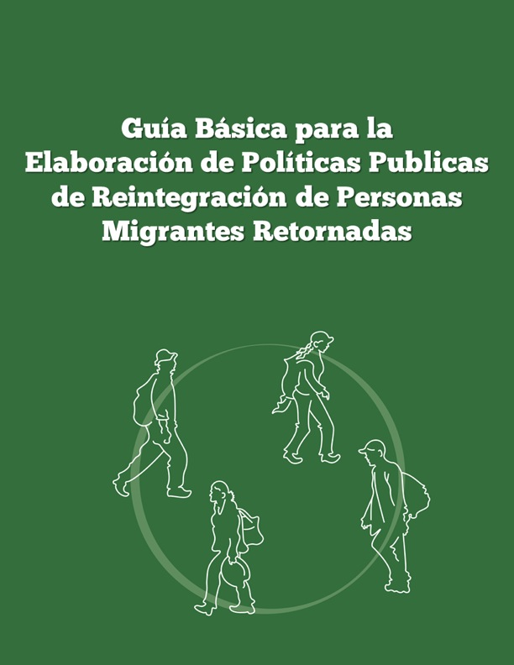
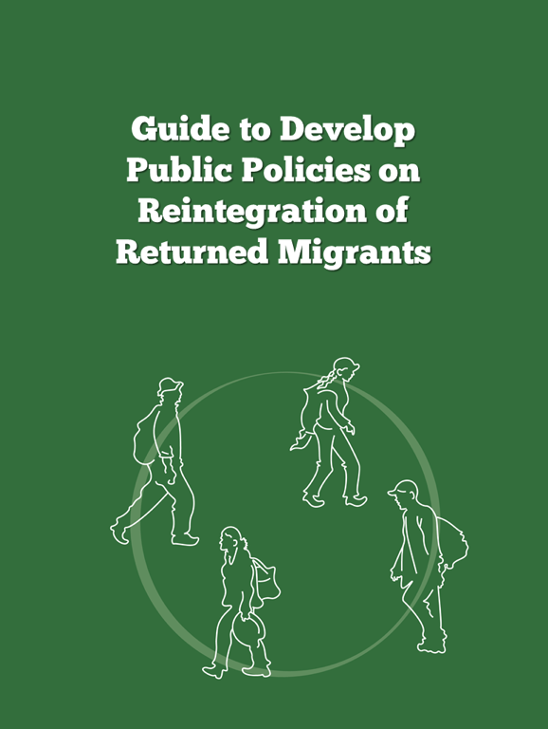
Updated document on reintegration policies

