Slide 1

CHILD PROTECTION OFFICERS
Nombre de la Presentación

Slide 2
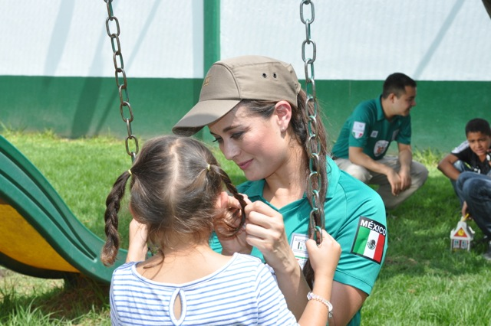
DISTRIBUTION
Federal Delegation | Total
1. Aguascalientes | 5
2. Baja California | 20
3. Baja California Sur | 4
4. Campeche | 7
5. Chiapas | 27
6. Chihuahua | 28
7. Coahuila | 17
8. Colima | 10
9. Distrito Federal | 34
10. Durango | 8
11. Estado de México | 4
12. Jalisco | 10
13. Guanajuato | 10
14. Guerrero | 11
15. Hidalgo | 13
16. Michoacán | 8
General Directorate of Migration Control and Verification | 13
General Directorate for the Protection of Migrants | 2
GENERAL TOTAL
424
Federal Delegation | Total
17. Morelos | 5
18. Nayarit | 1
19. Nuevo León | 15
20. Oaxaca | 21
21. Puebla | 5
22. Querétaro | 6
23. Quintana Roo | 9
24. San Luis Potosí | 7
25. Sinaloa | 9
26. Sonora | 21
27. Tabasco | 26
28. Tamaulipas | 23
29. Tlaxcala | 4
30. Veracruz | 32
31. Yucatán | 6
32. Zacatecas | 3
Note: Based on data provided by the Administrative Liaison Officers of the 32 Federal Delegations of INM.

Slide 3
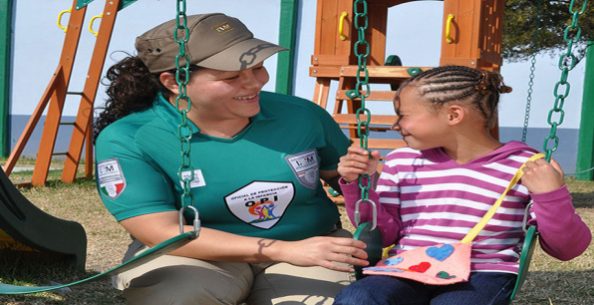
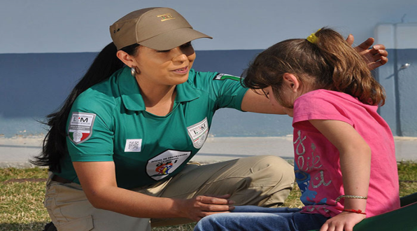
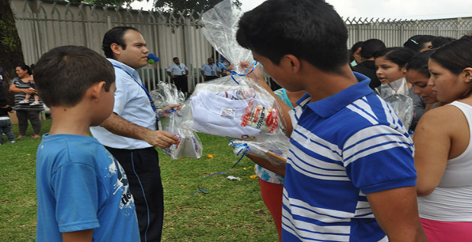
ASSISTANCE PROCEDURE FOR ALIEN UNACCOMPANIED BOYS, GIRLS AND ADOLESCENTS
1
The Child Protection Officer (OPI) interviews the boy, girl or adolescent to identify if he or she entered national territory accompanied by a (blood) relative. If not, the child will be identified as an alien unaccompanied migrant.
.
The OPI informs the boy, girl or adolescent about his or her rights in an appropriate manner according to the development and age of the boy, girl or adolescent.
If no immediate medical care needs are identified, the boy, girl or adolescent will be referred to the closest migration station, where the necessary actions should be taken to protect his or her physical and psychological integrity. The head of the migration station should notify SNDIF to enable the boy, girl or adolescent to receive the necessary assistance as well as access to representation services, legal aid and social counselling.

Slide 4
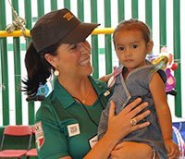
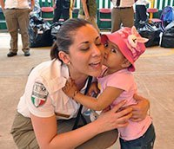
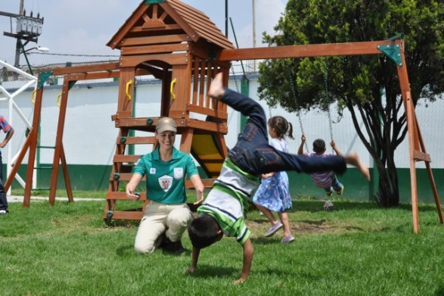
ASSISTANCE PROCEDURE FOR ALIEN UNACCOMPANIED BOYS, GIRLS AND ADOLESCENTS
2
The boy, girl or adolescent will be informed in an age-appropriate manner about the right to apply for refugee status, and the OPI will accompany the alien unaccompanied migrant boy, girl or adolescent if required.
.
.
The situation will be resolved – considering the best interest of the child – through one of the following options: assisted return or applying for refugee status.
.
If transferral is not possible, the boy, girl or adolescent should be sheltered at the migration station, and the OPIs should verify that the necessary conditions are in place to provide assistance to boys, girls or adolescents in vulnerable situations.
For the cases where assisted return is chosen, relevant procedures will be implemented to enable the boy, girl or adolescent to obtain the required identity and travel documents, if necessary; written notice will be given of the definitive exit of the country and the boy, girl or adolescent will be informed about the return procedure, and a diplomatic or consular representative will be contacted.
Finally, the OPI should accompany the unaccompanied alien migrant boy, girl or adolescent to his or her country of origin.

Slide 5
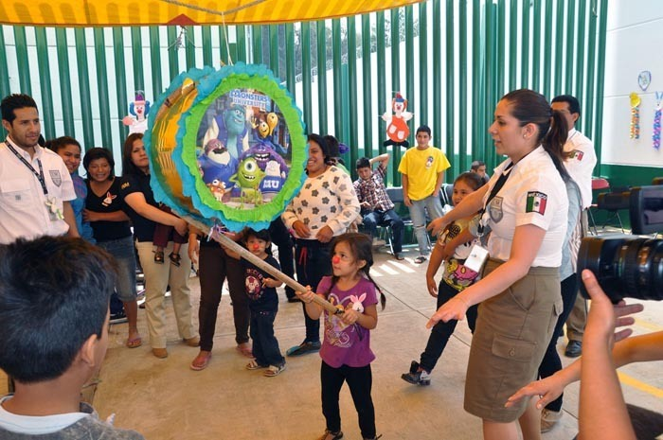
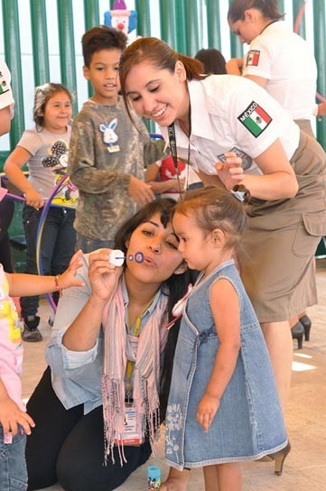
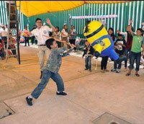
ADDITIONAL ACTIVITIES
The OPIs promote recreational activities each day – games and sports and cultural activities –which are appropriate for the age of each boy, girl or adolescent.

Slide 6

ASSISTED MIGRANT BOYS, GIRLS AND ADOLESCENTS, 2009-2015
BY TRAVEL CONDITION
Condition | 2014 | % | 2015
Accompanied | 12,155 | 52.67% | 10,611
Unaccompanied | 10,923 | 47.33% | 10,098
TOTAL | 23,078 | 100% | 20,709

Slide 7
ASSISTED MIGRANT BOYS, GIRLS AND ADOLESCENTS
BY GENDER
Gender | 2014 | % | 2015
Male | 14,830 | 64.26% | 13,747
Female | 8,248 | 35.74% | 6,962
TOTAL | 23,078 | 100% | 20,709
BY NATIONALITY
Country | 2014 | % | 2015
Honduras | 9,665 | 41.88% | 6,076
Guatemala | 7,936 | 34.39 | 10,056
El Salvador | 4,881 | 21.15% | 4,107
Other | 596 | 2.58% | 470
Total | 23,078 | 100% | 20,709

