Slide 1

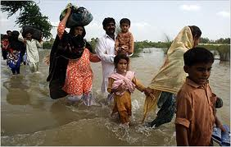
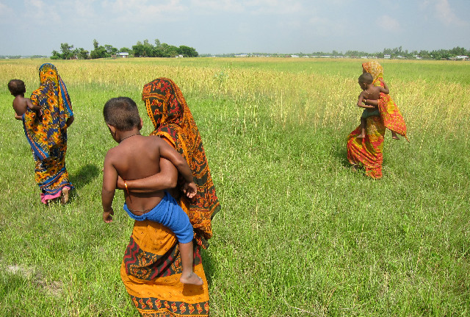
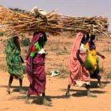



Introduction to the Discussion Paper on Draft Elements of a Guide to Effective Practices
Prof. Walter Kaelin, Envoy of the Chairmanship of the Nansen Initiative
San José, 11 February 2015
The Nansen Initiative is primarily funded by the governments of Norway and Switzerland. The Initiative also benefits from generous funding from the European Commission and Germany .

Slide 2
Purpose
To facilitate the deliberations about possible elements of a Guide on Effective Practices that can assist immigration authorities of RCM participating countries in the application of relevant domestic laws and policies by highlighting effective practices that are mainly drawn from state practice in the RCM region. [para. 2]
Not to create a new set of obligations, or require that new laws be passed, or to extend State obligations under international law [para. 14]

Slide 3
Background
Rich seam of existing law, policies and practices in RCM region on humanitarian protection for aliens in disaster situations [para. 13]
But absence of a principled and agreed approach [para. 11]

Slide 4
Displacement
Three categories of displacement:
  spontaneous or assisted evacuation to avoid the immediate risks posed by natural hazards;
  spontaneous flight during the disaster to escape death or injury;
  a movement to access protection and assistance, such as medical care and shelter. [para. 7]
Secondary movements after being internally displaced or movements as a response to a slow-onset natural hazard or environmental degradation, are predominantly voluntary in nature.[para. 8]

Slide 5
Core Principles
The humanitarian response is non-political in nature, and grounded in respect for fundamental human rights;
The Effective Practices Guide is based on a shared and cooperative approach among RCM States;
The principal emphasis rests on facilitating the favourable exercise of discretion in immigration law;
The Effective Practices Guide is without prejudice to the application of existing international or national law.
Etc. [para. 15]

Slide 6
Situations
Context of rapid-onset disasters caused by natural hazards.
“Disaster” = “A serious disruption of the functioning of a community or a society - involving widespread human, material, economic or environmental losses and impacts which exceeds the ability of the affected community or society to cope using its own resources - which is caused in part or in whole by a sudden and serious natural hazard.” [para. 16]

Slide 7
Beneficiaries
Three categories:
[1] Aliens who are seeking to travel to, enter and/or stay in a foreign country during or in the aftermath of a disaster in their country of origin, or in anticipation of such a disaster, and who:
Face a real risk to their life or safety in their country of origin due to the effects of the disaster; OR
Are otherwise seriously and personally affected by the disaster.
[2] Aliens, whose country of origin is affected by a disaster, and who are seeking non-return and/or stay in a foreign country in which they are already physically present, and who:
a. Face a real risk to their life or safety in their country of origin due to the effects of the disaster; OR
b. Are otherwise seriously and personally affected by the disaster.
[3] Aliens living in, or transiting through, a foreign country and who are affected by a disaster.

Slide 8
Beneficiaries …
[2] Aliens, whose country of origin is affected by a disaster, and who are seeking non-return and/or stay in a foreign country in which they are already physically present, and who:
Face a real risk to their life or safety in their country of origin due to the effects of the disaster; OR
Are otherwise seriously and personally affected by the disaster.
[3] Aliens living in, or transiting through, a foreign country and who are affected by a disaster. [para. 18]

Slide 9
Applicable law
Use of regular migration categories [paras. 21 – 23]
Use of exceptional migration categories [paras. 24 – 25]
[Exceptional] use of refugee and complementary protection categories [para. 25]

Slide 10
Positive use of immigration discretion on humanitarian grounds
Two elements:
Providing for discretion on humanitarian grounds
Exercising discretion on humanitarian grounds [paras. 28 – 30]

Slide 11
Positive use of immigration discretion on humanitarian grounds …
Humanitarian reasons on an individual basis where the relevant person is seriously and personally affected by the disaster:
Victim of the disaster / Survivor but facing extreme hardship in the aftermath of the disaster
Direct and serious impact is consequence of the disaster
Special vulnerabilities to be taken into account
Absence of strong contrary factors (criminality etc.)
Serious impact might result from combination of disaster and other humanitarian factors. [paras. 31 – 37]

Slide 12
Positive use of immigration discretion on humanitarian grounds …
Humanitarian reasons on a group basis in situations of mass-influx [para. 38]

Slide 13
Obligations limiting discretion
Human rights considerations [para. 40]
Child rights considerations [para. 41]
Considerations relating to victims of people-trafficking and –smuggling [para. 42]
Considerations relating to refugee status and complementary protection [para. 43]

Slide 14

Thank you for your attention
www.nanseninitiative.org
The Nansen Initiative is primarily funded by the governments of Norway and Switzerland. The Initiative also benefits from generous funding from the European Union.
The European Commission is the EU’s executive body. “The European Union is made up of 27 Member States who have decided to gradually link together their know-how, resources and destinies. Together, during a period of enlargement of 50 years, they have built a zone of stability, democracy and sustainable development whilst maintaining cultural diversity, tolerance and individual freedoms. The European Union is committed to sharing its achievements and its values with countries and peoples beyond its borders”.

