Slide 1
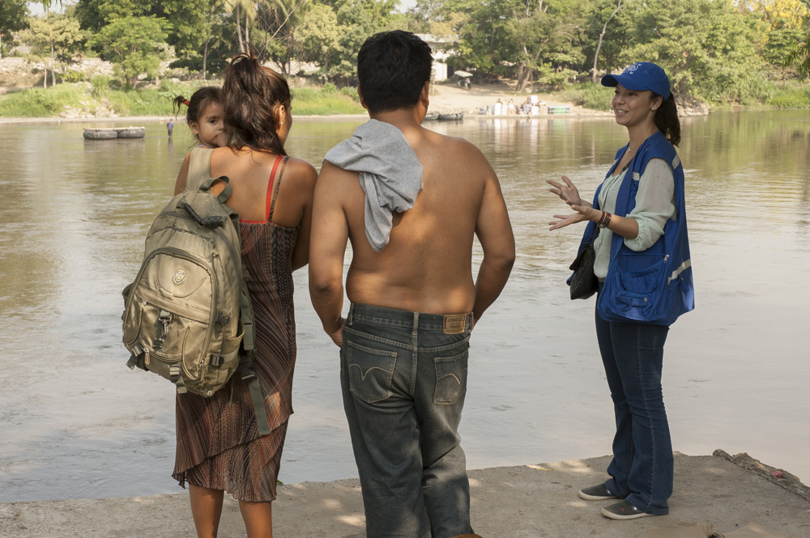

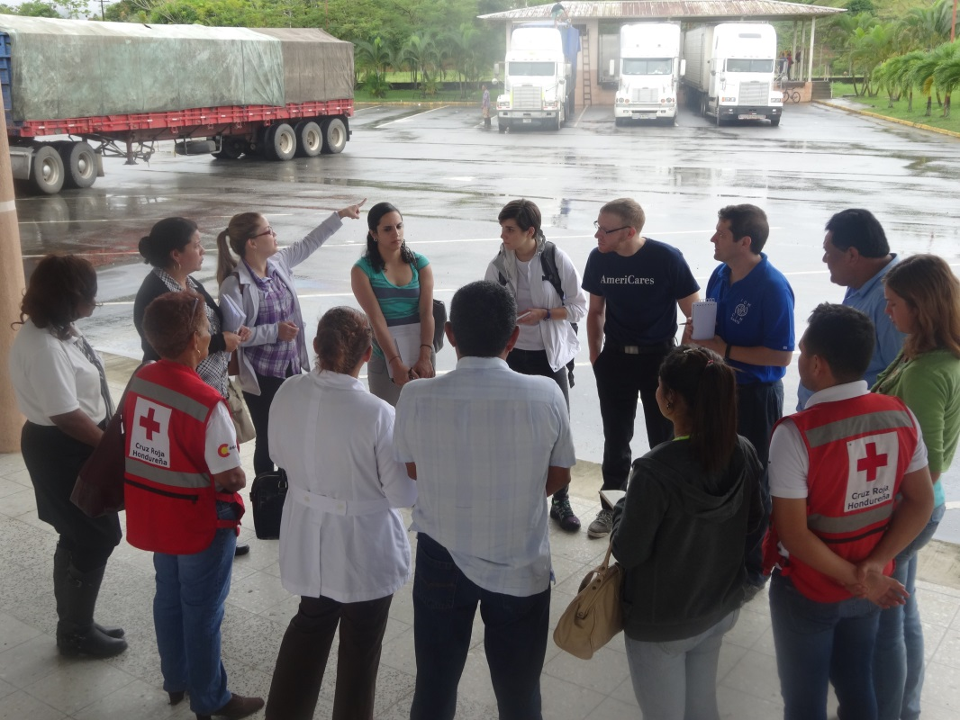
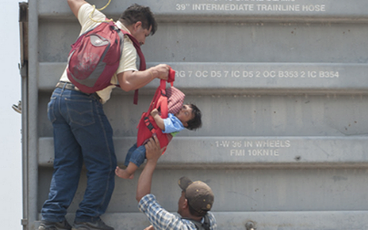
Proposal:
Central American Joint Initiative on the Health of Migrants and their families
Notes:
The

Slide 2
Context
High migration flows
Clandestinity and irregularity
Health Consequences
Response should be:
Multi-sectoral
Multinational
Specialized
Integral
Limited access to health
Articulated and coordinated
Should grant basic health access in the region
Vulnerable groups migrating
Multiple spaces of vulnerability
Structural barriers no route and destination
Stigma and discrimination
Increased vulnerability to disease and disability
Psychosocial consequences
Limited access to services
Family fragmentation
Increased risk to infectious diseases
Consider all the migration cycle
Migration is a Determinant of Health

Slide 3
Implementation of a Central American Joint Initiative on the Health of Migrants and their families
Main objective of the project
Implement a multi-sectoral platform that facilitates access and interchanging of information, as well as coordination and joint programming between government institutions, civil society, the private sector, academia and other stakeholders for the design and implementation of integrated and comprehensive responses regarding the health of migrants.
Technical Level
Joint Leadership
Link
Knowledge Platform

Slide 4
GOVERNMENT INSTITUTIONS
(Multi-sectoral)
JOINT INITIATIVE
*Information
*Coordination
*Link
*Advisory
REGIONAL
ASSOCIATIONS
RCM - COMISCA
CIVIL SOCIETY AND ACADEMIA ORGANIZATIONS
UN AGENCIES, DEVELOPMENT PARTNERS, DONORS

Slide 5
Strategic Objectives
Strategic Objective 1
STRATEGIC INFORMATION
Ensure access to strategic information that informs and promotes decision-making in the programming and inclusive policy formulation for the migration population in the region.
Strategic Objective 2
MULTI-SECTORAL & MULTINATIONAL NETWORKING
Strategic Objective 3
POLICIES AND TECHNICAL SUPPORT
Provide technical support, facilitate and promote legal instruments and regional and national policies to ensure better health conditions of migrants and their families.
Strengthen the multi-sectoral association to link and facilitate the implementation of regional and national strategies specific to the context and needs of migrant populations.

Slide 6
Objective Activities
Strategic Objective 1
STRATEGIC INFORMATION
Strategic Objective 2
MULTI-SECTORAL & MULTINATIONAL NETWORKING
Strategic Objective 3
POLICIES AND TECHNICAL SUPPORT
Biannual meetings of experts and partners
Design and update webpage
Newsletter (2 editions per year)
Development and maintenance of a health and migration information platform
Share links to relevant information , articles and publications at national/regional /global levels
Register and share relevant events
Provide technical advice
Link multi-sectoral and multinational efforts
Ensure compliance with the Annual Work Plan
Report to the Steering Committee
Updated mailing lists

Slide 7
Technical Secretariat:
Initially (1st year of implementation)
International Organization for Migration (IOM) Regional Office
The Steering Committee (main governance structure) consist of representatives from:
• Governments and Regional Associations: Ministries of Health, Migration Offices, COMISCA, RCM, etc.
• Civil Society Organizations: HIVOS, CICR, Jesuit service, Order Scalabriniani, Medicus Mundi, etc.
• UN Agencies: The regional offices of IOM, OPS-OMS, UNICEF, UNFPA, ONUSIDA, PNUD.
• Academia: FLACSO, National Institute of Public Health of Mexico (INSP), Universities.
Partner Organizations
Steering Committee
Secretariat

Slide 8
Implementation of a Central American Joint Initiative on the Health of Migrants and their families
Technical Secretariat:
Provide or suggest expert technical support and strategy to Partner Organizations
Coordinate biannual meetings of experts and the Steering committee
Serve as link between members
Follow up on agreements and Action Plan
Coordinate communications
Maintain and update Knowledge Platform
Develop and update web page, newsletters, contact lists, and events
Other functions will be defined by the Steering Committee
Partner Organizations
Steering Committee
Secretariat

Slide 9
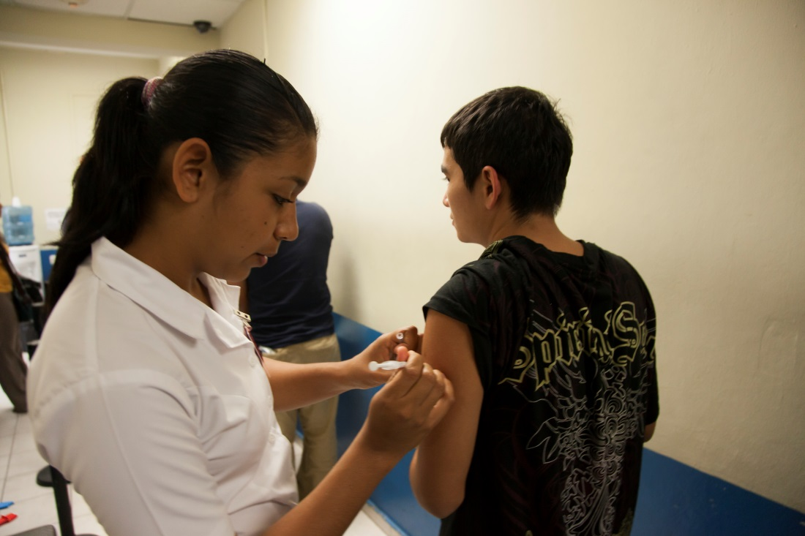
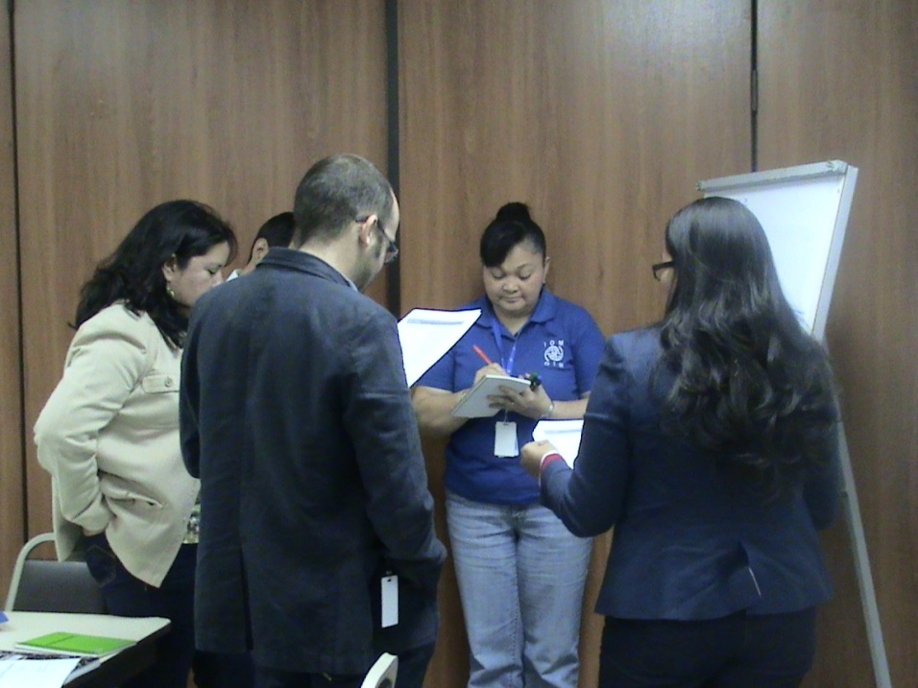
Thank you!
Dr.
Carlos Van der Laat
Oficial Regional of Health and Migration, IOM
cvanderlaat@iom.int
Please communicate your organization’s interest in being part of this Joint Initiative

