Slide 1
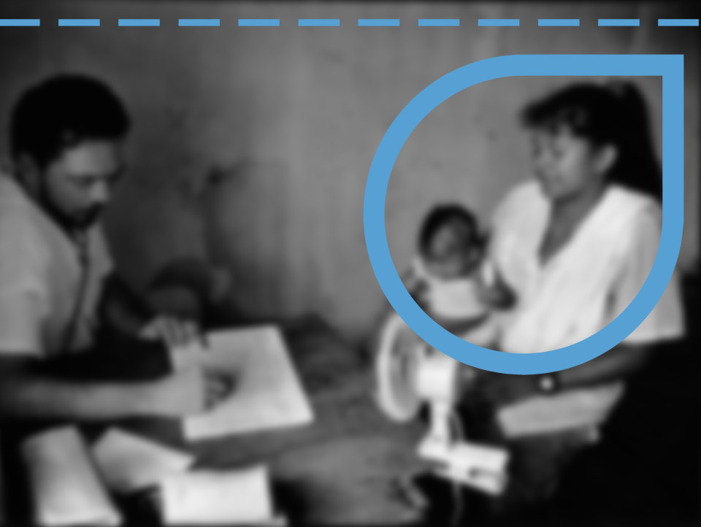
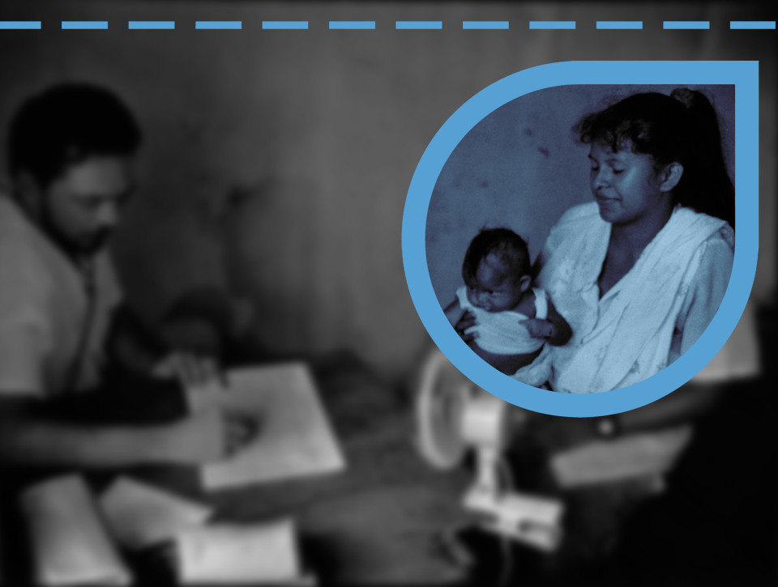

Migration as a Determinant of Health:
Some concepts to start with
September 28, 2016
San José, Costa Rica

Slide 2

Mensaje Clave:
La migración como determinante social de la salud
Migration for the benefit of all
Including health!

Slide 3



While migration is not necessarily a risk to health, migration can be a social determinant of health
Characteristics of the migration process can lead to increased health vulnerabilities

Slide 4


Healthy migrant effect
Exhausted migrant effect
Phases of the migration cycle | ¿Got sick ?
 | Yes |  | No |  | NR |  | total
 | Valor | % | Valor | % | Valor | %
Before migration | 6 | 5% | 113 | 93% | 2 | 2% | 121
Transit | 11 | 9% | 108 | 89% | 2 | 2% | 121
Destination | 35 | 29% | 86 | 71% |  | 0% | 121
Return | 26 | 21% | 95 | 79% |  | 0% | 121
After return | 49 | 40% | 71 | 59% | 1 | 1% | 121
OIM, 2015
Personas Retornadas: situación de Salud en el ciclo migratorio – El Salvador

Slide 5


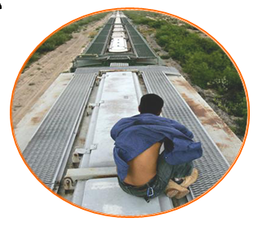
Transit
Destination country
or community
Return
Origin country
or community

Slide 6


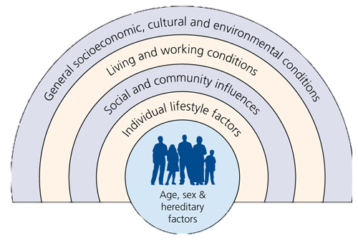
MIGRATION

Slide 7
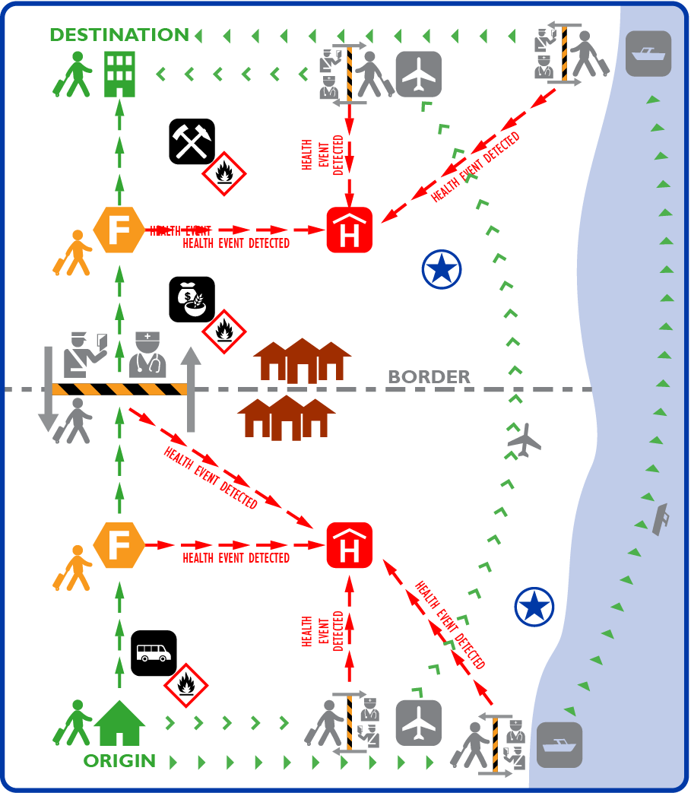

¿Who?
¿Where?
The Mobility Continuum
All
In all spaces
Notes:
Mobility as A known social determinant of health and Direct contributor to spread of diseases
Understanding mobility ➔ better prevention, detection and response to public health threats
Borders as spaces
Borders as part of the mobility continuum
Mobility induced spaces of vulnerability: pathways and congregation points
Understanding mobility for better prevention, detection and response to health threats means:
Better targeting of resource allocation and priority locations
Forecasting spread of diseases through mobility corridors
Primary Health Care strengthening along the vulnerable corridors, including through health screening and referral procedures
Integration of mobility information into disease surveillance and response (including through EOC structures)
Borders as spaces beyond points of entry

Slide 8


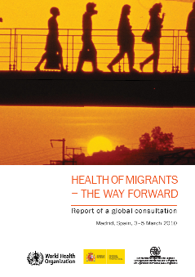
2008 WHA61.17 Resolution
on Health of Migrants
Operational Framework on Migrants’ Health
Monitoring Migrant Health
Policy and Legal Frameworks
Migrant-Sensitive Health Systems
Partnerships, Networks and Multi country Frameworks
Notes:
In 2008, the WHO World Health Assembly endorsed a resolution on the Health of Migrants (WHA 61.17) that spelled out actions for governments to enhance the health of migrants and promote bilateral and multilateral collaboration.

Slide 9


Thank you!
Carlos Van der Laat
Regional Migration Health Officer
cvanderlaat@iom.int

