Slide 1


New Actions and Best Practices in Combating Trafficking in Persons

Slide 2

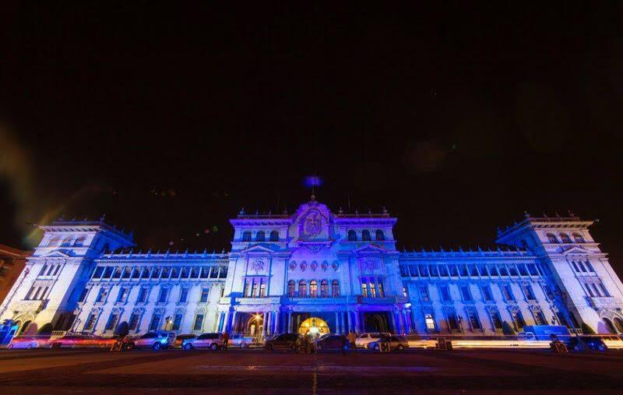
Launching the Corazón Azul (Blue Heart) Campaign

Slide 3
Launching the Corazón Azul
(Blue Heart) Campaign
To inform others about trafficking in persons;
To establish coordination mechanisms to effectively address trafficking in persons;
To develop mechanisms to warn the general public with the objective of reducing the vulnerability of potential victims;
To encourage massive participation of the general public, generating spaces for comments and discussion of the role of citizens in eradicating this crime;
To strengthen the confidence of the general public to report this crime and/or collaborate with competent authorities.

Slide 4
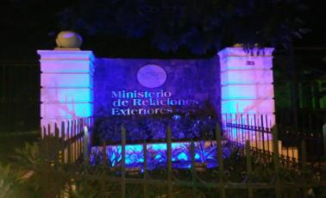
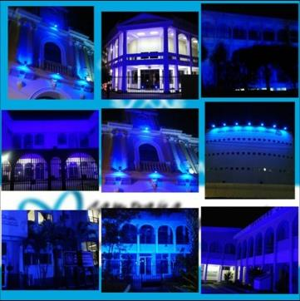
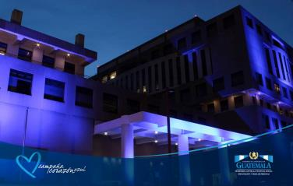
Illuminating Buildings
July 28
Launching of the Corazón Azul Campaign
Urban Art
Ministry of Foreign Affairs, Public Prosecutor’s Office, the Judiciary and others.

Slide 5
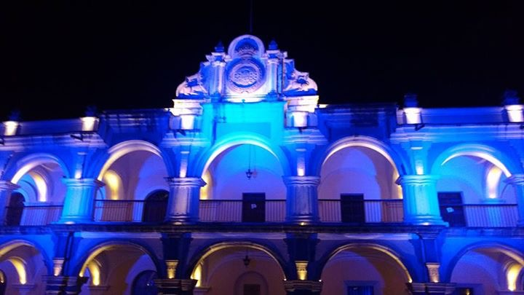
Antigua Guatemala

Slide 6
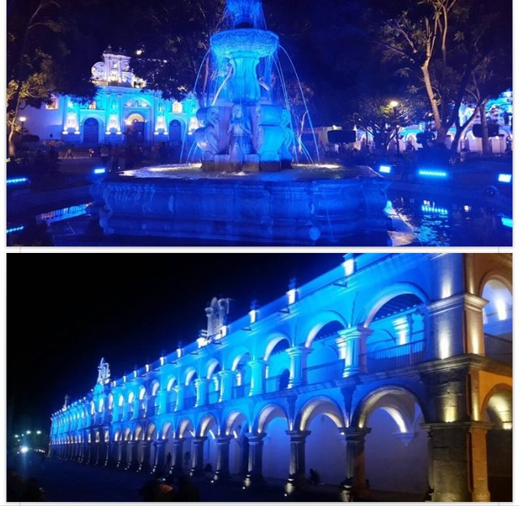
Antigua Guatemala

Slide 7
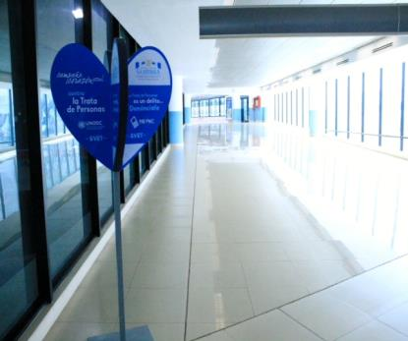
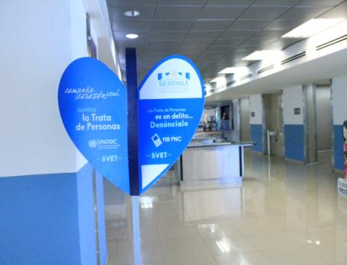
La Aurora International Airport
3D Images

Slide 8
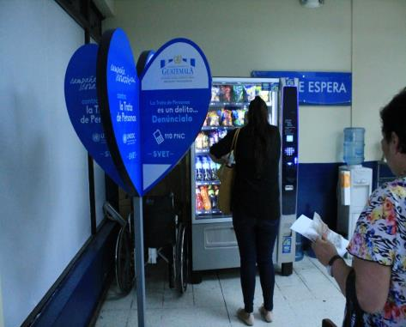
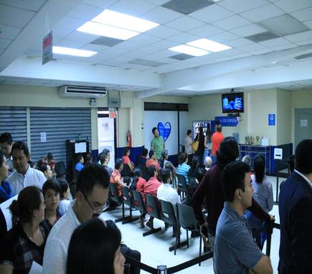
General Migration Office

Slide 9
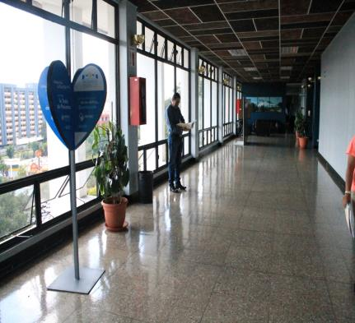
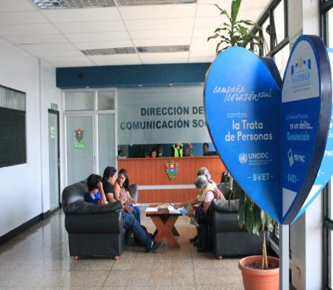
Guatemala City Hall

Slide 10
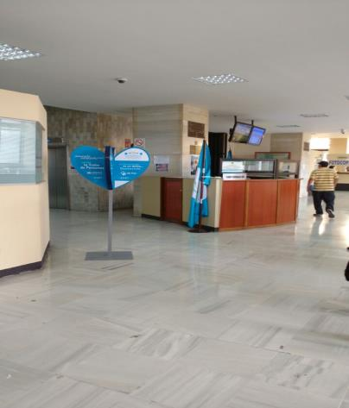
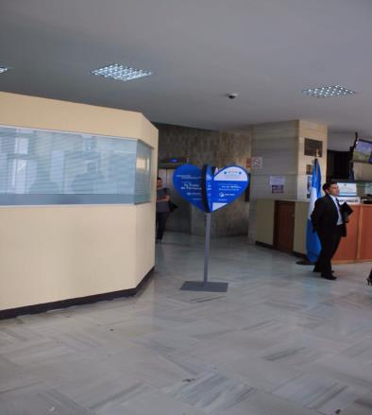
Judicial Body

Slide 11
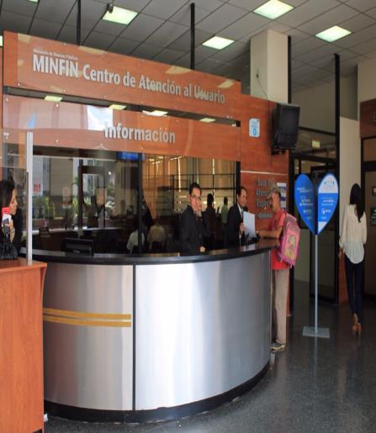
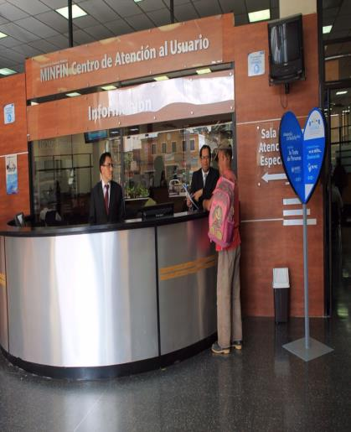
Ministry of Public Finance

Slide 12
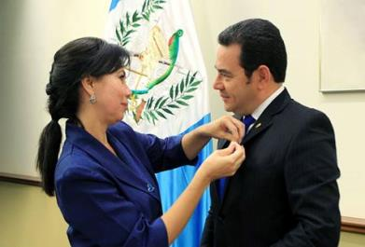
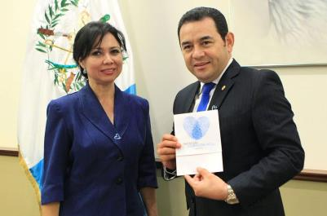
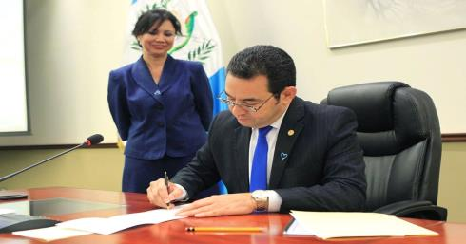
Corazón Azul Campaign

Slide 13
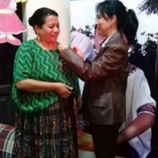
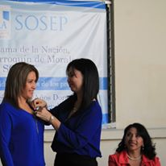
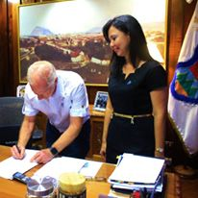
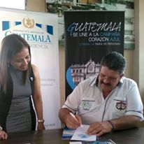
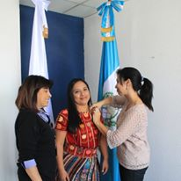
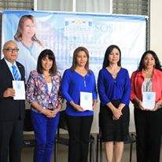
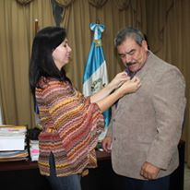
Corazón Azul Campaign

Slide 14
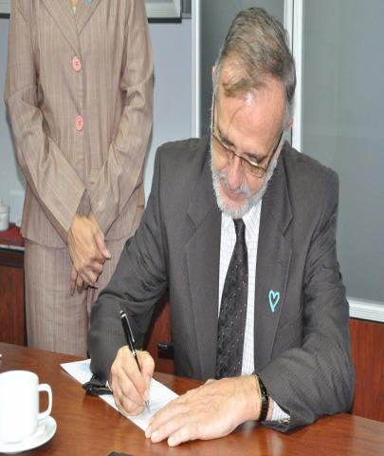
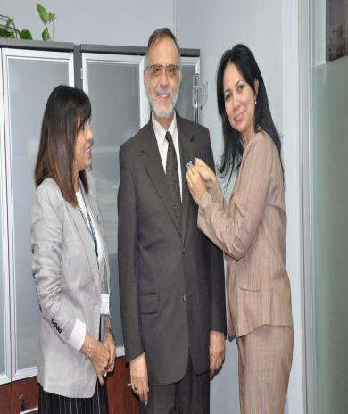
Corazón Azul Campaign

Slide 15
Prevention Material
Forced Labour

Slide 16
Prevention Material
Labour Exploitation

Slide 17
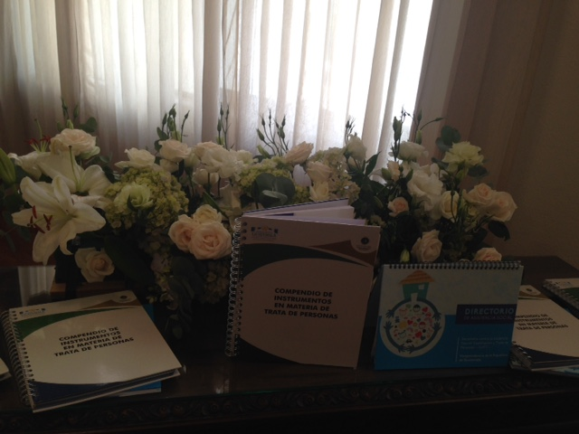
Compilation of Tools and Directory of Social Welfare Institutions

Slide 18
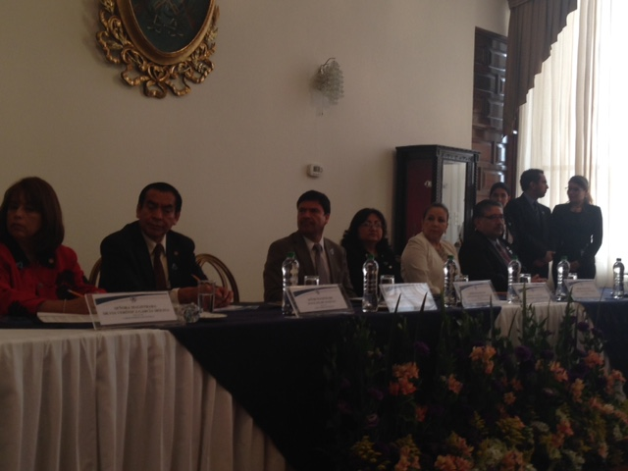
Compilation of Tools and Directory of Social Welfare Institutions

Slide 19
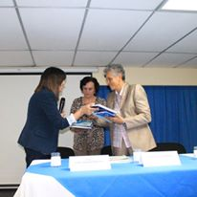
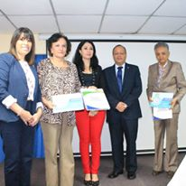
Compilation of Tools and Directory of Social Welfare Institutions

Slide 20
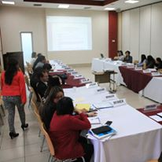
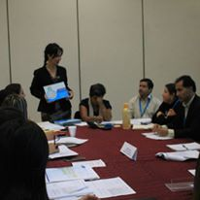
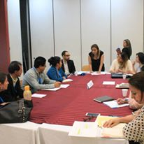
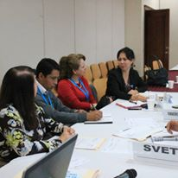
Strengthening of CIT

Slide 21
Strengthening of CIT
Developing a screening questionnaire to promote the identification of victims of trafficking in persons and homologate interviewing guides for the identification of victims;
Developing a form for referral of cases of trafficking in persons.

Slide 22
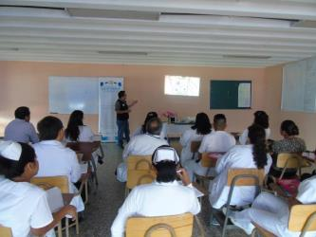
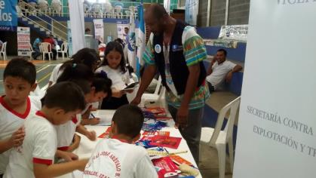
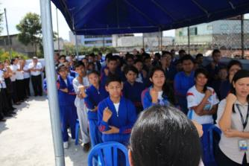
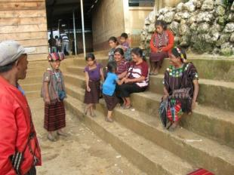
Training in 3 Mayan Languages, Garifuna and Sign Language

Slide 23
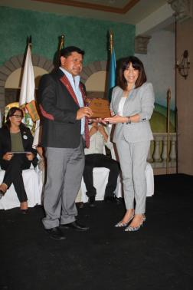
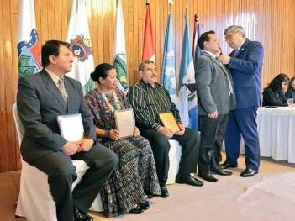
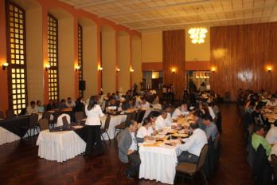
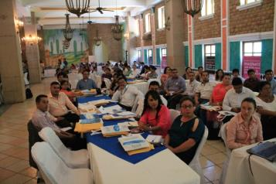
Activating VET Networks in 11 Departments

Slide 24
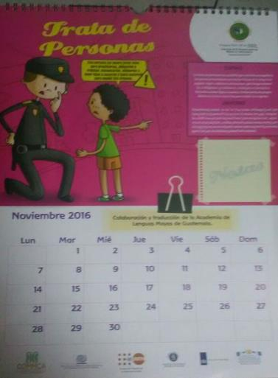
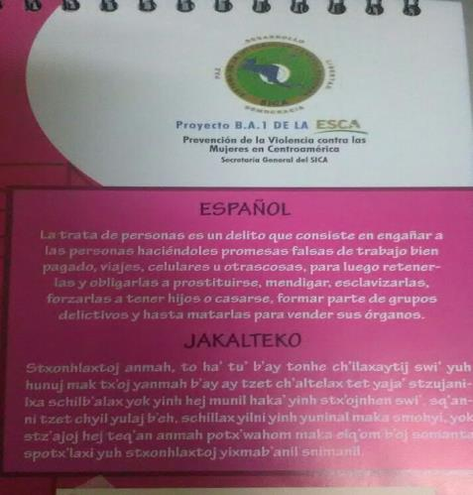
Calendar in Mayan Languages

Slide 25
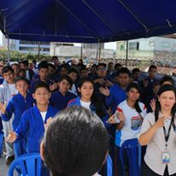
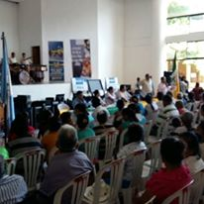
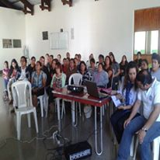
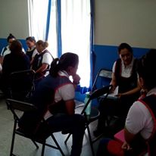
Training Manual

Slide 26





Assistance to Victims
OCCUPATIONAL THERAPY
INDIVIDUAL AND GROUP THERAPY
JOB TRAINING

Slide 27
Migrant Smuggling
Reforms to the Immigration Act – Decree 95-98 of the Congress of the Republic of Guatemala, Decree 10-2015
The reform typifies the crime of migrant smuggling with a punishment of 6-8 years imprisonment. In addition, the criminal type “smuggling of Guatemalan nationals” is established with the objective of preventing, suppressing, punishing and eradicating this crime, with a punishment of 6-8 years imprisonment.

Slide 28
Migrant Smuggling
In the Division Against Trafficking in Persons of the Public Prosecutor’s Office, the following functional units are in place for referral of cases of different modes of trafficking in persons, and specialized staff has been designated to address migrant smuggling:
Unit Against the Sale of Persons and Irregular Adoptions;
Unit Against Sexual Exploitation;
Unit Against Labour Exploitation and Other Modes of Trafficking in Persons;
Unit for Comprehensive Assistance (a psychologist and a social worker); and
Unit Against Migrant Smuggling.

Slide 29
Migrant Smuggling
Division of Investigation of Migrant Smuggling, National Civil Police Force (PNC)
By General Order 67-2014 of the General Sub-directorate of Criminal Investigation of the National Civil Police Force (PNC), the Unit for Investigation of Migrant Smuggling was established in the Department Against Organized Crime of the PNC, with the specific role of investigating cases of foreigners and nationals who are victims of the crime of migrant smuggling by land, sea and air.

Slide 30
THANK YOU

