Slide 1

(Government of Guatemala,
Ministry of Foreign Affairs)

Slide 2
advances of Guatemala in matters relating to trafficking in persons
Ministry of Foreign Affairs
Guatemala, November 24, 2014

Slide 3
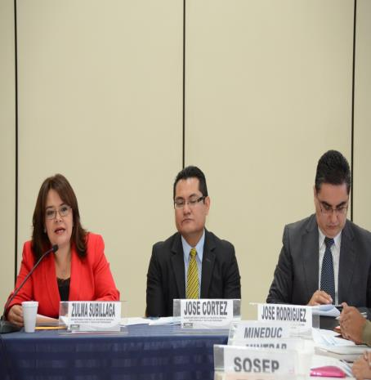
Inter-institutional Committee Against Trafficking in Persons – CIT
The following actions have been implemented this year:
7 ordinary meetings
1 extraordinary meeting
9 meetings of sub-committees
21 departmental networks against sexual violence, exploitation and trafficking in persons established in every department of the country.

Slide 4
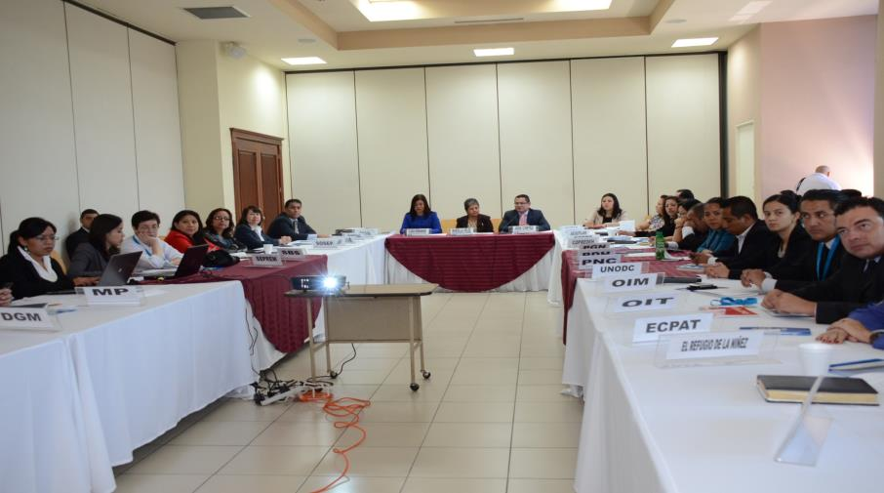
Inter-institutional Committee Against Trafficking in Persons – CIT

Slide 5
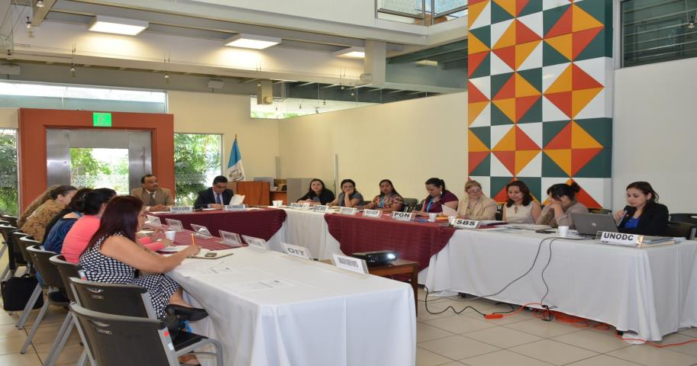
Inter-institutional Committee Against Trafficking in Persons – CIT

Slide 6
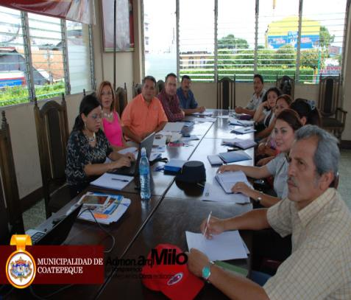
21 Departmental Networks
Coatepeque Department Network
21 departmental networks against sexual violence, exploitation and trafficking in persons established in 21 departments of the country.

Slide 7
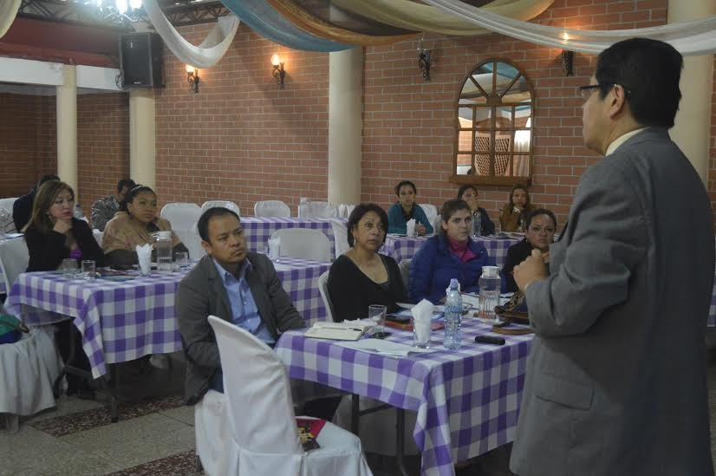
21 Departmental Networks

Slide 8
Prevention Actions
Training on prevention by the various institutions that are members of CIT, for their respective staff and the general public;
The Secretariat Against Sexual Violence, Exploitation and Trafficking in Persons – SVET – developed, with support from ILO, a campaign against trafficking in persons for the purpose of labour exploitation and forced labour, through audio-visual materials such as an educational video entitled “Con los Ojos Abiertos” (With open eyes);
Campaigns, workshops and various actions to prevent trafficking in persons, covering all 22 departments of the country and oriented toward the general public.

Slide 9
… Prevention Actions
A national awareness-raising programme to prevent sexual violence, exploitation and trafficking in persons, currently being developed by SVET and the Ministry of Education;
Implementing, for the second year in a row, a training programme for medical and auxiliary staff from national hospitals in the country, with the objective of expanding their knowledge about the topic and identifying potential cases of trafficking in persons.

Slide 10
Detection, Assistance and Protection Actions
Entry into force of the Protocol of the General Directorate of Migration for the Detection and Referral of Cases of Trafficking in Persons;
In September, the Secretariat Against Sexual Violence, Exploitation and Trafficking in Persons – SVET – opened 3 shelters for comprehensive assistance to victims of trafficking, located in the departments of Guatemala, Quetzaltenango and Coban.
Assistance has been provided to 45 victims of trafficking in persons at the new shelters, including girls, female adolescents and women.

Slide 11
Repatriation Actions
With the recent updating and dissemination of the new Protocol for Inter-institutional Coordination for the Repatriation of Victims of Trafficking:
Orderly and safe repatriation of alleged victims of trafficking: 9 Guatemalan nationals abroad were repatriated and 1 foreign national was repatriated to her country of origin.

Slide 12
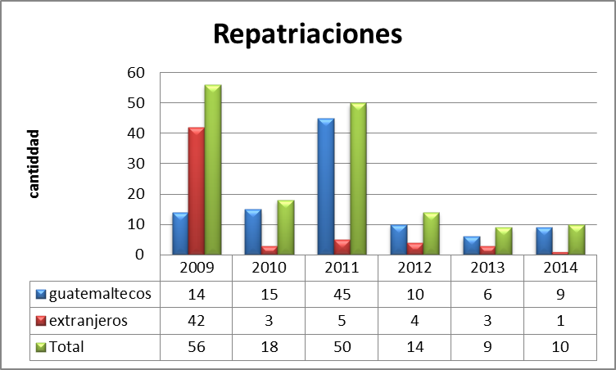
Repatriations, 2009 – November 2014
Repatriations
Guatemalans
Foreigners

Slide 13
Prosecution and Punishment Actions
This year thus far, the Public Prosecutor Against Trafficking in Persons of the Office of the Public Prosecutor has recorded a total number of 26 persons charged with the crime of trafficking in persons, 36 arrest warrants and 61 search actions.

Slide 14
THANK YOU

