Slide 1

Advances in the Protection of Accompanied and Unaccompanied Migrant Boys, Girls and Adolescents and their Families
Second Meeting of the Ad Hoc Group on Migrant Boys, Girls and Adolescents
Mexico City, April 15-16, 2015

Slide 2
CONTEXT: EL SALVADOR
In the past decades migration has transformed the Salvadoran society, with a significant impact on the economic, social and cultural development of the country.
An estimated 3,009,160 Salvadorans are living outside the national borders.
The main country of destination of Salvadoran migrants is USA (with close to 2.5 million Salvadorans already living in the US).
Followed by Canada, with an estimated 120,000 Salvadorans living in this country and increasing migration flows to Europe.
Thus, more than one third of our population is living outside national territory. Therefore, migration and its implications and challenges are critical for the country.

Slide 3
CONTEXT: EL SALVADOR
El Salvador is a country of origin, transit, destination and return of migrants.
From 2013 to February 2015, a total number of 87,027 adults have returned from Mexico and the US, by land and air.
During that same period of time, 7,419 boys, girls and adolescents have returned from Mexico by air and land.
Due to its geographic location, El Salvador has become a territory of transit for African and Asian nationals on their journey toward the US. Refugee status applications have been received from these migrants in our country.
In recent years, a significant increase has been observed in intra-regional migration, and El Salvador has become a country of destination, primarily for Nicaraguan, Honduran and Guatemalan migrants.

Slide 4
THE SALVADORAN STATE RECOGNIZES:
Migrants as subjects of rights, regardless of their migration status;
Salvadorans abroad as strategic subjects promoting development, and their contributions to societies of origin and destination.

Slide 5
STATE PROTECTION FOR SALVADORANS ABROAD:
A double mandate – Constitutional and International:
Human rights protection: Article 2 of the Constitution, and current International Human Rights Agreements;
Vienna Convention on Consular Relations: The obligation to provide consular assistance and protection to nationals of the sending State (Articles 5 & 36).

Slide 6
STATE PROTECTION FOR SALVADORANS ABROAD:
Law on the Comprehensive Protection of Boys, Girls and Adolescents (LEPINA). Within the framework of formulating public policies to benefit boys, girls and adolescents, the State should establish actions and measures to enable providing assistance and protection to migrant boys, girls and adolescents and developing plans for international cooperation relating to return processes (Article 41);
National Policy on the Comprehensive Protection of Boys, Girls and Adolescents. To promote national- and international-level programmes for humanitarian action for boys, girls and adolescents in need of specialized assistance in order to safeguard their personal integrity. Aimed at: missing or migrant boys, girls and adolescents victims of trafficking, etc. (Strategy 2.3, Lines of Action 5 & 6).

Slide 7
STATE PROTECTION FOR SALVADORANS ABROAD:
Formulating the Special Law on Protection and Development of Salvadoran Migrants and their Families;
Approved on March 17, 2011;
The objective of this law is to develop constitutional guiding principles to ensure the rights of Salvadoran migrants and their families;
This led to the establishment of the National Council for the Protection and Development of Migrants and their Families (CONMIGRANTES), with participation of associations of Salvadorans abroad, civil society, government institutions, academia, small and medium-sized enterprises, etc.

Slide 8
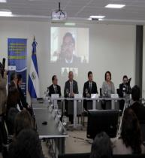
COMPOSED OF 18 INSTITUTIONS:
5 invited institutions
8 observers
CONMIGRANTES
1
REPRESENTATIVE FROM SMALL AND MEDIUM-SIZED ENTERPRISES
3 REPRESENTATIVES FROM ASSOCIATIONS OF SALVADORANS ABROAD
1
REPRESENTATIVE FROM PRIVATE UNIVERSITIES
11
GOVERNMENT REPRESENTATIVES
1
REPRESENTATIVE FROM CIVIL SOCIETY ORGANIZATIONS
1
REPRESENTATIVE FROM THE UNIVERSITY OF EL SALVADOR

Slide 9
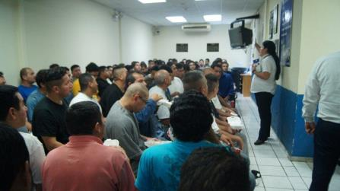
CURRENT SITUATION IN REGARD TO RETURNED PERSONS
6 flights of returned persons arrive from the US (Monday through Friday) at Oscar Arnulfo Romero International Airport (135 per flight, on average);
Boys, girls and adolescents arrive from Mexico on commercial airlines;
16 buses arrive by land each week (Monday through Sunday) through La Hachadura border (a maximum of 38 persons per bus.

Slide 10
CURRENT SITUATION IN REGARD TO RETURNED PERSONS
Assistance provided by ISNA, March 31, 2015 (psychological first aid):
1,514 boys, girls and adolescents were assisted through group interventions;
29 (2%) boys, girls and adolescents required emergency reception;
13 boys, girls and adolescents in vulnerable situations were referred to the Protection Board.

Slide 11
Returned Boys, Girls and Adolescents, by Gender and Year *
*Source: General Directorate of Migration and Immigration

Slide 12
Accompanied and Unaccompanied Boys, Girls and Adolescents *
*Source: General Directorate of Migration and Immigration

Slide 13
EDADES DE NIÑAS, NIÑOS Y ADOLESCENTES MIGRANTES
Migration is more frequent for the 15 to
17-year age group, followed by
the 10 to 14-year age group *
*Source: General Directorate of Migration and Immigration

Slide 14
ACTIONS AND INSTRUMENTS
Strengthening the consular network and its location in territories that are critical in terms of the vulnerability of migrants. This has involved establishing Consular Protection Agencies and restructuring the existing agencies;
Establishing a Call Centre at the headquarters serving US, Canada and Mexico and providing comprehensive services;
Designing an Observatory of Human Rights and Crime Against Salvadoran Migrants, as well as protocols for consular action;
Establishing a Monitoring, Analysis and Production Unit to report situations of human rights violations and migrants victims of crime;
Agreement “Banco Genético Forense de Familiares de Migrantes no Localizados” [Genetic Forensic Data Bank of Relatives of Missing Migrants] (EAAF, COFAMIDE, Human Rights Ombudsman’s Office and Ministry of Foreign Affairs).

Slide 15
ACTIONS AND INSTRUMENTS
A guidance card for inter-institutional coordination at the reception centre for repatriated persons;
Capacity-building to ensure that the returned persons are received in a dignified manner.
DGME | ISNA
Immediate assistance (snack, telephone calls, reception kit, money, shelter for family groups); Restructuring physical spaces at the facilities, to be used for the reception of boys, girls and adolescents returning by air and land; An increase in the number of staff providing direct assistance to boys, girls and adolescents returning by land and air; Capacity-building on assistance to boys, girls and adolescents for relevant officers; Managing the support from non-governmental organizations and international organizations; Negotiating support from the Ministry of Finance, through the General Directorate of Customs, to establish mechanisms to expedite customs procedures for boys, girls and adolescents returning by air and land. | Establishing a team to provide psychological first aid; Adapting physical space for emergency reception; Equipment, furniture and emergency kit; Protocol for the Assistance to Boys, Girls and Adolescents Victims of Sexual Violence; Capacity-building on assistance to returned boys, girls and adolescents after the return. $ 881,384.

Slide 16
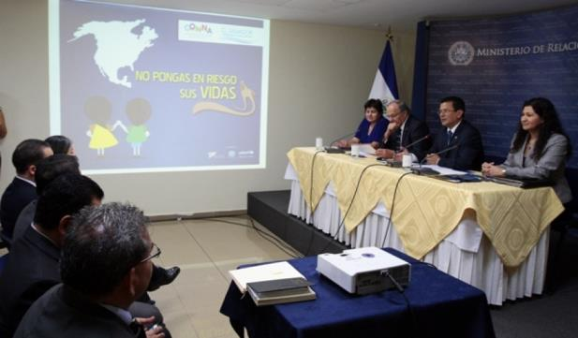
AWARENESS-RAISING CAMPAIGN
              Efforts to prevent the risks associated to the irregular migration of boys, girls and adolescents have been strengthened through an awareness-raising campaign entitled “No pongas en riesgo sus vidas” [Don’t place their lives at risk]. The effort is led by the government, with participation of civil society as well as international organizations such as UNICEF and IOM.

Slide 17
ACTIONS AND INSTRUMENTS
A 2014-2019 Government Strategic Plan, considering – under one of its central themes – Salvadorans abroad regardless of their migration status.
Protocol for the Protection and Assistance to Migrant Boys, Girls and Adolescents:
  Prior to return: Consular assistance and protection and complementary coordination with State institutions and civil society organizations;
  During return: Inter-institutional coordination to ensure dignified reception and referral to services that ensure on-going psychosocial assistance;
  After the return: Territorial coordination mechanisms to ensure the reintegration of the returned persons.

Slide 18
ASSISTANCE PHASES
Prior to return:
  Consular assistance and protection and inter-institutional interventions in national territory and along the migration route, coordinated with and complemented by civil society. Consulates placing the individual and his or her human rights at the centre;
  A system to generate information to identify, monitor and analyse the situation of Salvadoran migrants abroad, in countries of transit and destination.

Slide 19
ASSISTANCE PHASES
During return: Filing complaints or initiating legal proceedings to benefit the affected nationals – before prosecutors, public prosecutors, judges, immigration authorities, national human rights institutions, etc.
Institutionalizing the participation of State institutions in return processes, in accordance with their competencies;
Coordination with international organizations and non-governmental organizations (volunteers, donations, assistance in recreational areas).
Assistance:
Immediate (snack, telephone calls, reception kit, clothes, shoes, money, shelter for family groups);
Psychosocial and medical assistance.

Slide 20
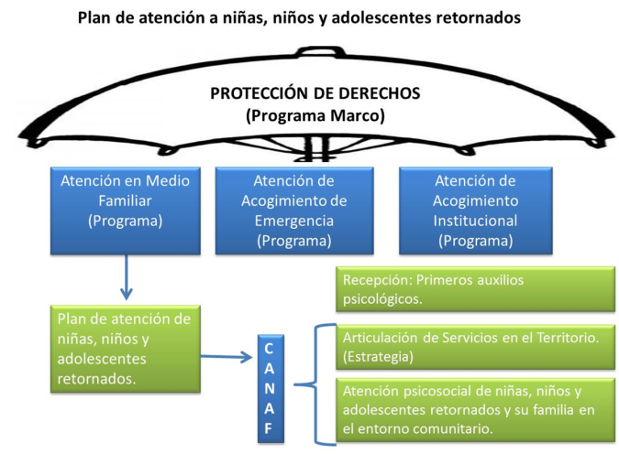
ASSISTANCE PHASES
C. After the return: Territorial coordination mechanisms to ensure the reintegration of the returned persons.

Slide 21
THANK YOU!

