Slide 1




re
XXI Regional Conference on Migration
VICE-MINISTERIAL MEETING
San Pedro Sula, Honduras, November 17-18, 2016
SHARED RESPONSIBILITY AND
BEST PRACTICES IN
THE WORK OF THE RCM
Presentation
of the
Dominican Republic

Slide 2




XXI Regional Conference on Migration
Vice-Ministerial Meeting
San Pedro Sula, Honduras, November 17-18, 2016
Today, migration has become a complex matter which is in constant evolution. The simplistic scheme of country of origin/country of destination has given way to a much more complex phenomenon, where countries and regions play a multiple role in the different facets of migration – origin, transit, destination and return.
Globalization has contributed to the increase in the mobility of people. More than 214 million persons worldwide are migrants, and the movement of persons from one place to another increases each year. As a result, migration has become an important topic on the global agenda of the different countries and international organizations.

Slide 3
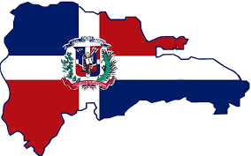
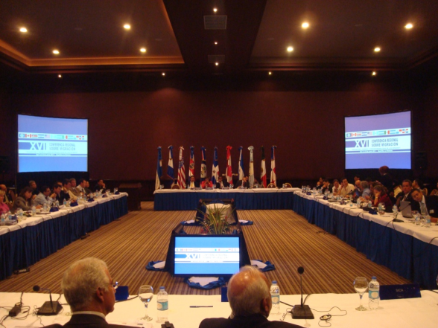
XXI Regional Conference on Migration
Vice-Ministerial Meeting
San Pedro Sula, Honduras, November 17-18, 2016
XVI Regional Conference on Migration
La Romana, Dominican Republic, June 7-10, 2011
“Migration and Labour: Shared Responsibility among States”
1.-The importance was recognized of updating the roles of the RCM, given that the phenomenon of migration is in constant evolution, and therefore, it is necessary to adopt mechanisms to discuss the current situation.
2.-The need was identified to formulate joint actions to address the protection and assistance needs of extracontinental migrants and refugees in the region.
3.- The importance of regional cooperation was highlighted, involving countries of origin, transit and destination to effectively combat migrant smuggling and trafficking, including frauds and crimes committed by unscrupulous migration consultants.

Slide 4
XXI Regional Conference on Migration
Vice-Ministerial Meeting
San Pedro Sula, Honduras, November 17-18, 2016
STATISTICAL DATA OF THE PNRE
DATA | XX RCM | % | XXI RCM | %
TOTAL R. PNRE | 288,467 |  | 288,467
APPROVED | 239, 956 | 83% | 249,824 | 87%
C. DELIVERED | 168,538 | 70% | 228,392 | 91%
MISSING | 71,418 | 30% | 21,434 | 9%
MEN | 112,154 | 67% | 163,862 | 66%
WOMEN | 56,384 | 33% | 85,962 | 34%
SINGLE |  |  | 172,988 | 69%
COMMON-LAW RELATIONSHIP |  |  | 65,122 | 26%
MARRIED |  |  | 11,714 | 5%

Slide 5
XXI Regional Conference on Migration
Vice-Ministerial Meeting
San Pedro Sula, Honduras, November 17-18, 2016
COUNTRIES WITH THE HIGHEST NUMBERS OF PERSONS WITH REGULARIZED MIGRATION STATUS
No. | COUNTRY | NUMBER | %
1 | HAITI | 244,256 | 98%
2 | ITALY | 726 | 0.29%
3 | UNITED STATES | 647 | 0.25%
4 | VENEZUELA | 405 | 0.16%
5 | CUBA | 367 | 0.15%
6 | SPAIN | 352 | 0.14%
7 | COLOMBIA | 328 | 0.13%
8 | CANADA | 309 | 0.12%
9 | FRANCE | 278 | 0.11%

Slide 6



XXI Regional Conference on Migration
Vice-Ministerial Meeting
San Pedro Sula, Honduras, November 17-18, 2016
With an open and objective vision and a firm political will, all involved actors can participate in seeking the best solutions concerning migration. The shared responsibility among all RCM Member Countries, civil society and international organizations can contribute significantly to achieving increasingly effective migration policies in the region in regard to the protection of the rights of migrants.
THANK YOU

