Slide 1



Best Practice in Assistance and Protection for
Migrant Boys, Girls and Adolescents
COSTA RICA
2015

Slide 2

In 2010, a technical Bipartite Commission for the Assistance and Protection of Boys, Girls and Adolescents was established.
Initially, it was composed of the following:
- General Directorate of Migration and Immigration
- National Board for Children
COMMISSION FOR CHILDREN AND ADOLESCENTS

Slide 3
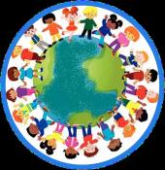
The Commission was established with the objective of creating coordination mechanisms and tools to enable the officers of DGME and PANI to provide assistance and protection – within the framework of the plan for joint actions and in an efficient and effective manner – to foreign boys, girls and adolescents in different migration situations, ensuring compliance with the principle of the best interest of the child at all times.

Slide 4

THE TRIPARTITE COMMISSION IN 2013
The Ministry of Foreign Affairs and Cult joined the Commission.

Slide 5
ACHIEVEMENTS
Inter-institutional and intersectoral coordination: National Learning Institute, Ministry of Justice, UNHCR and ACAI;
Regular bi-weekly meetings;
Direct communication with liaison officers;
Mutual support;
Collaboration and support from international organizations: IOM, UNHCR, UNICEF.

Slide 6
ACHIEVEMENTS
Letter of Cooperation between DGME, PANI, UNHCR and ACAI;
Joint training efforts;
Process with the Civil Registry to review the registration of births of indigenous migrant boys, girls and adolescents;
Establishing a link with ESME;
Analysis, evaluation and recommendations to leaders;
Coordination with counterparts at an international level;
Follow-up on and implementation of regional agreements.

Slide 7
ACHIEVEMENTS
Developing a handbook on inter-institutional assistance to boys, girls and adolescents victims of exploitation: sexual, commercial, trafficking, child labour and adolescents in hazardous work;
Designing, developing and implementing protocols:
  For the Assistance of Boys, Girls and Adolescents Whose Parents are in the Process of Being Deported;
  For the Regularization of the Stay of Boys, Girls, and Adolescents under the Protection of PANI;
  For the Detection, Assistance and Comprehensive Protection of Boys, Girls and Adolescents Requiring International Protection: refuge seekers, refugees, stateless persons;
  For Action by DGME-INA-PANI for foreign students needing to regularize their migration status;
  For the Assistance and Protection of Foreign Unaccompanied or Separated Boys, Girls and Adolescents Outside their Countries of Origin.

Slide 8
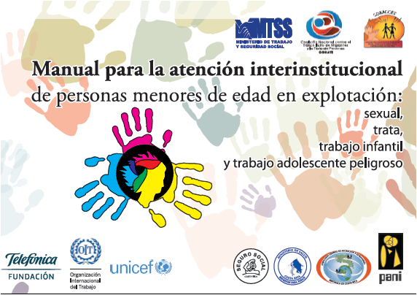

Slide 9
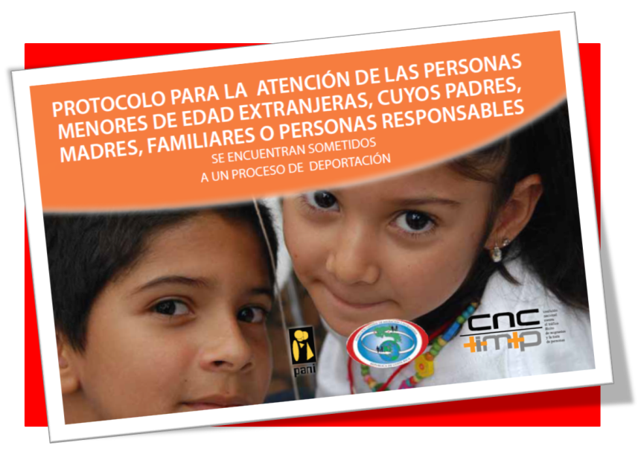

Slide 10
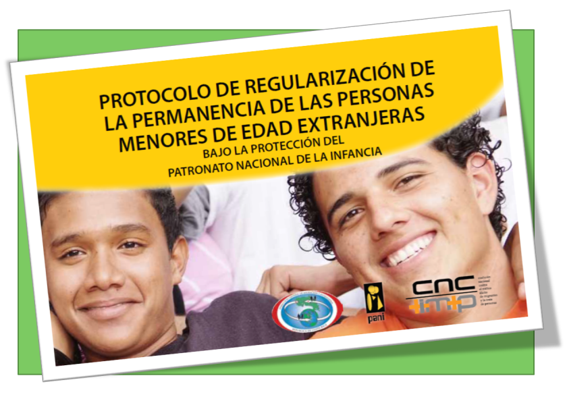

Slide 11
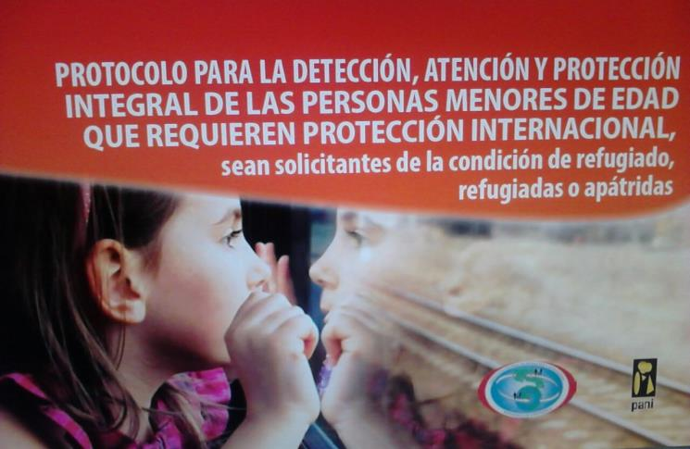

Slide 12
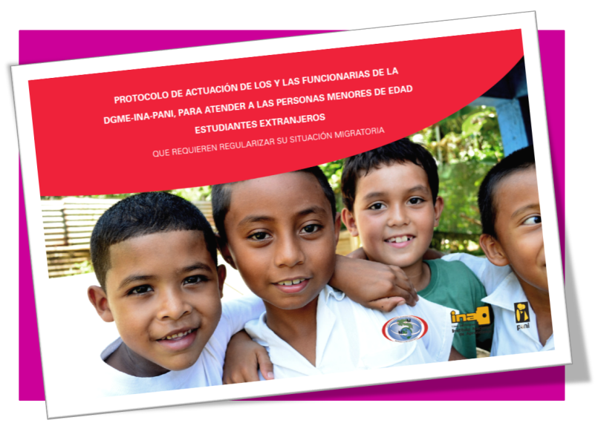

Slide 13
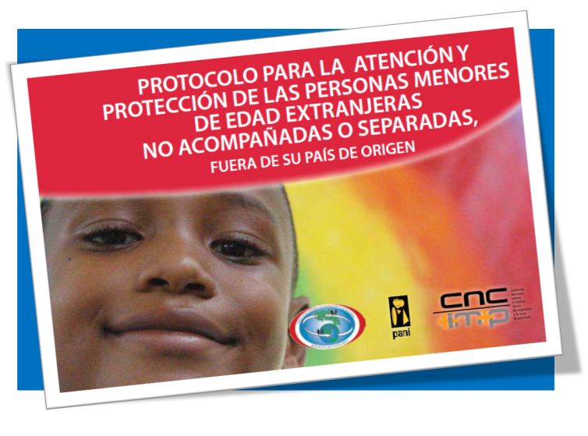

Slide 14
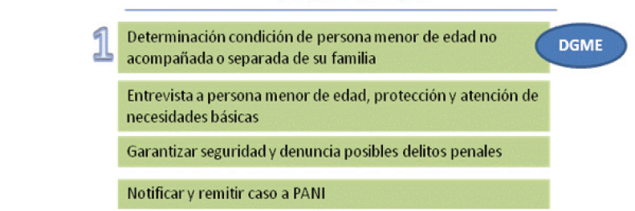






  For the Assistance and Protection of Foreign Unaccompanied or Separated Boys, Girls and Adolescents Outside their Countries of Origin

Slide 15
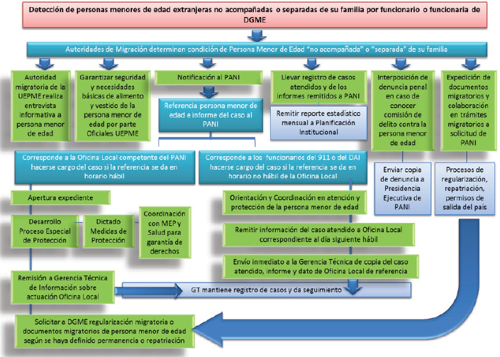

Slide 16
CHALLENGES
To declare the Tripartite Commission for Boys, Girls and Adolescents of public interest;
Within the Commission, to incorporate the procedure for determining the best interest of the child for every process involving boys, girls or adolescents;
To strengthen and expand intersectoral and inter-institutional coordination for specific topics. For example: regularization of migrant boys, girls and adolescents in training and education processes, Penal Juvenil, UNHCR and ACAI;
A Consular Handbook on International Protection of Costa Rican Boys, Girls and Adolescents;
To waive payment of fees and taxes in migration procedures for boys, girls and adolescents;
To continue implementing the regional agreements.

Slide 17
CHALLENGES
To finalize the Protocol for the Assistance and Protection of Foreign Accompanied Boys, Girls and Adolescents in Vulnerable Situations Outside their Countries of Origin;
Protocol for Repatriation;
Reintegration and integration of returned Costa Rican migrant boys, girls and adolescents;
Integration of migrant boys, girls and adolescents;
To submit joint projects for the comprehensive protection of boys, girls and adolescents using the Social Fund and the Fund to Combat Migrant Trafficking and Smuggling;
To work with the Ministry of Public Education to ensure access to education for boys, girls and adolescents with irregular migration status;
To develop a protocol for specialized assistance to indigenous boys, girls and adolescents;
To implement matrices for follow-up on cases and statistics.

Slide 18

Thank you
COSTA RICA,2015

