Slide 1


General Directorate of Migration and Immigration, Costa Rica
Data on Migration Flows at the Southern Border (Paso Canoas)
(General Directorate of Migration and Immigration)

Slide 2
COSTA RICA
Historically, Costa Rica has experienced massive flows of immigrants as a result of the ongoing violations of inalienable human rights due to economic, political and social problems affecting the various countries in the world.
1970s: Massive entry of Central American immigrants;
1990s: Migration of Nicaraguans as a result of natural disasters;
2002: An increase in Colombians applying for refugee status;
2008 – 2010: A significant movement of nationals from Eritrea and Somalia, extra-continental migration flows;
2010 – 2014: Entry of a very high number of Cuban migrants and ongoing extracontinental migration flows.

Slide 3
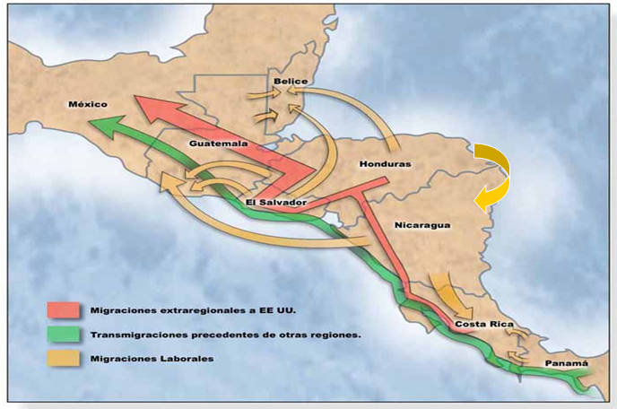
Source: FLACSO

Slide 4
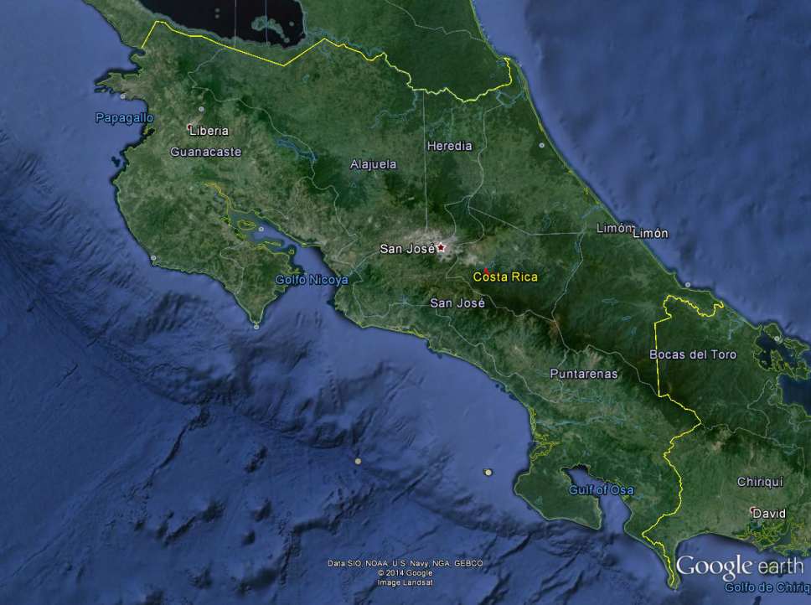

Paso Canoas
Regional Office
Brunca Region
Paso Canoas

Slide 5
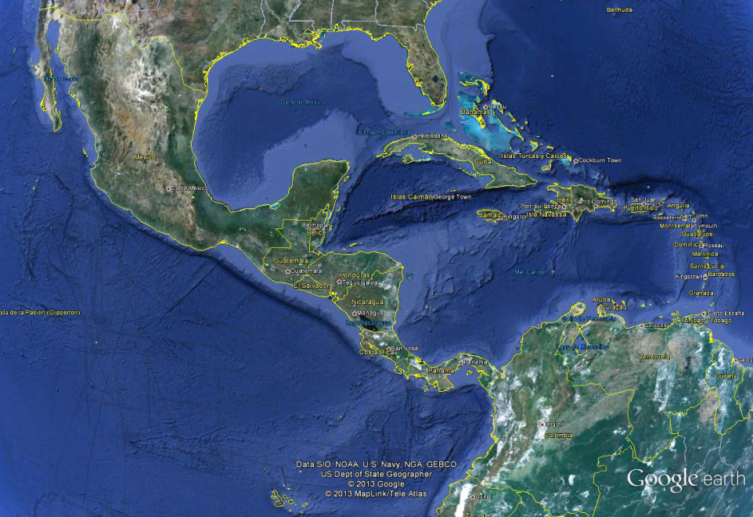



The Most Frequently Used Route
Cuba-Ecuador-Colombia-Costa Rica
USA
Mexico
Cuba
Costa Rica
Panama
Colombia
Ecuador

Slide 6
Foreign Nationals Summoned to Refuge and to the
Professional Immigration Police (PPM)
General Total
January – September 2014
Paso Canoas Regional Delegation
Situation experienced at the southern border
Nationality | Total
Cuba | 2799
Somalia | 161
Colombia | 119
Ghana | 60
Nepal | 54
Eritrea | 23
Bangladesh | 19
Nigeria | 13
Ethiopia | 10
Ecuador | 8
Cameroon | 3
Guinea | 3
Togo | 2
Ivory Coast | 1
Gambia | 1
Jamaica | 1
Jordan | 1
Pakistan | 1
Western Sahara | 1
Senegal | 1
Zambia | 1

Slide 7
Foreign Senior Citizens Summoned to Refuge and the PPM
By Gender
January – September 2014
Paso Canoas Regional Delegation
Country | Men | Women
Cuba | 2103 | 36
Somalia | 150 | 1
Colombia | 67 | 0
Ghana | 56 | 640
Nepal | 54 | 0
Eritrea | 22 | 0
Bangladesh | 19 | 0
Nigeria | 12 | 2
Ethiopia | 5 | 0
Guinea | 3 | 1
Cameroon | 2 | 0
Ecuador | 2 | 0
Togo | 2 | 0
Ivory Coast | 1 | 0
Gambia | 1 | 1
Jamaica | 1 | 0
Jordan | 1 | 0
Pakistan | 1 | 0
Western Sahara | 1 | 7
Senegal | 1 | 0
Zambia | 1 | 0
Men
Women

Slide 8
Foreign Boys, Girls and Adolescents Summoned to Refuge
By Gender
January – September 2014
Paso Canoas Regional Delegation
The groups include accompanied and unaccompanied boys, girls and adolescents, considered by Costa Rica to be at extremely high risk.
Country | Men | Women
Colombia | 8 | 8
Cuba | 37 | 19
Ecuador | 5 | 1
Eritrea | 1 | 0
Ethiopia | 0 | 3
Ghana | 3 | 0
Somalia | 4 | 0

Slide 9
Total Number of Foreign Nationals Summoned to Refuge
January – September 2014
Paso Canoas Regional Delegation
Immigrants leave their countries devastated by violence or flee from mandatory military service, poverty, political regimes, natural disasters and human rights violations.
Nationality | Total
Cuba | 371
Colombia | 88
Somalia | 86
Ghana | 11
Bangladesh | 6
Nigeria | 4
Ecuador | 3
Eritrea | 2
Cameroon | 1
Ethiopia | 1
Gambia | 1

Slide 10
Total Number of Foreign Nationals Summoned to PPM
January – September 2014
Paso Canoas Regional Delegation
Summoned to PPM | Total
Cuba | 2428
Somalia | 75
Nepal | 54
Ghana | 49
Colombia | 25
Eritrea | 21
Bangladesh | 19
Ethiopia | 9
Nigeria | 9
Ecuador | 5
Cameroon | 4
Guinea | 3
Togo | 2
Ivory Coast | 1
Jamaica | 1
Jordan | 1
Pakistan | 1
Western Sahara | 1
Senegal | 1
Zambia | 1
Summoned to the Professional Immigration Police with the aim of continuing the administrative procedures established in Act 8764.

Slide 11
Special Immigration Situations Team
2011 – first six months of 2014
Nationality | Total
Cuba | 617
Colombia | 311
Somalia | 46
Ghana | 43
Nigeria | 14
Nepal | 11
Bangladesh | 10
Ethiopia | 8
Cameroon | 7
Eritrea | 7
Nicaragua | 5
Congo | 4
El Salvador | 4
Brazil | 3
N.I. | 3
Spain | 2
Sierra Leone | 2
Sri Lanka | 2
Venezuela | 2
Zimbabwe | 2
Afghanistan | 1
Burkina Faso | 1
Ecuador | 1
Honduras | 1
Libya | 1
Mali | 1
Moldova | 1
Dominican Republic | 1
Syria | 1
Syria | 1
Uruguay | 1
General total | 1114

Slide 12
REGIONAL CONSULTATION GROUP ON MIGRATION (RCGM)
REGIONAL CONFERENCE ON MIGRATION (RCM)
MATRIX FOR THE SYSTEMATIZATION OF
CUBAN MIGRATION FLOWS IN THE REGION
COSTA RICA, 2014
MONTH AND YEAR | TYPE OF MIGRATION MOVEMENT |  | REJECTED AT THE BORDER | DEPORTED | IRREGULAR MIGRANTS | REFUGEE STATUS APPLICANTS ** | IDENTIFIED CASES OF TRAFFICKING | IDENTIFIED CASES OF MIGRANT SMUGGLING | SPECIAL MIGRATION SITUATIONS *
 | INGRESOS | EGRESOS
January | 304 | 272 | 2 | 0 |  | 15 | 0 | 0 | 207
February | 190 | 201 | 2 | 0 |  | 12 | 0 | 0 | 201
March | 243 | 276 | 8 | 0 |  | 10 | 0 | 0 | 201
April | 258 | 322 | 2 | 0 |  | 7 | 0 | 0 | 202
May | 223 | 349 | 1 | 0 |  | 8 | 0 | 0 | 261
June | 228 | 321 | 1 | 0 |  | 4 | 0 | 0 | 229
July | 278 | 303 | 1 | 0 |  | 13 | 0 | 0 | 371
August | 239 | 301 | 1 | 0 |  | 17 | 0 | 0 | 409
September | 191 | 235 | 0 | 1 |  | 14 | 0 | 0 | 544
October | 205 | 232 | 4 | 0 |  | 44 | 0 | 0 | 469
November* | 86 | 114 |  | 23 |  | 13 | 0 | 0 | 465
Total | 2.445 | 3.715 | 17 | 0 |  | 86 | 0 | 0 | 2.625

Slide 13
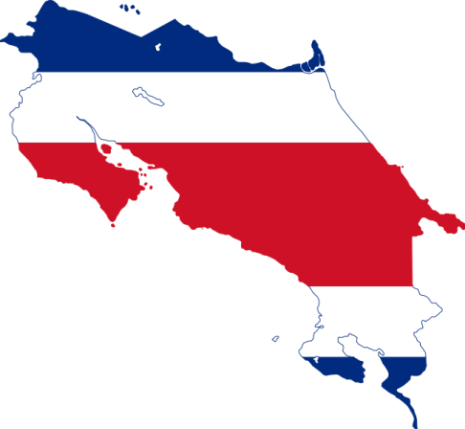

www.migracion.go.cr

