Slide 1

REGIONAL COALITION
AGAINST TRAFFICKING IN
PERSONS
RCM
Trafficking in Persons
San Pedro Sula, Honduras, 2016

Slide 2

Achievements
Designing the Logo of the Regional Coalition;
Incorporating Mexico and the Dominican Republic as active members;
Including Migrant Smuggling as a topic to be addressed by the Regional Coalition;
Including Canada, Colombia, United States, ECPAT and the Regional Network for Civil Organizations on Migration (RNCOM) as observers.

Slide 3

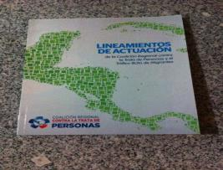
Deliverables of the Regional Coalition
National Guidelines for Strengthening
Institutional Coordination:
Include input, guidelines and commitments for institutional coordination to guide the actions of coalitions, councils, committees and national secretariats, with the aim of helping to improve institutional capacity for coordination and agreements concerning means and efforts to effectively combat the crime of trafficking in persons.

Slide 4

Documents Generated
Regional Strategy for Comprehensive Assistance and Accompaniment of Victims of Trafficking in Persons in Central America:
Agreed among the Member Countries of the Regional Coalition. A practical guide for effective comprehensive assistance to victims of the crime of trafficking in persons at a regional level. Provides an appropriate framework for the protection of victims, including minimum standards for assistance.

Slide 5

Documents and Regional Actions
Regional Communication Strategy to prevent trafficking in persons in Central America;
“Comunica” (Communicate) Regional Communication Strategy, IADB Project;
Implementing a prevention campaign oriented toward vulnerable populations.

Slide 6
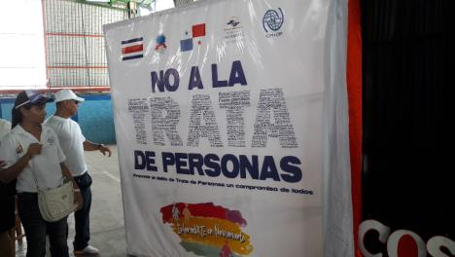
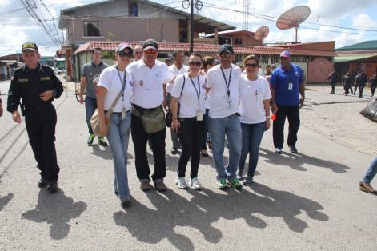
Binational Walk
Costa Rica-Panama

Slide 7
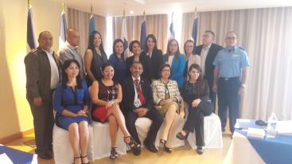
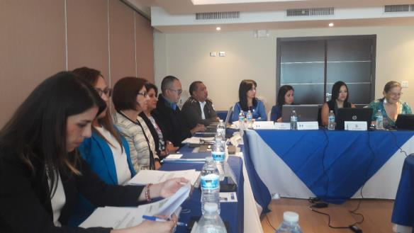

17th Meeting of the Regional Coalition
Chair: Panama. Secretary: Guatemala.

Slide 8
17th Meeting of the Regional Coalition
“Contributing to the Strengthening of a Comprehensive Approach to the Crime of Trafficking in Persons in Central America” Project (ECPAT/Guatemala)1;
Developing a monitoring and evaluation system and plan;
Designing a regional strategy for assistance;
A study on the barriers and limitations in implementing the regional protocol for the repatriation of victims – a comparative study of national protocols and the regional protocol;
Strategic Plan 2017-2027;
Presentation and delivery of the Regional Strategy for Assistance to Victims (IOM);
Renewal of authorities.

Slide 9

Activity

Slide 10
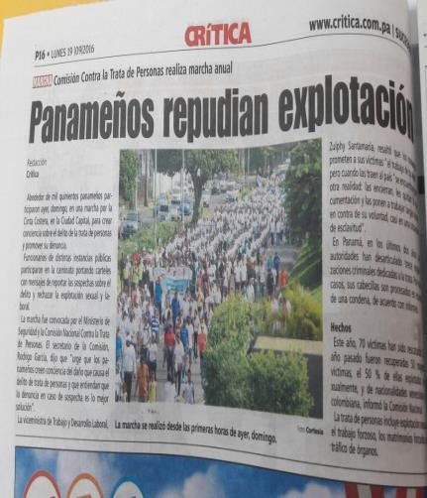
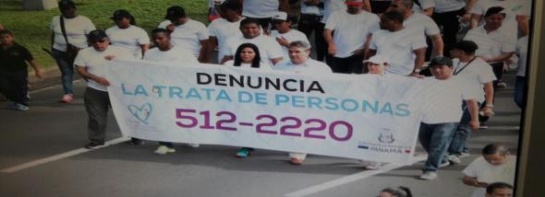
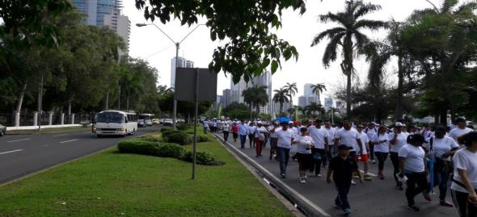
Activity

Slide 11
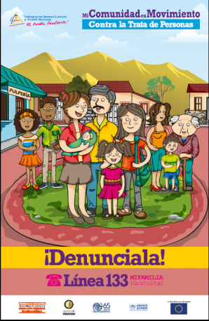
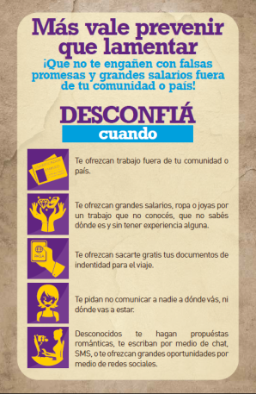


Slide 12

Advances
Establishing the Regional Coalition;
Expanding the Regional Coalition;
New members;
Including the topic of migrant smuggling;
Developing joint documents with a regional strategic vision on prevention, dissemination and combating of the crime of trafficking in persons.

Slide 13
Advances
Developing regional guidelines;
Regional Strategy for Comprehensive Assistance and Accompaniment of Victims of Trafficking in Persons in the Member Countries of the Regional Coalition (IOM);
Cooperation has been improved to strengthen the efforts of the Regional Coalition.

Slide 14
Rationale of the Regional Strategy
To define and formulate coordinated, relevant, feasible and specific actions at a regional level which, implemented by the Regional Coalition Against Trafficking in Persons and Migrant Smuggling, enable improving comprehensive assistance to victims of trafficking in persons, in cooperation with other regional processes and organizations addressing the issue of trafficking in persons.

Slide 15
What is understood as Comprehensive Assistance
Prompt and effective interventions by institutions committed to addressing the issue, coordinating efforts to ensure the restoration of the physical, mental and psychological well-being and personal empowerment of the victim to enable the victim to develop a new life project and achieve social and family reintegration.

Slide 16
Regional Strategy for Comprehensive Assistance
General Objective
To improve assistance to victims of trafficking in persons in the Member Countries of the Regional Coalition.
Specific Objectives
To ensure access to high-quality assistance and protection services for victims of trafficking in persons, with a rights approach.
To ensure the continuity of comprehensive assistance and protection for victims in different countries.
To facilitate communication and coordination of efforts between countries in the region in providing assistance to victims of trafficking in persons.

Slide 17

DEFINING THE REGIONAL CRITICAL ROUTE
Country where the crime is committed
Recognizing the victim of trafficking in persons
National Comprehensive Assistance Route
Primary Assistance
Initial Evidence
Interpol
Prosecutor
Consulates
Ministries of Foreign Affairs
State Institutions
Police Force
Relevant institutions in the country of origin (child, women, family, men)
Immigra-tion
Comprehensive Assistance
Risk Assessment
Resettlement
Refuge
Return
Always voluntary
Country of origin or third country

Slide 18
NEXT STEPS AND CHALLENGES
1.1 To establish and implement a regional critical route for assistance to victims of trafficking in persons.
1.2 To strengthen the capacity of the Regional Coalition to implement the critical route for assistance to victims of trafficking.
1.3 To promote the establishment and adoption of a regional agreement on resettlement and reintegration.
Improved regional coordination concerning assistance to victims of trafficking in persons
To help improve assistance for victims of trafficking in persons, prevention and combating of the crime in Central America and the Dominican Republic.
Strengthened use of effective practices in prevention and comprehensive assistance to victims of trafficking in persons
2.1 To design a regional strategy and implement national communication campaigns aimed at preventing trafficking in persons.
2.2 To conduct awareness-raising workshops for key sectors and actors.

Slide 19
NEXT STEPS AND CHALLENGES
Strengthened national and regional coordination mechanisms for the prosecution and combating of the crime of trafficking in persons
3.1 To train staff from institutions involved in criminal investigation relating to trafficking in persons.
3.2 To review and promote the harmonization of national legislation on investigation, prosecution and punishment of the crime of trafficking in persons.
3.3 To strengthen mechanisms and systems to exchange information at a regional level.
3.4 To improve the identification and effective referral of victims of trafficking in persons.
To help improve assistance for victims of trafficking in persons, prevention and combating of the crime in Central America and the Dominican Republic
Improved regional and national coordination for the implementation of actions with a comprehensive approach of combating trafficking in persons.

Slide 20
“The present time invites us to give priority to actions which generate new processes in society, so as to bear fruit in significant and positive historical events. We cannot permit ourselves to postpone “certain agendas” for the future. The future demands of us critical and global decisions…”
Pope Francis at the 70th United Nations General Assembly
September 25, 2015

