Slide 1
ICRC
Humanitarian Assistance in the Region International Committee of the Red Cross (ICRC) – Mexico
Dr Eliana Olaizola
Regional Health Coordinator
Regional Conference on Migration
San José, Costa Rica
September 2016

Slide 2
THE ICRC AND MIGRATION IN THE REGION
ICRC
Reasons for the actions of the ICRC relating to migration in Mexico and Central America:
  Links between migration and violence;
  Unmet humanitarian needs;
  Added value of the ICRC;
Complementarity / coordination with other actors;
Acute humanitarian emergencies.

Slide 3
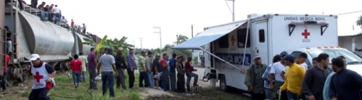
BASIC ASSISTANCE AND FEATURES
ICRC
Meeting the basic needs and contributing to the protection of migrants in vulnerable situations.
Basic health care at border crossings and areas not covered
Assistance to re-establish contact with family members
Assistance for the return transport of deported boys, girls and adolescents
Assistance for persons with amputations, serious injuries or diseases
Water and sanitation projects in shelters
Visiting migration stations, communicating with relevant authorities
Support for the Centre for Assistance to Returned Migrants in Honduras, Guatemala and Mexico: RFL, health, water
Support for the Centre for Assistance to Victims of Violence in Guatemala (psychosocial support)
Psychosocial support for family members of missing migrants in El Salvador

Slide 4
ICRC
The ICRC, together with civil society, has carried forward the programme for assistance to migrants with the following primary objective:
To provide access to high-quality health care for migrants in transit and returned migrants in Mexico and Central America.
The assistance includes: Basic health care;
Referral;
Telephone calls;
Guidance;
Support for transport;
Shelter, in some cases.

Slide 5
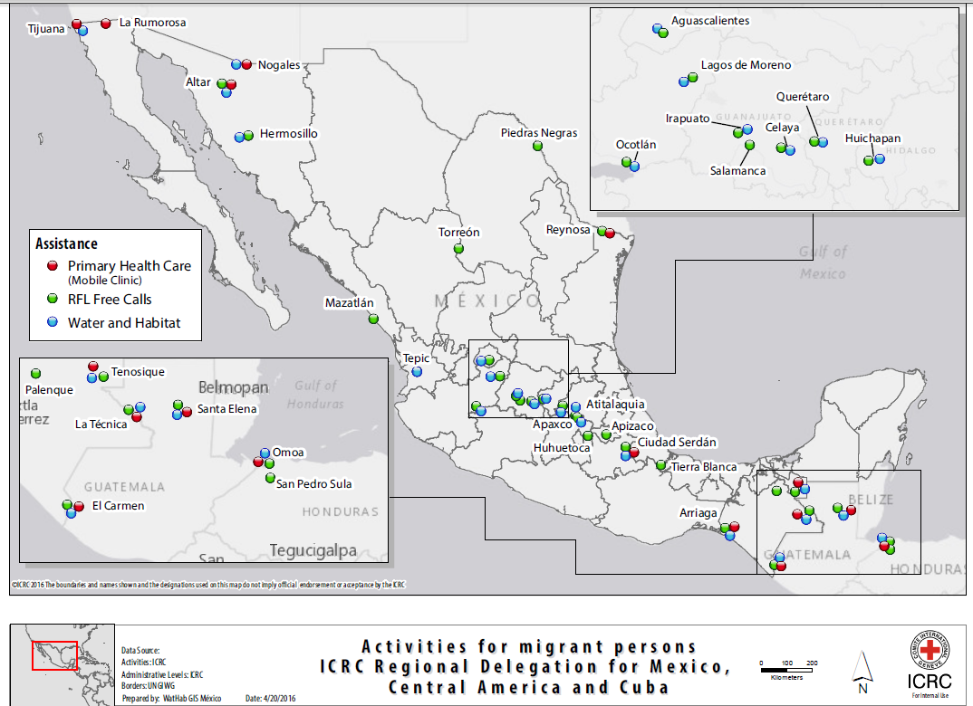
ASSISTANCE ALONG THE MIGRATION ROUTE
ICRC
In collaboration with local civil society in the region:

Slide 6
EVOLUTION OF THE NUMBER OF CASES WHO RECEIVED HEALTH CARE AT A REGIONAL LEVEL
Mexico, Guatemala AND Honduras
2015 - 2016 (JANUARY-JULY)
ICRC

Slide 7
Number of persons who received health care AT A REGIONAL LEVEL, by gender
Mexico, Guatemala and Honduras
2015 - 2016 (january-july)
ICRC

Slide 8
Number of persons who received health care AT A REGIONAL LEVEL, by AGE
Mexico, Guatemala and Honduras
2015 - 2016 (january-july)
ICRC
Notes:
México: > 15 años 98.5%, < 15 años 1.5%
Guatemala: > 15 años 98%, < 15 años 2%
Honduras: 100% > 15 años

Slide 9
Most frequently IDENTIFIED diseases during medical consultations in the region
Mexico, Guatemala and Honduras
2015 – 2016 (january - july)
ICRC
Notes:
Los mayores casos de Diabetes son registrados en México, Estado de Sonora (Altar y Nogales)

Slide 10
ICRC
Humanitarian Assistance for Migrants with
Amputations, Serious Injuries or
Diseases

Slide 11
Actions in coordination with civil society in the region and other organizations involved with migrant populations (consulates, the National Institute of Migration – INM, health facilities of the Secretariat of Health, the International Organization for Migration – IOM);
Surgical and osteosynthesis materials;
Rehabilitation before and after prostheses; prostheses and orthoses;
Coordination for transfer and medical accompaniment during transfer, if required, (together with civil society) to the country of origin;
Support for medical follow-up in the country of origin for 3 months after the return;
Integration into the physical rehabilitation programme in facilities supported by the ICRC in the country of origin; support with replacement of prostheses and re-modelling of stumps, if necessary.
ICRC

Slide 12
ICRC
Three of the programmes executed by the ICRC in the region converge:
Assistance for migrant populations victims of violence;
The physical rehabilitation programme;
The surgery programme.
The complementarity of the three programmes is obvious, given the nature of the specific health needs of returned migrants.

Slide 13
NUMBER OF CASES OF HUMANITARIAN ASSISTANCE provided to MIGRANTS WITH AMPUTATIONS AND/OR SERIOUS INJURIES
MEXICO
2015 – 2016 (JANUARY-JULY)
ICRC
2015
Number of cases of PROSTHESES | 21
Number of cases of OSTEOSYNTHESIS MATERIALS | 5
Orthoses and other support (wheel chair, crutches, canes, medication, medical studies, transfer by ambulance) | 22
2016 (January – July)
Number of cases of PROSTHESES | 21
Number of cases of OSTEOSYNTHESIS MATERIALS | 16
Orthoses and other support (wheel chair, crutches, canes, medication, medical studies, transfer by ambulance) | 14

Slide 14
NUMBER OF CASES OF HUMANITARIAN ASSISTANCE provided to MIGRANTS WITH AMPUTATIONS AND/OR SERIOUS INJURIES
MEXICO
2015 – 2016 (JANUARY-JULY)
ICRC

Slide 15
ORTHOSES DELIVERED
ICRC

Slide 16
ACTIVITIES OF THE ICRC AT MIGRATION STATIONS (EM) IN MEXICO
ICRC
Objective: To verify the conditions of migrants at migration stations.
Multidisciplinary teams of the ICRC, composed of PROT, ASSISTANCE (health, including SM&APS and Wathab) and FIELD visits to migration stations throughout the country;
The health system is present at the migration stations; composed of health practitioners hired under different modes by the migration stations, INM or SSA;
Deficient quality of health care, does not cover public health aspects for populations in confinement conditions.

Slide 17
MIGRATION STATIONS
ICRC
The health system at the migration stations has little connection to the general health system outside the migration stations;
Lack of knowledge of health needs at migration stations and lack of provision, by health authorities, of the resources required to meet health needs;
Absence of programmes of the national health system at the migration stations.

Slide 18
ICRC
Challenges

Slide 19
CHALLENGES
ICRC
Achieving access to health care for migrant populations, not only emergency care, and for all levels of complexity;
Lack of information and awareness of the health workers;
A health system without a proper basis in countries of origin of returned migrants;
Migration stations with health care services equivalent to the health care provided outside the migration stations.

Slide 20
CHALLENGES
ICRC
To have access to high-quality and integrated medical qualitative and quantitative statistical data;
An epidemiological profile of migrant populations;
Monitoring their constant variations to be able to anticipate what resources are required to cover emerging needs;
With participation of the different health systems at a regional level, which are ultimately responsible for providing these resources as well as the required health care.

Slide 21
CHALLENGES
ICRC
Active, dynamic and coordinated monitoring of the migration routes;
Identifying emerging needs associated to new contexts in the phenomenon of migration (for example, health > southern border > new migration routes in Mexico > increased vulnerability of migrant populations to forgotten and emerging diseases such as Chagas, Zika, etc.)

Slide 22
CHALLENGES
ICRC
Addressing the issue of sexual violence along the migration route;
The main problem associated to migration;
Addressing this issue in a comprehensive and coordinated manner;
A response adapted to mobility (protocols) and sometimes, limited visibility of migrant populations.

Slide 23
CHALLENGES
ICRC
Coordinating actions to assist migrants that are carried out by different national and international organizations and institutions in the region.

Slide 24
CHALLENGES
ICRC
Achieving (for the ICRC, through the surgery programme) the required impact in the implementation of correct amputation procedures, with the aim of improving the social reintegration of returned migrants and reducing their need to use the health system in the country of origin.

