Slide 1
ICRC
Actions of the International Committee of the Red Cross to Address
Migration Matters in Mexico and Central America and
Effective Practices Observed
Regional Conference on Migration
San Pedro Sula, Honduras
November 2016

Slide 2
ICRC
The International Red Cross and Red Crescent Movement is committed to meeting the humanitarian needs of migrants, particularly those in highly vulnerable situations, regardless of their migration status.
The reasons why the International Committee of the Red Cross (ICRC) implements actions relating to migration in the region are:
Humanitarian needs;
Added value of the ICRC because of its experience and presence in the region;
Links between migration and violence;
Complementariness/coordination with other actors.

Slide 3
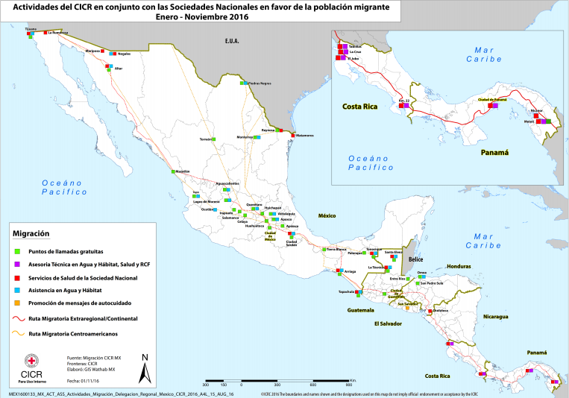
ASSISTANCE ALONG THE MIGRATION ROUTE
ICRC
In collaboration with the Red Cross national societies in the region:

Slide 4
SHARED RESPONSIBILITY
ICRC
Working with an approach of collaboration between States oriented toward the well-being of persons and their protection and assistance. Does not replace the individual responsibilities of each State.
States should strengthen their coordination efforts and their collaboration with humanitarian aid organizations and organizations providing assistance in order to understand, expand and improve access of migrants to basic assistance and protection services.

Slide 5
Problems of a humanitarian nature
ICRC
Access to basic health care;
Policies and practices on return and/or deportation and detention of migrants;
Unaccompanied migrant boys, girls and adolescents;
Missing migrants.

Slide 6
BEST PRACTICES – ACCESS TO HEALTH CARE
ICRC
Problems:
Lack of active, dynamic and coordinated monitoring actions along the migration route;
Lack of access to health care;
Lack of information and awareness-raising of health service providers about the rights of migrants;
Absence of protocols for health care adapted to populations on the move;
Lack of integration of health services into detention centres.
Recommendations:
To ensure access to health care for everyone, including migrant populations;
Protocols for health care adapted to populations on the move;
Awareness-raising of public health officials on the rights of migrants;
Access to high-quality and appropriate health care for persons in custody of immigration authorities;
To identify the specific needs of persons with amputations and to provide appropriate assistance to meet their needs.

Slide 7
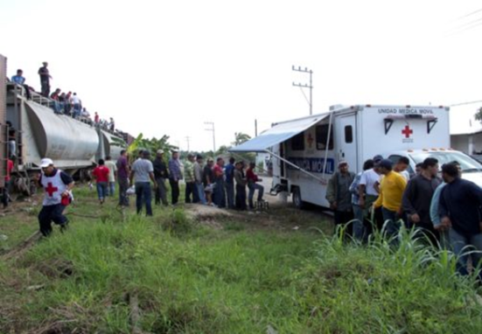
Best Practices:
  Health services initiated by Red Cross national societies progressively taken on by the health care systems in each country;
  Applying protocols for assistance for populations on the move;
  Alliances to integrate migrants with amputations into rehabilitation programmes.
ICRC

Slide 8
BEST PRACTICES – MANAGEMENT OF MIGRATION FLOWS
ICRC
Problems:
  Systematic detention of migrants;
  Lack of access to health care, counselling and legal aid;
  Separating family units;
  Lack of information for migrants on their rights and alternatives.
  Recommendations:
  Detention of migrants should be an exceptional measure, always considering alternatives to detention first, especially for migrants in vulnerable situations.
  Detention of migrants should not be used as a deterrent.
  Detention should only be ordered on a case-by-case basis, without any discrimination whatsoever.

Slide 9
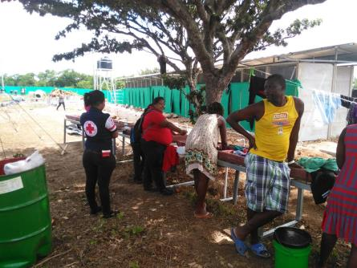
BEST PRACTICES
ICRC
Actions by relevant authorities, together with civil society, to provide alternatives to detention for unaccompanied boys, girls and adolescents and refugee status applicants;
Reception processes for migrants in countries of transit;
Actions oriented toward strengthening the capacities of civil society in regard to accommodation for migrants.

Slide 10
BEST PRACTICES – missing persons and their relatives
ICRC
Problems:
High risk for migrants of going missing along the migration route;
Absence of regional mechanisms facilitating the search for missing persons;
Breaking of family links.
  Recommendations:
  To prevent and investigate cases of missing persons, facilitating actions to maintain family links and family unity;
  To recognize the role of consular representations, considering their key role in seeking information about missing persons and the need for consulates to provide consular protection;
  To establish regional mechanisms to facilitate the search for missing persons – alive and dead – and ensure that family links are restored.

Slide 11
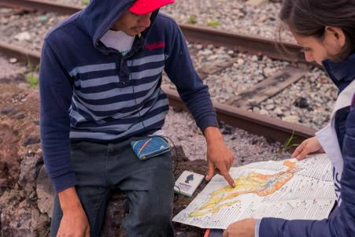
Best Practices
Including the topic of missing migrants in discussion groups and management mechanisms concerning the matter of missing persons;
Disseminating messages about self-care and increasing the number of call points to prevent and mitigate the risk of going missing;
Developing a regional database of finger prints and/or linking existing forensic databases;
Coordination in border regions between authorities, consulates and civil society.
ICRC

Slide 12
BEST PRACTICES – RETURN AND/OR DEPORTATION PROCESSES
ICRC
Problems:
Systematic return and/or deportation processes;
Failing to comply with the principle of non-refoulement;
Humanitarian consequences of deportation/return processes (family separation, alleged abuse, forced return, etc.)
Recommendations:
To comply with the principle of non-refoulement, in accordance with international law and the commitments taken on by States, and to ensure access to procedures for refugee status, complementary protection, political asylum or statelessness;
To provide special assistance to persons who may be in vulnerable situations;
Every person who is deported must be returned under dignified conditions;
Every return and/or deportation process should be implemented with minimal humanitarian consequences.

Slide 13
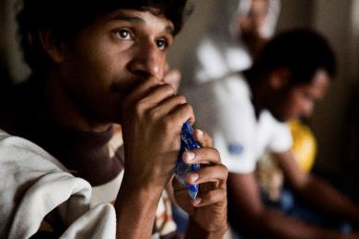
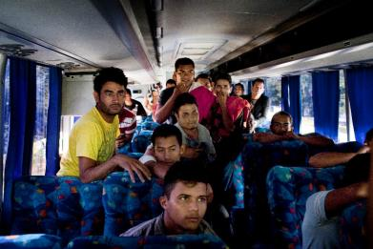
Best Practices
- A project for a Consular Centre for Protection to Migrants to provide protection and assistance to migrants and ensure that they are treated with respect and dignity;
- Return and reception of persons under dignified conditions;
- A new role of consular officers as helpers in refugee status application processes of nationals of the country they represent.
ICRC

Slide 14
COMMITMENT OF THE MOVEMENT
Adoption of the Toluca Declaration, November 2016
Commitments taken on by 25 national societies, ICRC & IFRC:
To strengthen coordination between the different components of the Movement;
Greater involvement of national societies in providing humanitarian aid to migrants.
ICRC

Slide 15
ANY QUESTIONS?
ICRC
Thank you

