Slide 1
WORKSHOP ON UNSCRUPULOUS IMMIGRATION CONSULTANTS
TALLER SOBRE TRAMITADORES DE INMIGRACION INESCRUPULOS
Ciudad de Guatemala
15 -17 December/Diciembre 2014
Notes:
Holding Slide

Slide 2
Presentation Outline
The Canadian Experience
  Introduction to Citizenship and Immigration Canada
  Overview and history of the immigration representatives issue
Legislative Changes
  Overview and intent of legislative changes
Regulatory Body
  The Immigration Consultants of Canada Regulatory Council (ICCRC)
Public Awareness Campaign
  Canada’s efforts to promote, inform and engage on all aspects of authorized representatives

Slide 3
The Immigration Process
People seek to come to Canada for many reasons:
  Tourists
  Temporary Workers
  Students
  Skilled Workers
  Family reunification
People who come to Canada must meet entry visa requirements:
  There are a number of requirements that applicants need to meet before entering Canada. These include meeting health and security admission criteria and possessing valid travel documents.
Applicants often turn to immigration representatives to help with their processes:
  Representatives give immigration advice and help to visa applicants, usually for a fee.

Slide 4
The Canadian Experience
Overview and history of the immigration representatives issue
Before 2003 – immigration consultants were unregulated. There was widespread concern about practices in the immigration consulting industry which left vulnerable people exposed to misleading advice and exploitation.
No regulation meant anyone could call themselves an immigration representative. Challenges Included:
  No Training
  No Certification
  False promises
  Excessive fees
  Exploitative/coercive behaviour
  Incorrect advice

Slide 5
The Canadian Experience Continued
Regulating the Industry
  Canadian Society of Immigration Consultants (CSIC) was formed in 2003 to regulate immigration consultants.
  The Immigration & Refugee Protection Regulations (IRPR) were amended in 2004 to recognize CSIC as the new governing body of immigration consultants and identify who could provide immigration advice for a fee.
  “Authorized representative” was defined as a member in good standing with the Canadian Society of Immigration Consultants (CSIC), a provincial law society, or the Chambre des notaires du Québec.

Slide 6
The Canadian Experience Continued
Standing Committee Report
  Despite the amendments to the Immigration and Refugee Protection Regulations (IRPR) and the introduction of a regulatory body, concerns remained regarding the regulation of immigration consultants.
  There were concerns from CSIC members including:
    Governance and transparency issues
    High membership fees

Slide 7
Public Consultation on Immigration Consultants
In the Spring of 2009, the Minister for CIC announced the launch of a public information campaign to combat immigration fraud and to warn against unscrupulous immigration representatives.
In addition to town-hall meetings, an online public survey was developed to gather information from individuals who used immigration consultants.
11,200 individuals responded to the survey. Of those, 38% (4,282 people) completed the full questionnaire.
Key message of the responses - that the applicant needs to research the immigration process, their potential consultant and maintain an active role in their application process.

Slide 8
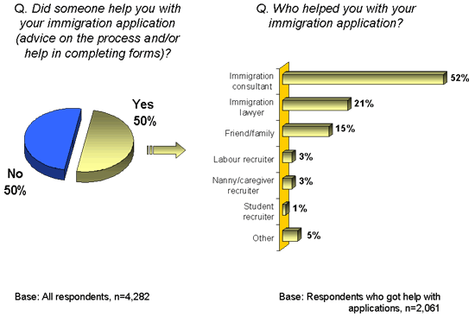
Results of Public Consultation on Immigration Consultants
Seeking help with an immigration application

Slide 9
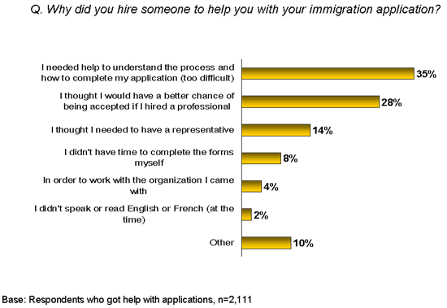
Results of Public Consultation on Immigration Consultants
Reasons for Seeking Help

Slide 10
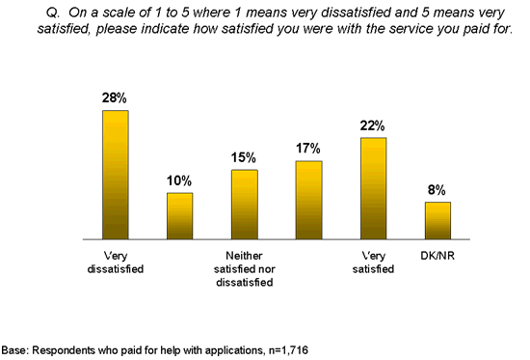
Results of Public Consultation on Immigration Consultants
Experience with immigration assistance
Satisfaction with services paid for was evenly split among respondents.
Virtually the same proportions of respondents were very or somewhat satisfied (39%) or very or somewhat dissatisfied (38%) with the service they paid for. However, more respondents reported being “very” dissatisfied (28%) than “very” satisfied (22%). More than one in 10 (15%) said they were neither satisfied nor dissatisfied.

Slide 11
Legislative Changes
Overview and intent of legislative changes
Amendments were made to the Immigration and Refugee Protection Act and came into force on June 30, 2011. They introduced a number of improvements to the regulations to protect immigrants and the integrity of Canada’s immigration program.
New offence provision. It is an offence for anyone other than an authorized representative to knowingly advise or represent a person:
  for a fee or other consideration
  in connection with an application or proceeding under the IRPA
Provided the Minister the ability to designate, or revoke the designation of, a governing body.

Slide 12
New Regulatory Body - ICCRC
New regulatory body: The Immigration Consultants of Canada Regulatory Council (ICCRC) was established June 30, 2011.
  The ICCRC was designated as the governing body to regulate immigration consultants because it demonstrated it has the necessary competence, integrity, accountability, good governance and viability to effectively regulate the immigration consultant profession in the public interest.
  The 2013 ICCRC Annual Report lists over 2,700 Regulated Canadian Immigration Consultants (RCICs).
  The ICCRC has an up-to-date membership list on its website which can be searched by name, business name, or ICCRC membership number.

Slide 13
About the ICCRC
The ICCRC is an independent national not-for-profit corporation designated by Citizenship & Immigration Canada.
The ICCRC ‘s vision - To be an effective, fair and transparent regulator of the Canadian immigration consulting profession.
As the national regulator of Canada’s immigration consulting profession the ICCRC’s mission is to protect consumers of immigration services through effective regulation of immigration consultants and promotion of the benefits of using only authorized immigration representatives.

Slide 14
Who can be a RCIC?
Must be at least 18 years of age and a Canadian citizen, Canadian Permanent Resident, or a Status Indian within the meaning of the Canadian Indian Act.
Must graduate from an Immigration Practitioner Program (course of studies) accredited by the ICCRC.
Must pass a Full Skills Exam (FSE).
Must pass an ICCRC-approved language proficiency test (English or French).
Must not have a criminal record and not be in bankruptcy.
Must attest to good character and good conduct consistent with ICCRC Code of Professional Ethics.

Slide 15
Authorized Representatives
Authorized Representatives |  | Unpaid Representatives
Must be members in good standing with: |  | Must not charge a fee or consideration:
A Canadian provincial/territorial law society |  | Family or friends
The Chambre des notaires du Quebec |  | Non-governmental and religious organizations
The Immigration Consultants of Canada Regulatory Council (ICCRC) |  | International organizations which have agreements with the Government of Canada
CIC will not deal with representatives who charge for their services and are not members of one of the above groups |  | Some International organizations and others that have agreements with the Government of Canada can be compensated. An example is the International Organization for Migration (IOM).

Slide 16
Stakeholders dos and don’ts
Dos | Don’ts
Direct someone to the CIC website to find information on: Immigration programs Application forms, or Authorized immigration representatives Provide services such as: Translation Travel arrangements Couriers Advise international students on how to select their courses or register Conduct job interviews | Explain and/or advise on someone’s immigration options Guide a client on how to select the best immigration stream Complete and submit immigration forms on a client’s behalf Communicate with CIC and the CBSA on a client’s behalf (except for direct translation of a client’s written or spoken submissions) Represent a client in an immigration application or proceeding Represent a client in an arranged employment opinion or labour market opinion application Advertise that they can provide immigration advice for consideration

Slide 17
CIC Operational Procedures
All applicants must submit a Use of Representative form (IMM 5476) if they are using a representative (paid or unpaid).
CIC checks all IMM5476 forms to ensure the representative is authorized.
CIC checks the listed representative and their unique identification number on-line to validate their status with the ICCRC or a Canadian provincial/territorial law society or the chambre des notaires in Quebec.
Only one representative may be named per application.
CIC must be notified of any change of representative.

Slide 18
Complaint Process
If the representative is a lawyer, Quebec notary, a student-at-law, or a paralegal regulated by a law society:
  The complaint should be filed with the regulatory body to which the representative belongs (e.g., a Canadian provincial/territorial law society, the Chambre des notaires du Québec).
If the representative is a member of the Immigration Consultants of Canada Regulatory Council (ICCRC):
  The complaint against the regulated consultants should be filed with the ICCRC.
If the compliant is launched by an officer or CIC staff member, CIC will file the complaint with the respective regulatory body.

Slide 19
The ICCRC Complaints and Discipline Process
COMPLAINT
Unauthorized Representative
RCIC
Law Enforcement Agencies (RCMP or CBSA)
Director of Complaints & Discipline
Resolution between Complainant & RCIC
No Resolution between Complainant & RCIC
Complaints Committee
Settlement between Complainant & RCIC
Caution or admonition to the RCIC
Discipline Committee
Refuse to refer to Discipline Committee
Not guilty
Guilty
Penalty
673 complaints against members since ICCRC was established.
711 complaints against unauthorized representatives since ICCRC was established.

Slide 20
New Regulatory Provisions
April 2012 - Information Sharing Regulations came into force:
  The amendment to the Immigration and Refugee Protection Regulations (IRPR) authorized CIC, the Canada Border Services Agency (CBSA) and the Immigration and Refugee Board (IRB) to disclose information relating to the professional or ethical conduct of representatives to their respective governing bodies.
  The Information Sharing Regulations require the designated body of immigration consultants to provide information to the Minister which would assist in evaluating whether it is governing in the public interest, and Regulations to facilitate the disclosure of information concerning the ethical or professional conduct of immigration representatives to those responsible for governing or investigating that conduct.

Slide 21
Challenges
Regulating the immigration representative business has been successful, but not without its challenges.
  Ensuring all stakeholders understand and follow the Use of Representatives rules and regulations.
  Protecting vulnerable potential immigrants, newcomers, students and others, not just from fraudulent representatives, but from incompetent representatives who are trying to help (student advisers, travel agents, adoption agencies, etc).
  Minimizing the “grey areas” such as the challenge of determining whether an institution or individual has received “consideration.”

Slide 22
Public Awareness Campaign
  International Cooperation:
  January 2009 - CIC Minister launched the international strategy on bilateral visit to India.
  Bilateral engagements continued during trips to India, China, the Philippines, Australia and Europe (2010) and Pakistan (2011).
  2011 – A coordinated media campaign was launched with the support of Australia, New Zealand, the United Kingdom and the United States. The overseas campaign was aimed at prospective immigrants, permanent residents and Canadian citizens.
  Presentation on efforts to regulate immigration consultants at the 2011 Regional Conference on Migration in Santo Domingo, Dominican Republic.
  June 2013, Secretaría de Gobernación (SEGOB) - CIC meeting in Ottawa.
  February 2014, Mexico City, Mexico – Workshop on Unscrupulous Consultants.

Slide 23
Public Awareness Campaign Continued
Canada’s Efforts
Multilingual domestic advertising campaign warning people not to be taken in by crooked immigration consultants launched in 2011.
CIC has developed additional communication products and made the information on authorized immigration representatives more prominent on our website for each line of business. Outreach materials on the CIC website are more visible and readily accessible. The strategy developed includes key messages for those working with stakeholders (educational institutions, HR professionals, travel agents etc).
In March 2014, CIC ran a public awareness campaign with the ICCRC and Federation of Law Societies of Canada on the topic of authorized immigration representatives.

Slide 24
Partnership Building
CIC is Committed to Strong International Partnerships:
  Robust stakeholder engagement strategy.
  Ongoing open dialogue with all partners to combat unscrupulous behaviour by consultants.
  Communication with the public on anti-fraud practices.
  Information sharing practices with partners.
  Joint anti-fraud measures with partners.

Slide 25
Discussion and Questions and Answers
More information and resources
http://www.cic.gc.ca/english/resources/publications/consultations/consultations.asp#who
http://www.cic.gc.ca/english/e-services/portal.asp
http://www.iccrc-crcic.ca/home.cfm?setLanCookie=En
Merci!

