Slide 1
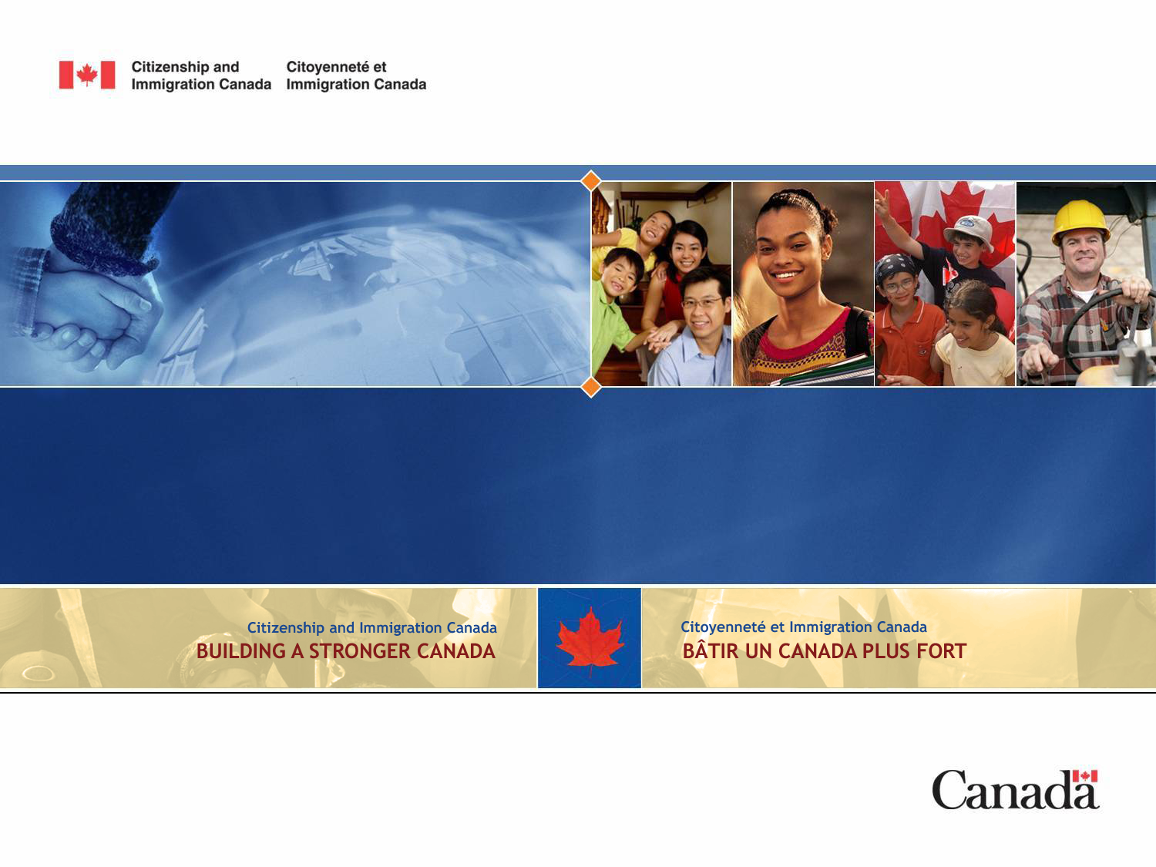
Regional Workshop on Temporary Protection Status and/or Humanitarian Visas in Situations of Disaster
February 2015

Slide 2
OVERVIEW
Removals Policies (Temporary Suspension of Removal (TSR) and Administrative Deferral of Removal (ADR))
Pre-Removal Risk Assessment (PRRA)
Difference between TSR/ADR and PRRA
Special Measures
Public Policy Provisions
Consular Assistance
Humanitarian Assistance

Slide 3
Removals Policies
A Temporary Suspension of Removals (TSR) prevents removals by the Canada Border Services Agency (CBSA) to a country or place when conditions such as war or environmental disaster threaten the lives or security of the entire population.
Examples of a Temporary Suspension of Removals (TSR) include Haiti (since 2004) and Zimbabwe (since 2002). The TSR imposed on both were lifted on December 1, 2014. The conditions in Haiti and Zimbabwe improved and the Government of Canada considered that there is no longer a generalized risk to the entire civilian population in these countries.
An Administrative Deferral of Removal (ADR) is imposed by the CBSA when immediate action is needed to temporarily defer removals in situations of humanitarian crisis. An ADR is generally imposed under short timeframes.

Slide 4
Pre-Removal Risk Assessments (PRRA)
The Pre-Removal Risk Assessment (PRRA) is a potential safety net for individuals who may face new risks following a negative asylum claim decision at the Immigration and Refugee Board (IRB).
A PRRA evaluates whether a person would face persecution, torture, risk to life or risk of cruel and unusual treatment or punishment, if returned to his or her country of origin.
The Bar on Access to the PRRA
Changes in conditions within a country of origin may arise that could put failed claimants at risk of refoulement if returned.
Retroactive to one year, nationals, or a class of nationals from an exempted country are permitted to access a PRRA.
The purpose of the bar on PRRA is to streamline the asylum system and enable faster removals of failed claimants.

Slide 5
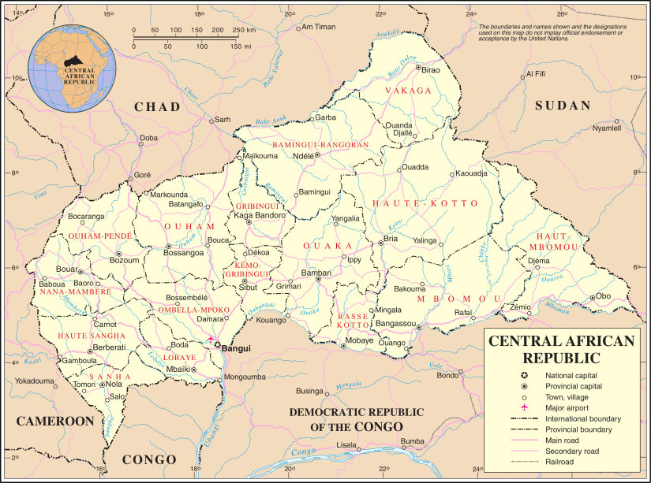
PRRA Bar Exemptions
However, circumstances may arise in a country of origin that would warrant a new risk assessment, thus the IRPA allows for an exemption to the bar on access to the PRRA.
The most recent example was for the Central African Republic.
Example: Central African Republic (CAR)
Violence between the Christian and Muslim populations significantly escalated in December 2013.
Lack of state protections meant a significant increase in personalized risk to nationals of CAR if removed from Canada – particularly if they were Muslim or Christian.
This change in country conditions in CAR prompted CIC to institute an exemption to the bar on PRRA between May 12, 2013, and
May 11, 2014.

Slide 6
Differences Between ADR/TSR and PRRA
Administrative Deferral of Removal and Temporary Suspension of Removal are based on generalized risk to an entire population, while the Pre-Removal Risk Assessment takes into account individualized risk.
The PRRA allows for a review of the risk factors for an asylum claimant who had a negative decision at the IRB, while ADRs and TSRs only temporarily suspend removals of failed asylum claimants because of the situation in the country of origin.

Slide 7
Special Measures
CIC responds operationally to victims of natural disasters – for example, priority processing of Permanent Resident applications for family members affected by a natural disaster.
This was done for victims of Typhoon Haiyan and in other cases.

Slide 8
Humanitarian and Compassionate and
Public Policy Provisions
Section 25.2 of the Immigration and Refugee Protection Act (IRPA) authorizes the Minister of CIC to grant permanent resident status, or an exemption from any criteria or obligations of the IRPA, based on public policy considerations.
Public policies are created at the discretion of the Minister, and have been used to admit vulnerable minorities and persons in refugee-like situations to Canada for humanitarian reasons, including those affected by natural disasters.

Slide 9
Humanitarian and Compassionate and
Public Policy Provisions (cont’d)
Special measures for Victims of Sexual Violence in Haiti (2011)
Admitting 40 victims of sexual violence
in Haiti, plus their dependants, who
were displaced by the earthquake and
were identified by UNHCR as being in
need of protection.
Alberta flood special assistance measures (2013)
Automatically extending or restoring the status of affected temporary residents, and waiving certain fees and other specific requirements for temporary and permanent residents, and for Canadian citizens whose passports and other documents were lost, damaged or destroyed.

Slide 10
Consular Assistance
Canada uses a number of tools to provide consular assistance to Canadians overseas affected by natural disasters or by conflict:
  Standing Rapid Deployment Team
  Safe transportation to the closest safe location;
  Standard Operating Procedures;
  The Stabilization and Reconstruction Task Force managed by the Department of Foreign Affairs, Trade and Development; as well as
  Specific consular policies and procedures to identify and process citizens.
  Emergency Watch and Response Center (CEC)

Slide 11
Humanitarian Assistance
The Department of Foreign Affairs, Trade and Development responds to crises through the provision of humanitarian assistance.
Canada's response is the result of close cooperation among DFATD humanitarian aid officers, representatives of other departments, and other international partners, such as the Office of the United Nations High Commissioner for Refugees, the International Committee of the Red Cross, and the World Food Programme.

Slide 12
QUESTIONS?
Contact: caroline.fahmy@cic.gc.ca

