Slide 1
Regional Conference on Migration
Canadian Consular Services
Mexico – November 2015

Slide 2

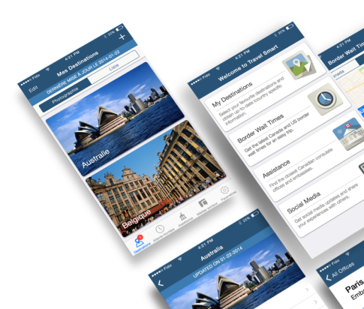
Travel Smart Mobile App
CURRENT MOBILE APP
Low User Adoption
Difficult, counter-intuitive to acquire
Does not leverage smart phone functionality
No notification, no device storage, no geo-location
RELEASE 2
More interactive features
  Travel Wizard
  Registration
  International Emergencies
MODERNIZED SOLUTION (RELEASE 1)
Downloadable from Apple iStore and Google Play Stores
Leverages device functionalities
First Native app produced by DFATD
Features:
  Country Travel Advice/Advisories
  Canada/US Border Wait Times
  Assistance Coordinates Abroad
  Social Media
  Offline info can be accessed without network connectivity
Notes:
In 2013, the Travel Smart mobile Web app was launched providing Canadians with essential travel information. The previous app was available as a “web application” only, meaning it was not available in popular app stores. At that time, no advertising budget was allotted, and due to an unfamiliar method of installing the app, limited pickup was achieved despite existing promotional efforts (web, social media, and outreach events).
A new Travel Smart app has been developed from the ground up and will be through the Apple app store and Google Play making it more accessible to Canadian users. This mobile app is part of DFATD’s ongoing 21st Century Consular Plan.
The approach to the app was to release a tool that would provide Canadians access to a first set of information that is most frequently accessed from our travel.gc.ca website. The app will make available real-time access to:
Country Travel Advice and Advisories
Canada/US Border Wait Times
Assistance Coordinates for Government of Canada Offices Abroad, and
Social media feeds for Travel.gc.ca
It will also leverage the device storage to provide access to the information offline.
The notification feature of the phone will push a notification on updates to the information, particularly the Travel Advice or Advisory of a particular destination.
Geo-location features can also be enabled to access more precise location specific information such as the nearest Canada-US border wait time.

Slide 3
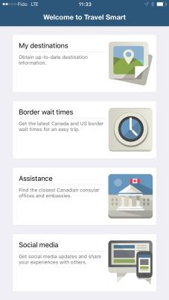
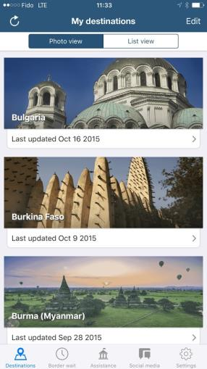
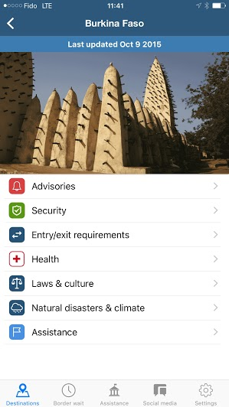
Travel Smart Mobile App
Notes:
Canadian travellers will be able to access the Government of Canada’s Travel Advise and Advisories for their travel destination.
They will able to access real-time data, which has been time stamped for the cases where the information was being accessed offline.
The user of the app will be able to select as many destinations as they want to have access to.
Other features include having an enhanced user interface and design that would visually indicate an “avoid travel advisory”.

Slide 4
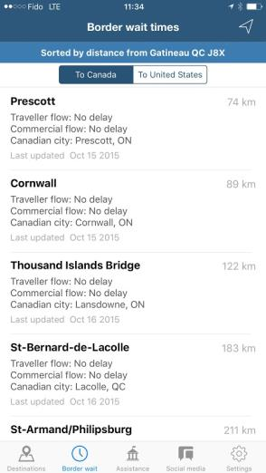
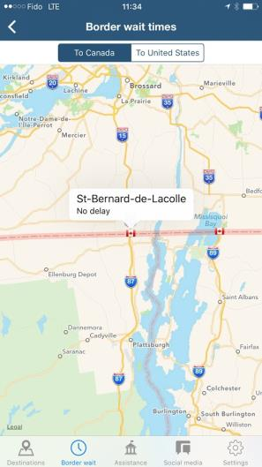
Travel Smart Mobile App
Notes:
Border wait times are one of the most visited pieces of information on the travel.gc.ca website.
The enhance Travel Smart app will be able to leverage geolocation features (if enabled) to present more precise information on border wait times based on your geolocation.

Slide 5
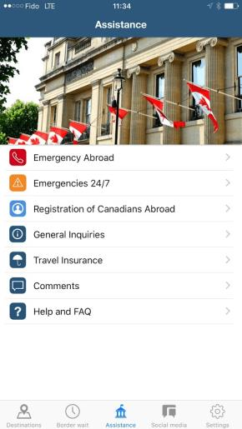
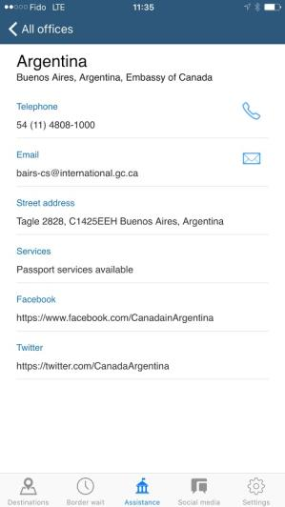
Travel Smart Mobile App
Notes:
The new Travel Smart mobile app will also make available assistance coordinates for the destinations selected.
The app will allow the user to dial, email and link to the appropriate contact channel available on the mobile device.
It will also provide the ability to reach the central Emergency Watch and Response Center in Ottawa for Emergencies 24/7.
In the first release, there will be links to the Registration of Canadians Abroad and for future releases we will be looking at more enhanced access to information on those Canadians who may be in an affected zone of an international emergency event abroad.
We also have a general inquiries line, a channel to receive feedback or comments on the App and a small help section.

Slide 6
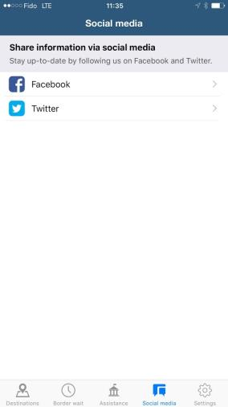

Travel Smart Mobile App
Notes:
Last but not least, we have introduced a social media section that would allow the user to access social media feeds.
The first release is scoped to provide access to the travel.gc.ca channels which is a good start since these channels are very current and often tweet and retweet the l (mission/country) social media messages, as well a host of other messaging that they follow.
Future releases will consider making the mission/country social media presence also available.
Future releases are currently being discussed and will focus on making information during an international emergency event more available. Links to service delivery triaging solutions such as the Travel Wizard (which we will talk about shortly) will also be looked at.
The approach is to design and launch an iterative viable product. We will also be using in-application analytics to guide modifications and enhancements.

Slide 7

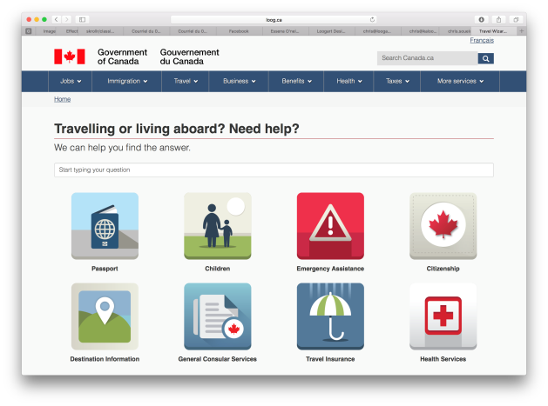
Travel Wizard
Current Scope
19 Scenarios
Emergency Services
General Consular Services
Passport/Citizenship Inquiries
Traveling with Children
Travel Insurance Inquiries
Outcomes
One succinct answer to frequent routine inquiries
Self-help to lists, fees, and other relevant information
Metrics analysis
Content Governance
Notes:
The Travel Wizard is an interactive online tool that will triage high volume and routine inquiries.
It will encourage self-help to information such as lists of lawyers, consular fees, local instructions, hours of operations and other relevant information required to obtain consular assistance abroad.
The first version of the Travel Wizard will make 19 scenarios available. These include frequently asked questions on:
Travel prepardeness such as entry/exit requirements or dual citizens
Emergency assistance when abroad, such as medical asssitance, lost passports, etc. and
General services such as the authentication of documents, just to name a few.
The Travel Wizard is still under development and targeted to be released in early 2016.

Slide 8
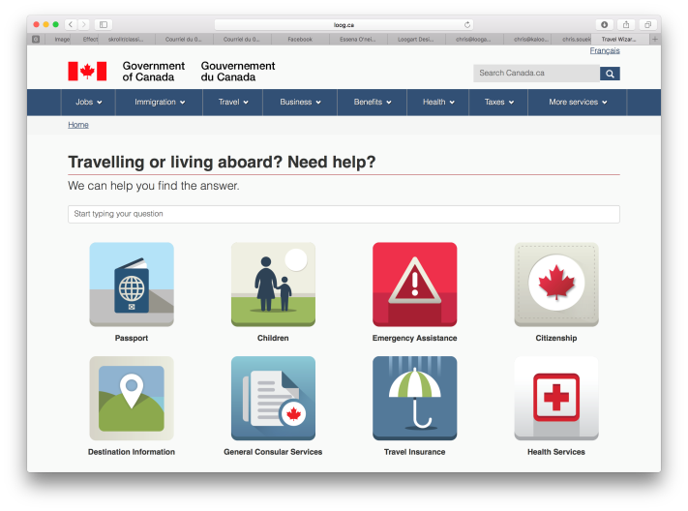
Travel Wizard
Notes:
Clicking on a tile will give you access to a certain set of scenarios.
You can also use a search bar that will recognize keywords and provide you another way to access the various scenarios in the Travel Wizard.
For example, if you had an inquiry about how to renew your passport abroad, you would click on the Passport tile.

Slide 9
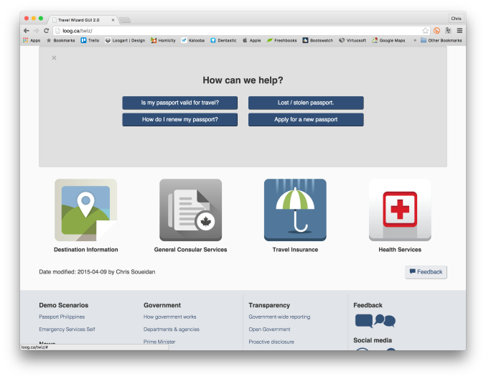
Travel Wizard
Notes:
The Passport tile would give you access to the four scenarios we have prototyped.
Clicking on How do I renew my passport? You will get a series of triaging questions that will help build your answer (next two screens)

Slide 10



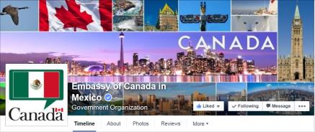

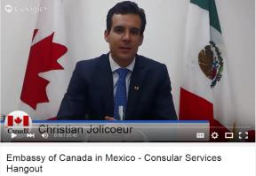
Social Media

Slide 11
