Slide 1
Conferencia Regional sobre Migración
Servicios Consulares de Canadá
México, noviembre de 2015

Slide 2

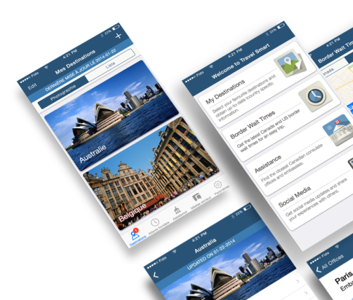
Aplicación para teléfono móvil
“Travel Smart”
APLICACIÓN ACTUAL PARA TELÉFONO MÓVIL
Bajo índice de adopción por usuarios
Difícil, adquisición contraria al sentido común
No aprovecha la funcionalidad de los teléfonos inteligentes
No cuenta con notificación ni almacenamiento de dispositivo ni localización geográfica
SEGUNDA EDICIÓN
Más características interactivas:
  Asistente de viajes
  Registro
  Emergencias internacionales
SOLUCIÓN MODERNIZADA (PRIMERA EDICIÓN)
Se puede descargar en “iStore” de Apple y
“Play Stores” de Google
Aprovecha las funcionalidades de los dispositivos
La primera aplicación local producida por DFATD
Características:
  Asesoría de viaje en el país/avisos
  Tiempos de espera en la frontera entre Canadá y los Estados Unidos
  Coordenadas de asistencia en el extranjero
  Medios sociales
  Se puede obtener acceso a información fuera de línea sin conectividad en red
Notes:
In 2013, the Travel Smart mobile Web app was launched providing Canadians with essential travel information. The previous app was available as a “web application” only, meaning it was not available in popular app stores. At that time, no advertising budget was allotted, and due to an unfamiliar method of installing the app, limited pickup was achieved despite existing promotional efforts (web, social media, and outreach events).
A new Travel Smart app has been developed from the ground up and will be through the Apple app store and Google Play making it more accessible to Canadian users. This mobile app is part of DFATD’s ongoing 21st Century Consular Plan.
The approach to the app was to release a tool that would provide Canadians access to a first set of information that is most frequently accessed from our travel.gc.ca website. The app will make available real-time access to:
Country Travel Advice and Advisories
Canada/US Border Wait Times
Assistance Coordinates for Government of Canada Offices Abroad, and
Social media feeds for Travel.gc.ca
It will also leverage the device storage to provide access to the information offline.
The notification feature of the phone will push a notification on updates to the information, particularly the Travel Advice or Advisory of a particular destination.
Geo-location features can also be enabled to access more precise location specific information such as the nearest Canada-US border wait time.

Slide 3
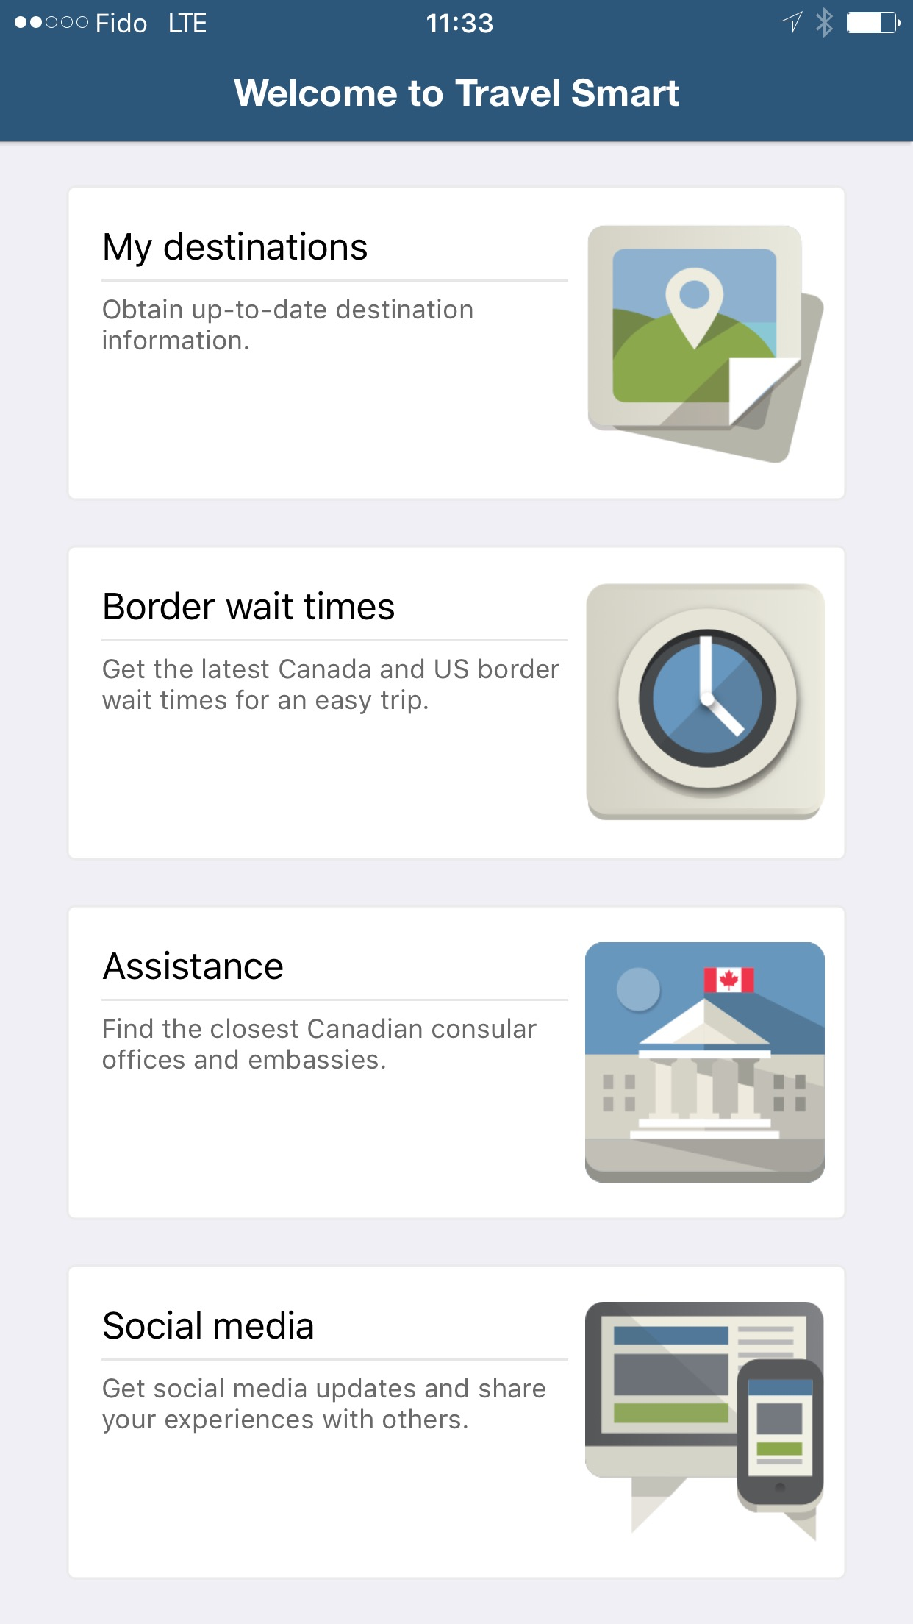
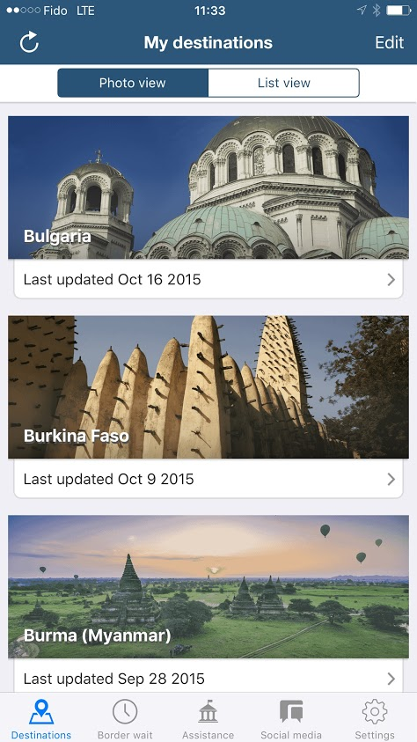
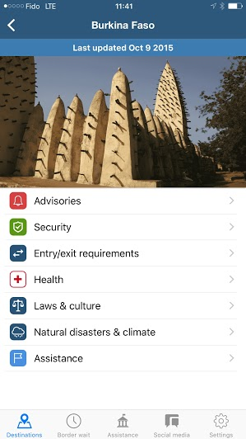
Aplicación para teléfono móvil
“Travel Smart”
Notes:
Canadian travellers will be able to access the Government of Canada’s Travel Advise and Advisories for their travel destination.
They will able to access real-time data, which has been time stamped for the cases where the information was being accessed offline.
The user of the app will be able to select as many destinations as they want to have access to.
Other features include having an enhanced user interface and design that would visually indicate an “avoid travel advisory”.

Slide 4
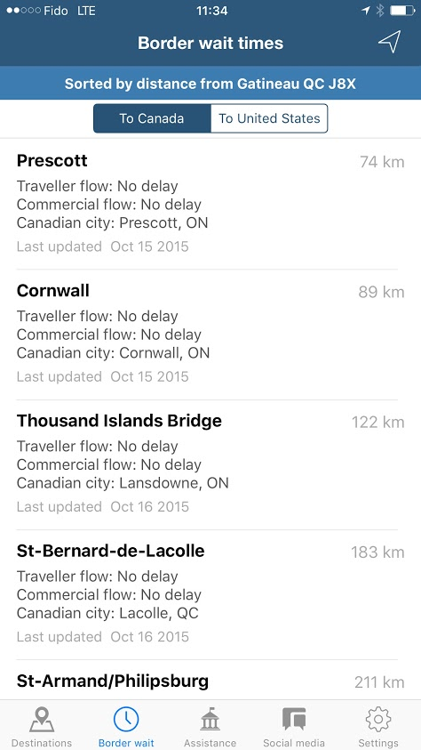
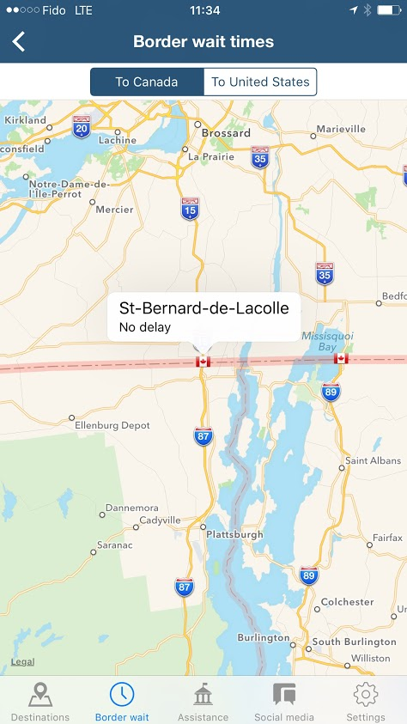
Aplicación para teléfono móvil
“Travel Smart”
Notes:
Border wait times are one of the most visited pieces of information on the travel.gc.ca website.
The enhance Travel Smart app will be able to leverage geolocation features (if enabled) to present more precise information on border wait times based on your geolocation.

Slide 5
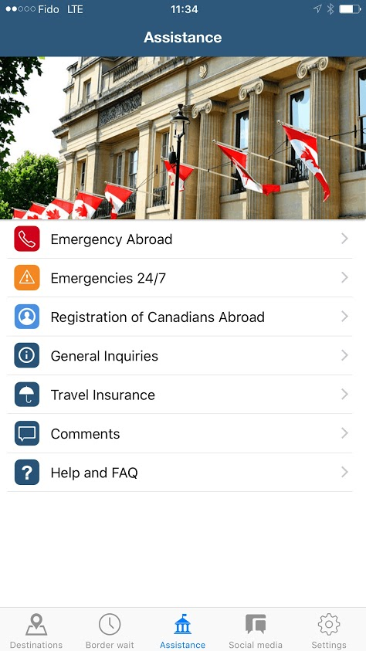
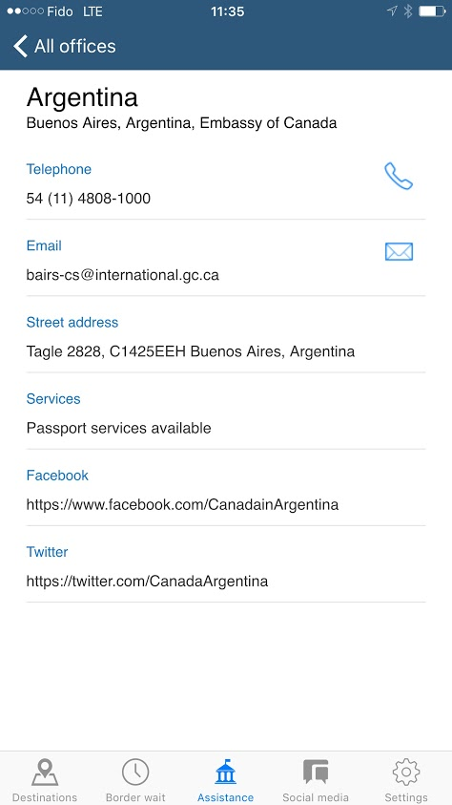
Aplicación para teléfono móvil
“Travel Smart”
Notes:
The new Travel Smart mobile app will also make available assistance coordinates for the destinations selected.
The app will allow the user to dial, email and link to the appropriate contact channel available on the mobile device.
It will also provide the ability to reach the central Emergency Watch and Response Center in Ottawa for Emergencies 24/7.
In the first release, there will be links to the Registration of Canadians Abroad and for future releases we will be looking at more enhanced access to information on those Canadians who may be in an affected zone of an international emergency event abroad.
We also have a general inquiries line, a channel to receive feedback or comments on the App and a small help section.

Slide 6
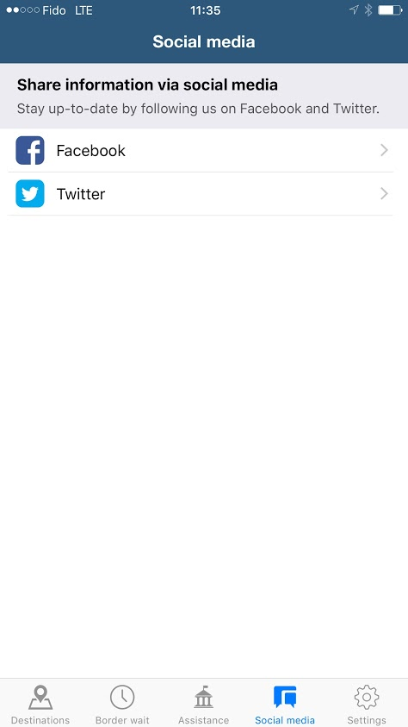

Aplicación para teléfono móvil
“Travel Smart”
Notes:
Last but not least, we have introduced a social media section that would allow the user to access social media feeds.
The first release is scoped to provide access to the travel.gc.ca channels which is a good start since these channels are very current and often tweet and retweet the l (mission/country) social media messages, as well a host of other messaging that they follow.
Future releases will consider making the mission/country social media presence also available.
Future releases are currently being discussed and will focus on making information during an international emergency event more available. Links to service delivery triaging solutions such as the Travel Wizard (which we will talk about shortly) will also be looked at.
The approach is to design and launch an iterative viable product. We will also be using in-application analytics to guide modifications and enhancements.

Slide 7

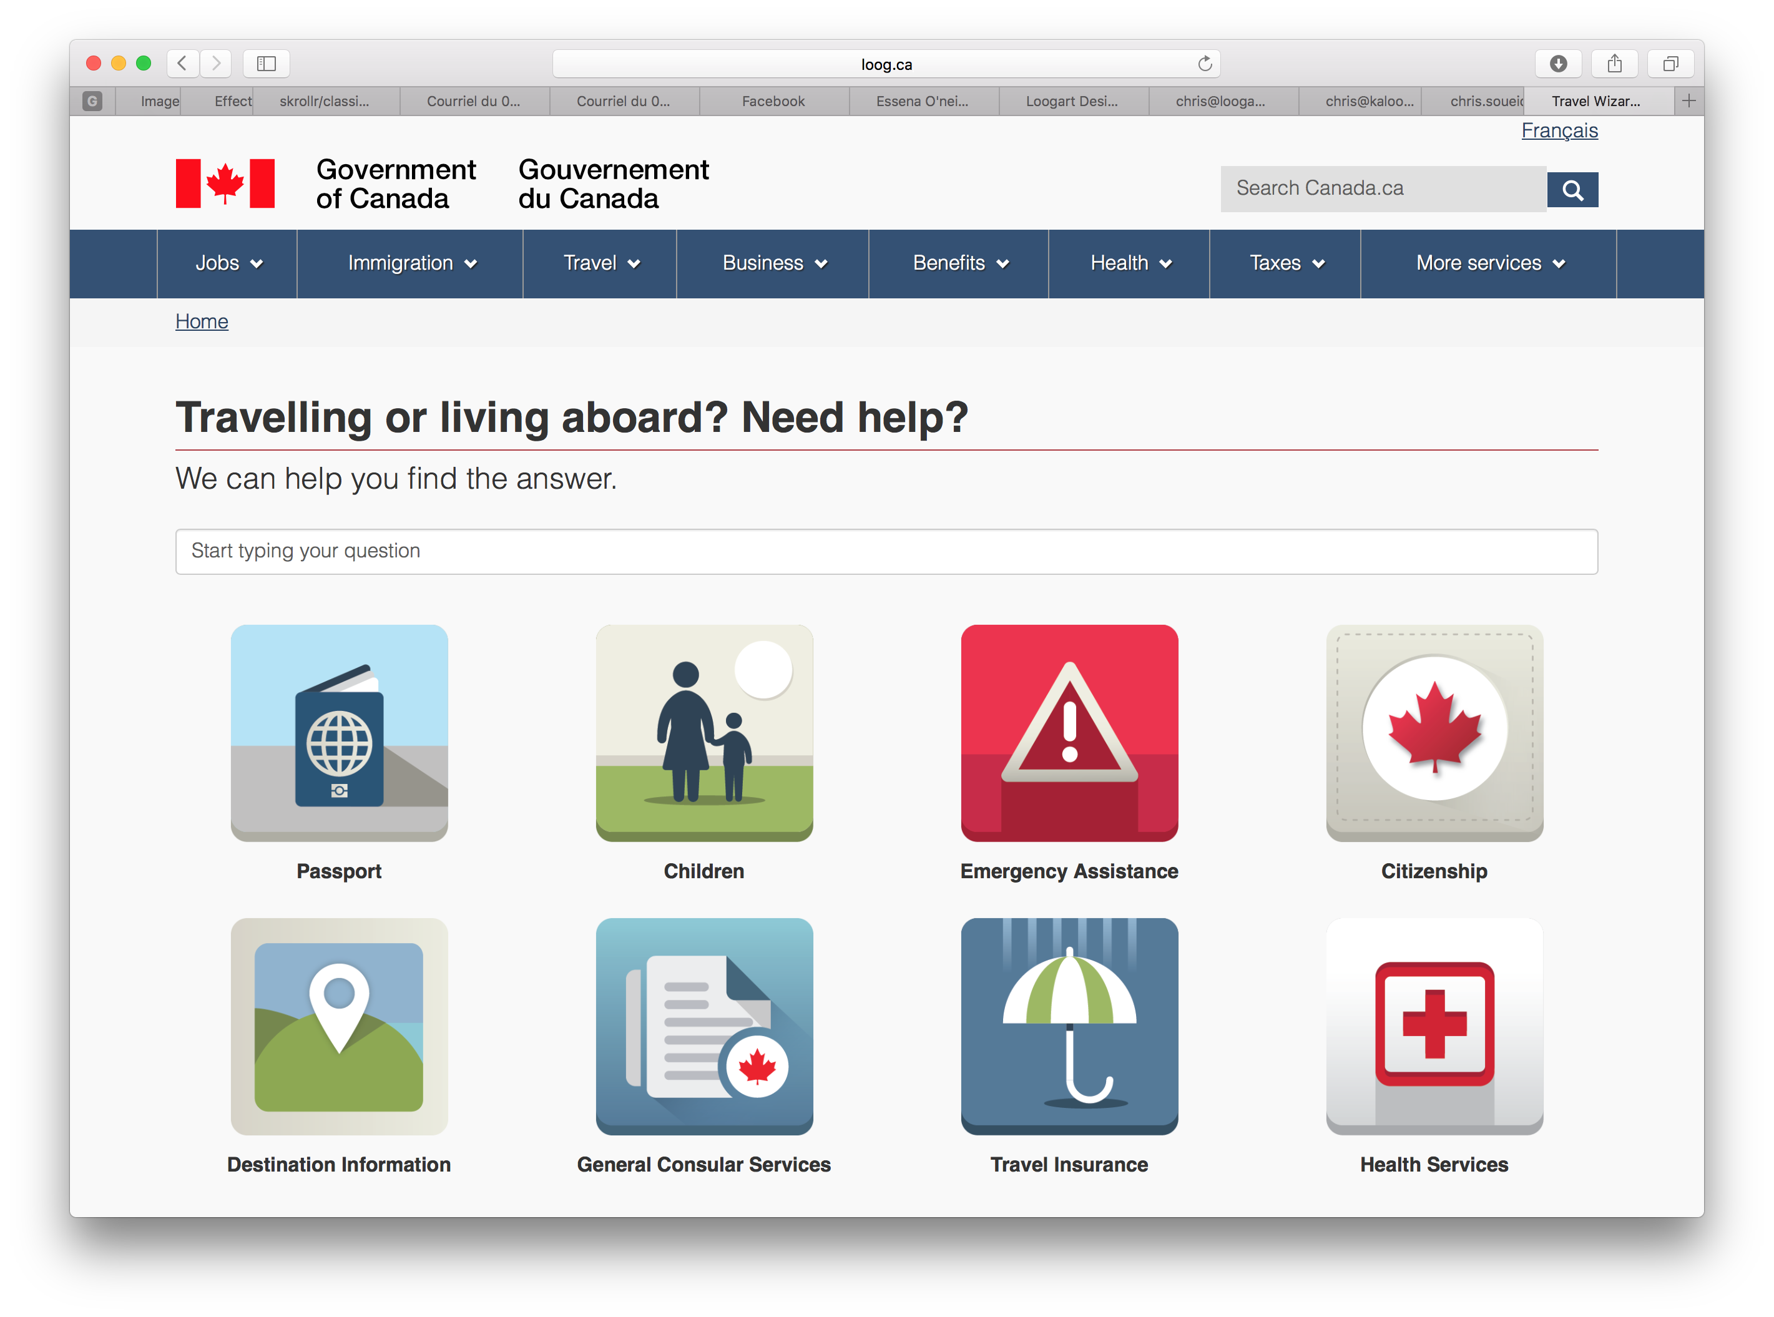
Asistente de viajes
Alcance actual
19 situaciones
Servicios para emergencias
Servicios consulares generales
Consultas sobre pasaportes y ciudadanía
Viajes con niños
Consultas sobre seguros de viaje
  Resultados
  Una respuesta concisa a consultas rutinarias frecuentes
  Autoayuda para obtener listas, tarifas y demás información importante
  Análisis de métricas
  Manejo de contenidos
Notes:
The Travel Wizard is an interactive online tool that will triage high volume and routine inquiries.
It will encourage self-help to information such as lists of lawyers, consular fees, local instructions, hours of operations and other relevant information required to obtain consular assistance abroad.
The first version of the Travel Wizard will make 19 scenarios available. These include frequently asked questions on:
Travel prepardeness such as entry/exit requirements or dual citizens
Emergency assistance when abroad, such as medical asssitance, lost passports, etc. and
General services such as the authentication of documents, just to name a few.
The Travel Wizard is still under development and targeted to be released in early 2016.

Slide 8
Asistente de viajes
Notes:
Clicking on a tile will give you access to a certain set of scenarios.
You can also use a search bar that will recognize keywords and provide you another way to access the various scenarios in the Travel Wizard.
For example, if you had an inquiry about how to renew your passport abroad, you would click on the Passport tile.

Slide 9
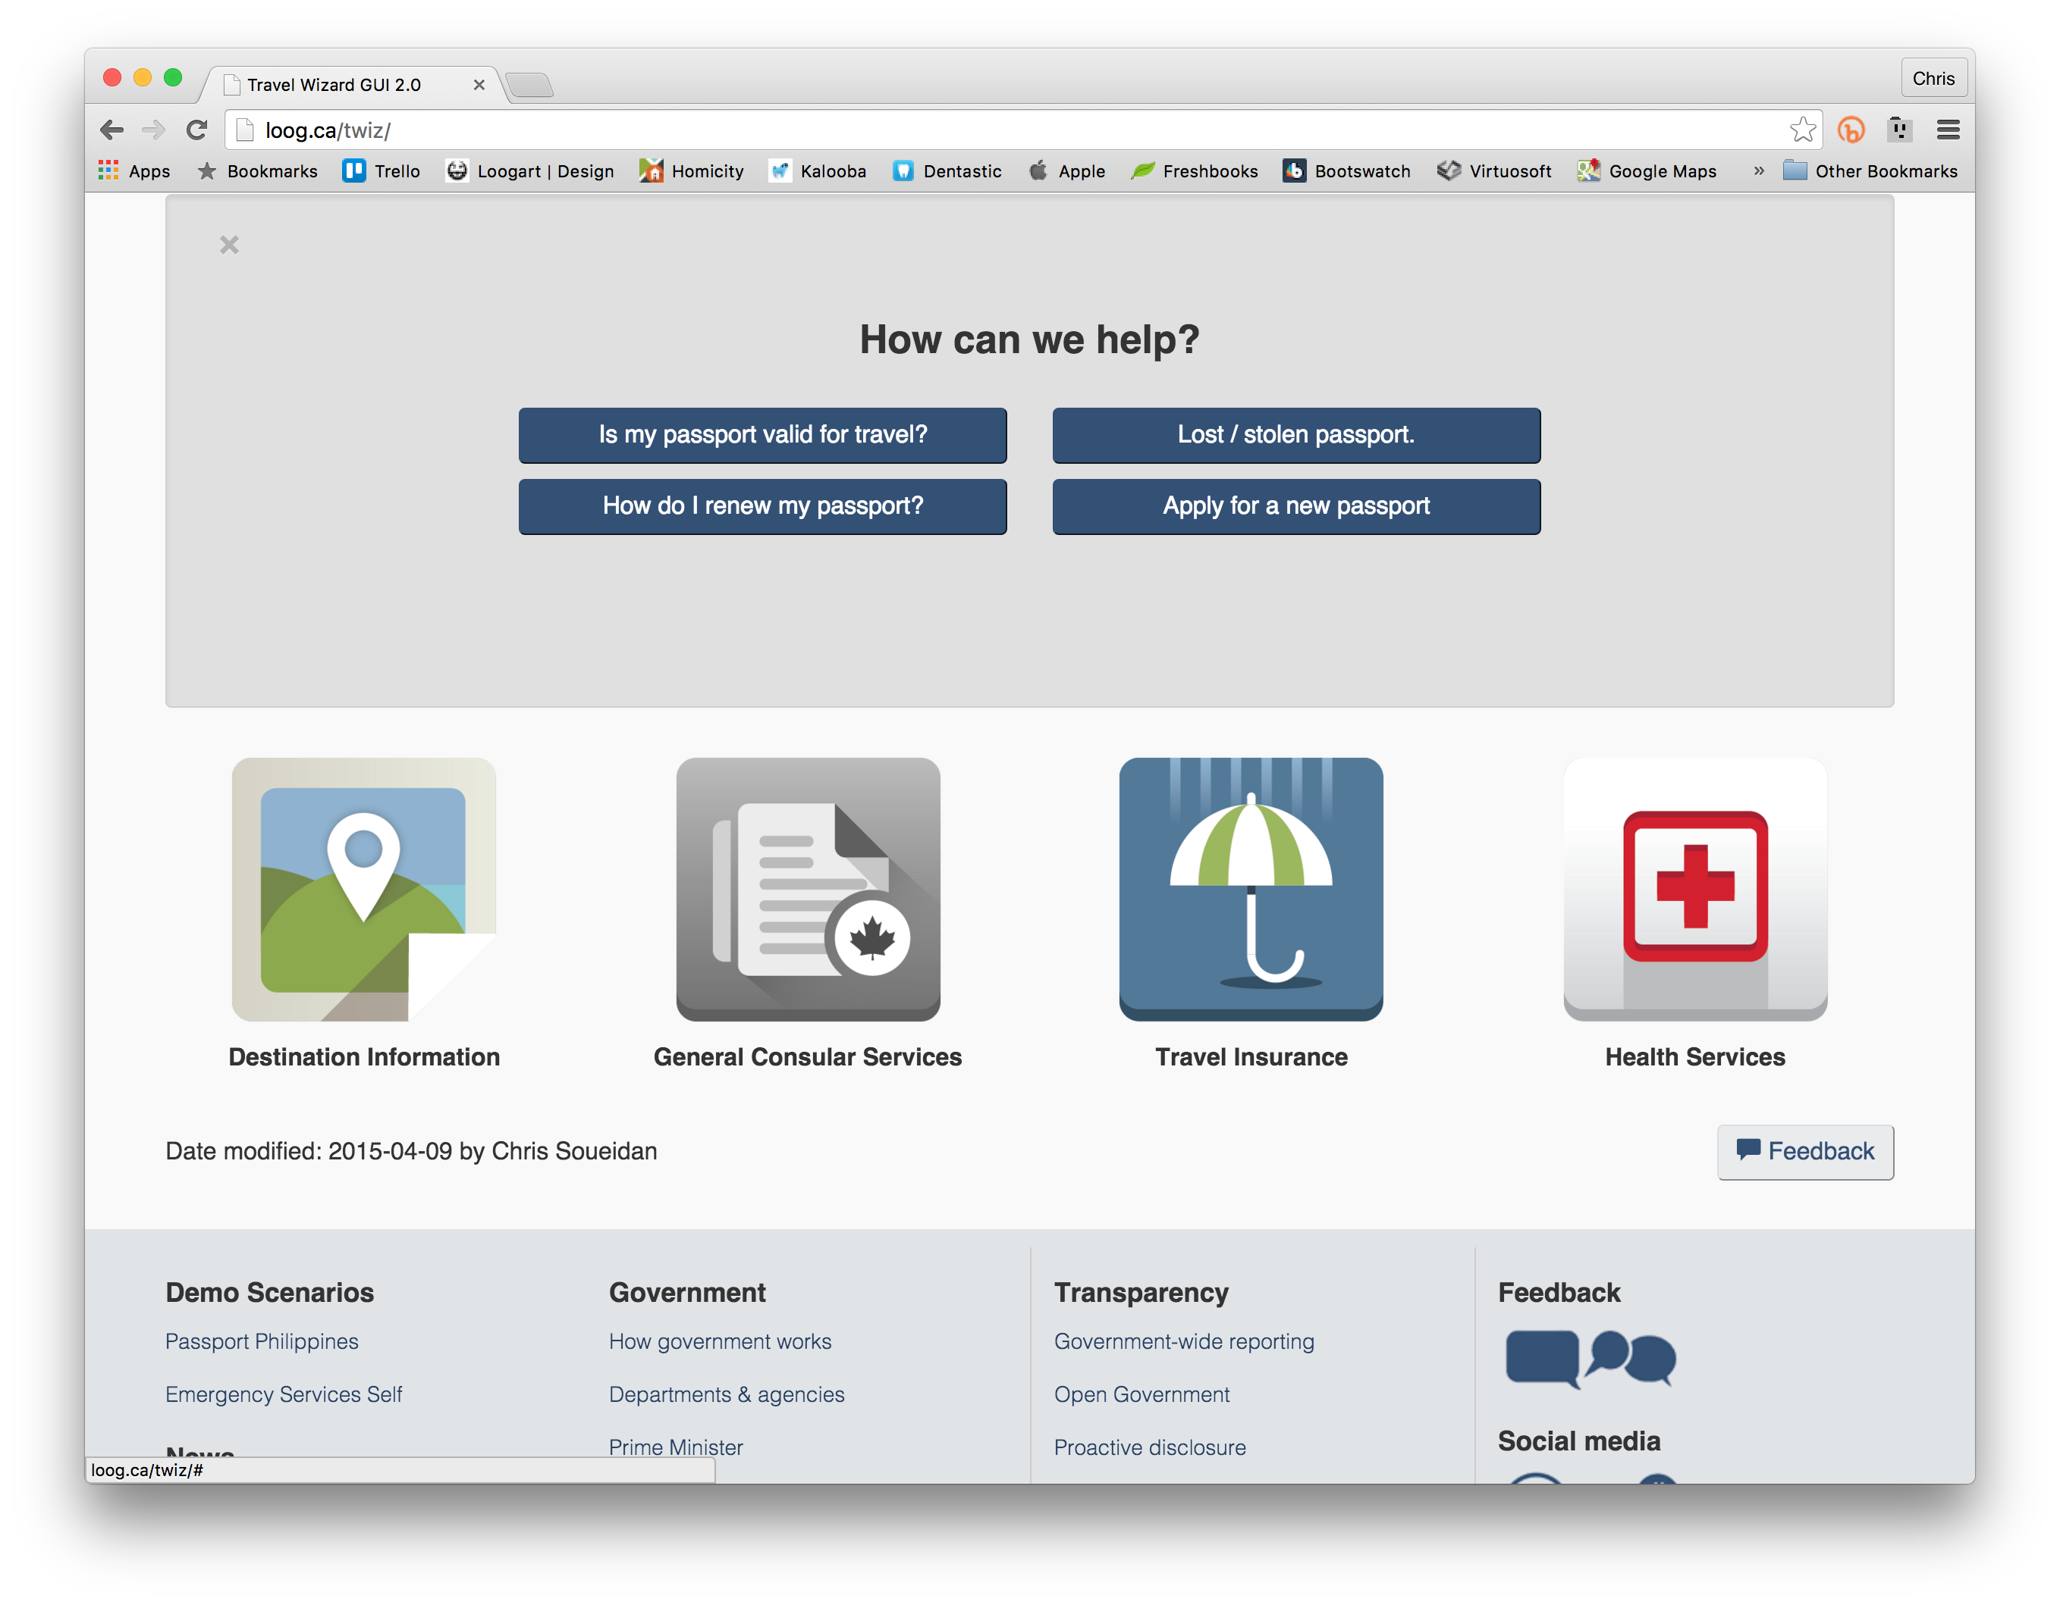
Asistente de viajes
Notes:
The Passport tile would give you access to the four scenarios we have prototyped.
Clicking on How do I renew my passport? You will get a series of triaging questions that will help build your answer (next two screens)

Slide 10



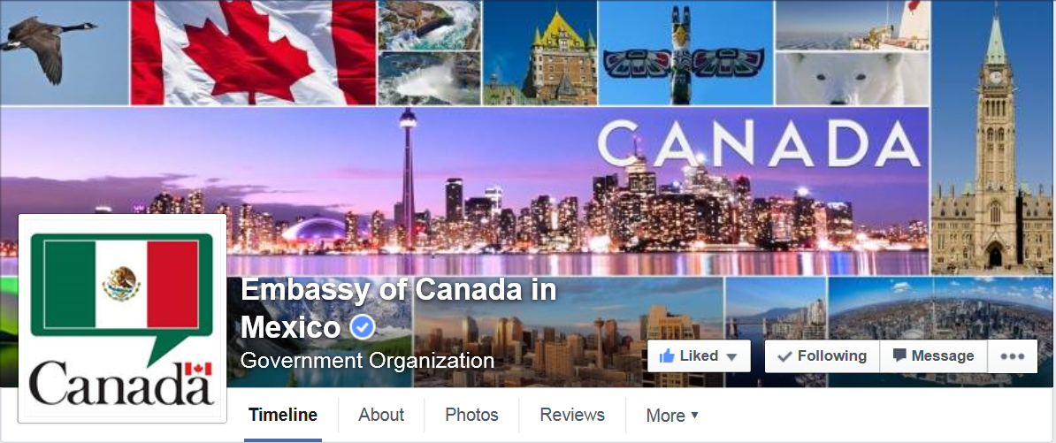

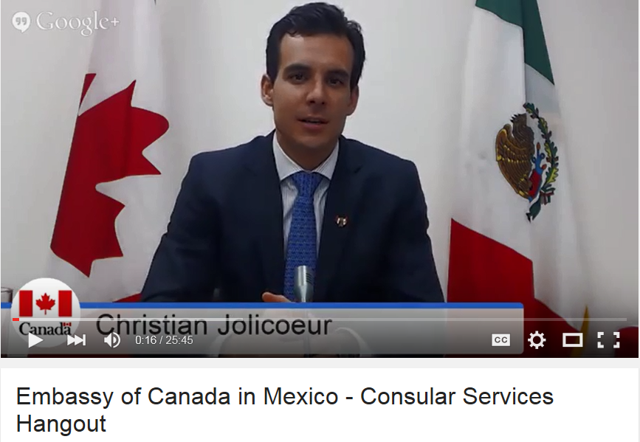
Medios sociales

Slide 11
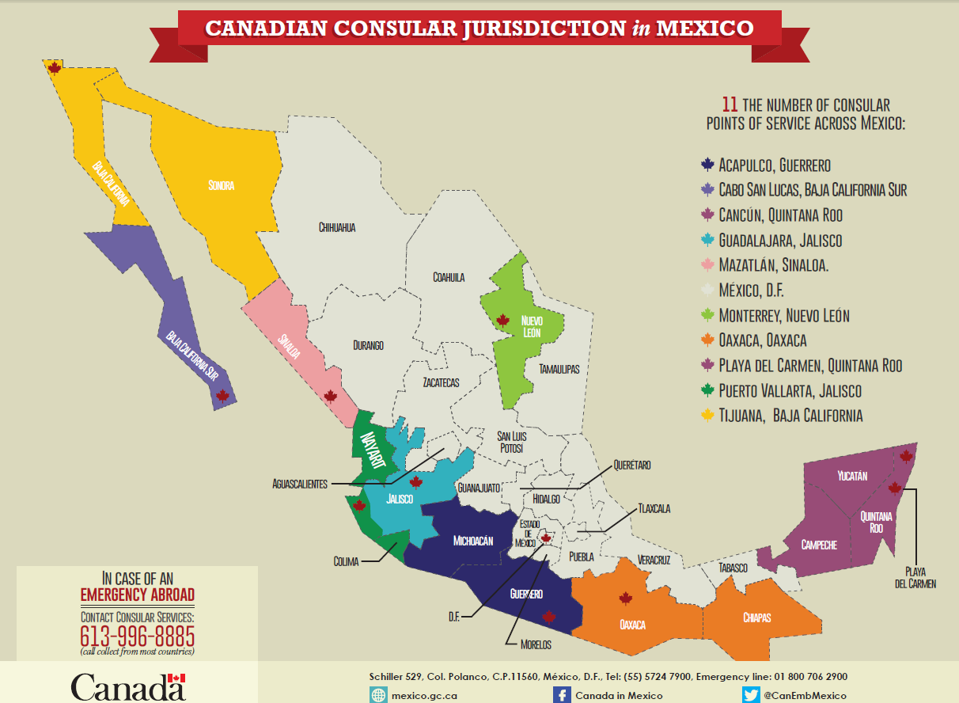
JURISDICCIÓN CONSULAR DE CANADÁ en MÉXICO
11 NÚMERO DE PUNTOS DE
SERVICIOS CONSULARES EN MÉXICO:

